Slide 1

Printer Working Group Plenary Session
®
The Printer Working Group
November 14, 2016
PWG Virtual Face to Face Meetings
Smith Kennedy (HP Inc.)
Copyright © 2016 The Printer Working Group. All rights reserved. The IPP Everywhere and PWG logos are registered trademarks of the IEEE-ISTO.

Slide 2

Plenary Agenda
®
Administrivia
PWG Steering Committee Updates
PWG Workgroup Status [WG Chairs]
  Internet Printing Protocol (IPP)
  Semantic Model (SM)
  Imaging Device Security (IDS)
Liaison Status
  Trusted Computing Group (TCG)
  Gartner
Next Meetings
Copyright © 2016 The Printer Working Group. All rights reserved. The IPP Everywhere and PWG logos are registered trademarks of the IEEE-ISTO.

Slide 3
Administrivia
®
Welcome and Introductions
Confirm Minutes Taker
Review PWG Patent Policy
Agenda for the Week
Future PWG Meeting Schedule
2016 Membership
PWG Officers
Copyright © 2016 The Printer Working Group. All rights reserved. The IPP Everywhere and PWG logos are registered trademarks of the IEEE-ISTO.

Slide 4
PWG Patent Statement
®
PWG standards may include the known use of essential patents and patent applications provided the PWG Chair receives assurance from the patent holder or applicant with respect to patents whose infringement is, or in the case of patent applications, potential future infringement the applicant asserts will be, unavoidable in a compliant implementation of either mandatory or optional portions of the standard. This assurance shall be provided without coercion.
Copyright © 2016 The Printer Working Group. All rights reserved. The IPP Everywhere and PWG logos are registered trademarks of the IEEE-ISTO.

Slide 5
PWG Patent Statement
®
This assurance shall be either:
  A general disclaimer to the effect that the patentee will not enforce any of its present or future patent(s) whose use would be required to implement either mandatory or optional portions of the proposed PWG standard against any person or entity complying with the standard; or
  A statement that a license for such implementation will be made available without compensation or under reasonable rates, with reasonable terms and conditions that are demonstrably free of any unfair discrimination.
Copyright © 2016 The Printer Working Group. All rights reserved. The IPP Everywhere and PWG logos are registered trademarks of the IEEE-ISTO.

Slide 6
PWG Patent Statement
®
The PWG is not in a position to give authoritative or comprehensive information about evidence, validity or scope of patents or similar rights, but it is desirable that any available information should be disclosed. Therefore, all PWG members shall, from the outset, draw PWG's attention to any relevant patents either their own or of other organizations including their Affiliates that are known to the PWG members or any of their Affiliates, although PWG is unable to verify the validity of any such information.
Copyright © 2016 The Printer Working Group. All rights reserved. The IPP Everywhere and PWG logos are registered trademarks of the IEEE-ISTO.

Slide 7
Inappropriate Topics for
PWG Working Group Meetings
®
Do Not Discuss:
The validity/essentiality of patents/patent claims
The cost of specific patent use
Licensing terms or conditions
Product pricing, territorial restrictions, or market share
Don’t discuss ongoing litigation or threatened litigation
DO formally object if inappropriate topics are discussed
Copyright © 2016 The Printer Working Group. All rights reserved. The IPP Everywhere and PWG logos are registered trademarks of the IEEE-ISTO.

Slide 8
Agenda Overview
®
Tuesday, August 23
  9:00 – 10:15 PWG Plenary
  10:15 – 10:30 Break
  10:30 – 12:30 IDS WG : HCD Protection Profile certification
  issues discussion
  12:30 – 1:30 Lunch
  1:30 – 3:00 IPP: Status, IPP Everywhere Self Certification
  3:00 – 3:15 Break
  3:15 – 5:00 IPP WG: IPP 3D Printing Extensions,
  Finishings 2.1
Wednesday, August 24
  9:00 – 12:00 SM WG: Semantic Model 3, 3D Printing
  Extensions, 3D PJT
  12:00 – 1:00 Lunch
  1:00 – 3:00 IPP WG: System Service, Next Steps
Copyright © 2016 The Printer Working Group. All rights reserved. The IPP Everywhere and PWG logos are registered trademarks of the IEEE-ISTO.

Slide 9
Future PWG Meeting Schedule
®
2017 (Tentative Dates)
  February 14-16 : Sunnyvale, CA – Hosted by Apple Inc.
  (Joint PWG/ OpenPrinting)
  April 25-26 : Boise, ID – Hosted by HP Inc.
  August ??? : ???
  October / November ??? : ???
Copyright © 2016 The Printer Working Group. All rights reserved. The IPP Everywhere and PWG logos are registered trademarks of the IEEE-ISTO.

Slide 10
2016 Membership
®
28 Members (27 Voting, 1 Non-Voting)
Apple | High North | MWA Intelligence | Thinxtream Technologies
Brother Industries | Intel | Northlake | Toshiba America Business Solutions
Canon | Konica Minolta | Oki Data | Tykodi Consulting Services LLC
Conexant Systems | Kyocera Document Solutions Inc. | Qualcomm | Xerox
Danny Brennan | Lexmark | Ricoh
Epson | Meteor Network | Samsung
Fuji Xerox | Microsoft | Sharp Labs
HP Inc. | MPI Tech | Technical Interface Consulting (N-V)
Copyright © 2016 The Printer Working Group. All rights reserved. The IPP Everywhere and PWG logos are registered trademarks of the IEEE-ISTO.

Slide 11
PWG Officers (2015-2017 Term)
®
PWG Chair: Smith Kennedy, HP Inc.
PWG Vice-Chair: Alan Sukert, Xerox
PWG Secretary: Ira McDonald, High North
Copyright © 2016 The Printer Working Group. All rights reserved. The IPP Everywhere and PWG logos are registered trademarks of the IEEE-ISTO.

Slide 12
Github Organization and Repositories
®
Github organization account:
  https://github.com/istopwg
Web site repository:
  https://github.com/istopwg/website
Semantic Model Repository
  https://github.com/istopwg/pwg-semantic-model
IPP Everywhere Self Certification Tools
  https://github.com/istopwg/ippeveselfcert
IPP Registry
  https://github.com/istopwg/ippregistry
Copyright © 2016 The Printer Working Group. All rights reserved. The IPP Everywhere and PWG logos are registered trademarks of the IEEE-ISTO.

Slide 13
IPP Everywhere Certified Printers
Certified Printers listed on PWG IPP Everywhere page
  https://www.pwg.org/dynamo/eveprinters.php
19 printers certified so far – certify your printer today!
Certification test suite 1.0 Update 1 available now

Slide 14
PWG Design Philosophy Whitepaper
Purpose:
  To provide newcomers to the PWG and the PWG members and officers themselves with simple, high-level definitions of the set of tenets and design principles held by the PWG that guide the design and creation of its technologies
Content:
  Value of late binding (best fidelity in Cloud servers, enables job redirection)
  Intent vs. process for output fidelity
  Value of separating job ticket / job information from document content
  IPP design patterns?

Slide 15
PWG Process v4.0
Original notion: Update existing Process 3.0 to merge in subsequently published PWG process documents
  pwg-policy-call-for-obj-last-call-formal-vote-draft-2.txt (draft)
  ipp-registry-policy.txt
  pwg-billing-policy-20141001.txt
  pwg-white-policy-20140505.txt
  pwg-charter-policy-20140407.txt
  pwg-prototype-policy-20121029.txt
  pwg-namespace-policy-20160820.txt (new updated draft)
Revised notion: Refactor the Process document to describe the processes of the PWG to make them simple and obvious to the uninitiated reader:
  Proposing new work to the PWG
  Approving new work and assigning to a PWG work group
  PWG approval for various document types
    whitepaper
    standard
    etc.

Slide 16
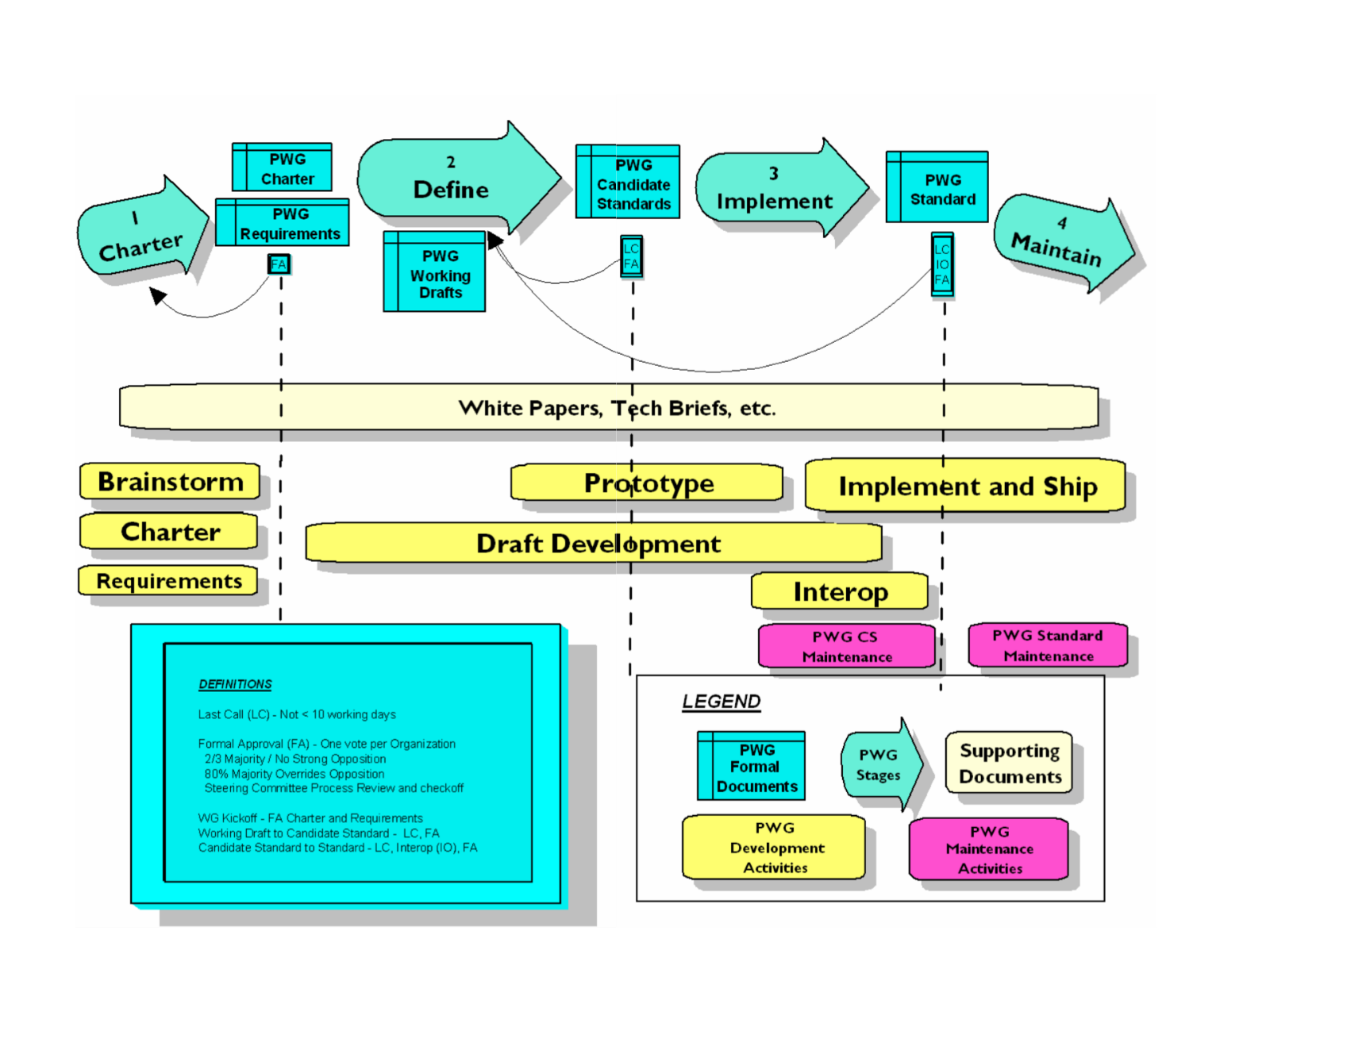
PWG Process v4.0
Process 3.0 diagram

Slide 17
PWG Workgroup Status
®
The Printer Working Group
Copyright © 2016 The Printer Working Group. All rights reserved. The IPP Everywhere and PWG logos are registered trademarks of the IEEE-ISTO.

Slide 18
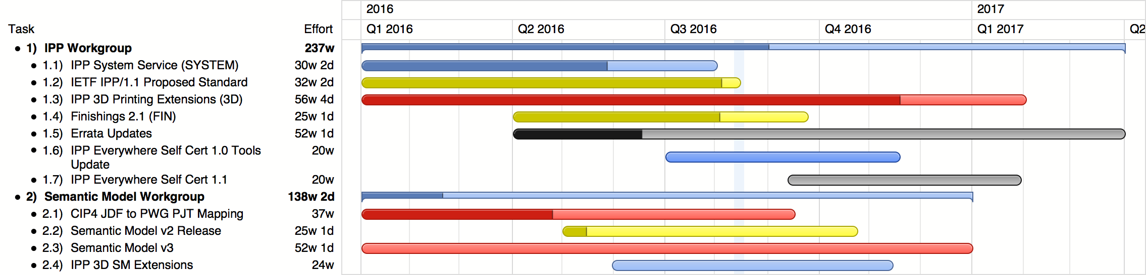
Work In Progress
®
Planned
Interim
Prototype
Prototyped
Stable
Copyright © 2016 The Printer Working Group. All rights reserved. The IPP Everywhere and PWG logos are registered trademarks of the IEEE-ISTO.

Slide 19
IPP Workgroup Status
®
The Printer Working Group
Paul Tykodi (TCS), Ira McDonald (High North)
Copyright © 2016 The Printer Working Group. All rights reserved. The IPP Everywhere and PWG logos are registered trademarks of the IEEE-ISTO.

Slide 20
IPP WG: Charter
®
Current charter:
  http://ftp.pwg.org/pub/pwg/ipp/charter/ch-ipp-charter-20151225.pdf
The Internet Printing Protocol (IPP) workgroup is chartered with the maintenance of IPP, the IETF IPP registry, and support for new clients, network architectures (Cloud, SDN), service bindings for MFDs and Imaging Systems, and emerging technologies such as 3D Printing
In addition, we maintain the IETF Finisher MIB, Job MIB, and Printer MIB registries, and handle synchronization with changes in IPP
Copyright © 2016 The Printer Working Group. All rights reserved. The IPP Everywhere and PWG logos are registered trademarks of the IEEE-ISTO.

Slide 21
IPP WG: Officers
®
IPP WG Co-Chairs:
  Paul Tykodi (TCS)
  Ira McDonald (High North)
IPP WG Secretary:
  Michael Sweet (Apple)
IPP WG Document Editors:
  Ira McDonald (High North) – IPP System Service (SYSTEM), IETF IPP/1.1
  Michael Sweet (Apple) – IPP System Service (SYSTEM), IETF IPP/1.1, IPP 3D Printing Extensions
  Smith Kennedy (HP Inc.) – IPP Finishings 2.1
Copyright © 2016 The Printer Working Group. All rights reserved. The IPP Everywhere and PWG logos are registered trademarks of the IEEE-ISTO.

Slide 22
IPP WG: Status (1/3)
®
IETF RFCs in development:
  IETF IPP/1.1: Encoding and Transport (obsoletes RFC 2910/3382)
  → APPROVED
  IETF IPP/1.1: Model and Semantics (obsoletes RFC 2911/3381/3382)
  → IETF Last Call until Sept. 6, 2016
PWG Specifications in development:
  IPP 3D Printing Extensions (3D) - Prototype Draft
  IPP System Service (SYSTEM) - Interim Draft
  IPP Finishings 2.1 (FIN) - Stable Draft
Copyright © 2016 The Printer Working Group. All rights reserved. The IPP Everywhere and PWG logos are registered trademarks of the IEEE-ISTO.

Slide 23
IPP WG: Status (2/3)
®
Recent Full Standard:
  PWG 5100.12-2015: IPP 2.0, 2.1, and 2.2
Recent Candidate Standards:
  PWG 5100.20-2016: IPP Everywhere Printer Self-Certification Manual v1.0 (SELFCERT)
  PWG 5100.19-2015: IPP Implementor's Guide v2.0 (IG)
  PWG 5100.18-2015: IPP Shared Infrastructure Extensions (INFRA)
Recent IETF RFCs:
  RFC 7612: LDAP Schema for Printer Services
  RFC 7472: IPP over HTTPS Transport Binding and “ipps” URI Scheme
Copyright © 2016 The Printer Working Group. All rights reserved. The IPP Everywhere and PWG logos are registered trademarks of the IEEE-ISTO.

Slide 24
IPP WG: Status (3/3)
®
Up-to-date pending IANA registrations online:
  http://www.pwg.org/ipp/ipp-registrations.xml
  Continue to maintain this in parallel for new specifications
  Github repository:
    https://github.com/istopwg/ippregistry
IPP Everywhere Printer Self-Certifications:
  Submission page:
    https://www.pwg.org/ippeveselfcert
  Printer listing page:
    https://www.pwg.org/printers
  Still waiting for our first submission!
IPP Sample Code:
  Github repository:
    https://github.com/istopwg/ippsample
  Fork of CUPS code includes ippfind, ippproxy, ippserver, and ipptool
Copyright © 2016 The Printer Working Group. All rights reserved. The IPP Everywhere and PWG logos are registered trademarks of the IEEE-ISTO.

Slide 25
IPP WG: More Information
®
We welcome participation from all interested parties
IPP Working Group web page
  http://www.pwg.org/ipp/index.html
Subscribe to the IPP mailing list
  https://www.pwg.org/mailman/listinfo/ipp
IPP WG holds weekly phone conferences announced on the IPP mailing list
  Next conference calls September 12, 2016 at 3pm ET and September 19, 2016 at 4pm ET to discuss 3D Printing
Copyright © 2016 The Printer Working Group. All rights reserved. The IPP Everywhere and PWG logos are registered trademarks of the IEEE-ISTO.

Slide 26
Semantic Model Workgroup
Jeremy Reitz (Xerox)
Copyright © 2016 The Printer Working Group. All rights reserved. The IPP Everywhere and PWG logos are trademarks of The Printer Working Group.
26

Slide 27

Introduction
The current Semantic Model workgroup is the latest in a series of PWG workgroups documenting and maintaining the Hard Copy Imaging System model.
This model defines the semantic elements that constitute the imaging services and subunits of a network connected Imaging System, and the actions that operate on the objects and elements of the model, independent of a specific protocol or network environment.
By the current workgroup charter, the primary function of the workgroup is to keep the model updated with additions and changes developed by other PWG workgroups, to make the model documentation accessible without the need for special software, and to provided for the review and approval of model updates by the PWG membership.
Copyright © 2016 The Printer Working Group. All rights reserved. The IPP Everywhere and PWG logos are trademarks of The Printer Working Group
27

Slide 28
Project Status – Current Projects
Mapping CIP4 JDF to PWG Print Job Ticket v1.0 (JDFMAP)
  Current draft (ftp://ftp.pwg.org/pub/pwg/sm3/wd/wd-smjdfmap10-20150604.pdf) is at Prototype level, awaiting prototype reports.
  Soliciting candidates to do prototyping in progress.
Update and Finalization of Semantic Model 2
  Produce an updated version of SM2, reflecting corrections and reasonable additions from IPP, but no Cloud or 3D aspects.
  A compilation of IANA-registered IPP attributes has been made and potential corresponding element names were generated. (elements-IANA-registry-20160815.xlsx). The effort to finalize the gap list is still in progress and there are continuing questions which should be resolved with IPP WG help.
Creation of Semantic Model 3
  Start afresh with SM3 to reflect updated view of MFD, with addition of Cloud aspects and 3D Print and Scan Services.
  Initial work posted here: https://github.com/istopwg/sm3
  With Daniel Leaving this will require a new volunteer to continue the effort.
New 3D Print Efforts
  New 3D Print efforts following the IPP project are within the scope of chartered projects, but will be identified in a charter update.
Copyright © 2016 The Printer Working Group. All rights reserved. The IPP Everywhere and PWG logos are trademarks of The Printer Working Group
28

Slide 29
PWG 3D Printing Job Ticket Efforts
The PWG/IPP approach to printing is most effectively presented in abstract Print Service Capabilities (PSC), Print Job Ticket (PJT), and Print Job Receipt (PJR)structures.
  It is desirable to include sample versions of these structures when presenting the PWG Model to other standards bodies. It would be appropriate to include both 2D and 3D samples in the SM web pages.
Set of 2D Printing Structures
  Sample Print Job Ticket exists in PWG Print Job Ticket specification section 19. A short narrative describing the intended job features will be added.
  A sample Print Job Ticket Capabilities exists in Section 20.
  A Sample Print Job Receipt for the same job can be generated.
Set of 3D Printing Structures
  The SM Workgroup has started generating a 3D Print Job Ticket example. This will be supported by:
    A sample 3D Print Job Description
    A sample 3D Print Service Capabilities
    A sample 3D Print Job Receipt
    Initial work posted here: https://github.com/istopwg/sm3
Copyright © 2016 The Printer Working Group. All rights reserved. The IPP Everywhere and PWG logos are trademarks of The Printer Working Group
29

Slide 30
3D Print Service Efforts
Because of the distinct differences between 2D Printing and 3D Printing Elements, 3D Printing in the Semantic Model is represented as a distinct service.
The IPP 3D Extensions specification provides explicit information on the additional elements needed to support 3D Printing.
The 3D Print Service Model is created starting with the existing Print Service Model and deleting and adding elements following the information in the IPP 3D Extensions specification.
Although the 3D Print Service is to be included in SM3, a good first cut can be made at this time when the model can be better coordinated with the IPP 3D Print effort.
Copyright © 2016 The Printer Working Group. All rights reserved. The IPP Everywhere and PWG logos are trademarks of The Printer Working Group
30

Slide 31
Other Issues and Next Steps
Continuing the Semantic Model effort requires the participation of more PWG members, both for active generation of material and for review. Participation is dependent on:
  An understanding on the part of both the participant and the supporting company of the value of the semantic model.
  Presentation of the Semantic Model documentation in a form that is easily understandable, so that participation does not require either special knowledge or software.
The Semantic Model Workgroup has been posting “browsesable” forms of the model and the operations. We need to know if other PWG members find these forms of the documentation usable and sufficient to consider the content.
Copyright © 2016 The Printer Working Group. All rights reserved. The IPP Everywhere and PWG logos are trademarks of The Printer Working Group
31

Slide 32
More Info/How to participate
We welcome more participation from member companies
Much of the discussion of issues will be on the SM3 mail list. You must subscribe to the list to be able to post to the list. See http://www.pwg.org/mailman/listinfo/sm3 to subscribe.
The group maintains a Web Page for Semantic Model that includes links to the latest documents, schema and a browse-able version of the schema at http://www.pwg.org/sm3
Next conference call: December 7, 2016; 10:00 – 11:00 Pacific Time / 1:00 – 2:00 PM Eastern Time.
    Call-in toll-free number (US/Canada): 1-866-469-3239
    Call-in toll number (US/Canada): 1-650-429-3300
    Call-in toll number (US/Canada): 1-408-856-9570
    https://ieee-isto.webex.com/ieee-isto/e.php?MTID=m123b376f8d9bdc7d9ff0ff43ed7d1610
Copyright © 2016 The Printer Working Group. All rights reserved. The IPP Everywhere and PWG logos are trademarks of The Printer Working Group.
32

Slide 33
IDS Workgroup Status
®
The Printer Working Group
Alan Sukert (Xerox)
Copyright © 2016 The Printer Working Group. All rights reserved. The IPP Everywhere and PWG logos are registered trademarks of the IEEE-ISTO.

Slide 34
IDS: Original Charter
®
Investigate and define standards for addressing general security attributes for imaging devices and services. Our general goals are to:
  Define standard metrics and protocol bindings to assess the health of Hardcopy Devices to gauge if they should be granted access to a network.
  Define a set of standard security and policy attributes and values for authorizing Hard Copy Devices, their services and users in a global workspace
  Provide a general security model for other PWG standards to reference
Provide a path for vendors to review and contribute to the definition of Common Criteria HCD Protection Profiles
Copyright © 2016 The Printer Working Group. All rights reserved. The IPP Everywhere and PWG logos are registered trademarks of the IEEE-ISTO.

Slide 35
IDS: Status
®
The IDS workgroup is currently in “hibernation”
  Will be revived as needed
  Documents in process by IDS Working Group when WG went into “hibernation” have either been approved by PWG or archived for work by other PWG Working Groups in future
Common Criteria HCD Protection Profiles
  Some issues have been found in implementing Sep 2015 HCD Protection Profile
  Discussing issues during this PWG Face to Face Meeting so we can provide feedback on them to US and Japanese Schemes
  Want resolution of these issues by both Schemes in a timely manner
Copyright © 2016 The Printer Working Group. All rights reserved. The IPP Everywhere and PWG logos are registered trademarks of the IEEE-ISTO.

Slide 36
Liaison Status
®
The Printer Working Group
Copyright © 2016 The Printer Working Group. All rights reserved. The IPP Everywhere and PWG logos are registered trademarks of the IEEE-ISTO.

Slide 37

Trusted Computing Group (TCG)
®
Next TCG Members Meetings
  17-21 October 2016 – Seoul, South Korea – Ira to call in
Trusted Mobility Solutions (TMS) – Ira is co-chair and co-editor
  Scope: enterprise, medical, banking, virtualization, mobile mgmt
  Formal – ETSI (NFV), Open Mobile Alliance (device mgmt), Global Platform (TEE protected environment), Mobey Forum (banking/payments, biometrics authentication, integrity)
  Informal - 3GPP, ITU-T, Small Cell Forum (platform integrity)
Mobile Platform (MPWG) – Ira is co-editor
  Scope: mobile phones, PDAs, eBook readers, etc.
  Formal liaisons – Global Platform (TEE), Mobey Forum (banking)
  Multiple Stakeholder Model – TCG approved March 2016
Public Review Specifications
  http://www.trustedcomputinggroup.org/resources/specifications_in_public_review
  TCG TPM 2.0 Library rev135 – ends 09/17/16
  TCG Guidance for Securing Resource-Constrained Devices v1r17
  – ends 09/12/17
Copyright © 2016 The Printer Working Group. All rights reserved. The IPP Everywhere and PWG logos are registered trademarks of the IEEE-ISTO.

Slide 38
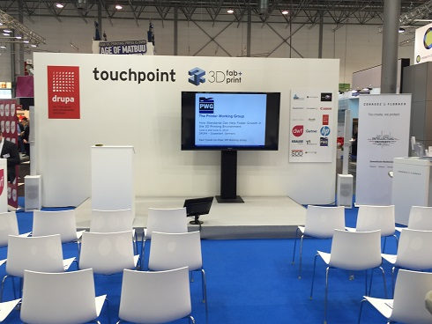
Drupa Tradeshow – Düsseldorf Germany
May 31st – June 10th, 2016
®
Drupa Tradeshow 2016 – Paul Tykodi (Co-Chair of the IPP Working Group) delivered two IPP 3D related presentations at the 3D fab+print sponsored Touchpoint in Hall 7a
Copyright © 2016 The Printer Working Group. All rights reserved. The IPP Everywhere and PWG logos are registered trademarks of the IEEE-ISTO.

Slide 39
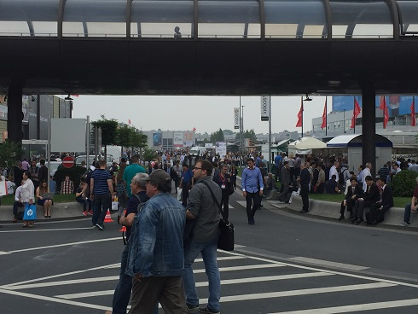
Drupa Tradeshow – Düsseldorf Germany
May 31st – June 10th, 2016
®
Drupa Tradeshow 2016 – Paul Tykodi (Co-Chair of the IPP Working Group) delivered two IPP 3D related presentations at Drupa in early June of 2016. The Drupa tradeshow exhibitors were spread throughout almost 20 different buildings.
Copyright © 2016 The Printer Working Group. All rights reserved. The IPP Everywhere and PWG logos are registered trademarks of the IEEE-ISTO.

Slide 40
Drupa Tradeshow – Düsseldorf Germany
May 31st – June 10th, 2016
®
PWG Member Drupa Tradeshow 2016 Highlights
  HP Promoted its Jet Fusion line of 3D Printing Devices for industrial applications
    Initial products are controlled by software developed by Siemens for HP
  Ricoh displayed its first internally developed 3D printing device the Ricoh AM S5500P
  Canon announced a partnership with 3D Systems to begin selling certain 3D Systems manufactured equipment through the existing 2D device focused Canon Sales Distribution network for office equipment
  Note: - Interest declared by manufacturers visited by Mr. Tykodi during his time at the tradeshow, regarding the PWG IPP 3D effort, was most pronounced in the areas of job ticketing, job receipts, and retrieval of job processing log files.
Copyright © 2016 The Printer Working Group. All rights reserved. The IPP Everywhere and PWG logos are registered trademarks of the IEEE-ISTO.

Slide 41
Gartner Report on the Future Need for 3D Printing Workflow Software Products
®
Pete Basiliere – Quoted From Gartner web site:
  “Pete Basiliere is Research Vice President - Imaging and Print Services. Mr. Basiliere provides research-based insights on 3D printing, digital printing systems and software applications, customer communications management (CCM), strategic document outsourcing (SDO) and automated document factory (ADF) best practices, go-to-market strategies, and technology trends.”
  New Article Published in August 2016 – “Innovation Insight for 3D Print Workflow Software” – https://www.gartner.com/doc/3407830
  Future PWG Meeting (TBD) - Pete has agreed to remotely attend either a future IPP 3D teleconference or a special PWG meeting to further discuss 3D printing topics.
Copyright © 2016 The Printer Working Group. All rights reserved. The IPP Everywhere and PWG logos are registered trademarks of the IEEE-ISTO.

Slide 42
Other Questions / Comments
®
Copyright © 2016 The Printer Working Group. All rights reserved. The IPP Everywhere and PWG logos are registered trademarks of the IEEE-ISTO.

Slide 43
Next PWG Meetings
®
February 14-16 : Sunnyvale, CA – Hosted by Apple
Inc. (Joint PWG/ OpenPrinting)
April 25-26 : Boise, ID – Hosted by HP Inc.
August ??? : ???
October / November ??? : ???
Dates in RED are tentative...
Copyright © 2016 The Printer Working Group. All rights reserved. The IPP Everywhere and PWG logos are registered trademarks of the IEEE-ISTO.

