Slide 1
PWG Print Semantics
Its Benefit to Cloud Printing

Slide 2
PWG Print Semantics
Open Standard
May extract, copy, publish, display, distribute, modify and incorporate into other works
Implemented in all current printers
Vendor neutral
Designed to be scalable (Subsets and extensions)
Maps cleanly to existing printer protocols, Print Job Tickets and embedded PDL instructions
Does not contain Driver specific or UI specific complexities
Semantics reused in other MFD services

Slide 3
PWG Printer
Represents a Virtual Printer or Queue
Well defined state model represented by one attribute with a second attribute providing additional clarification and extensibility
Each Printer has attributes that represent:
Overall status and current conditions (e.g. Printer is Stopped, Jam in media path)
Descriptive information (e.g. Name, Location)
Default Print Ticket (specifies the processing behavior for aspects not specified in Print Job Print Ticket)
Capabilities (i.e. The allowed values of elements in a Print Ticket)
Configuration of subunits (e.g. number of trays, media loaded)
Provides view of queued, processing and completed Jobs

Slide 4
PWG Print Job
Represents a single unit of work to be performed by the Printer
Well defined state model represented by one attribute with a second attribute providing additional clarification and extensibility
Jobs may contain multiple Documents
Each Job has attributes that represent:
Status (e.g. Job is Processing, PDL is being interpreted, impressions completed, timestamps)
Job Ticket
Descriptive information (e.g. Name, owner)
Job Processing instructions (e.g., Copies, Covers, Finishings)
Document Processing instructions (e.g., Media, Print Quality, Sides)
Documents (Documents or Document References for this Job)
Descriptive information (e.g. Name, owner)
Document Processing instructions (e.g., Media, Print Quality, Sides)

Slide 5
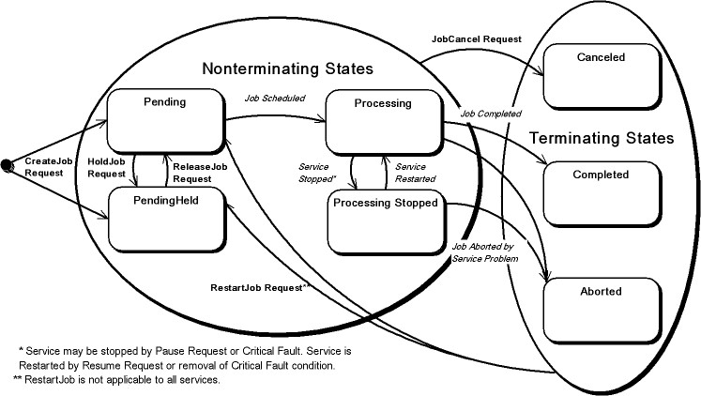
Job State
Fixed well defined states and transitions
Consistent across job types in an MFD

Slide 6
Job State Reasons
Provides additional information on Job State
Includes well defined values and is extensible
Existing values include:
Job Incoming | Job Queued | Job Outgoing | Queued In Device
Job Transforming | Job Printing | Job Completed Successfully | Job Completed With Warnings
Job Completed With Errors | Document Access Error | Digital Signature Did Not Verify | Job Canceled At Device
Resources Are Not Ready | Job Timed Out | Job Hold Until Specified | Job Password Wait

Slide 7
Print Semantic Evolution and the PWG

Slide 8
Print Job Ticket
Derived from standards dating back more than 20 years
The semantics are used in every modern print protocol
Large set of semantic elements and values are defined
Elements and values are extensible
Semantics scale from home printers to production printers
Existing semantics include:
Copies | Sides | Media | Media Type
Orientation | Staple | Jog Offset | Number Up
Job Priority | Covers | Insert Sheets | Binding
Job Hold | Job Password | Imposition | Proof Printing
Job Name | Job Owner | Accounting ID

Slide 9
Simple Job Ticket (XML)
<?xml version="1.0" encoding="UTF-8"?> <pwg:PrintJobTicket xsi:schemaLocation="PrintJobTicket.xsd" xmlns:pwg="http://www.pwg.org/schemas/2009/8/sm"> <pwg:PrintDocumentProcessing> <pwg:Finishings> <pwg:Finishing>Staple</pwg:Finishing> </pwg:Finishings> <pwg:Media>na_letter_8.5x11in</pwg:Media> <pwg:MediaType>stationery</pwg:MediaType> <pwg:OrientationRequested>Portrait</pwg:OrientationRequested> <pwg:Quality>Normal</pwg:Quality> <pwg:Sides>TwoSidedLongEdge</pwg:Sides> </pwg:PrintDocumentProcessing> <pwg:PrintJobDescription> <pwg:JobName>Cloud Print</pwg:JobName> <pwg:JobOriginatingUserName>Hastings</pwg:JobOriginatingUserName> </pwg:PrintJobDescription> <pwg:PrintJobProcessing> <pwg:JobCopies>4</pwg:JobCopies> </pwg:PrintJobProcessing> </pwg:PrintJobTicket>

Slide 10
Simple Job Ticket (JSON)
{ "PrintJobTicket": { "PrintDocumentProcessing": { "Finishings": { "Finishing": "Staple" }, "Media": "na_letter_8.5x11in", "MediaType": "stationery", "OrientationRequested": “Portrait", "Quality": "Normal", "Sides": "TwoSidedLongEdge" }, "PrintJobDescription": { "JobName": "Cloud Print", "JobOriginatingUserName": "Hastings" }, "PrintJobProcessing": { "JobCopies": 4 } } }

Slide 11
Simple Document Ticket(XML & JSON)
<?xml version="1.0" encoding="UTF-8"?> <pwg:PrintDocumentTicket xsi:schemaLocation="PrintJobTicket.xsd" xmlns:pwg="http://www.pwg.org/schemas/2009/8/sm"> <pwg:PrintDocumentDescription> <pwg:DocumentName>PwgAndCloudPrinting.pdf</pwg:DocumentName> <pwg:LastDocument>true</pwg:LastDocument> <pwg:DocumentFormat>application/pdf</pwg:DocumentFormat> <pwg:DocumentUri>ftp://ftp.pwg.org/pub/pwg/mfd/white/PwgAndCloudPrinting.pdf</pwg:DocumentUri> <pwg:Impressions>12</pwg:Impressions> </pwg:PrintDocumentDescription> </pwg:PrintDocumentTicket> { "PrintDocumentTicket": { "PrintDocumentDescription": { "DocumentName": "PwgAndCloudPrinting.pdf", "LastDocument": true, "DocumentFormat": "application/pdf", "DocumentUri": "ftp://ftp.pwg.org/pub/pwg/mfd/white/PwgAndCloudPrinting.pdf", "Impressions": 8 } } }

Slide 12
Additional Resources
PWG
http://www.pwg.org/
Workgroups include Internet Printing Protocol(Model, Semantics, encoding & Transport), Semantic Model (Print Semantics) , Multifunction Device (A generalization of the Semantic Model to cover services other than print)
PWG Print Job Ticket Schema
Download: ftp://ftp.pwg.org/pub/pwg/mfd/schemas/PwgPrintJobTicket042610.zip
Browse: http://www.pwg.org/mfd/navigate/PwgSmRev194_PrintJobTicket.html#Link71B http://www.pwg.org/mfd/navigate/PwgSmRev194_PrintDocumentTicket.html#Link714
PWG Semantic Model Specification v1
See section 7 for table containing PWG vocabulary
ftp://ftp.pwg.org/pub/pwg/candidates/cs-sm10-20040120-5105.1.pdf

