Slide 1
Continuous Integration
Michael Sweet, Lakeside Robotics
September 14, 2022

Slide 2
Continuous Integration
Mostly Github Actions workflows used to validate/test software changes
"Build" workflows to build projects on various OS's (Linux, macOS, Windows) and architectures (ARM, x86, etc.)
./configure && make && make test
"CodeQL", "Coverity", "LGTM", and other static code analysis workflows to look for errors/issues
"Docker" for making Docker images
Also snapcraft, AppImage, Flatpak, etc. builders which are triggered by changes pushed to the corresponding repositories

Slide 3
Github Actions
Defined in YML files under ".github/workflows" in your repository
Actions can be triggered by pushes to the repository or started manually
Private data (access tokens, certificates, etc.) can be added to the environment that is passed
Some services available under the "Actions" tab on the web site, others you need to setup by hand or through a third-party web site

Slide 4
Example: PAPPL build.yml
name: Build
on:
push:
branches: [ master ]
pull_request:
branches: [ master ]
jobs:
build-linux:
runs-on: ubuntu-20.04
steps:
- uses: actions/checkout@v2
- name: update build environment
run: sudo apt-get update --fix-missing -y
- name: install prerequisites
run: sudo apt-get install -y avahi-daemon cppcheck libavahi-client-dev libcups2-dev libcupsimage2-dev libgnutls28-dev libjpeg-dev libpam-dev libpng-dev libusb-1.0-0-dev zlib1g-dev
- name: configure
env:
CC: /usr/bin/gcc
run: ./configure --enable-debug --enable-maintainer
- name: make
run: make
- name: test
env:
ASAN_OPTIONS: leak_check_at_exit=false
run: make test || cat testsuite/testpappl.log
- name: clang static analyzer
run: cd pappl && make CC=clang "GHA_ERROR=::error::" clang
- name: cppcheck
run: cd pappl && make "GHA_ERROR=::error::" cppcheck
build-macos:
runs-on: macos-latest
steps:
- uses: actions/checkout@v2
- name: install prerequisites
run: brew install cppcheck libjpeg libpng libusb
- name: configure
run: ./configure --enable-debug --enable-maintainer --enable-sanitizer
- name: make
run: make
- name: test
run: make test || cat testsuite/testpappl.log
- name: clang static analyzer
run: cd pappl && make "GHA_ERROR=::error::" clang
- name: cppcheck
run: cd pappl && make "GHA_ERROR=::error::" cppcheck
build-windows:
runs-on: windows-latest
steps:
- uses: actions/checkout@v2
- name: setup-msbuild
uses: microsoft/setup-msbuild@v1.0.2
- name: nuget restore
run: cd vcnet; nuget restore pappl.sln
- name: msbuild
run: cd vcnet; msbuild pappl.sln
- name: test
run: cd vcnet; ./copy-dlls.bat x64\Debug; cd x64\Debug; ./testpappl -c -l testpappl.log -L debug -o testpappl.output -t all

Slide 5
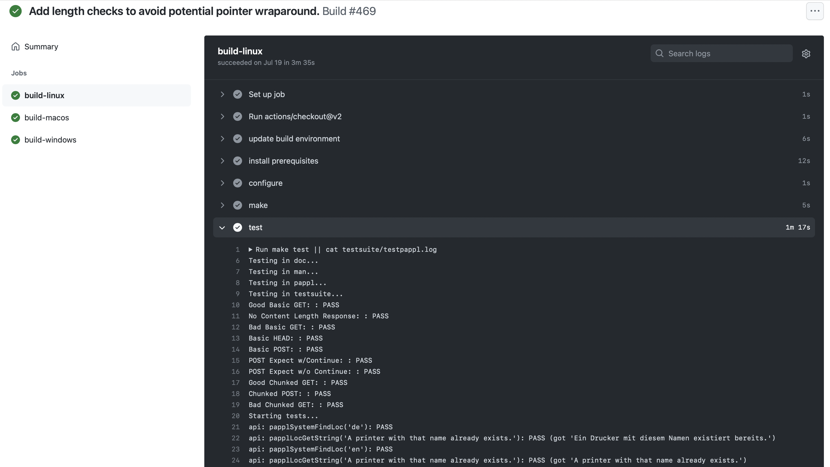
Output: PAPPL build.yml

Slide 6
Printing Projects Using CI
CUPS: builders and code analysis, runs full CUPS automated test suite
ippeveselfcert: builders and code analysis, runs self-cert against ippeveprinter
ippsample: builders and code analysis, runs various IPP standard test files, transforms, and (work in progress) cloud/proxy tests
libcups (3.0): builders and code analysis, runs ippeveprinter, ippfind, and ipptool to test basic IPP/2.0 conformance
LPrint: builders, code analysis, and snapcraft packaging
PAPPL: builders and code analysis, test suite exercises 90+% of PAPPL API and functionality
PDFio: builders and code analysis, test suite exercises 100% of PDFio API and functionality

Slide 7
Resources
AppImage: https://appimage.org/
CodeQL: https://codeql.github.com/
Coverity: https://scan.coverity.com/
Docker: https://www.docker.com/
Flatpak: https://www.flatpak.org/
Github Actions: https://github.com/features/actions
LGTM: https://lgtm.com/
Snapcraft: https://snapcraft.io/

