Slide 1
Open Printing Project Updates - 2019
Joint PWG/Open Printing Meeting - Lexington, KY
Apr 16, 2019
Aveek Basu
Till Kamppeter

Slide 2
GSoC 2018 Projects
Conversion of bannertopdf to QPDF: To make all filters in cups-filters which use Poppler only use the standard API of Poppler and no unstable, unofficial APIs.
Enhancements for ipptool: Write additional ipptool scripts for coverage of operations and attributes that are required by IPP Everywhere, but not yet tested in IPP Everywhere Self-Certification process.
PWG Raster "ippdoclint" program: To have a tool that can take an input PWG Raster document file and check it’s structure and report any errors / warnings / issues with the document's structure or content.
Content-oriented printer auto-selection: Cluster arbitrary collection of printers (all available printers) into one queue with merged PPD with all options of all printers available. Depending on the document and which options the user sets the printer where the job gets printed is selected automatically.
*Common Print Dialog Backends project: D-Bus interface to separate the print dialog GUI from the communication with the actual printing system (CUPS, Google Cloud Print, …) having each printing system being supported with a backend and these GUI-independent backends working with all print dialogs (GTK/GNOME, Qt/KDE, LibreOffice, …).
(This project is partly complete)

Slide 3
GSoC Project List for 2019
Upcoming Projects:
Generic Framework to turn legacy drivers consisting of CUPS filters and PPDs into Printer Applications: Printer Applications are simple daemons which emulate a driverless IPP network printer on localhost, do the conversion of the print jobs into the printer's format, and send the job off to the printer. And as a physical driverless IPP printer they advertise themselves via DNS-SD and provide there capability information on (IPP) request from the client.
IPP: ipptool test suite for IPP System Service: To develop additional ipptool test scripts for all new operations, objects, attributes defined in IPP System Service v1.0 (e.g., Create-Printer).
IPP: ipptool test suite updates for IPP errata updates: to develop additional ipptool test scripts for IPP errata including IPP Document Object v1.1, IPP Job Extensions v1.1, and IPP 3D Printing Extensions v1.1.

Slide 4
GSoC Project List for 2019
Upcoming Projects:
Improve the pdftoraster filter to not need copying Poppler source code or using unstable APIs: One of the filters, pdftoraster, rasterizes PDF files into CUPS/PWG Raster, uses Poppler but makes use of unstable APIs of Poppler, requiring frequent modifications when Poppler gets updated. The task for the student is here to improve pdftoraster's interface with Poppler, for example using Poppler's PPM (generic raster) output and converting it into CUPS/PWG Raster.
Turn the scp-dbus-service of system-config-printer into C: system-config-printer was written in Python and therefore scp-dbus-service is also written in Python. This makes it depend on Python and the related libraries to get loaded into memory when started. This can cause delays during boot. The student's task is to turn the scp-dbus-service of system-config-printer into C, either as D-Bus service (would work out-of-the-box with many GUIs) or as a C library with API (simpler), ideally both. This will make it easier to write printer setup tools in practically any programming language.
lattening non-static content (like filled forms) in PDF files for print

Slide 5
2019 Mentors & Admins
Sl | Project Name | Mentor Details
1 | Generic Framework to turn legacy drivers consisting of CUPS filters and PPDs into Printer Applications: | Till Kamppeter
2 | IPP: ipptool test suite for IPP System Service | Smith Kennedy Ira McDonald Danny Brennan
3 | IPP: ipptool test suite updates for IPP errata updates: | Smith Kennedy Ira McDonald Danny Brennan
4 | Improve the pdftoraster filter to not need copying Poppler source code or using unstable APIs: | Sahil Arora
5 | Turn the scp-dbus-service of system-config-printer into C: | Zdenek Dohnal
GSoC Org Admins (The Linux Foundation):
Aveek Basu (basu.aveek@gmail.com)
Till Kamppeter (till.kamppeter@gmail.com)

Slide 6
Issues Fixed (cups-filters)
Students have also worked on the following cups-filters GitHub issues:
Completed:
# 65: Add a simple "fill page" scaling option to imagetoraster and pdftopdf (print-scaling=fill)
# 81: segmentation fault (zero page read) in libcupsfilters.so from imagetopdf with corrupted gif
# 82: cupsfilter hangs with 100% cpu usage with corrupted gif
In Progress:
# 78: Support 'vnd.cups-banner' format to be converted by a 'x-bannertopdf' filter
# 89: Cups daemon notifies avahi about printers before it starts responding to clients cups queries on port 631

Slide 7
What’s New In Open Printing
We are participating in Google Season Of Docs: “Let's bring open source and technical writer communities together, to the benefit of both. Together we raise awareness of open source, of docs, and of technical writing.”
LF Wiki Page: https://wiki.linuxfoundation.org/gsoc/google-season-of-docs-2019
GSoD: https://developers.google.com/season-of-docs
We are participating in Google Code In: Google Code-in is a contest to introduce pre-university students (ages 13-17) to open source software development. Since 2010, 8,108 students from 107 countries have completed over 40,100 open source tasks!
GCI: https://codein.withgoogle.com
Linux Plumbers Conference: We are in talks with the concerned authority on having a Open Printing mini conference to be held at Linux Plumbers this year

Slide 8
What’s New In Open Printing
Open Printing in a New Look:

Slide 9
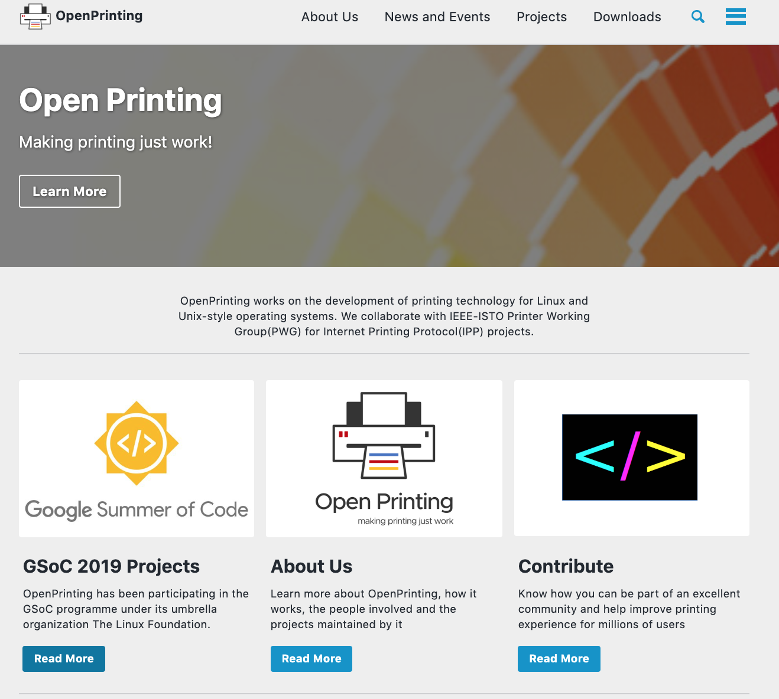
What’s New in Open Printing
A brand new website (upcoming) :
Migration: Related migration work for foomatic and other areas are going on in parallel.
Development link: https://openprinting.github.io/#

Slide 10
What Are The Students Saying?
Let’s Watch Out:
https://drive.google.com/file/d/1AP4X-LDVbAJMfuPfrtq_TgNKeHljCyt4/view?ts=5bbc66a3

Slide 11
Questions
Q & A

Slide 12
Thank You
Thank You !!

