Slide 1
The Linux Foundation - Common Print Dialog Project
Google Summer Of Code - 2017
Aveek Basu
Till Kamppeter

Slide 2
Objective
Objective:
To make printing easy for the users of desktop systems and mobile devices.
Develop a well-designed print dialog where one can easily find the right printer under the available printers, set general, printer-specific, and document-specific options, preview the printout, and send the job.
Consistence between applications, printing should work the same way from every application, the print dialog should be the same all over the system.
Users get access to all printers (network\USB\IPP\Google Cloud Print) and all print options from any desktop application.
Meant to be contributed to the appropriate upstream projects so that all Linux distributions will get improved by this.

Slide 3
Initial Idea
Initial Idea:
To have separate Print Dialogs each for gtk and qt.
Separate CUPS, IPP, Cloud Print backends for gtk and qt.
DBus layers for communication.
Reference:
Using Canonical’s design for the CPD: https://wiki.ubuntu.com/Printing
Using the D-Bus code written in earlier GSoC: https://wiki.linuxfoundation.org/openprinting/cpdapi

Slide 4
Current Plan
Based on the announcement from Canonical to drop Unity 8 and the current development at GNOME to come up with a new gtk CPD within 2yrs, the initial CPD idea had to be changed.
No development of gtk CPD. Main concentration to be on qt
Reuse parts of Unity 8 code already developed by Canonical: (https://launchpad.net/ubuntu-printing-app)
Modify the IPP, Google Cloud Print Backend code written by GNOME and make it use for qt CPD: (https://git.gnome.org/browse/gtk+/tree/modules/printbackends)
Writing a patch for Libre Office.

Slide 5
Student Selection Process
Student Selection Process:
Student selection process started from Jan 2017 much before GSoC announcement.
Computer Science departments of premier universities were approached.
A record application of near about 65 students received from different universities to work on Open Printing projects.
After a series of interviews and assignments, 7 students got selected and the batch was ready much before Google opened their window for student application.
Students were given basic training on the code specially CUPS and the backends to make them accustomed to the code.

Slide 6
Selected Students
Selected Students:

Slide 7
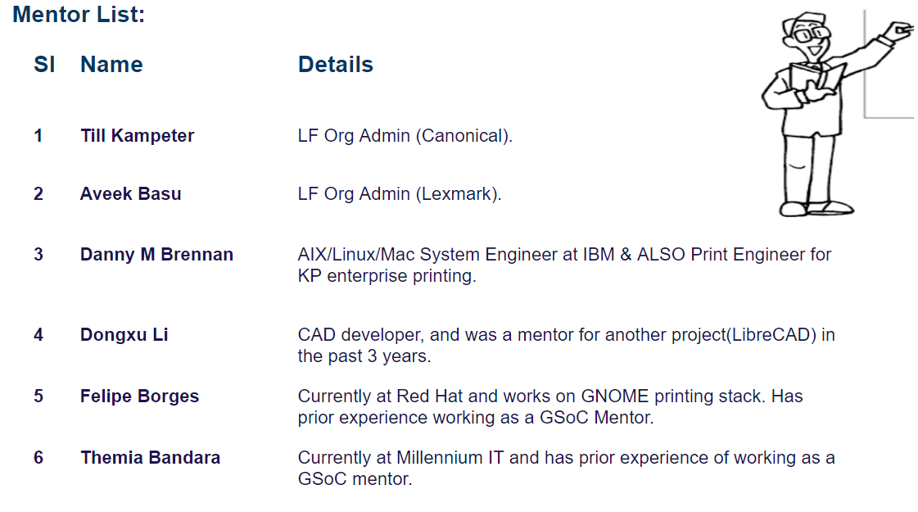
Mentors

Slide 8
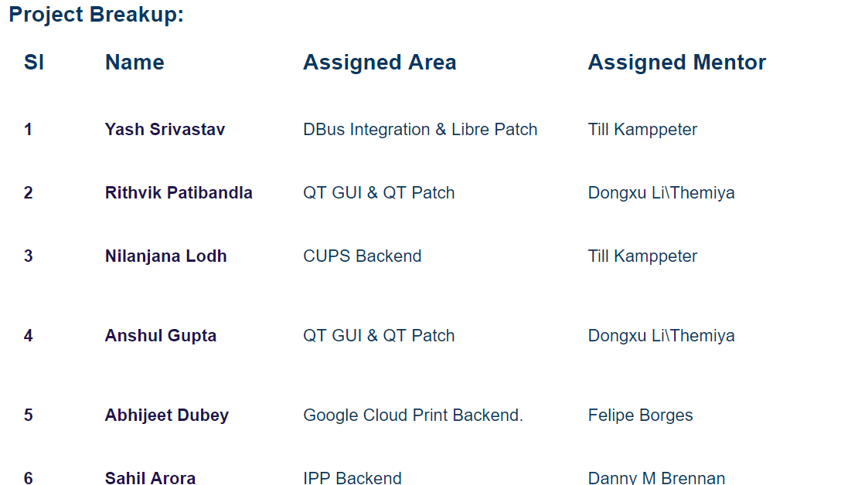
Project Breakup

Slide 9
Questions
Q & A

Slide 10
Thank You
Thank You !!
For any further queries, please feel free to get in touch:
Aveek Basu: basu.aveek@gmail.com
Till Kamppeter: till.kamppeter@gmail.com

