Slide 1
GSoC Project Updates - 2022
PWG OP Joint Summit
May 17, 2022
Aveek Basu - Program Manager

Slide 2
GSoC 2022 Projects
Add Avahi calls for discovering and resolving driverless IPP printers and Optimize the processes: The project aims to implement functions utilizing Avahi service discovery APIs and use them in libcupsfilter package. This implementation will include functions for service browsing only, resolving only, and also BrowseAndResolve. The presence of these independent functions will help us manipulate the complete process of service discovery and optimize it to make it faster. This optimization of the current slow service-resolve step by ippfind utility inside CUPS is the primary motivation for this project.
GUI for discovering non-driverless printers and finding suitable Printer Applications for them: Currently, most modern printers are driverless and support IPP printing and are set up automatically with CUPS. Printers that do not do driverless IPP need to be set up manually in the supported Printer Applications. As there will be several different Printer Applications and each one supporting another set of printers it is not trivial for the user to discover available non-IPP-driverless printers and find out which is the Printer Application to use and whether it is already installed. The idea is to create a GUI tool for the user which lists available, non-IPP-driverless printers, local (USB) and network devices and then set up printers in supported Printer Applications.
Adding CPDB support to existing Print Dialogs: Print Dialogs are one of the most used features for many people, and it is important that they stay up to date with the current print technologies (like CUPS) and be able to quickly adopt any new such upcoming technology (XYZ Cloud Printing Service). The print technology developers should also be able to fix any bugs as soon as they are found. However, since most Print Dialogs are provided natively by the GUI toolkits (and in some cases applications like LibreOffice and Chrome), this is often not the case. This is because the GUI toolkits themselves are large projects with long release cycles, and they have a lot of other similarly important things to work on. As of current, most GUI toolkits like GTK and QT connect their Print Dialogs directly with the print technologies like CUPS which creates problems for both.

Slide 3
GSoC 2022 Projects
Converting Braille embosser support into a printer application: Cups-filters presently supports Braille embossers through a set of PPD files and shell scripts that transform documents into a textual layout, the text into Braille dots, and the Braille dots to braille embosser-specific formats. This must be transferred to the newer CUPS infrastructure, Printer Applications, for long-term maintenance and wide availability. To complete the work, we must first convert the shell script into a C function that can be readily accessed by the printer application. Then we create a new printer application for braille embosser.
Scanning Support in PAPPL with eSCL Support: Our task here is to build an eSCL scan interface to the programme so that it can imitate an eSCL scanner. The most prevalent communication protocol for driverless scanning is eSCL, which is also used by AirPrint. eSCL is the HTTP-based protocol that Apple employs for AirScan, which is accessible on all multi-function printers that also support AirPrint and is meant to facilitate scanning from Apple's iOS-enabled mobile devices. The specifications of eSCL are not published, however as an HTTP-based protocol, it was not difficult for the creators of eSCL-related applications to reverse-engineer. With these apps already in place, we will port them to PAPPL and build tests for them.
Scanning Support in PAPPL with IPP Scan Interface: In PAPPL, the development is proceeding in the way so that PAPPL not only can be used for creating Printer Applications but also for creating Scanner Applications (emulation of a driverless IPP), or even an emulation of a driverless IPP multi-function device. Now my task is to add IPP Scan Interface by extending the IPP server of PAPPL to understand IPP Scan requests and respond to them appropriately, so that the application emulates an IPP Scan device.
Create new printer setup tool for the GNOME Control Center: A lot of users expect that if they plug in a USB printer that it is immediately available for use, without need to set it up. It is, therefore, important to build a Printer Setup Tool that provides the functionality to handle IPP services and to manage the non-driverless printers. Thus, the idea is to integrate three important components together for creating a GNOME Control Center module to automate the process of setting up a printer without facing any obstacles.

Slide 4
GSoC 2022 Projects
Make a native Printer Application from Gutenprint: Gutenprint is usually used as a classic CUPS driver with a CUPS filter and a PPD file generator. As mentioned above, CUPS will not support PPD files anymore from version 3.x on, and when using the CUPS Snap one cannot install PPD-based drivers already now. Therefore it is concluded that a Printer Application of Gutenprint is required to be developed using the PAPPL and libgutenprint library. Since PPD has limitations, therefore, the Application will do away with PPD files internally by making the mentioned libraries function calls. This project aims to build a Printer Application for GutenPrint which will not only do away with internal PPD files but also help to display a flexible UI for the printer capabilities.
Deliverables:-
1. A Printer Application for GutenPrint based on PAPPL and libgutenprint library will be developed.
2. All the options and parameters of the GutenPrint driver will be accessible from the Printer Application’s Web Interface.
3. The Printer Application will be available in the Snap Store with added description for the users. 4)Write documentation for the Printer Application for the users. Plan of Action:- At first, I will learn about the PAPPL, Gutenprint driver, and libgutenprintlib library. After that, I will analyze the available "lprint" Printer Application developed by Michael Sweet which also doesn't use PPD files to get an idea on how to code a printer application. Thus, with help from mentors and the community, I will code the printer application. After the printer application, I will sandbox it in Snap Store. Lastly, I will add the driver's parameters and options to the frontend/web interface of the printer's web admin.
Click here for more details.

Slide 5
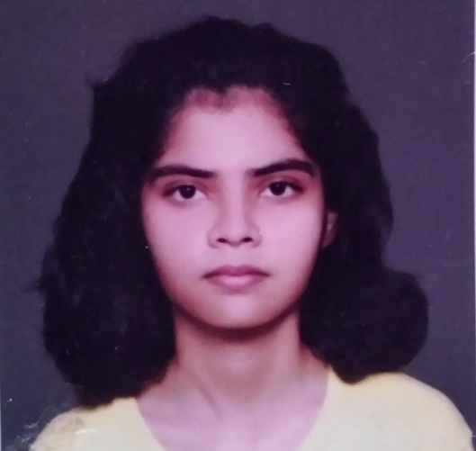
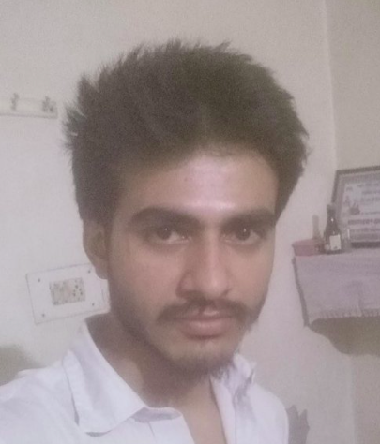
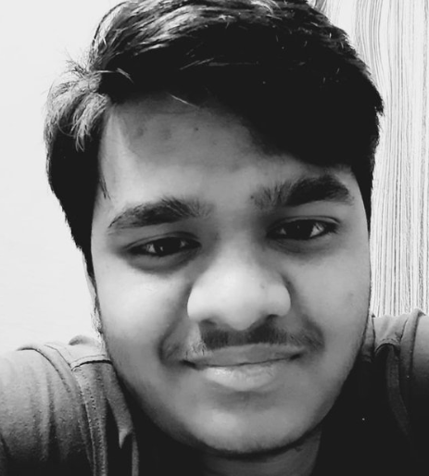
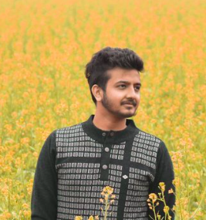
GSoC 2021 Projects
Bhavna Kosta (GSoC-2021)
Suraj Kulriya (GSoC-2021)
Pratyush Ranjan (GSoC-2021)
Pranshu Kharkwal (GSoC-2021)
Divyasheel Kumar (GSoC-2021)

Slide 6
From the students..!!
Demo Time

Slide 7
Demo - Pranshu Kharkwal
Create a universal filter to replace the chain of individual cups filters: CUPS uses various filters to convert one file type to another to facilitate printing in linux. These filters have existed as external binary executables from a long time. Later it was decided to convert these filters into filter functions, as calling external executables is a resource consuming process. Most of the filters had already been converted to filter functions, and the remaining functions were to be converted in this year's GSoC by another student. Now that filters are converted to filter functions, there was a need to create a single utility, which would call these filter functions according to the requirement, and that exactly was what my project was all about. I created a "universal" filter function, which would be called once, and would in turn create the required filter chain, and call it to perform the conversion.

Slide 8
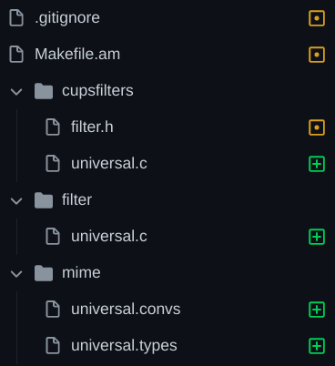
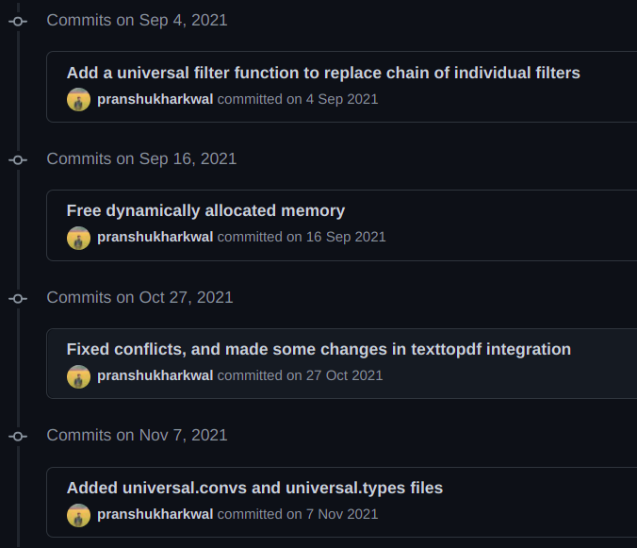
Demo - Pranshu Kharkwal

Slide 9
Experiences - Pranshu Kharkwal
Learning Experience Future Plans

Slide 10
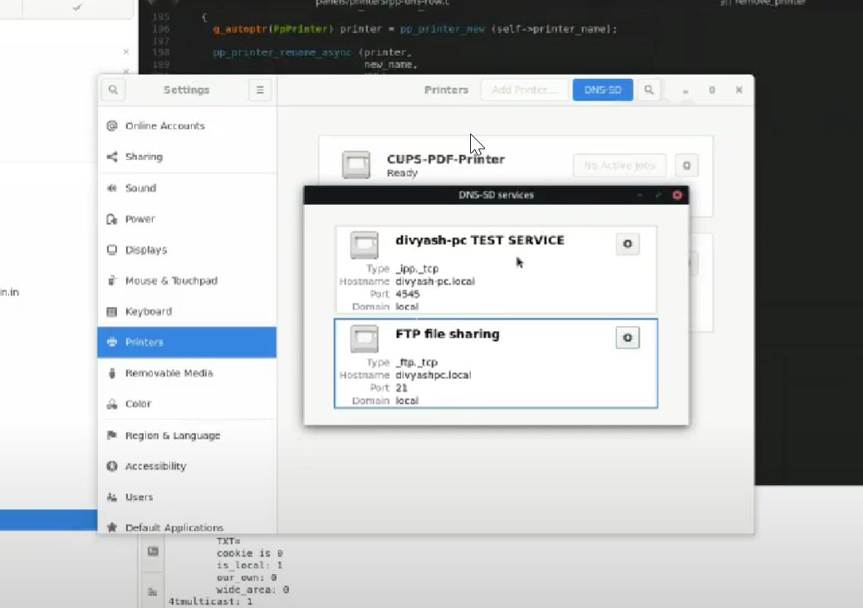
Project - Divyasheel Kumar
Project - GUI for listing and managing available IPP Print/Scan services (or DNS-SD-advertised network services in general)
This project is a combination of the gtk+ frontend library and the avahi-client backend. Using these 2 technologies I built an easily accessible tool housed in the gnome-control-center that can list all the available ipp(s) and http(s) services broadcasted on a network.
DNS-SD has been around for quite sometime now but most of the users are unaware of such services being broadcasted. This tool can list all such services with a click of a button. It does not just list them but also removes duplicates from different network interfaces, and also allows you to navigate to their respective administration website url. This makes using these services very user friendly.

Slide 11
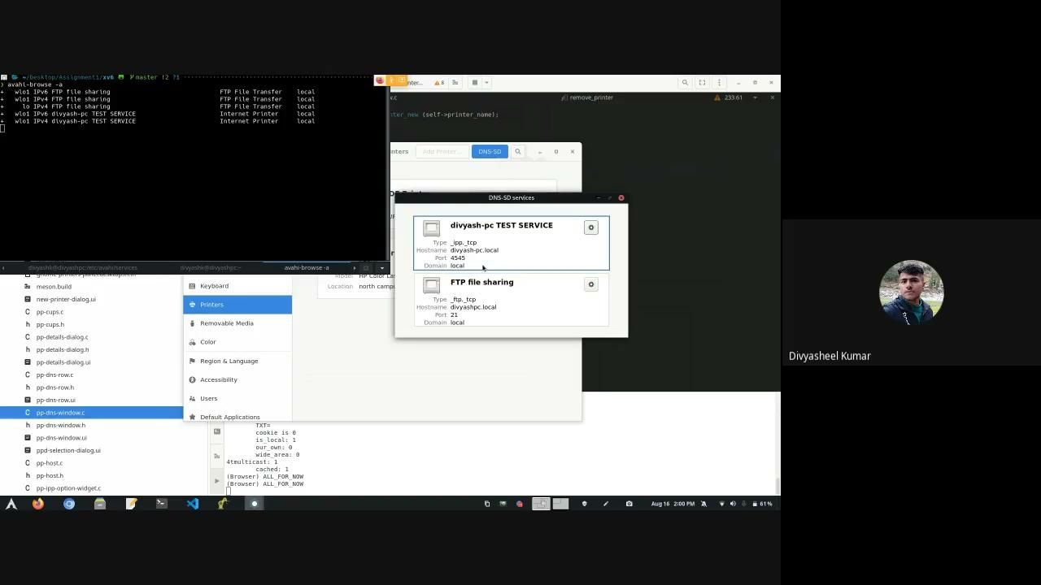
Demo - Divyasheel Kumar

Slide 12
Summary - Divyasheel Kumar
Learning :
When I started the project I had a very little understanding for Gtk and Avahi. I was primarily more comfortable with CUPs and it’s codebase. But I managed to learn both the library’s C implementation and interesting concepts like Custom Widgets in gtk and also the GNOME’s way of doing things.
Experience :
Working on this project during the summers with people from around the globe was an extraordinary experience for me. I had very flexible working hours and freedom to work whenever and wherever I wanted. This was the best part about the whole experience.
Future Plans :
I wish to continue contributing to open source by working as a part of the Open Printing community. I also plan on adding more features to this project either as a contributor in my free time or a mentor in the upcoming GSOCs.

Slide 13
OP Initiatives
Linux Plumbers Conference 2021 (Virtual): Link: https://www.youtube.com/watch?v=nQxWoXO90FM&t=4s
Upcoming for 2022:
Open Printing MC proposal for Linux Plumbers 22 has been selected by the LPC Committee. Inviting speakers for talks.
LPC 2022 Sep 12 - 14 (Dublin)

Slide 14
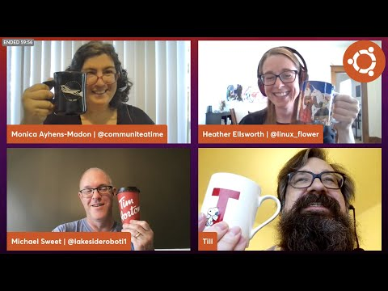
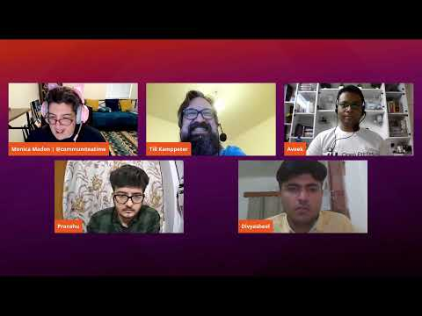
OP Initiatives
Ubuntu Desktop Team Indaba - August 27, 2021
Summer of Printers | Community Office Hours - Oct 7, 2021
FOSS Asia 2021 - Lightning Talks

Slide 15
GSoC 2022 Mentors & Admins
Till Kamppeter
Michael Sweet
Ira McDonald
Smith Kennedy
Danny Brennan
Zdenek Dohnal
Pranshu Kharkwal
Solomon Peachy
Deepak Patankar
Rithvik Patibandla
Dheeraj Yadav
Welcome New
Mentors !!
Admins: Till Kamppeter Aveek Basu

Slide 16
Thank You
Thank You !!
Twitter: Open_Printing Telegram: Join Us Email: basu.aveek@gmail.com.

