Slide 1


Notes:
So Mopria would like you to join us in our goal to make mobile printing easy. By adding a print button to your app, it benefits the user by providing them with a simplified way to print from their Android devices and also provides your app with greater relevance by increasing user retention and engagement.
When you do enable printing, Mopria would also like to help you market your app by listing it on the Mopria website.
So if you are interested in enabling print, please stop by the Mopria booth.

Slide 2
Mopria Alliance Mission
The Mopria Alliance provides universal standards and solutions for print and scan.
Notes:
We know that users want to print from their phones and tablets. An overwhelming number of consumers and majority of business users have wanted or needed to print from the mobile devices that are with them every day.

Slide 3






















Mopria Membership*
Founders & Board Members
Executive & Board Members
Executive Members
Adopters
*Represents more than 98% of the worldwide printer business

Slide 4
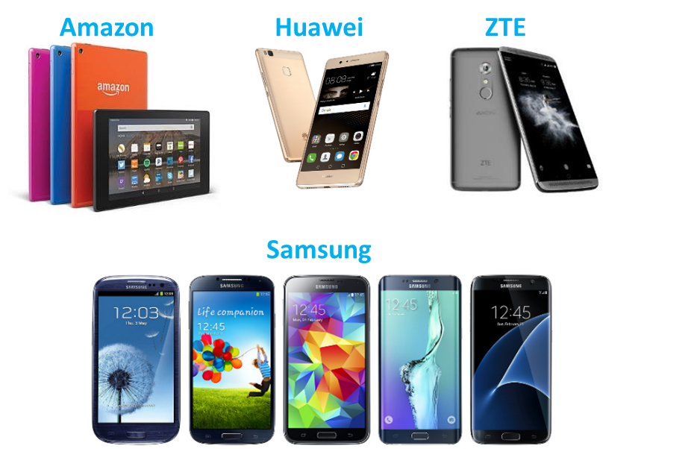
Mopria Print Reaches Critical Mass
1B+ Installs: Combined Amazon, Huawei, Samsung and ZTE pre-load devices and installations from Google Play and Chinese app stores and the Default Print Service on Android 8 & 9.
120+ Million Certified Printers: From 24 printer companies with 3,000 certified printer models
Half a Billion Pages Printed

Slide 5
Mopria Print Service
Development
Mopria Print Service 2.0 (September 2016)
Supports Enterprise features including:
  - transport security (SSL/TLS)
  - stapling
  - accounting
  - pin printing
  - user authentication
Share to print for:
  - Images
  - PDF documents
Improve stability and performance
Mopria Print Service 2.1 (December 2016)
Allows you to choose the print quality.
Adds N-up printing to the list of supported workplace features
Find out printer information prior selection on Android 7.0

Slide 6
Mopria Print Service
Development
Mopria Print Service 2.3 (November 2017)
Launcher content improvements:
- How to Print
- Available printers, printer information, add printers
- Troubleshooting information
Advanced finishing options
Share to print for
  - Web Files
  - Text files
  - Content from web-based apps
Bug fixes
Mopria Print Service 2.4 (March 2018)
Support multiple input trays
Support printer side enterprise policies
Support additional larger media sizes for PDF printers
Additional advanced finishing options
Enabling MDNS printer discovery over access points that perform packet aggregation. Common in enterprise environments.
Bug fixes

Slide 7
Mopria Print Service
Development
Mopria Print Service 2.5 (July 2018)
Automatic caching of printer defaults for Duplex and Media Size
Support for Multiple Hole Punch
Ability to select more than one Finishing option
Bug fixes

Slide 8

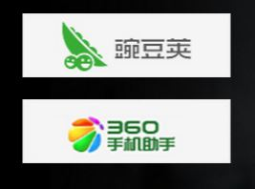




Mopria Print Distributed Globally
Significant Install Growth
Chinese App Stores
Default Print Service
Android 8 & 9
Mopria Website
Direct Downloads
-For MDM and customers without app store access
Library Integrated with Members’ Applications

Slide 9
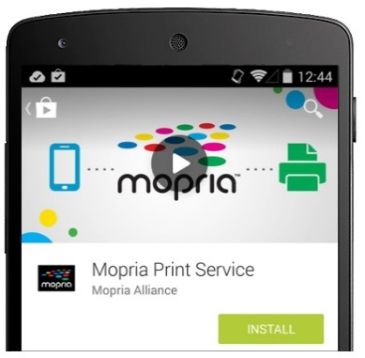

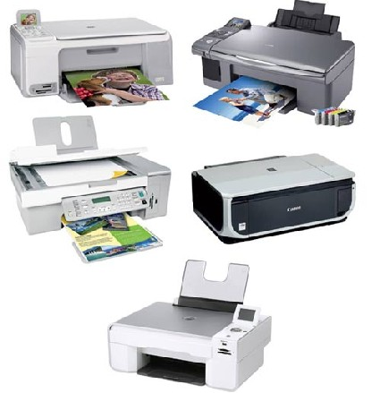





Progress on Android
Task 1:
Mopria certified printers – 90% of all new printers
3,000+ certified printers from 24 brands
100 million+ print devices
Task 2:
Out-of-box Android printing
MPS in Google Play
Task 3:
Samsung Print Service with Mopria Print Library
Huawei, Amazon Kindle Fire and ZTE devices
Mopria technology in Android 8 and 9 Default Print Service
Task 4:
Drive print adoption in mobile apps
Ongoing

Slide 10







Mopria + Android – Making Mobile Print Easy
Mopria Contributions Began with Kit Kat
Android 4.3
JELLY BEAN
Android 4.4
KIT KAT
Android 5
LOLLIPOP
Android 6
MARSHMALLOW
Android 7
NOUGAT
Android 8
OREO
Android 9
PIE
Each App Handled Print
Local Printing Enabled (Android Print Framework)
Enhanced Printing Features
Print Service On By Default/Print Service Discovery
Mopria Integrated

Slide 11
Thank you

