Slide 1
Standards for 3D Printing
®
The Printer Working Group
Paul Tykodi, PWG IPP Workgroup Co-Chair
Copyright © 2019 The Printer Working Group. All rights reserved. The IPP Everywhere and PWG logos are registered trademarks of the IEEE-ISTO.

Slide 2
About the Printer Working Group
®
The PWG is a Program of the IEEE Industry Standard and Technology Organization (ISTO) with members including printer and multi-function device manufacturers, print server developers, operating system providers, print management application developers, and industry experts
Originally founded as an IETF WG in 1991
Standards body responsible for SNMP Printer, Finisher, and Job MIBs as well as the Internet Printing Protocol (IPP) and PWG Semantic Model
IPP has been in 2D printers since 1999 (20 years), in 98%+ of all 2D printers sold in the world today
We enjoy an open standards development process, and all specifications are freely available
Copyright © 2019 The Printer Working Group. All rights reserved. The IPP Everywhere and PWG logos are registered trademarks of the IEEE-ISTO.

Slide 3
3D Printing Standards Work
®
Web page:
https://www.pwg.org/3d
Initial standards work began with a "Birds of a Feather" session at the August 2014 PWG Face-to-Face meeting
PWG Candidate Standard 5100.21-2019: "IPP 3D Printing Extensions v1.1" was developed by the IPP workgroup as part of an effort to enable direct and service-based 3D printing
The IPP workgroup also defined a PWG Semantic Model (XML) schema based on this IPP extension suitable for data exchange and embedding within common 3D file formats such as 3MF and 3D PDF documents so that user intent is preserved regardless of the transport or workflow used.
"PWG 3D Print Job Ticket and Associated Capabilities v1.0 (PJT3D)” was published as a best practice document in August 2017
Copyright © 2019 The Printer Working Group. All rights reserved. The IPP Everywhere and PWG logos are registered trademarks of the IEEE-ISTO.

Slide 4
IPP 3D Printing Extensions v1.1
®
The 1.1 specification has a focus on FDM/"desktop" printers
Extensible model allows us to support other materials and technologies easily
IPP provides access control, authorization, and authentication over a secure transport
IPP provides an abstract data model for representing materials, printer sub-units, and state
IPP provides intent-based Job Tickets and Printer Capabilities - the User specifies what they want and the Printer determines how to do it
IPP provides Job Receipts which record accounting information such as the material usage, processing times, and so forth
Copyright © 2019 The Printer Working Group. All rights reserved. The IPP Everywhere and PWG logos are registered trademarks of the IEEE-ISTO.

Slide 5
IPP 3D Printing Extensions v1.1
®
For printers with slicing capabilities, IPP 3D requires support for the 3D Manufacturing File Format (3MF) and recommends support for PDF with U3D or PRC 3D content
3D PDF Consortium is looking into adding support for one of the ISO STEP standards to 3D PDF as well
AMF was considered for the standard but isn't freely available and most implementations only support a subset
... but IPP does support any file format a printer supports
We don't currently have a required layered (pre-sliced) format
Two recommended formats: "Safe" G-Code and 3MF Slice
The PWG Safe G-Code Subset "best practice" document (Formal Approval expected in June 2019) defines a "safe" subset of G-Code for FDM printers without slicing capabilities
3MF Slice Extension scales better to different technologies
Copyright © 2019 The Printer Working Group. All rights reserved. The IPP Everywhere and PWG logos are registered trademarks of the IEEE-ISTO.

Slide 6
AAA and Security
®
IPP supports all of the standard HTTP authentication schemes (Basic, Digest, OAuth, MutualAuth, Negotiate, etc.) plus X.509 certificate validation over TLS
Commonly used with LDAP-based authorization frameworks (ActiveDirectory, OpenDirectory, etc.)
IPP 3D requires TLS (1.2 or higher) support
Copyright © 2019 The Printer Working Group. All rights reserved. The IPP Everywhere and PWG logos are registered trademarks of the IEEE-ISTO.

Slide 7
Abstract Data Model
®
Every printer is different, so the PWG developed a high-level abstract data model to enable useful monitoring for maintenance, availability/reliability, etc.
Key information is preserved (classes of sub-units, types of materials, temperatures, levels, etc.) without exposing implementation details that are not needed
Copyright © 2019 The Printer Working Group. All rights reserved. The IPP Everywhere and PWG logos are registered trademarks of the IEEE-ISTO.

Slide 8
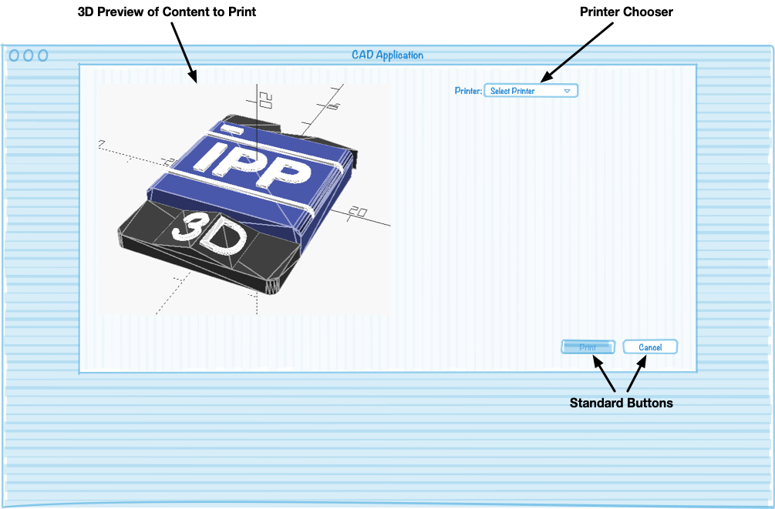
Printer UI Derived from Capabilities
®
Copyright © 2019 The Printer Working Group. All rights reserved. The IPP Everywhere and PWG logos are registered trademarks of the IEEE-ISTO.

Slide 9
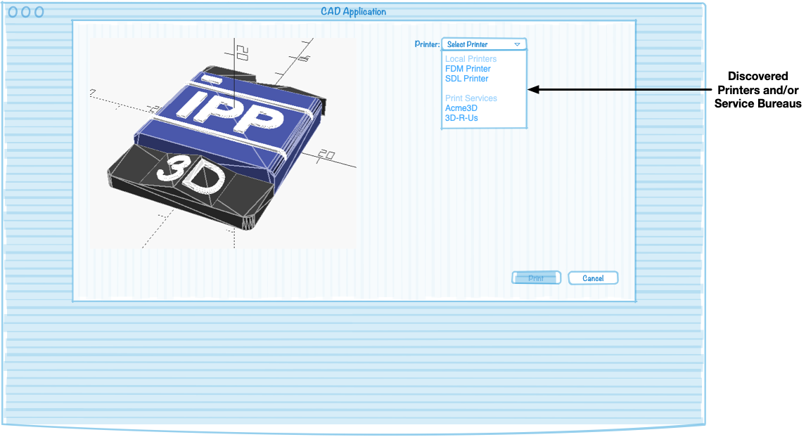
Printer UI Derived from Capabilities
®
Copyright © 2019 The Printer Working Group. All rights reserved. The IPP Everywhere and PWG logos are registered trademarks of the IEEE-ISTO.

Slide 10
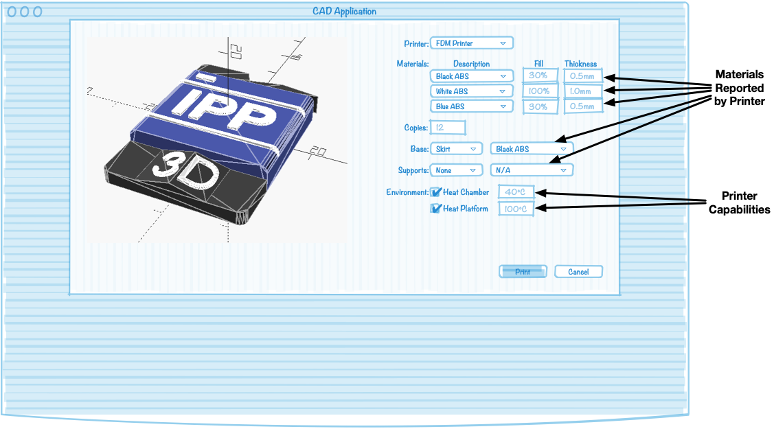
Printer UI Derived from Capabilities
®
Copyright © 2019 The Printer Working Group. All rights reserved. The IPP Everywhere and PWG logos are registered trademarks of the IEEE-ISTO.

Slide 11
Intent-Based Job Tickets
®
IPP assumes that the printer knows how to print something - we don't tell the printer to move the extruder head or prepare a powder bed, we tell it we want an object printed with a certain material and a certain accuracy
Job Ticket and Capabilities reflect the minimum information needed for the printer to process a job as the user intends
What, not how
Copyright © 2019 The Printer Working Group. All rights reserved. The IPP Everywhere and PWG logos are registered trademarks of the IEEE-ISTO.

Slide 12
Job Receipts
®
Records the actual Job Ticket values that were used, including how much of each material was used, errors that occurred during processing, and so forth
Primary usage is for accounting, but also can be used operationally for determining supply orders, maintenance periods, etc.
Copyright © 2019 The Printer Working Group. All rights reserved. The IPP Everywhere and PWG logos are registered trademarks of the IEEE-ISTO.

Slide 13
How to Participate
®
We welcome participation from all interested parties
Participation is free and does not require PWG membership
IPP Working Group web page
https://www.pwg.org/ipp/index.html
Subscribe to the IPP mailing list
https://www.pwg.org/mailman/listinfo/ipp
IPP WG holds conference calls on alternate Thursdays from 3:00pm to 4:30pm ET
Meetings announced on IPP mailing list
Copyright © 2019 The Printer Working Group. All rights reserved. The IPP Everywhere and PWG logos are registered trademarks of the IEEE-ISTO.

