Slide 1
GovPrint Interoperability Workshop
28th October, 2019

Slide 2

Printing is boring……(but it is still important)
Users expect to print when they want to……
IT see it as a old tech……
Procurement want to buy products…...

Slide 3
Users still need to print
The need for print hasn’t gone away
But it is changing…..

Slide 4
Interoperability Workshop Agenda
Introduction - objectives and ground rules
Context / background - why Government needs it?
What does it need to do?
How could and should it be done?
What do we do next?

Slide 5
Organisations Represented
Canon
Cirros
EveryonePrint
Forcepoint
HP
Kofax
Konica Minolta
Kyocera
Lexmark
LRS
OneQ
PaperCut
PrinterLogic
PrinterOn
ProcessFusion
Ricoh
SCC
Thinprint Ezeep
Xerox
Printer Working Group (PWG)

Slide 6
Meeting Objectives
Review proposed standards
Identify challenges
Agree standards in principle (not detail)
Agree next steps

Slide 7
Some ground rules….
Do not share confidential information in the meeting
Participation does not mean a commitment to develop or deliver
GDS is not precious about proposed standards
Questions / discussion at any point
If we run out of time we will skip to next steps

Slide 8
Before we start….
Let’s not focus on reasons not to do it
We can identify the challenges (technical, commercial & cultural)
Today is about feasibility not delivery
Focus on the MVP requirements
Many participants are online

Slide 9
Some context, the story so far
GDS Common Technology Services (CTS)
UK Government Hubs Programme
Smarter Working
Mobile workers in multiple buildings operated multiple organisations (mobility & multi-tenancy)
Notes:
GDS CTS - looked at options to deploy common solutions across government, basically too difficult - difficult to meet everyone’s needs and ‘not invented here’
Two projects have carried on GovWifi and GovPrint
Government Hubs programme - shared buildings with multiple suppliers and a shared IT stack
Smarter ways of working - move to digital and move to increasingly mobile workforce, users work in shared spaces and work in other departments buildings
Two general trends that need to be supported – mobility and multi-tenancy

Slide 10
We asked suppliers….
How can users access printing across multiple organisations?
No viable ideas - only option proposed was for everyone to use the same solution!!

Slide 11
Problem statement
A department has their own print service
Enable the print service to interoperate with other print services such that
Users can access print services in other locations
Users can roam across print services

Slide 12
Back to basics
What does it need to do?
What open standards options are there?
What is/are the best option(s)?
Produced Interoperability Discussion Paper v1
Shared with suppliers
Produced Interoperability Discussion Paper v2

Slide 13
Some definitions
Home Service
Guest Service
Users submit jobs to Home Service
Users can release jobs via Guest Service
Notes:
Home Service - the print service provided by the users’ home department
Guest Service - another departments service that the user can access as a guest using their home service credentials

Slide 14
What does it need to do?
Authenticate the user
User Selects print job(s)
User Authorises transfer
Transfer files
Release print job(s)
Report outcome
Notes:
Authenticate user using Home Service credentials
Select print jobs to be released
Authorise Home service to send jobs to Guest Service
Transfer print files from home to guest print service
Release print jobs at selected printer
Report outcome of print jobs from guest to home service

Slide 15
Candidate standards
Don’t reinvent the wheel
Standards that can work together
Internet Printing Protocol (IPP)
OAuth 2.0 (Device Grant Authorisation)
PDF
Notes:
More detail of all standards in the discussion paper
IPP
Secure protocol to support network printing using https.
OAuth2
Open standard for access delegation - enable an authenticated user to authorise one service to access their information held on another service using an Access Token
Multiple ‘grant types’ or methods for a service to get an Access Token, proposing to use Device Grant
PDF for document format
All are well adopted, have an active development programme and are supported in dev environment

Slide 16
Candidate standards
Step | Function | Performed by | Open Standard
Authenticate | Authenticate user | Home service | NA
Select | Select print jobs | Home service | NA
Authorise | Authorise transfer | Interoperability | OAuth2 Device Grant
Transfer | Transfer | Interoperability | IPP Infra PDF
Release | Release job on MFD | Guest service | NA
Report | Report outcome | Interoperability | IPP Infra

Slide 17
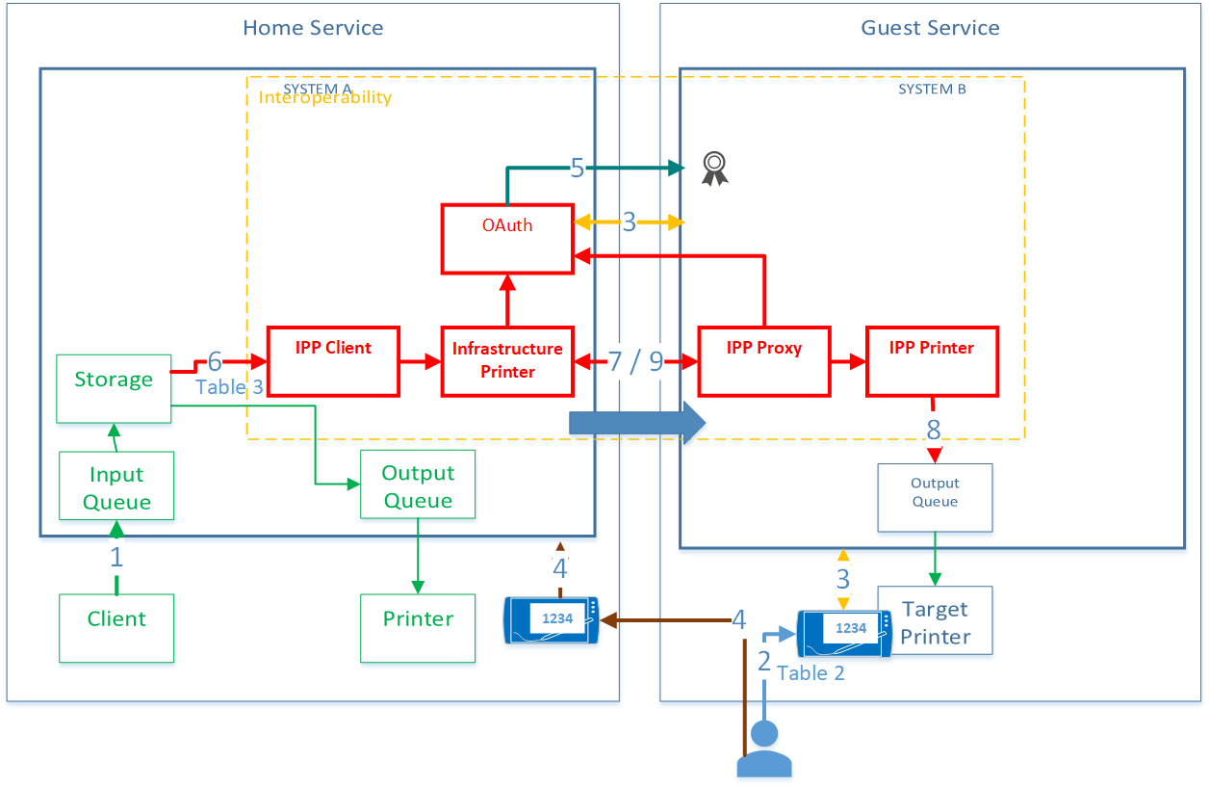
Technical summary
OAuth2 - 2 to 5
(Table 2 p14)
IPP - 6 to 9
(Table 3 p16)
Notes:
Stages 2 to 5 summarised in Table 2 page 14
Stages 6 to 9 summarised in Table 3 page 16
Submit Job to home queue>storage
‘Guest Print’ + Home Service on Target Printer (Table 2)
Start OAuth2 Device Grant -
Guest Service gets ‘device code’ from Home Service OAuth
Displays device code on Target Printer
On Home Service (web / App) user
Authenticates
Select print jobs
Enters ‘device code’
Authorises transfer
Home Service OAuth2 service gives an Access Token to Guest Service
Home service uses IPP Client to submit print jobs to Infrastructure Printer (Table 3)
Job Transfer
Infrastructure Printer updates ‘job fetchable’ event
IPP Proxy requests fetchable job details and presents Access Token
Infrastructure Printer checks validity of Access Token with OAuth2 service and gets ‘username’ associated with token
Infrastructure Printer returns details of fetchable jobs for token ‘username’
IPP Proxy creates Job on IPP Printer with ‘output-device-uuid’ = OAuth2 start device name
IPP Proxy gets all documents associated with the job and presents Access Token and adds them to the job on the IPP Printer
IPP Printer forwards to queue for Target Printer
IPP Proxy sends update to Infrastructure Printer confirming output of job

Slide 18
Discussion
Authorise | Can OAuth2 support the requirements? Are there better alternatives to OAuth2? Are there better alternatives to OAuth2 Device Flow e.g. OpenID Connect
Transfer | Can IPP Infra support the requirements? Are there better alternatives to IPP? Can IPP Infra provide a secure method to transfer print jobs? Does IPP Infra provide the range of operators, objects and attributes required? Is PDF a suitable format for print jobs?
Report | Can IPP support the required attributes for reporting

Slide 19
OAuth2 Device Grant discussion
Table 2 OAuth2 Device Authorisation Grant

Slide 20
IPP Discussion
Operators (tables 4 and 5)
Attributes (tables 6 to 9)
Events (tables 10 and 11)
Document format - PDF 1.7
Notes:
Table 4 page 19 and Table 5 page 20 outline key Operators that need to be supported
Table 6 to 9 outline the key attributes that need to be supported

Slide 21
Next steps
Do we want to take this forward?
How do we take it forward?
Extend the discussion paper into a draft standard?
GDS can set up a Basecamp group to support collaboration and discussion

Slide 22

Sometimes printing can be interesting

Slide 23
GovPrint Interoperability Workshop
28th October, 2019

