Slide 1
IPP Workgroup Session
®
The Printer Working Group
November 15, 2022
Copyright © 2022 The Printer Working Group. All rights reserved. The IPP Everywhere and PWG logos are trademarks of the IEEE-ISTO.

Slide 2
Before We Begin...
®
PWG Antitrust Policy:
https://www.pwg.org/chair/membership_docs/pwg-antitrust- policy.pdf
The IEEE-ISTO Printer Working Group ("PWG") will not become involved in the business decisions of its Members. The PWG strictly complies with applicable antitrust laws. Every PWG meeting attendee shall comply with this policy. The PWG Officers and PWG Workgroup Officers are responsible to ensure that this policy is adhered to in all PWG activities.
PWG Intellectual Property Policy:
https://www.pwg.org/chair/membership_docs/pwg-ip-policy.pdf
TL;DR: Anything you say in a PWG meeting or email to a PWG address can be used in a PWG Document
(but please do read the IP policy above if you haven't done so)
Copyright © 2022 The Printer Working Group. All rights reserved. The IPP Everywhere and PWG logos are trademarks of the IEEE-ISTO.

Slide 3
Agenda (1/3)
®
November 15, 2022 (US Eastern Standard Time)
When | What
10:00 - 10:45 | PWG Plenary
10:45 - 11:00 | IPP WG: Status
11:00 - 12:00 | IPP WG: Prototype-Ready Specifications
12:00 - 12:45 | Lunch Break
12:45 - 14:00 | IPP WG: Evolution of IPP/2.x and IPP Everywhere
Copyright © 2022 The Printer Working Group. All rights reserved. The IPP Everywhere and PWG logos are trademarks of the IEEE-ISTO.

Slide 4
Agenda (2/3)
®
November 16, 2022 (US Eastern Standard Time)
When | What
10:00 - 11:00 | IPP WG: IPP Production Printing Extensions v2.0
11:00 - 12:00 | IPP WG: IPP Driver Replacement Extensions v2.0
12:00 - 12:45 | Lunch Break
12:45 - 14:30 | IPP WG: Evolution of IPP and OAuth
Copyright © 2022 The Printer Working Group. All rights reserved. The IPP Everywhere and PWG logos are trademarks of the IEEE-ISTO.

Slide 5
Agenda (3/3)
®
November 17, 2022 (US Eastern Standard Time)
When | What
10:00 - 12:00 | IDS WG: Status and Discussion
12:00 - 12:45 | Lunch Break
12:45 - 13:45 | IPP WG: 3D Printing Liaisons
13:45 - 14:00 | IPP WG: Next Steps
Copyright © 2022 The Printer Working Group. All rights reserved. The IPP Everywhere and PWG logos are trademarks of the IEEE-ISTO.

Slide 6
Charter
®
Current charter:
https://ftp.pwg.org/pub/pwg/ipp/charter/ch-ipp-charter-20210409.pdf
The Internet Printing Protocol (IPP) workgroup is chartered with the maintenance of IPP and the IETF IPP registry, and support for new clients, network architectures (Cloud, SDN), MFD/Imaging service bindings, and emerging technologies such as 3D Printing
In addition, we maintain the IETF Finisher MIB, Job MIB, and Printer MIB registries, the PWG MIBs, the PWG Semantic Model schema, and handle synchronization with changes in IPP
Copyright © 2022 The Printer Working Group. All rights reserved. The IPP Everywhere and PWG logos are trademarks of the IEEE-ISTO.

Slide 7
Errata
®
Pending:
PWG 5100.5-2019 (Document Object v1.1): 4 issues
PWG 5100.6-2003 (Page Overrides v1.0): 2 issues
PWG 5100.8-2003 ("-actuals" v1.0): 1 issue
PWG 5100.9-2009 (Printer State Extensions v1.0): 2 issues
PWG 5100.15-2014 (FaxOut v1.0): 2 issues
PWG 5100.18-2015 (Infrastructure Extensions v1.0): 8 issues
PWG 5100.19-2015 (Implementor's Guide v2.0): 8 issues
PWG 5100.22-2019 (System Service v1.0): 3 issues
PWG 5107.3-2019 (MFD Alerts v1.1): 1 issue
In-Progress:
PWG 5100.3-2001 (Production Printing): 2 issues
PWG 5100.7-2019 (Job Extensions v2.0): 8 issues
PWG 5100.11-2010 (JPS2 - Enterprise Printing): 7 issues
PWG 5100.12-2015 (IPP 2.0, 2.1, and 2.2): 2 issues
PWG 5100.13-2012 (JPS3 - Driver Replacement): 15 issues
PWG 5100.14-2020 (IPP Everywhere v1.1): 4 issues
PWG 5100.20-2020 (IPP Everywhere v1.1 Self-Cert): 1 issue
Copyright © 2022 The Printer Working Group. All rights reserved. The IPP Everywhere and PWG logos are trademarks of the IEEE-ISTO.

Slide 8
Prototype-Ready Specifications
®
IPP Encrypted Jobs and Documents v1.0 (TRUSTNOONE)
https://ftp.pwg.org/pub/pwg/ipp/wd/wd-ipptrustnoone10-20210519.pdf
IPP Enterprise Printing Extensions v2.0 (EPX)
https://ftp.pwg.org/pub/pwg/ipp/wd/wd-ippepx20-20211101.pdf
IPP Job Extensions v2.1 (JOBEXT)
https://ftp.pwg.org/pub/pwg/ipp/wd/wd-ippjobext21-20221105.pdf
Copyright © 2022 The Printer Working Group. All rights reserved. The IPP Everywhere and PWG logos are trademarks of the IEEE-ISTO.

Slide 9
IPP Job Extensions v2.1
®
Prototype draft:
https://ftp.pwg.org/pub/pwg/ipp/wd/wd-ippjobext21-20221105-rev.pdf
Updates PWG 5100.7-2019: IPP Job Extensions v2.0
Primary focus is clarifications for "media-col", "media-col-database", "media-col-ready", "media-size", and "media-size-supported"
Also adds:
Missing attributes: "job-hold-until-time-supported", "job-processing-time"
New values for "media-source" and "print-content-optimize"
Q: Add "max-page-ranges-supported" from IANA registry?
Proposed schedule:
Stable draft and IPP WG last call Q4 2022
Copyright © 2022 The Printer Working Group. All rights reserved. The IPP Everywhere and PWG logos are trademarks of the IEEE-ISTO.

Slide 10
Lunch Break
®
The Printer Working Group
Resuming at 12:45pm ET
Copyright © 2022 The Printer Working Group. All rights reserved. The IPP Everywhere and PWG logos are trademarks of the IEEE-ISTO.

Slide 11
IPP/2.x Fourth Edition
®
Current interim draft:
https://ftp.pwg.org/pub/pwg/ipp/wd/wd-ippbase23-20220809-rev.pdf
Errata update of PWG 5100.12-2015:
Clarification about Get-Printer-Attributes operation
Definition of classes or categories of printers
Updated document references, including an informative reference to IPP Everywhere
Simplified reference tables and conformance requirements
New history of the development of the Internet Printing Protocol content to explain how we ended up with different protocol versions with the same encoding
Proposed schedule:
Prototype draft after EPX 2.0 and JOBEXT 2.1
Copyright © 2022 The Printer Working Group. All rights reserved. The IPP Everywhere and PWG logos are trademarks of the IEEE-ISTO.

Slide 12
IPP Everywhere v2.0
®
Current prototype draft:
https://ftp.pwg.org/pub/pwg/ipp/wd/wd-ippeve20-20221107-rev.pdf
Major update of PWG 5100.14-2020: IPP Everywhere v1.1
Most RECOMMENDED items become REQUIRED
New CONDITIONALLY REQUIRED items
REQUIRE "printer-firmware-xxx" Printer Status attributes
REQUIRE Get-Printers from PWG 5100.22 for print servers
RECOMMEND IPP-USB support
Proposed schedule:
Stable draft Q1/Q2 2023
Copyright © 2022 The Printer Working Group. All rights reserved. The IPP Everywhere and PWG logos are trademarks of the IEEE-ISTO.

Slide 13
IPP Everywhere Printer Self-Certification Manual v2.0
®
Initial draft:
https://ftp.pwg.org/pub/pwg/ipp/wd/wd-ippeveselfcert20-20220510.pdf
Major update to PWG 5100.20-2020
Synchronize with changes in IPP Everywhere v2.0
Add IPP-USB support (particularly for USB-only printers)
Add feature tests for duplex, finishings, roll, tray
Add Get-Printers test for servers
Proposed schedule:
Prototype draft and beta tools Q1 2023
Copyright © 2022 The Printer Working Group. All rights reserved. The IPP Everywhere and PWG logos are trademarks of the IEEE-ISTO.

Slide 14
IPP Everywhere™ v2.0 Printer Self-Certification Tests
®
Existing tests:
mDNS/DNS-SD - required service types, TXT keys, and values
IPP - required operations, attributes, and values, 'media-needed'
Document - basic printing tests for PWG Raster, JPEG, and PDF
New tests:
Color printing - verify print-color mode works to switch between color and grayscale for PWG Raster, JPEG, and PDF
Duplex printing - verify odd number of pages works, PWG Raster, JPEG (fail/ignore), PDF
Stapling, Folding, Punching - verify all supported staple values work for PWG Raster, JPEG, and PDF with different numbers of pages, duplex modes (as supported)
Trimming/cutting - verify cutter works for roll media (as supported)
Server - verify Get-Printers operation works, do IPP tests against each reported printer
JPEG and PDF tests only performed if the Printer supports them
Copyright © 2022 The Printer Working Group. All rights reserved. The IPP Everywhere and PWG logos are trademarks of the IEEE-ISTO.

Slide 15
Self-Certification Tools
®
Platforms:
Linux: Drop Red Hat, Ubuntu 22.04 LTS for Intel/ARM?
macOS: macOS 12+ for Intel and Apple Silicon
Windows: Windows 10+ and higher for Intel
Mobile (Android/iOS/iPadOS) and other desktop OS's also possible
Add command-line and GUI front-end (rather than running individual scripts)
Look at publishing on corresponding App stores as free apps
Potential issues with using ISTO as "vendor"
Maybe have one PWG member publish the official apps instead?
Copyright © 2022 The Printer Working Group. All rights reserved. The IPP Everywhere and PWG logos are trademarks of the IEEE-ISTO.

Slide 16
(New) Proposed Tool
®
"ippevetool"
GUI and command-line
Run self-certification tests
Inspect TXT records, Printer attributes, resources (icon/profile/string), and X.509 certificates
Do ad-hoc print tests using canned and/or user-supplied files
Do ad-hoc ipptool tests using canned and/or user-supplied files
Look-up specs for attributes and values via IPP registry
Copyright © 2022 The Printer Working Group. All rights reserved. The IPP Everywhere and PWG logos are trademarks of the IEEE-ISTO.

Slide 17
(New) Proposed Tool
®
Implement using Flutter (GUI) and Dart (language)
One code base for all platforms
Compiles to native code
Potential for supporting Android, *BSD, and iOS/iPadOS
Existing "nsd" mDNS/DNS-SD library can be used for Android, iOS/iPadOS, macOS, and Windows
Need to write Avahi nsd plugin ("nsd_avahi") for Linux/*BSD
Need to implement proper IPP library for Dart
Also considered: native GUI (different for each platform), Electron (Javascript), and FLTK (C++)
Copyright © 2022 The Printer Working Group. All rights reserved. The IPP Everywhere and PWG logos are trademarks of the IEEE-ISTO.

Slide 18
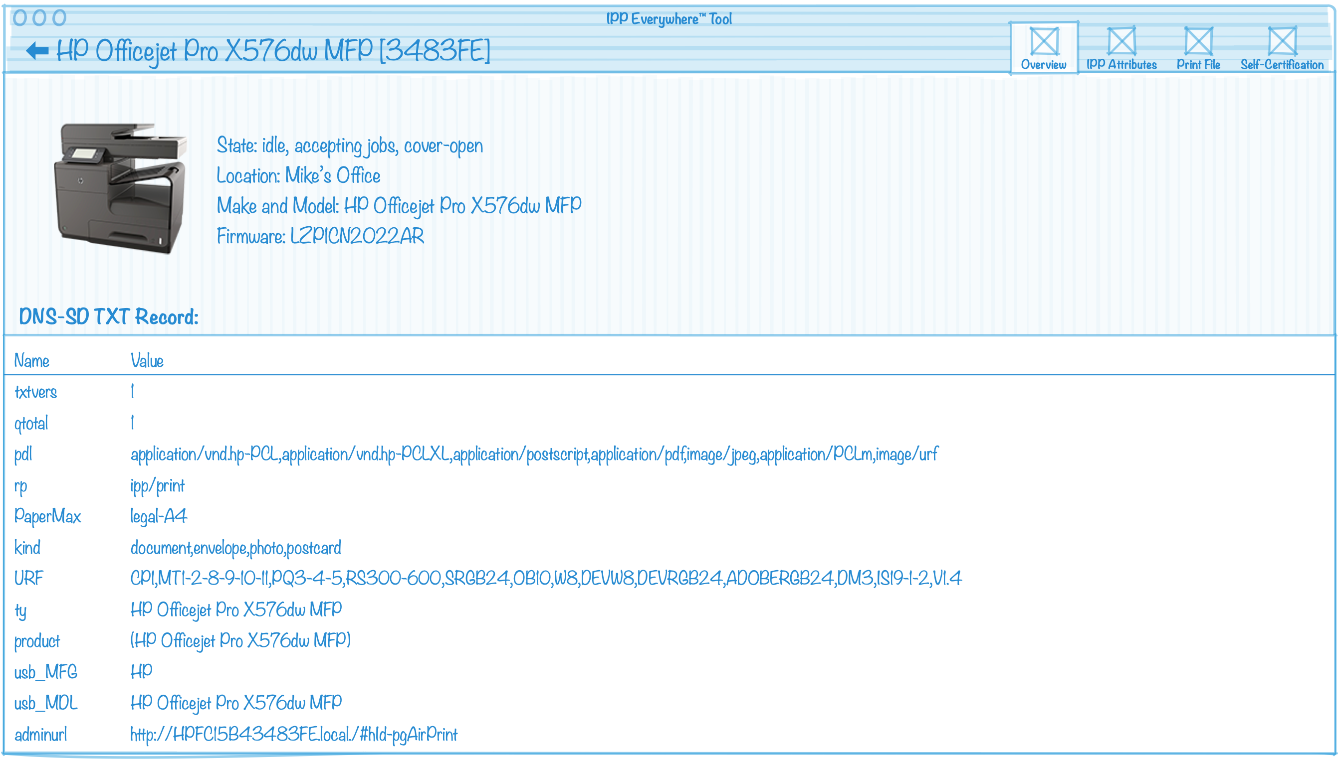
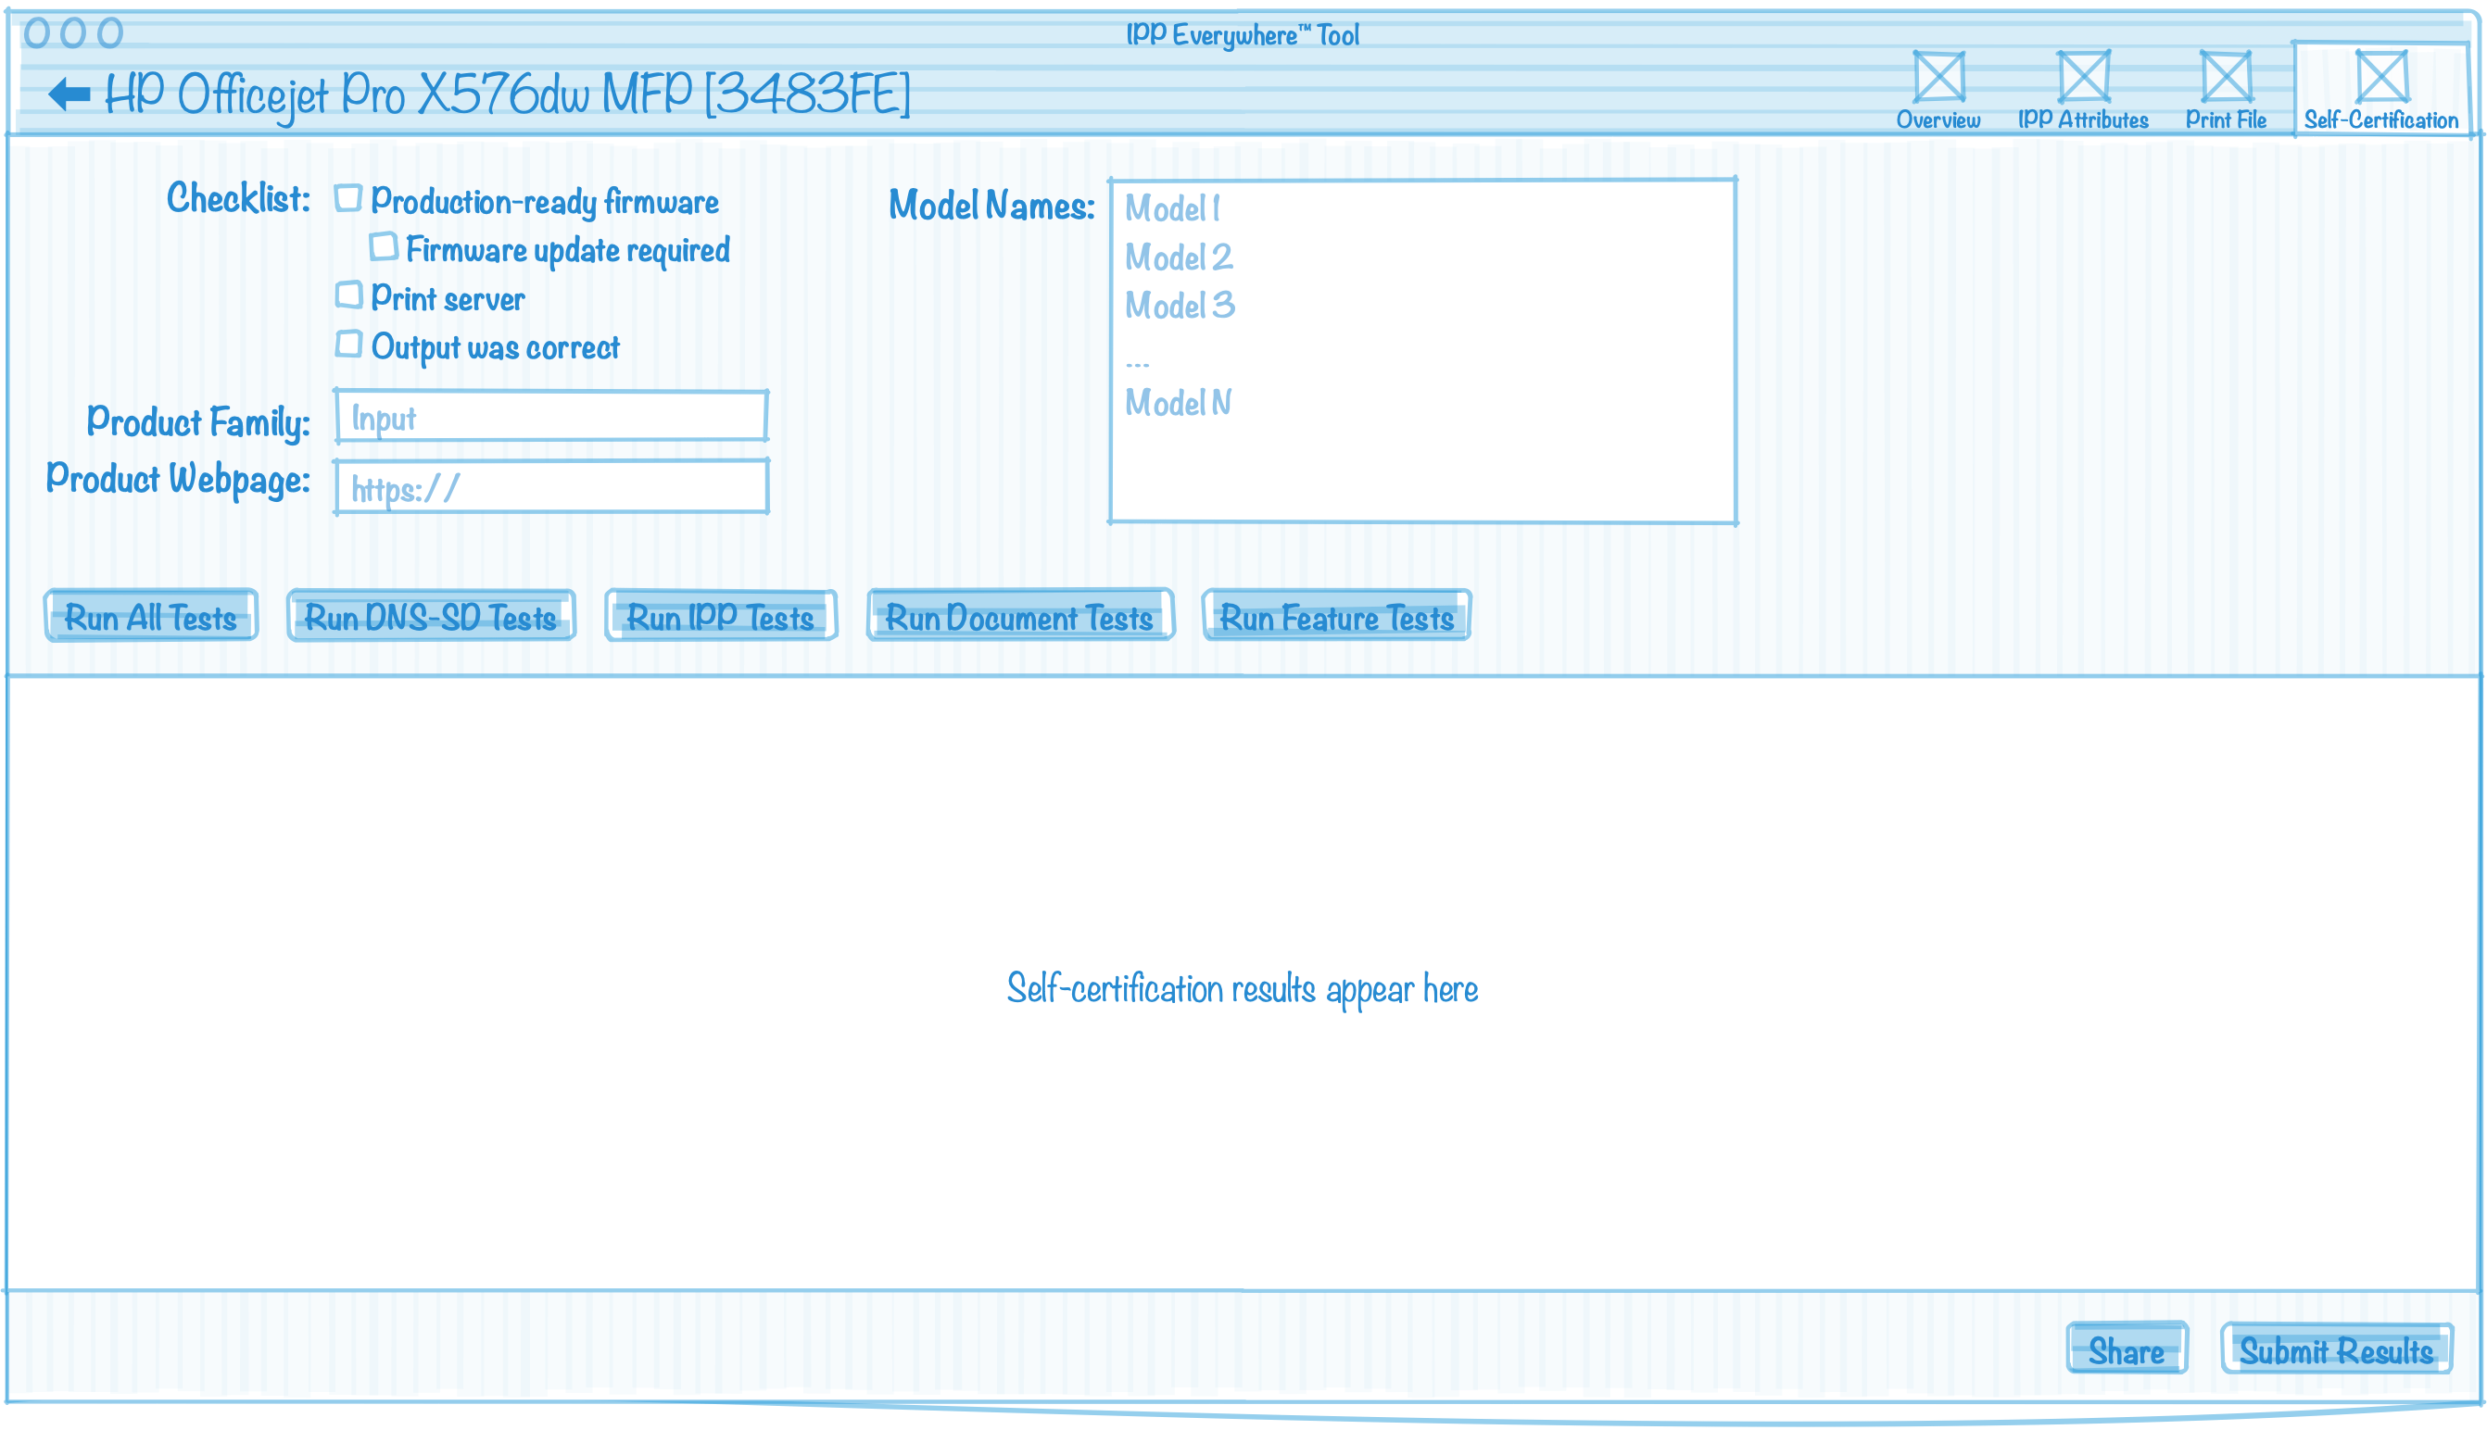
(New) Proposed Tool (con't)
®
Copyright © 2022 The Printer Working Group. All rights reserved. The IPP Everywhere and PWG logos are trademarks of the IEEE-ISTO.

Slide 19
IPP Workgroup Session
®
The Printer Working Group
November 16, 2022
Copyright © 2022 The Printer Working Group. All rights reserved. The IPP Everywhere and PWG logos are trademarks of the IEEE-ISTO.

Slide 20
Before We Begin...
®
PWG Antitrust Policy:
https://www.pwg.org/chair/membership_docs/pwg-antitrust- policy.pdf
The IEEE-ISTO Printer Working Group ("PWG") will not become involved in the business decisions of its Members. The PWG strictly complies with applicable antitrust laws. Every PWG meeting attendee shall comply with this policy. The PWG Officers and PWG Workgroup Officers are responsible to ensure that this policy is adhered to in all PWG activities.
PWG Intellectual Property Policy:
https://www.pwg.org/chair/membership_docs/pwg-ip-policy.pdf
TL;DR: Anything you say in a PWG meeting or email to a PWG address can be used in a PWG Document
(but please do read the IP policy above if you haven't done so)
Copyright © 2022 The Printer Working Group. All rights reserved. The IPP Everywhere and PWG logos are trademarks of the IEEE-ISTO.

Slide 21
Agenda
®
November 16, 2022 (US Eastern Standard Time)
When | What
10:00 - 11:00 | IPP WG: IPP Production Printing Extensions v2.0
11:00 - 12:00 | IPP WG: IPP Driver Replacement Extensions v2.0
12:00 - 12:45 | Lunch Break
12:45 - 14:30 | IPP WG: Evolution of IPP and OAuth
Copyright © 2022 The Printer Working Group. All rights reserved. The IPP Everywhere and PWG logos are trademarks of the IEEE-ISTO.

Slide 22
IPP Production Printing Extensions v2.0 (PPX)
®
Stable draft
https://ftp.pwg.org/pub/pwg/ipp/wd/wd-ippppx20-20221109.pdf
Updates PWG 5100.3-2001: IPP Production Printing Attributes
Prototyping completed in the ippsample project
PWG Last Call completed, needs PWG Formal Approval
10 responses without objections, 35 comments:
https://ftp.pwg.org/pub/pwg/ipp/wd/lcrc-ippppx20.txt
Copyright © 2022 The Printer Working Group. All rights reserved. The IPP Everywhere and PWG logos are trademarks of the IEEE-ISTO.

Slide 23
IPP Driver Replacement Extensions v2.0 (NODRIVER)
®
Stable Draft:
https://ftp.pwg.org/pub/pwg/ipp/wd/wd-ippnodriver20-20221027.pdf
Updates PWG 5100.13-2013: IPP Job and Printer Extensions - Set 3 (JPS3)
Old title "Driverless Printing Extensions"
Prototyping completed in the PAPPL project
PWG Last Call ends November 28, 2022
Copyright © 2022 The Printer Working Group. All rights reserved. The IPP Everywhere and PWG logos are trademarks of the IEEE-ISTO.

Slide 24
Lunch Break
®
The Printer Working Group
Resuming at 12:45pm ET
Copyright © 2022 The Printer Working Group. All rights reserved. The IPP Everywhere and PWG logos are trademarks of the IEEE-ISTO.

Slide 25
Evolution of IPP and OAuth
®
Wiki:
https://github.com/istopwg/ippsample/wiki/IPP-and-OAuth
Goals:
Define/reference best practices for using OAuth/OpenID with IPP
Prototype/deploy OAuth/OpenID support for printing
Update existing IPP specifications:
PWG 5100.11-2010: IPP Job and Printer Extensions - Set 2 (JPS2) (Now titled "IPP Enterprise Printing Extensions v2.0 (EPX)")
PWG 5100.18-2015: IPP Shared Infrastructure Extensions v1.0 (INFRA)
PWG 5100.22-2019: IPP System Service v1.0 (SYSTEM)
PWG 5199.10-2019: IPP Authentication Methods v1.0 (AUTH)
Publish new IPP best-practice:
PWG 5199.x: Cloud Printing with IPP Everywhere v1.0
Copyright © 2022 The Printer Working Group. All rights reserved. The IPP Everywhere and PWG logos are trademarks of the IEEE-ISTO.

Slide 26
OAuth 2.0 Rich Authorization Requests
®
Current IETF draft:
https://datatracker.ietf.org/doc/draft-ietf-oauth-rar/
Abstract:
This document specifies a new parameter authorization_details that is used to carry fine-grained authorization data in OAuth messages.
Expands on OAuth scopes to provide fine-grained authorization
Possible application in IPP:
https://ftp.pwg.org/pub/pwg/ipp/whitepaper/google-authorization_details-20221111.pdf
Copyright © 2022 The Printer Working Group. All rights reserved. The IPP Everywhere and PWG logos are trademarks of the IEEE-ISTO.

Slide 27
OAuth Trust Model (Local Printer)
®
Authorization Server
AS validates user/resource
AS provides access token
Client validates AS
openid.example.org
AS validates Printer
AS validates access token
Printer validates AS
Client validates AS and Printer
Client provides access token
Printer validates access token
Client
Printer
user@example.org
printer.example.org
Copyright © 2022 The Printer Working Group. All rights reserved. The IPP Everywhere and PWG logos are trademarks of the IEEE-ISTO.

Slide 28
OAuth Trust Model (Cloud Printer)
®
Authorization Server
Infrastructure Printer
AS validates IP
AS validates access token
IP validates AS
openid.example.org
cprinter.example.org
AS validates user/resource
AS provides access token
Client validates AS
IP validates Proxy
Proxy validates IP
Client validates AS and Printer
Client provides access token
Printer validates access token
Proxy
Client
user@example.org
Printer
printer.example.org
Copyright © 2022 The Printer Working Group. All rights reserved. The IPP Everywhere and PWG logos are trademarks of the IEEE-ISTO.

Slide 29
Evolution of IPP and OAuth
®
IPP + OAuth first documented in PWG 5199.10-2019: IPP Authentication Methods v1.0
https://ftp.pwg.org/pub/pwg/informational/bp-ippauth10-20190816-5199.10.pdf
The IETF OAuth WG has/will publish(ed) new documents:
Current documents: https://datatracker.ietf.org/wg/oauth/documents/
(WG Consensus) OAuth 2.0 Security Best Current Practice https://datatracker.ietf.org/doc/draft-ietf-oauth-security-topics/
RFC 8628: OAuth 2.0 Device Authorization Grant https://datatracker.ietf.org/doc/rfc8628/
RFC 8693: OAuth 2.0 Token Exchange https://datatracker.ietf.org/doc/rfc8693/
Similarly, the OpenID Foundation has published updated specifications:
https://openid.net/developers/specs/
Copyright © 2022 The Printer Working Group. All rights reserved. The IPP Everywhere and PWG logos are trademarks of the IEEE-ISTO.

Slide 30
IPP and OAuth Work Items
®
Update documents:
IPP Authentication Methods v1.1/2.0 (AUTH)
IPP Enterprise Printing Extensions v2.0 (EPX) - Get-User-Printer-Attributes
IPP Shared Infrastructure Extensions v1.1/2.0 (INFRA)
IPP System Service v1.1/2.0 (SYSTEM)
New document:
PWG 5199.x: Cloud Printing with IPP Everywhere v1.0 best practice for cloud printing
Implement OAuth support in CUPS (Client and Printer/System)
CUPS includes an OAuth callback for bringing up any necessary UI or retrieving cached tokens, but we haven't implemented a default callback for Linux or macOS desktops
CUPS 2.5 cupsd and CUPS 3.0 sharing server are supposed to include OAuth-based authenticated queues
Implement OAuth support in PAPPL (Client) for IPP Proxy support
Implement OAuth support in IPP Sample for ippproxy (Client) and ippserver (Printer/System)
Copyright © 2022 The Printer Working Group. All rights reserved. The IPP Everywhere and PWG logos are trademarks of the IEEE-ISTO.

Slide 31
Evolution of IPP and OAuth (con't)
®
Microsoft Universal Print Service uses OAuth + special RESTful provisioning endpoint to issue an X.509 Client certificate that the IPP Proxy uses when negotiating a TLS connection with the IPP Infrastructure Printer
We have been talking about updates to PWG 5100.18 (INFRA) and 5100.22 (SYSTEM) to incorporate System-issued client certificates
Mopria also may have a cloud printing profile
Copyright © 2022 The Printer Working Group. All rights reserved. The IPP Everywhere and PWG logos are trademarks of the IEEE-ISTO.

Slide 32
Goals for PWG 5199.10 (AUTH)
®
Update for current standards and use cases/requirements
Promote interoperability with multiple implementations
Define/reference best practices
Extend IPP authentication model as needed
Copyright © 2022 The Printer Working Group. All rights reserved. The IPP Everywhere and PWG logos are trademarks of the IEEE-ISTO.

Slide 33
Errata for PWG 5199.10
®
Add information about getting server metadata (RFC 8414/OpenID) which provides capabilities and endpoints
Two different "well-known" resource paths
"oauth-authorization-server-uri (uri)" points to root ("https://oauth.example.com/")
GET "/.well-known/oauth-authorization-server" (RFC 8414) and "/.well-known/openid-configuration" (OpenID) to get JSON-formatted server metadata
Clarify resource identifiers for OAuth
Normally the "printer-uri (uri)" value
Define new "oauth-resource-uri (uri)" Printer Description/System Description attributes to make this explicit
Fix terminology to match OAuth RFCs as needed
Copyright © 2022 The Printer Working Group. All rights reserved. The IPP Everywhere and PWG logos are trademarks of the IEEE-ISTO.

Slide 34
Errata for PWG 5199.10 (con't)
®
Recommend RFC 7519 JSON Web Token
Recommend RFC 7636 Proof Key for Code Exchange by OAuth Public Clients
Add RFC 8693 OAuth Token Exchange
"grant_types_supported" server metadata lists 'urn:ietf:params:oauth:grant-type:token-exchange' when token exchange is supported
IANA OAuth registries: https://www.iana.org/protocols#index_O
"resource" parameter is usually the Printer URI but we'll have the "oauth-resource-uri (uri)" attribute to provide the correct URI
Will this cause problems for multi-homed servers?
Add RFC 8628 Device Authorization Grant for authorizing Printer/System
Talk more about OAuth scopes
Typically used to provide role/element-based access control
Probably not useful/scalable to use Printer UUIDs or other identifiers
Copyright © 2022 The Printer Working Group. All rights reserved. The IPP Everywhere and PWG logos are trademarks of the IEEE-ISTO.

Slide 35
IDS Workgroup Session
®
The Printer Working Group
November 17, 2022
Copyright © 2022 The Printer Working Group. All rights reserved. The IPP Everywhere and PWG logos are trademarks of the IEEE-ISTO.

Slide 36
Lunch Break
®
The Printer Working Group
Resuming at 12:45pm ET
Copyright © 2022 The Printer Working Group. All rights reserved. The IPP Everywhere and PWG logos are trademarks of the IEEE-ISTO.

Slide 37
IPP Workgroup Session
®
The Printer Working Group
November 17, 2022
Copyright © 2022 The Printer Working Group. All rights reserved. The IPP Everywhere and PWG logos are trademarks of the IEEE-ISTO.

Slide 38
Before We Begin...
®
PWG Antitrust Policy:
https://www.pwg.org/chair/membership_docs/pwg-antitrust- policy.pdf
The IEEE-ISTO Printer Working Group ("PWG") will not become involved in the business decisions of its Members. The PWG strictly complies with applicable antitrust laws. Every PWG meeting attendee shall comply with this policy. The PWG Officers and PWG Workgroup Officers are responsible to ensure that this policy is adhered to in all PWG activities.
PWG Intellectual Property Policy:
https://www.pwg.org/chair/membership_docs/pwg-ip-policy.pdf
TL;DR: Anything you say in a PWG meeting or email to a PWG address can be used in a PWG Document
(but please do read the IP policy above if you haven't done so)
Copyright © 2022 The Printer Working Group. All rights reserved. The IPP Everywhere and PWG logos are trademarks of the IEEE-ISTO.

Slide 39
Agenda
®
November 17, 2022 (US Eastern Standard Time)
When | What
10:00 - 12:00 | IDS WG: Status and Discussion
12:00 - 12:45 | Lunch Break
12:45 - 13:45 | IPP WG: 3D Printing Liaisons
13:45 - 14:00 | IPP WG: Next Steps
Copyright © 2022 The Printer Working Group. All rights reserved. The IPP Everywhere and PWG logos are trademarks of the IEEE-ISTO.

Slide 40
3D Printing and Scanning Discussions
®
Current documents:
PWG 5100.21-2019: IPP 3D Printing Extensions v1.1
PWG 5199.5-2017: PWG 3D Print Job Ticket and Associated Capabilities v1.0 (PJT3D)
PWG 5199.7-2019: PWG Safe G-Code Subset for 3D Printing v1.0
Proposed future work (2023-2024):
IPP 3D Scan Service v1.0 specification to address 3D scanning
IPP 3D Production Printing Extensions v1.0 specification to address VDMA - OPC UA "Joint Working Group (JWG) for Additive Manufacturing" efforts
Updated PWG 3D Print Job Ticket and Associated Capabilities v2.0 (PJT3D) best practice to incorporate production extensions and IPP 3D v1.1
Create sample 3MF print files with embedded job tickets, do more IPP 3D prototyping
Copyright © 2022 The Printer Working Group. All rights reserved. The IPP Everywhere and PWG logos are trademarks of the IEEE-ISTO.

Slide 41
3D Printing Liaisons
®
Have a new liaison agreement with the 3MF Consortium
Want to create some sample 3MF print files with embedded job tickets and do more IPP 3D prototyping
Collaborate with 3MF and AMSC to use IPP 3D to satisfy need to query device capabilities and securely submit content for printing
Copyright © 2022 The Printer Working Group. All rights reserved. The IPP Everywhere and PWG logos are trademarks of the IEEE-ISTO.

Slide 42
3D Meetings
®
November 4th: ASTM International Conference on Additive Manufacturing (ASTM ICAM 2022)
Alan presented and was well received
Invited to join one of their working groups
This Week: International Common Criteria Conference in Toledo, Spain
Alan presented on 3D printer certification yesterday
Transportation Research Board ‐ 2nd International Conference on 3D Printing and Transportation: May 2023 in Anaheim, CA:
Planning to attend in person – on site
Possibility to make a presentation on safe G‐code
Copyright © 2022 The Printer Working Group. All rights reserved. The IPP Everywhere and PWG logos are trademarks of the IEEE-ISTO.

Slide 43
Next Steps
®
The Printer Working Group
Copyright © 2022 The Printer Working Group. All rights reserved. The IPP Everywhere and PWG logos are trademarks of the IEEE-ISTO.

Slide 44
Next Steps
®
IPP/2.x Fourth Edition (Mike)
Prototype draft in Q1/Q2 2023
IPP Driver Replacement Extensions v2.0 (Smith)
PWG Last Call ends November 28, 2022
PWG Formal Approval Q1 2023
IPP Encrypted Jobs and Documents v1.0 (Mike/Smith)
Stable draft in Q2 2023
IPP Enterprise Printing Extensions v2.0 (Smith)
Stable draft in Q1 2023
IPP Everywhere v2.0 (Mike)
Stable draft in Q1/Q2 2023
IPP Everywhere Printer Self-Certification Manual v2.0 (Mike)
Prototype draft in Q1 2023
IPP Job Extensions v2.1 (Mike)
Stable draft and IPP WG last call in Q4 2022
IPP Production Printing Extensions v2.0 (Mike)
PWG Formal Approval Q1 2023
Copyright © 2022 The Printer Working Group. All rights reserved. The IPP Everywhere and PWG logos are trademarks of the IEEE-ISTO.

Slide 45
More Information
®
We welcome participation from all interested parties
IPP Working Group web page
https://www.pwg.org/ipp/index.html
Subscribe to the IPP mailing list
https://www.pwg.org/mailman/listinfo/ipp
IPP WG holds bi-weekly phone conferences announced on the IPP mailing list
Next conference calls scheduled for Thursday, December 8, 2022 and January 5, 2023 at 3pm ET
Copyright © 2022 The Printer Working Group. All rights reserved. The IPP Everywhere and PWG logos are trademarks of the IEEE-ISTO.

