Slide 1
IPP Workgroup Session, Day 1
®
The Printer Working Group
November 14, 2016
PWG Virtual F2F Meeting
Copyright © 2016 The Printer Working Group. All rights reserved. The IPP Everywhere and PWG logos are registered trademarks of the IEEE-ISTO.

Slide 2
PWG IP Policy
®
"This meeting is being held in accordance with the PWG Intellectual Property Policy"
http://www.pwg.org/chair/membership_docs/pwg-ip-policy.pdf
TL;DR: Anything you say in a PWG meeting or email to a PWG address can be used in a PWG standard
(but please do read the IP policy above if you haven't done so)
Copyright © 2016 The Printer Working Group. All rights reserved. The IPP Everywhere and PWG logos are registered trademarks of the IEEE-ISTO.

Slide 3
Agenda
®
November 14, 2016
When | What
1:30 - 3:00 | IPP Workgroup Status, IPP/1.1 Updates, IPP Finishings 2.1
3:00 - 3:15 | Break
3:15 - 5:00 | IPP Everywhere Printer Self-Certification, IPP 3D Printing Extensions
November 15, 2016
When | What
1:00 - 4:00 | IPP System Service, Next Steps
Copyright © 2016 The Printer Working Group. All rights reserved. The IPP Everywhere and PWG logos are registered trademarks of the IEEE-ISTO.

Slide 4
Charter
®
Current charter:
http://ftp.pwg.org/pub/pwg/ipp/charter/ch-ipp-charter-20151225.pdf
The Internet Printing Protocol (IPP) workgroup is chartered with the maintenance of IPP, the IETF IPP registry, and support for new clients, network architectures (Cloud, SDN), service bindings for MFDs and Imaging Systems, and emerging technologies such as 3D Printing
In addition, we maintain the IETF Finisher MIB, Job MIB, and Printer MIB registries, and handle synchronization with changes in IPP
Copyright © 2016 The Printer Working Group. All rights reserved. The IPP Everywhere and PWG logos are registered trademarks of the IEEE-ISTO.

Slide 5
Officers
®
IPP WG Co-Chairs:
Paul Tykodi (TCS)
Ira McDonald (High North)
IPP WG Secretary:
Michael Sweet (Apple)
IPP WG Document Editors:
Ira McDonald (High North) – IPP System Service (SYSTEM), IETF IPP/1.1
Michael Sweet (Apple) – IPP System Service (SYSTEM), IETF IPP/1.1, IPP 3D Printing Extensions
Smith Kennedy (HP Inc.) – IPP Finishings 2.1
Copyright © 2016 The Printer Working Group. All rights reserved. The IPP Everywhere and PWG logos are registered trademarks of the IEEE-ISTO.

Slide 6
Status (1/3)
®
IETF RFCs in development:
IETF IPP/1.1: Encoding and Transport (obsoletes RFC 2910/3382) - IESG Approved, RFC Editor's queue
IETF IPP/1.1: Model and Semantics (obsoletes RFC 2911/3381/3382) - IESG Approved, RFC Editor's queue
PWG Specifications in development:
IPP 3D Printing Extensions (3D) - Prototype Draft
IPP System Service (SYSTEM) - Interim Draft
IPP Finishings 2.1 (FIN) - Stable Draft, WG Last Call
Copyright © 2016 The Printer Working Group. All rights reserved. The IPP Everywhere and PWG logos are registered trademarks of the IEEE-ISTO.

Slide 7
Status (2/3)
®
Recent Full Standard:
PWG 5100.12-2015: IPP 2.0, 2.1, and 2.2
Recent Candidate Standards:
PWG 5100.20-2016: IPP Everywhere Printer Self-Certification Manual v1.0 (SELFCERT)
PWG 5100.19-2015: IPP Implementor's Guide v2.0 (IG)
PWG 5100.18-2015: IPP Shared Infrastructure Extensions (INFRA)
Recent IETF RFCs:
RFC 7612: LDAP Schema for Printer Services
RFC 7472: IPP over HTTPS Transport Binding and “ipps” URI Scheme
Copyright © 2016 The Printer Working Group. All rights reserved. The IPP Everywhere and PWG logos are registered trademarks of the IEEE-ISTO.

Slide 8
Status (3/3)
®
Up-to-date pending IANA registrations online:
http://www.pwg.org/ipp/ipp-registrations.xml
Continue to maintain this in parallel for new specifications
Github repository:
https://github.com/istopwg/ippregistry
IPP Everywhere Printer Self-Certifications:
Submission page:
https://www.pwg.org/ippeveselfcert
Printer listing page:
https://www.pwg.org/printers
19 printers currently listed
IPP Sample Code:
Github repository:
https://github.com/istopwg/ippsample
Fork of CUPS code includes ippfind, ippproxy, ippserver, and ipptool
Copyright © 2016 The Printer Working Group. All rights reserved. The IPP Everywhere and PWG logos are registered trademarks of the IEEE-ISTO.

Slide 9
IETF IPP/1.1 Updates
®
Developing two new RFCs to replace (obsolete) RFCs 2910, 2911, 3381 (deprecated job progress attributes), and 3382 (collection attribute syntax)
Stable drafts:
http://tools.ietf.org/html/draft-sweet-rfc2910bis
http://tools.ietf.org/html/draft-sweet-rfc2911bis
Both are approved and awaiting publication
RFCs will eventually be advanced to IETF Internet Standard through status change (IETF process)
Proposed schedule:
RFC Publication - Q4 2016
Copyright © 2016 The Printer Working Group. All rights reserved. The IPP Everywhere and PWG logos are registered trademarks of the IEEE-ISTO.

Slide 10
IPP Finishings 2.1
®
Current stable draft:
http://ftp.pwg.org/pub/pwg/ipp/wd/wd-ippfinishings21-20161109-rev.pdf
Do a PWG Call for Objections or PWG Formal Vote?
Some new attributes/member attributes (new technical content):
"media-sheets-supported" member attribute for "finishings-col-database" and "finishings-col-ready"
"stitching-method" member attribute for "stitching" member attribute of "finishings-col"
"printer-finisher-supplies" and "printer-finisher-supplies-description" attributes.
Formal vote will require a PWG Last Call first, delaying approval until 2017
Consensus among four attendees at November 2, 2016 conference call was to do a PWG Last Call and Formal Vote
Copyright © 2016 The Printer Working Group. All rights reserved. The IPP Everywhere and PWG logos are registered trademarks of the IEEE-ISTO.

Slide 11
Break
®
The Printer Working Group
Copyright © 2016 The Printer Working Group. All rights reserved. The IPP Everywhere and PWG logos are registered trademarks of the IEEE-ISTO.

Slide 12
IPP Everywhere Self-Certification
®
PWG 5100.20-2016: IPP Everywhere Printer Self-Certification Manual (SELFCERT)
http://ftp.pwg.org/pub/pwg/candidates/cs-ippeveselfcert10-20160219-5100.20.pdf
Released v1.0 Update 1 of self-certification tools on October 28th, 2016
Resources:
http://www.pwg.org/ipp/everywhere.html (for tools)
https://www.pwg.org/ippeveselfcert (submission form)
http://www.pwg.org/printers (printer list)
Github repository for tools:
https://github.com/istopwg/ippeveselfcert
Proposed Schedule:
1.1 errata update: Q1/Q2 2016
Copyright © 2016 The Printer Working Group. All rights reserved. The IPP Everywhere and PWG logos are registered trademarks of the IEEE-ISTO.

Slide 13
IPP Everywhere Self-Certification
®
1.0 Update 1 changes:
Issue #3: Fix handling of service instance names starting with "_".
PR #5: Add date to log files.
Issue #6: Do exact matches of service instance names.
Issue #7: Do not require a resource path of "/ipp/print".
Issue #9: Do not require "document-numbers" member attribute.
Issue #13: Allow 'unknown' values for "date-time-at-xxx" attributes.
Future 1.1 errata update for manual and tools in 2017:
More tests (Cancel-My-Jobs, Close-Job, Identify-Printer)
Other necessary changes that are not simple bug fixes in the tools/submission portal
Proposed schedule:
Interim working draft in Q1 2017
Copyright © 2016 The Printer Working Group. All rights reserved. The IPP Everywhere and PWG logos are registered trademarks of the IEEE-ISTO.

Slide 14
IPP 3D Printing Extensions
®
Current draft (prototype):
http://ftp.pwg.org/pub/pwg/ipp/wd/wd-ipp3d10-20160824-rev.pdf
Proposed schedule:
Stable draft next week
PWG Last Call Q4 2016
Prototype experience (next slide)
Copyright © 2016 The Printer Working Group. All rights reserved. The IPP Everywhere and PWG logos are registered trademarks of the IEEE-ISTO.

Slide 15
Prototype Experience (Apple)
®
Apple has implemented all of the required parts of the IPP 3D Printing Extensions - the current prototype is available at:
https://github.com/istopwg/ippsample
The "examples" directory contains sample 3MF files from the 3MF Consortium's Github samples repository, along with an ipptool test file (create-job-3d.test) that can be used to test a prototype.
One additional issue found during prototyping:
No way to tell Client that the Printer can reproduce multiple colors (not just the material color)
Proposal: Add "color-supported (boolean)" Printer Description attribute (standard attribute for 2D printing)
Copyright © 2016 The Printer Working Group. All rights reserved. The IPP Everywhere and PWG logos are registered trademarks of the IEEE-ISTO.

Slide 16
IPP Workgroup Session, Day 2
®
The Printer Working Group
November 15, 2016
PWG Virtual F2F Meeting
Copyright © 2016 The Printer Working Group. All rights reserved. The IPP Everywhere and PWG logos are registered trademarks of the IEEE-ISTO.

Slide 17
PWG IP Policy
®
"This meeting is being held in accordance with the PWG Intellectual Property Policy"
http://www.pwg.org/chair/membership_docs/pwg-ip-policy.pdf
TL;DR: Anything you say in a PWG meeting or email to a PWG address can be used in a PWG standard
(but please do read the IP policy above if you haven't done so)
Copyright © 2016 The Printer Working Group. All rights reserved. The IPP Everywhere and PWG logos are registered trademarks of the IEEE-ISTO.

Slide 18
Agenda
®
November 14, 2016
When | What
1:30 - 3:00 | IPP Workgroup Status, IPP/1.1 Updates, IPP Finishings 2.1
3:00 - 3:15 | Break
3:15 - 5:00 | IPP Everywhere Printer Self-Certification, IPP 3D Printing Extensions
November 15, 2016
When | What
1:00 - 4:00 | IPP System Service, Next Steps
Copyright © 2016 The Printer Working Group. All rights reserved. The IPP Everywhere and PWG logos are registered trademarks of the IEEE-ISTO.

Slide 19
IPP System Service (SYSTEM)
®
Current interim draft at:
http://ftp.pwg.org/pub/pwg/ipp/wd/wd-ippsystem10-20161101-rev.pdf
Combines and implements a concrete IPP binding of the following abstract Semantic Model 2.0 services and objects:
PWG 5108.06: System Object and System Control Service
PWG 5108.03: Network Resource Service
PWG 5109.1: Cloud Imaging Requirements and Model
In addition to making the System service responsible for resource management, this specification simplifies the data model, semantics, and life cycle of Resource objects (next slides)
Proposed Schedule:
Prototype draft in Q4 2016/Q1 2017
Copyright © 2016 The Printer Working Group. All rights reserved. The IPP Everywhere and PWG logos are registered trademarks of the IEEE-ISTO.

Slide 20
IPP Resource Object Model
®
Resource objects are managed by the System service
Only administrators can create, install, and cancel Resources
Simple state model and life cycle (later slide)
Resources include fonts, forms/templates, icons, logos, ICC profiles, firmware, and applications
Resources have a unique integer ID: "resource-id (integer(1:MAX))"
Resources can be allocated to Jobs and Printers
Job Resources are allocated with the Create-Job/Print-Job/Print-URI operations and the "resource-ids (1setOf integer(1:MAX))" operation attribute
Job Resources are deallocated when the Job reaches a terminating state
Printer Resources are allocated with the Create-Printer or Allocate-Printer-Resources operations and the "resource-ids (1setOf integer(1:MAX))" operation attribute
Printer Resources are deallocated with the Deallocate-Printer-Resources operation (Q: or Cancel-Resource???)
Copyright © 2016 The Printer Working Group. All rights reserved. The IPP Everywhere and PWG logos are registered trademarks of the IEEE-ISTO.

Slide 21
IPP Resource Description Attributes (Read-Write)
®
"resource-info (text(127))"
"resource-name (name(127))"
"resource-owner-col (collection)"
"owner-uri (uri)"
"owner-vcard (1setOf text(1023))"
Copyright © 2016 The Printer Working Group. All rights reserved. The IPP Everywhere and PWG logos are registered trademarks of the IEEE-ISTO.

Slide 22
IPP Resource Status Attributes (Read-Only)
®
"date-time-at-canceled (dateTime | unknown | no-value)"
"date-time-at-creation (dateTime | unknown)"
"date-time-at-installed (dateTime | unknown | no-value)"
"resource-data-uri (uri | no-value)"
"resource-format (mimeMediaType)"
"resource-id (integer(1:MAX))"
"resource-k-octets (integer(0:MAX))"
"resource-state (type1 enum)"
'pending', 'available', 'installed', 'canceled', 'aborted'
"resource-state-message (text(MAX))"
"resource-state-reasons (1setOf type2 keyword)"
'cancel-requested','install-requested','resource-incoming'
"resource-string-version (text(127))"
Copyright © 2016 The Printer Working Group. All rights reserved. The IPP Everywhere and PWG logos are registered trademarks of the IEEE-ISTO.

Slide 23
IPP Resource Status Attributes (con't) (Read-Only)
®
"resource-type (type2 keyword)"
'executable-firmware', 'executable-software', 'static-font', 'static-form', 'static-icc-profile', 'static-image', 'static-logo', 'template-document', 'template-job', 'template-printer'
"resource-uuid (uri)"
"resource-version (octetString(16))"
"time-at-canceled (integer(MIN:MAX) | no-value)"
"time-at-creation (integer(MIN:MAX))"
"time-at-installed (integer(MIN:MAX) | no-value)"
Question: Do we want to expose the resource allocation count, e.g., "resource-use-count (integer(0:MAX))"?
Implementations already need to track this
Cancel-Resource is delayed when a resource is allocated to a Job, Printer, or System (running firmware)
Copyright © 2016 The Printer Working Group. All rights reserved. The IPP Everywhere and PWG logos are registered trademarks of the IEEE-ISTO.

Slide 24
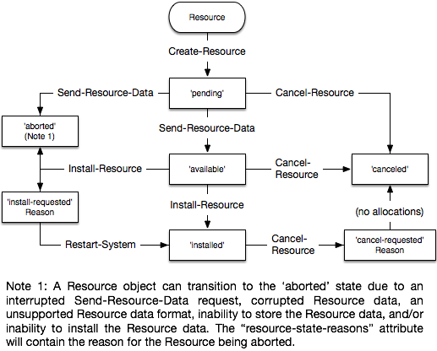
IPP Resource Life Cycle
®
Copyright © 2016 The Printer Working Group. All rights reserved. The IPP Everywhere and PWG logos are registered trademarks of the IEEE-ISTO.

Slide 25
Next Steps
®
The Printer Working Group
Copyright © 2016 The Printer Working Group. All rights reserved. The IPP Everywhere and PWG logos are registered trademarks of the IEEE-ISTO.

Slide 26
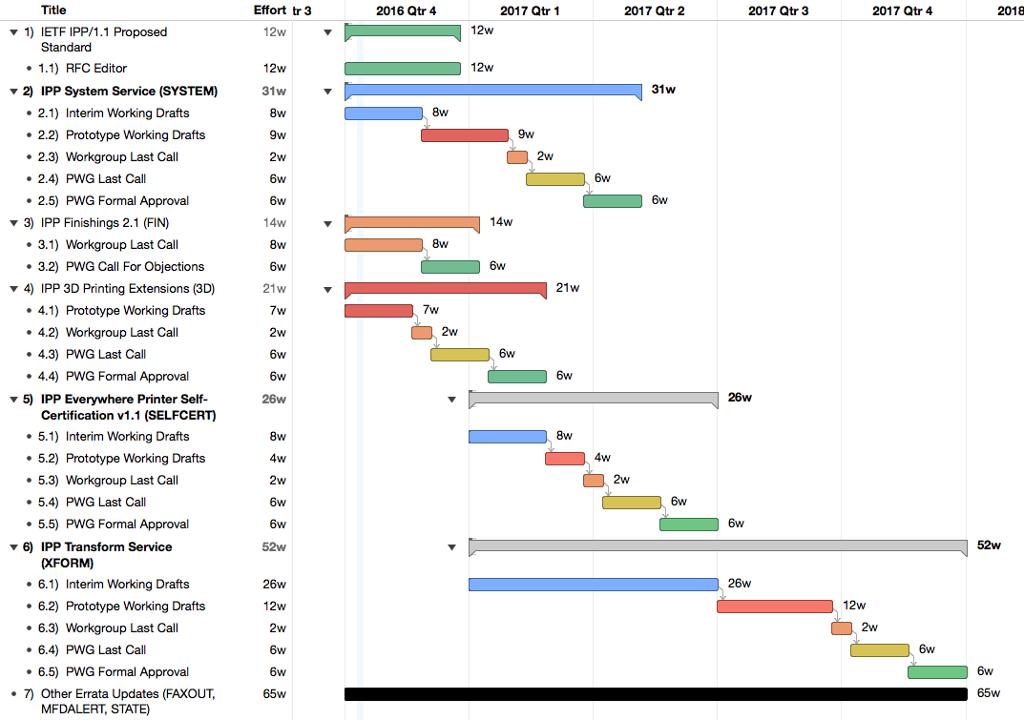
Next Steps
®
Copyright © 2016 The Printer Working Group. All rights reserved. The IPP Everywhere and PWG logos are registered trademarks of the IEEE-ISTO.

Slide 27
Next Steps
®
Advance IPP/1.1 to IETF Internet Standard
IETF process to advance to Internet Standard once RFCs are published...
IPP System Service
Prototype working draft in Q4 2016/Q1 2017
IPP 3D Printing Extensions
PWG Last Call in Q4 2016
IPP Finishings 2.1
PWG Call for Objections in Q4 2016
IPP Everywhere Printer Self-Certification Manual v1.1
Interim working draft in Q1 2017
IPP Transform Service v1.0
Initial working draft in Q1 2017
Other errata (IPP State, etc.) in 2017
Specific documents for 2017?
Volunteers?
Copyright © 2016 The Printer Working Group. All rights reserved. The IPP Everywhere and PWG logos are registered trademarks of the IEEE-ISTO.

Slide 28
More Information
®
We welcome participation from all interested parties
IPP Working Group web page
http://www.pwg.org/ipp/index.html
Subscribe to the IPP mailing list
https://www.pwg.org/mailman/listinfo/ipp
IPP WG holds weekly phone conferences announced on the IPP mailing list
Next conference calls November 30, 2016 and December 14, 2016 at 1pm ET
Copyright © 2016 The Printer Working Group. All rights reserved. The IPP Everywhere and PWG logos are registered trademarks of the IEEE-ISTO.

