Slide 1

IPP Workgroup Session
®
The Printer Working Group
November 4, 2015
PWG F2F Meeting
Somewhere in the Ether...
Copyright © 2015 The Printer Working Group. All rights reserved. The IPP Everywhere and PWG logos are registered trademarks of the IEEE-ISTO.

Slide 2

Agenda
®
November 4, 2015
When | What
9:00 - 9:30 | IPP Workgroup Status
9:30 - 10:30 | IETF IPP/1.1 Updates
10:30 - 10:45 | Break
10:45 - 12:00 | IPP Everywhere Printer Self-Certification
12:00 - 1:00 | Lunch
1:00 - 3:45 | IPP System Service
3:45 - 4:00 | Next Steps
Copyright © 2015 The Printer Working Group. All rights reserved. The IPP Everywhere and PWG logos are registered trademarks of the IEEE-ISTO.

Slide 3
Charter
®
The Internet Printing Protocol (IPP) workgroup is chartered with the maintenance of IPP, the IETF IPP registry, and to support new clients, network architectures, and service bindings for MFDs and Imaging Systems
In addition, we maintain the IETF Finisher MIB, Job MIB, and Printer MIB registries, and handle synchronization with changes in IPP
Copyright © 2015 The Printer Working Group. All rights reserved. The IPP Everywhere and PWG logos are registered trademarks of the IEEE-ISTO.

Slide 4
Officers
®
IPP WG Co-Chairs:
  Paul Tykodi (TCS)
  Ira McDonald (High North)
IPP WG Secretary:
  Michael Sweet (Apple)
IPP WG Document Editors:
  Ira McDonald (High North) – IPP System Service (SYSTEM), IETF IPP/1.1, IEEE IPP/2.0
  Michael Sweet (Apple) – IPP System Service (SYSTEM), IETF IPP/1.1, IEEE IPP/2.0
Copyright © 2015 The Printer Working Group. All rights reserved. The IPP Everywhere and PWG logos are registered trademarks of the IEEE-ISTO.

Slide 5
Status (1/2)
®
IETF RFCs in development:
  IETF IPP/1.1: Encoding and Transport (obsoletes RFC 2910/3382)
  - Stable Draft, AD Sponsor
  IETF IPP/1.1: Model and Semantics (obsoletes RFC 2911/3381/3382)
  - Stable Draft, AD Sponsor
PWG Specifications in development:
  IPP Everywhere Printer Self-Certification Manual 1.0 (SELFCERT)
  - Stable, WG Last Call Complete
  IPP System Service (SYSTEM) - Interim Draft
Copyright © 2015 The Printer Working Group. All rights reserved. The IPP Everywhere and PWG logos are registered trademarks of the IEEE-ISTO.

Slide 6
Status (2/2)
®
Recent Full (IEEE) Standard:
  PWG 5100.12-2015: IPP 2.0, 2.1, and 2.2
Recent Candidate Standards:
  PWG 5100.19-2015: IPP Implementor's Guide v2.0 (IG)
  PWG 5100.18-2015: IPP Shared Infrastructure Extensions (INFRA)
Recent IETF RFCs:
  RFC 7612: LDAP Schema for Printer Services
  RFC 7472: IPP over HTTPS Transport Binding and “ipps” URI Scheme
Up-to-date pending IANA registrations online:
  http://www.pwg.org/ipp/ipp-registrations.xml
  Continue to maintain this in parallel for new specifications
  (New) Github repository:
    https://github.com/istopwg/ippregistry
Copyright © 2015 The Printer Working Group. All rights reserved. The IPP Everywhere and PWG logos are registered trademarks of the IEEE-ISTO.

Slide 7
IETF IPP/1.1 Updates
®
Developing two new RFCs to replace (obsolete) RFCs 2910, 2911, 3381 (deprecated job progress attributes), and 3382 (collection attribute syntax)
Stable drafts:
  http://tools.ietf.org/html/draft-sweet-rfc2910bis
  http://tools.ietf.org/html/draft-sweet-rfc2911bis
  Drafts are being AD-sponsored by Barry Leiba, IETF ART Director, for publication as IETF Proposed Standard
  RFCs will eventually be advanced to IETF Internet Standard through status change (IETF process)
Proposed schedule:
  IETF Last Call - Q4 2015/Q1 2016
  IESG Approval - Q1/Q2 2016
Copyright © 2015 The Printer Working Group. All rights reserved. The IPP Everywhere and PWG logos are registered trademarks of the IEEE-ISTO.

Slide 8
IPP Everywhere Printer Self-Certification (SELFCERT)
®
Current stable draft, tools, and web site content:
  http://ftp.pwg.org/pub/pwg/ipp/wd/wd-ippeveselfcert10-20151009.pdf
  http://www.pwg.org/ipp/everywhere.html (for tools)
  http://beta.pwg.org/ippeveselfcert (submission form)
  http://beta.pwg.org/printers (printer list)
(New) Github repository for tools:
  https://github.com/istopwg/ippeveselfcert
Program changes:
  Due to ISTO legal feedback, self-certification program (and use of logo) is now limited to PWG members
  No more reviewers - web site form validates self-certification results and publishes new printers immediately
Proposed schedule:
  PWG Last Call starting today
Copyright © 2015 The Printer Working Group. All rights reserved. The IPP Everywhere and PWG logos are registered trademarks of the IEEE-ISTO.

Slide 9
Demo of Self-Certification
®
Copyright © 2015 The Printer Working Group. All rights reserved. The IPP Everywhere and PWG logos are registered trademarks of the IEEE-ISTO.

Slide 10
IPP System Service (SYSTEM)
®
Current interim draft at:
  http://ftp.pwg.org/pub/pwg/ipp/wd/wd-ippsystem10-20151102-rev.pdf
Proposed Schedule:
  Prototype draft in Q1 2016
Copyright © 2015 The Printer Working Group. All rights reserved. The IPP Everywhere and PWG logos are registered trademarks of the IEEE-ISTO.

Slide 11
Next Steps
®
The Printer Working Group
Copyright © 2015 The Printer Working Group. All rights reserved. The IPP Everywhere and PWG logos are registered trademarks of the IEEE-ISTO.

Slide 12
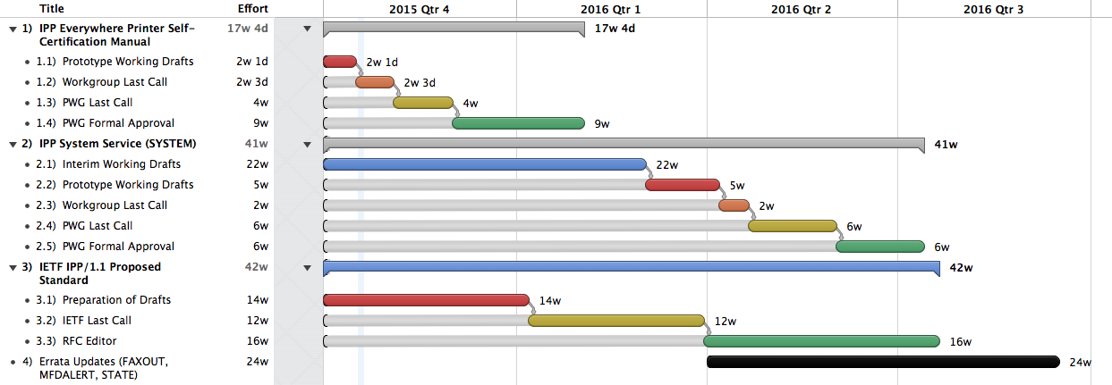
Next Steps
®
Copyright © 2015 The Printer Working Group. All rights reserved. The IPP Everywhere and PWG logos are registered trademarks of the IEEE-ISTO.

Slide 13
Next Steps
®
IPP Everywhere Printer Self-Certification Manual 1.0
  PWG Last Call starting today
IPP System Service (Mike/Ira)
  Prototype working draft in Q1 2016
Advance IPP/1.1 to IETF Proposed Standard
  IETF Last Call in Q1 2016
  IETF process to advance to Internet Standard once published...
Copyright © 2015 The Printer Working Group. All rights reserved. The IPP Everywhere and PWG logos are registered trademarks of the IEEE-ISTO.

Slide 14
More Information
®
We welcome participation from all interested parties
IPP Working Group web page
  http://www.pwg.org/ipp/index.html
Subscribe to the IPP mailing list
  https://www.pwg.org/mailman/listinfo/ipp
IPP WG holds bi-weekly phone conferences announced on the IPP mailing list
  Next conference calls November 16 and 30, 2015 at 3pm ET
  Held on same weeks of Imaging Device Security WG
Copyright © 2015 The Printer Working Group. All rights reserved. The IPP Everywhere and PWG logos are registered trademarks of the IEEE-ISTO.

