Slide 1
IPP Workgroup Session, Day 1
®
The Printer Working Group
February 14, 2017
Sunnyvale, CA (Apple)
Copyright © 2017 The Printer Working Group. All rights reserved. The IPP Everywhere and PWG logos are registered trademarks of the IEEE-ISTO.

Slide 2
PWG IP Policy
®
"This meeting is being held in accordance with the PWG Intellectual Property Policy"
http://www.pwg.org/chair/membership_docs/pwg-ip-policy.pdf
TL;DR: Anything you say in a PWG meeting or email to a PWG address can be used in a PWG standard
(but please do read the IP policy above if you haven't done so)
Copyright © 2017 The Printer Working Group. All rights reserved. The IPP Everywhere and PWG logos are registered trademarks of the IEEE-ISTO.

Slide 3
Agenda
®
February 14, 2017
When | What
2:30 - 3:00 | IPP Workgroup Status and Updates
3:00 - 5:00 | IPP System Service
February 15, 2017
When | What
9:00 - 9:45 | IPP Finishings 2.1
9:45 - 11:45 | IPP 3D and Related Standards
11:45 - 12:00 | Next Steps
Copyright © 2017 The Printer Working Group. All rights reserved. The IPP Everywhere and PWG logos are registered trademarks of the IEEE-ISTO.

Slide 4
Charter
®
Current charter:
http://ftp.pwg.org/pub/pwg/ipp/charter/ch-ipp-charter-20151225.pdf
The Internet Printing Protocol (IPP) workgroup is chartered with the maintenance of IPP, the IETF IPP registry, and support for new clients, network architectures (Cloud, SDN), service bindings for MFDs and Imaging Systems, and emerging technologies such as 3D Printing
In addition, we maintain the IETF Finisher MIB, Job MIB, and Printer MIB registries, and handle synchronization with changes in IPP
Copyright © 2017 The Printer Working Group. All rights reserved. The IPP Everywhere and PWG logos are registered trademarks of the IEEE-ISTO.

Slide 5
Officers
®
IPP WG Co-Chairs:
Paul Tykodi (TCS)
Ira McDonald (High North)
IPP WG Secretary:
Michael Sweet (Apple)
IPP WG Document Editors:
Ira McDonald (High North) – IPP System Service (SYSTEM)
Michael Sweet (Apple) – IPP System Service (SYSTEM), IPP 3D Printing Extensions
Smith Kennedy (HP Inc.) – IPP Finishings 2.1
Copyright © 2017 The Printer Working Group. All rights reserved. The IPP Everywhere and PWG logos are registered trademarks of the IEEE-ISTO.

Slide 6
Status (1/2)
®
PWG Specifications in development:
IPP 3D Printing Extensions (3D) - Completed PWG Formal Vote
IPP System Service (SYSTEM) - Interim Draft
IPP Finishings 2.1 (FIN) - PWG Formal Vote
Recent Candidate Standards:
PWG 5100.20-2016: IPP Everywhere Printer Self-Certification Manual v1.0 (SELFCERT)
Recent IETF RFCs:
RFC 8010: Internet Printing Protocol/1.1: Encoding and Transport
RFC 8011: Internet Printing Protocol/1.1: Model and Semantics
Copyright © 2017 The Printer Working Group. All rights reserved. The IPP Everywhere and PWG logos are registered trademarks of the IEEE-ISTO.

Slide 7
Status (2/2)
®
Up-to-date pending IANA registrations online:
http://www.pwg.org/ipp/ipp-registrations.xml
Continue to maintain this in parallel for new specifications
Github repository: https://github.com/istopwg/ippregistry
IPP Everywhere Printer Self-Certifications:
https://www.pwg.org/printers
25 printers currently listed
IPP Sample Code:
Github repository:
https://github.com/istopwg/ippsample
Fork of CUPS code includes ippfind, ippproxy, ippserver, and ipptool
Copyright © 2017 The Printer Working Group. All rights reserved. The IPP Everywhere and PWG logos are registered trademarks of the IEEE-ISTO.

Slide 8
IETF IPP/1.1 Updates
®
RFCs 8010 and 8011 have been published which replace (obsolete) RFCs 2910, 2911, 3381 (deprecated job progress attributes), and 3382 (collection attribute syntax)
Published RFCs:
http://tools.ietf.org/html/rfc8010
http://tools.ietf.org/html/rfc8011
RFCs will eventually be advanced to IETF Internet Standard through status change (IESG process described in RFCs 2026 and 6410)
Proposed schedule:
Request IESG change of status in July 2017 (six months after the publication of RFCs 8010 and 8011)
Copyright © 2017 The Printer Working Group. All rights reserved. The IPP Everywhere and PWG logos are registered trademarks of the IEEE-ISTO.

Slide 9
IPP Everywhere Self-Certification
®
Resources:
http://www.pwg.org/ipp/everywhere.html (for tools/info)
https://www.pwg.org/ippeveselfcert (submission form)
http://www.pwg.org/printers (printer list)
https://github.com/istopwg/ippeveselfcert (Github repo)
Released v1.0 Update 1 of self-certification tools on October 28th, 2016
Planning future 1.1 errata update for manual and tools in 2017:
More tests (Cancel-My-Jobs, Close-Job, Identify-Printer)
Other necessary changes that are not simple bug fixes in the tools/submission portal
Proposed Schedule:
1.1 errata update: Q1/Q2 2017
Copyright © 2017 The Printer Working Group. All rights reserved. The IPP Everywhere and PWG logos are registered trademarks of the IEEE-ISTO.

Slide 10
Break
®
The Printer Working Group
Copyright © 2017 The Printer Working Group. All rights reserved. The IPP Everywhere and PWG logos are registered trademarks of the IEEE-ISTO.

Slide 11
IPP System Service (SYSTEM)
®
Current interim draft at:
http://ftp.pwg.org/pub/pwg/ipp/wd/wd-ippsystem10-20170108-rev.pdf
Combines and implements a concrete IPP binding of the following abstract Semantic Model 2.0 services and objects:
PWG 5108.06: System Object and System Control Service
PWG 5108.03: Network Resource Service
PWG 5109.1: Cloud Imaging Requirements and Model
Proposed Schedule:
Prototype draft in Q1/Q2 2017
Copyright © 2017 The Printer Working Group. All rights reserved. The IPP Everywhere and PWG logos are registered trademarks of the IEEE-ISTO.

Slide 12
Proposal/White Paper
®
White Paper (if we have one):
...
Get-User-Printer-Attributes/Get-User-Supported-Values
Defines an operation that provides a Get-Printer-Attributes response filtered by the most authenticated user
Useful for things like limiting which users can print in color, use a particular letterhead, etc.
Clients that support the operation will only show available print options to the user instead of reporting an error (or having the options silently overridden by the Printer) when the user submits the job
Needed because Get-Printer-Attributes is not defined as an authenticated operation (so no clients support it), nor does it include the "most authenticated user identity" as a filter criteria (which isn't something we can expose using "get-attributes-supported")
Want to discuss how we will formally define and register this operation
Copyright © 2017 The Printer Working Group. All rights reserved. The IPP Everywhere and PWG logos are registered trademarks of the IEEE-ISTO.

Slide 13
IPP Workgroup Session, Day 2
®
The Printer Working Group
February 15, 2017
Sunnyvale, CA (Apple)
Copyright © 2017 The Printer Working Group. All rights reserved. The IPP Everywhere and PWG logos are registered trademarks of the IEEE-ISTO.

Slide 14
PWG IP Policy
®
"This meeting is being held in accordance with the PWG Intellectual Property Policy"
http://www.pwg.org/chair/membership_docs/pwg-ip-policy.pdf
TL;DR: Anything you say in a PWG meeting or email to a PWG address can be used in a PWG standard
(but please do read the IP policy above if you haven't done so)
Copyright © 2017 The Printer Working Group. All rights reserved. The IPP Everywhere and PWG logos are registered trademarks of the IEEE-ISTO.

Slide 15
Agenda
®
February 14, 2017
When | What
2:30 - 3:00 | IPP Workgroup Status and Updates
3:00 - 5:00 | IPP System Service
February 15, 2017
When | What
9:00 - 9:45 | IPP Finishings 2.1
9:45 - 11:45 | IPP 3D and Related Standards
11:45 - 12:00 | Next Steps
Copyright © 2017 The Printer Working Group. All rights reserved. The IPP Everywhere and PWG logos are registered trademarks of the IEEE-ISTO.

Slide 16
IPP Finishings 2.1
®
Current stable draft:
http://ftp.pwg.org/pub/pwg/ipp/wd/wd-ippfinishings21-20170111-rev.pdf
PWG Formal Vote ends February 17, 2017 (this Friday)
http://www.pwg.org/pipermail/pwg-announce/2017/003777.html
One reported issue/question concerning how to include the 'jog-offset' finishing process
Answer is to use a "finishing-template" value of 'job-offset'
Will investigate whether a "jogging" collection is necessary for "finishings-col" in a future update
Copyright © 2017 The Printer Working Group. All rights reserved. The IPP Everywhere and PWG logos are registered trademarks of the IEEE-ISTO.

Slide 17
IPP 3D Printing Extensions
®
Current stable draft:
http://ftp.pwg.org/pub/pwg/ipp/wd/wd-ipp3d10-20170110-rev.pdf
PWG Formal Vote Concluded on February 10, 2017
Results: ...
Editorial comments:
Need to update RFC 8010/8011 references (new publication date)
Request to change attribute name (next slide)
Next steps:
Publication: ASAP
Interoperability testing: Q1 2018?
Continue to develop IPP sample code?
Copyright © 2017 The Printer Working Group. All rights reserved. The IPP Everywhere and PWG logos are registered trademarks of the IEEE-ISTO.

Slide 18
IPP 3D Printing Extensions
®
Request to change name of "print-rafts" Job Template attribute to "print-base"
It is more than just rafts - values include 'brim', 'raft', and 'skirt'
Current name is a holdover from existing 3D printer UI which started with rafts and then added brims and skirts
No change in semantics, just a wording change
Also affects the 'raft' value for "material-purpose"
Change list:
"print-rafts" -> "print-base"
"print-rafts-default" -> "print-base-default"
"print-rafts-supported" -> "print-base-supported"
"material-purpose" value 'raft' -> 'base'
Copyright © 2017 The Printer Working Group. All rights reserved. The IPP Everywhere and PWG logos are registered trademarks of the IEEE-ISTO.

Slide 19
Other 3D Standards Activities
®
ANSI Additive Manufacturing Standardization Collaborative (AMSC)
http://www.ansi.org/amsc
ASTM F42
https://www.astm.org/COMMITTEE/F42.htm
ISO TC 261
http://www.iso.org/iso/iso_technical_committee?commid=629086
Copyright © 2017 The Printer Working Group. All rights reserved. The IPP Everywhere and PWG logos are registered trademarks of the IEEE-ISTO.

Slide 20
Other 3D Standards Activities
®
AMSC is trying to coordinate the standards activities of multiple organizations
Focus is largely on material and device standardization and validation for metal powder printing
Quality control issues are a major issue - very hard to get consistent, repeatable results
Machine interfaces are largely seen as an "unsolvable" problem
Probably due to the process orientation (implementation details differ wildly between vendors) - no attempt to develop an abstract data model or interfaces like we have in IPP/PWG SM
Currently no recognition of document formats other than STL and AMF
Most work is happening behind "closed doors" - investigating liaison opportunities
Copyright © 2017 The Printer Working Group. All rights reserved. The IPP Everywhere and PWG logos are registered trademarks of the IEEE-ISTO.

Slide 21
Where IPP 3D Fits
®
IPP provides a high-level vendor-neutral machine interface between Clients and Printers (or print services) that allows Clients to discover Printers, query for status and capabilities, submit jobs, and then query the status of those jobs
Capabilities can be extended to include things like material or process conformance to a particular standard (currently being defined by ANSI/ASTM/ISO)
Finishing processes can be extended to include things like annealing, polishing, etc., although typically such things are done by separate machines
Job processing already supports multiple document formats identified by MIME media type, i.e., supporting STL and AMF is already possible
In short: we are right in the middle
Copyright © 2017 The Printer Working Group. All rights reserved. The IPP Everywhere and PWG logos are registered trademarks of the IEEE-ISTO.

Slide 22
Next Steps
®
The Printer Working Group
Copyright © 2017 The Printer Working Group. All rights reserved. The IPP Everywhere and PWG logos are registered trademarks of the IEEE-ISTO.

Slide 23
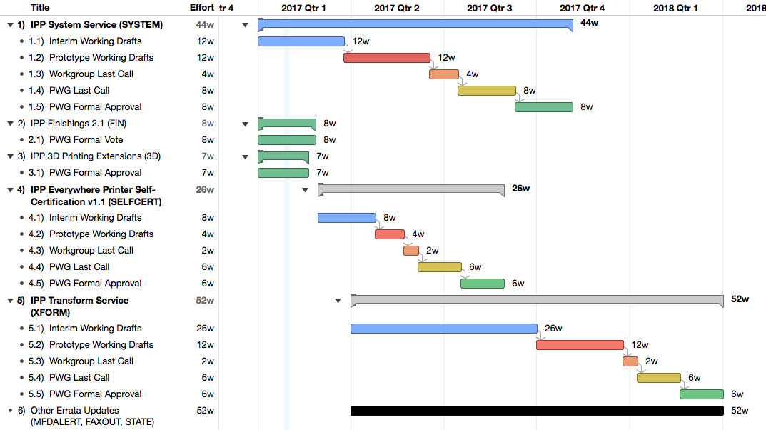
Next Steps
®
Copyright © 2017 The Printer Working Group. All rights reserved. The IPP Everywhere and PWG logos are registered trademarks of the IEEE-ISTO.

Slide 24
Next Steps
®
Advance IPP/1.1 to IETF Internet Standard
Request change of status in July 2017
IPP System Service
Prototype working draft in Q1/Q2 2017
IPP 3D Printing Extensions
Publish approved candidate standard
Other work/liaisons as appropriate
IPP Finishings 2.1
Complete PWG Formal Vote
IPP Everywhere Printer Self-Certification Manual v1.1
Interim working draft in Q1/Q2 2017
IPP Transform Service v1.0
Initial working draft in Q1/Q2 2017
Other errata (IPP State, etc.) in 2017
Specific documents for 2017?
Volunteers?
Copyright © 2017 The Printer Working Group. All rights reserved. The IPP Everywhere and PWG logos are registered trademarks of the IEEE-ISTO.

Slide 25
More Information
®
We welcome participation from all interested parties
IPP Working Group web page
http://www.pwg.org/ipp/index.html
Subscribe to the IPP mailing list
https://www.pwg.org/mailman/listinfo/ipp
IPP WG holds weekly phone conferences announced on the IPP mailing list
Next conference calls March 1, 2017 and March 15, 2017 at 1pm ET
Copyright © 2017 The Printer Working Group. All rights reserved. The IPP Everywhere and PWG logos are registered trademarks of the IEEE-ISTO.

