Slide 1
IPP Workgroup Session, Day 1
®
The Printer Working Group
February 10, 2016
PWG F2F Meeting
Sunnyvale, CA (Apple)
Copyright © 2016 The Printer Working Group. All rights reserved. The IPP Everywhere and PWG logos are registered trademarks of the IEEE-ISTO.

Slide 2
Agenda
®
February 10, 2016
When | What
1:00 - 1:15 | IPP Workgroup Status
1:15 - 1:45 | IETF IPP/1.1 Updates
1:45 - 4:00 | IPP System Service
February 11, 2016
When | What
9:00 - 12:00 | IPP 3D Printing Extensions
12:00 - 1:00 | Lunch
1:00 - 1:30 | IPP Job Password Repertoire
1:30 - 2:00 | Plethora of Proposals
2:00 - 2:30 | Next Steps
Copyright © 2016 The Printer Working Group. All rights reserved. The IPP Everywhere and PWG logos are registered trademarks of the IEEE-ISTO.

Slide 3
Charter
®
Current charter:
http://ftp.pwg.org/pub/pwg/ipp/charter/ch-ipp-charter-20151225.pdf
The Internet Printing Protocol (IPP) workgroup is chartered with the maintenance of IPP, the IETF IPP registry, and support for new clients, network architectures (Cloud, SDN), service bindings for MFDs and Imaging Systems, and emerging technologies such as 3D Printing
In addition, we maintain the IETF Finisher MIB, Job MIB, and Printer MIB registries, and handle synchronization with changes in IPP
Copyright © 2016 The Printer Working Group. All rights reserved. The IPP Everywhere and PWG logos are registered trademarks of the IEEE-ISTO.

Slide 4
Officers
®
IPP WG Co-Chairs:
Paul Tykodi (TCS)
Ira McDonald (High North)
IPP WG Secretary:
Michael Sweet (Apple)
IPP WG Document Editors:
Ira McDonald (High North) – IPP System Service (SYSTEM), IETF IPP/1.1
Michael Sweet (Apple) – IPP System Service (SYSTEM), IETF IPP/1.1, IPP 3D Printing Extensions
Smith Kennedy (HP Inc.) – IPP Job Password Repertoire
Copyright © 2016 The Printer Working Group. All rights reserved. The IPP Everywhere and PWG logos are registered trademarks of the IEEE-ISTO.

Slide 5
Status (1/2)
®
IETF RFCs in development:
IETF IPP/1.1: Encoding and Transport (obsoletes RFC 2910/3382) - Stable Draft, AD Sponsor
IETF IPP/1.1: Model and Semantics (obsoletes RFC 2911/3381/3382) - Stable Draft, AD Sponsor
PWG Specifications in development:
IPP Everywhere Printer Self-Certification Manual 1.0 (SELFCERT) - Stable, PWG Formal Vote
IPP System Service (SYSTEM) - Interim Draft
IPP 3D Printing Extensions (3D) - Interim Draft
PWG White Papers in development:
IPP Job Password Repertoire - Interim Draft
Copyright © 2016 The Printer Working Group. All rights reserved. The IPP Everywhere and PWG logos are registered trademarks of the IEEE-ISTO.

Slide 6
Status (2/2)
®
Recent Full Standard:
PWG 5100.12-2015: IPP 2.0, 2.1, and 2.2
Recent Candidate Standards:
PWG 5100.19-2015: IPP Implementor's Guide v2.0 (IG)
PWG 5100.18-2015: IPP Shared Infrastructure Extensions (INFRA)
Recent IETF RFCs:
RFC 7612: LDAP Schema for Printer Services
RFC 7472: IPP over HTTPS Transport Binding and “ipps” URI Scheme
Up-to-date pending IANA registrations online:
http://www.pwg.org/ipp/ipp-registrations.xml
Continue to maintain this in parallel for new specifications
Github repository:
https://github.com/istopwg/ippregistry
Copyright © 2016 The Printer Working Group. All rights reserved. The IPP Everywhere and PWG logos are registered trademarks of the IEEE-ISTO.

Slide 7
IPP Everywhere Printer Self-Certification (SELFCERT)
®
Current stable draft, tools, and web site content:
http://ftp.pwg.org/pub/pwg/ipp/wd/wd-ippeveselfcert10-20151110.pdf
http://www.pwg.org/ipp/everywhere.html (for tools)
http://beta.pwg.org/ippeveselfcert (submission form)
http://beta.pwg.org/printers (printer list)
Github repository for tools:
https://github.com/istopwg/ippeveselfcert
PWG Formal Vote until February 19, 2016
Copyright © 2016 The Printer Working Group. All rights reserved. The IPP Everywhere and PWG logos are registered trademarks of the IEEE-ISTO.

Slide 8
IETF IPP/1.1 Updates
®
Developing two new RFCs to replace (obsolete) RFCs 2910, 2911, 3381 (deprecated job progress attributes), and 3382 (collection attribute syntax)
Stable drafts:
http://tools.ietf.org/html/draft-sweet-rfc2910bis
http://tools.ietf.org/html/draft-sweet-rfc2911bis
Drafts are being AD-sponsored by Barry Leiba, IETF ART Director, for publication as IETF Proposed Standard
RFCs will eventually be advanced to IETF Internet Standard through status change (IETF process)
Proposed schedule:
IETF Last Call - Q1/Q2 2016
IESG Approval - Q2/Q3 2016
Copyright © 2016 The Printer Working Group. All rights reserved. The IPP Everywhere and PWG logos are registered trademarks of the IEEE-ISTO.

Slide 9
IPP System Service (SYSTEM)
®
Current interim draft at:
http://ftp.pwg.org/pub/pwg/ipp/wd/wd-ippsystem10-20160117-rev.pdf
Proposed Schedule:
Prototype draft in Q2 2016
Copyright © 2016 The Printer Working Group. All rights reserved. The IPP Everywhere and PWG logos are registered trademarks of the IEEE-ISTO.

Slide 10
IPP Workgroup Session, Day 2
®
The Printer Working Group
February 11, 2016
PWG F2F Meeting
Sunnyvale, CA (Apple)
Copyright © 2016 The Printer Working Group. All rights reserved. The IPP Everywhere and PWG logos are registered trademarks of the IEEE-ISTO.

Slide 11
Agenda
®
February 10, 2016
When | What
1:00 - 1:15 | IPP Workgroup Status
1:15 - 1:45 | IETF IPP/1.1 Updates
1:45 - 4:00 | IPP System Service
February 11, 2016
When | What
9:00 - 12:00 | IPP 3D Printing Extensions
12:00 - 1:00 | Lunch
1:00 - 1:30 | IPP Job Password Repertoire
1:30 - 2:00 | Plethora of Proposals
2:00 - 2:30 | Next Steps
Copyright © 2016 The Printer Working Group. All rights reserved. The IPP Everywhere and PWG logos are registered trademarks of the IEEE-ISTO.

Slide 12
IPP 3D Printing Extensions
®
Current draft (interim):
http://ftp.pwg.org/pub/pwg/ipp/wd/wd-ipp3d10-20160201-rev.pdf
Proposed schedule:
Prototype draft (content complete) Q3 2016
Items for discussion:
Do we want to require or recommend any document formats for 3D printing over IPP? Or simply talk about how to support different formats with implementation guidance?
PDF 2.0 and PDF/E add 3D content to PDF files (next slide)
IEEE work on 3D Printing (following slides)
Collaborating with other standards bodies and industry groups
Copyright © 2016 The Printer Working Group. All rights reserved. The IPP Everywhere and PWG logos are registered trademarks of the IEEE-ISTO.

Slide 13
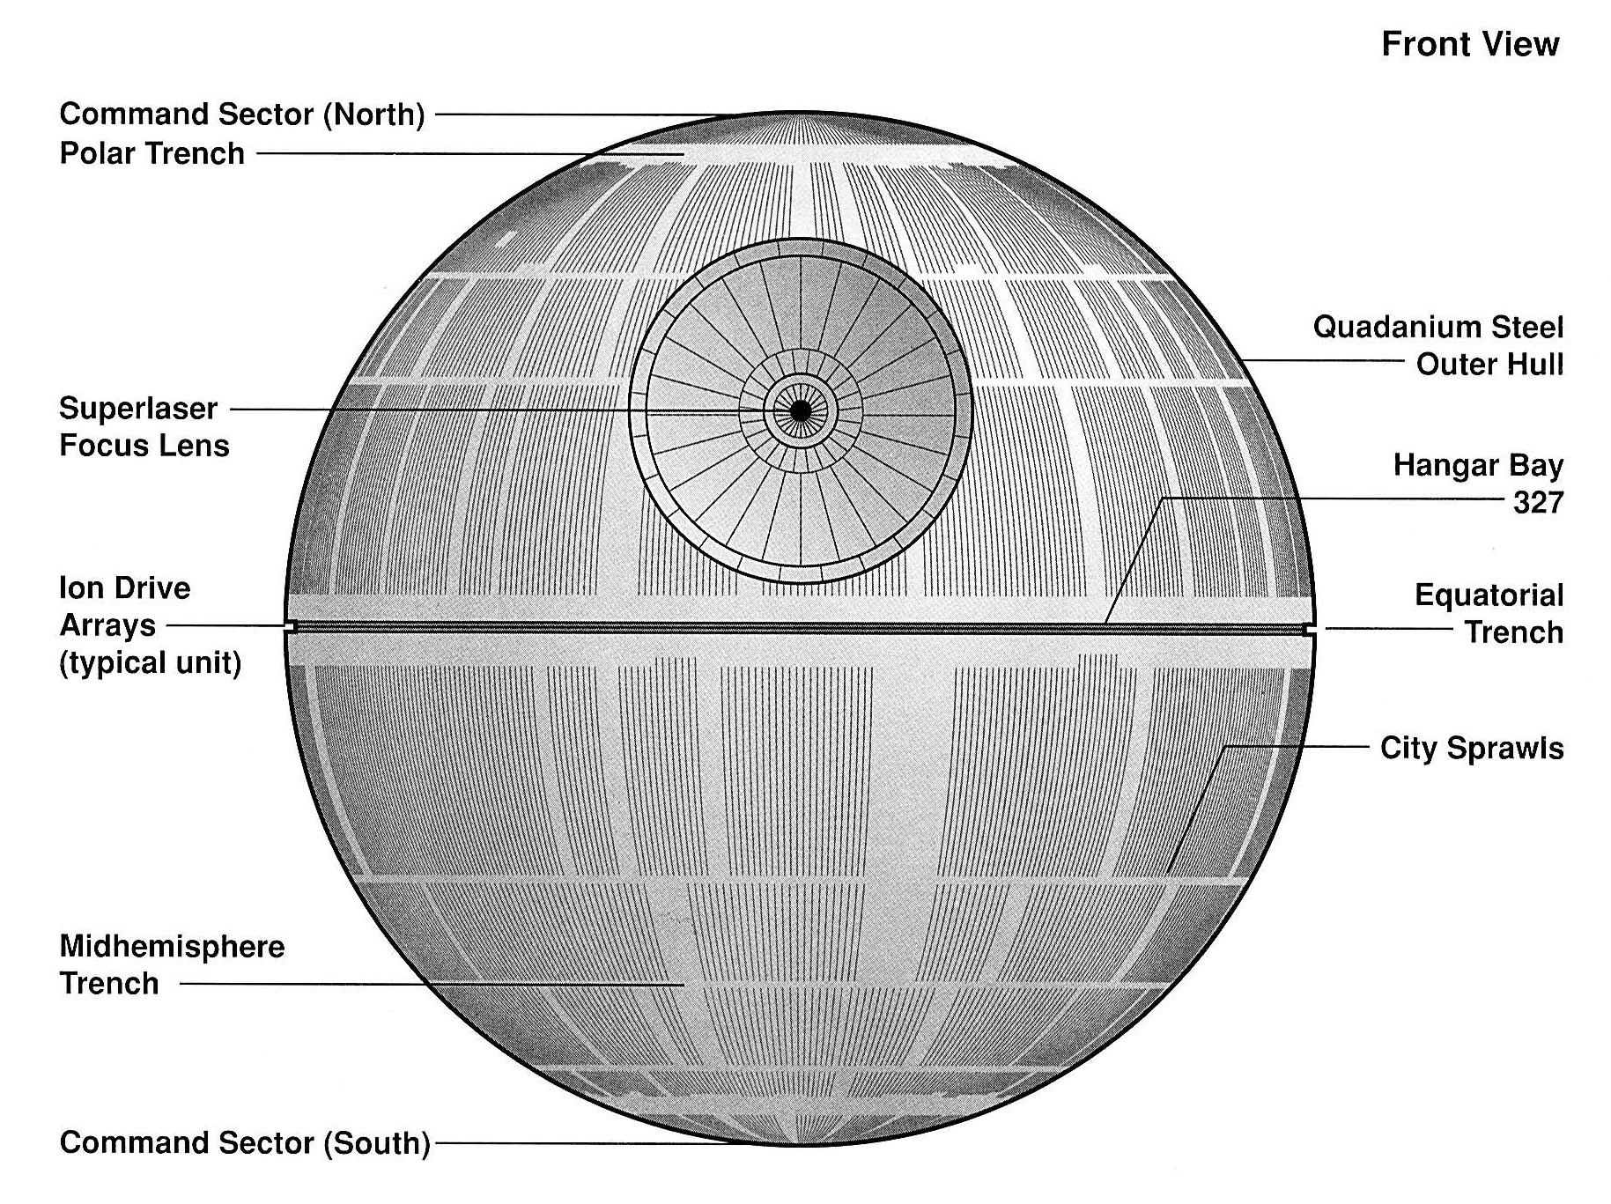
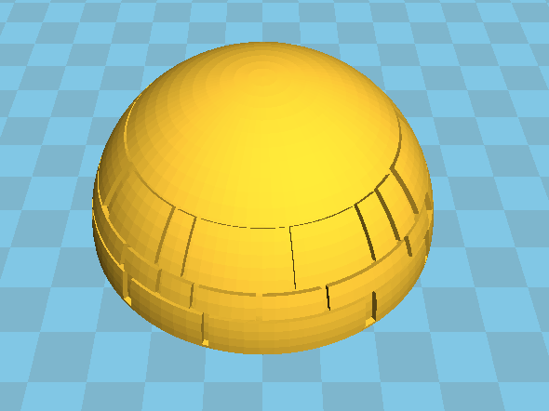
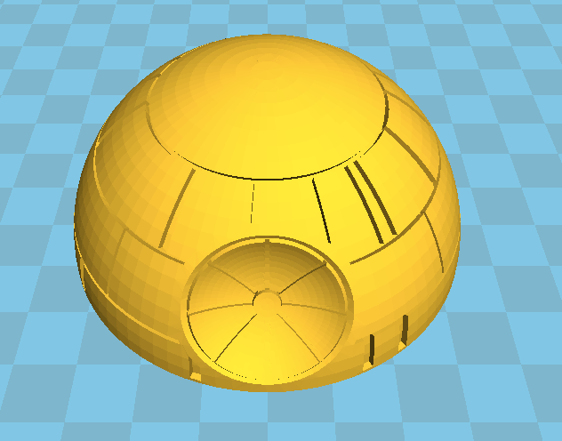
PDF 2.0 and PDF/E
®
How do we choose/identify content for printing (multiple U3D objects in file, potentially multiple objects per page or one object shared across multiple pages with different views)
How do we map materials between Job Ticket and PDF file?
PDF U3D content has named materials, same as AMF and 3MF...
Aliquam erat volutpat. Maecenas tempus mollis elementum. Fusce ut tortor sed mauris accumsan porta a quis nunc. Aliquam lacus nisi, porta eget sapien ac, dignissim tincidunt odio. Fusce luctus lacus a purus fringilla lobortis non a massa. Donec blandit suscipit volutpat. Cum sociis natoque penatibus et magnis dis parturient montes, na
Integer id rhoncus lorem, a scelerisque eros. Praesent bibendum nibh mauris, ac molestie arcu elementum rutrum. Donec nec augue non tellus ultrices ornare. Fusce sagittis iaculis sollicitudin. Sed sollicitudin ante lectus, nec ultricies tellus ullamcorper nec. Sed est mi, rutrum eu tempus non, porttitor egestas quam.
Copyright © 2016 The Printer Working Group. All rights reserved. The IPP Everywhere and PWG logos are registered trademarks of the IEEE-ISTO.

Slide 14
IEEE Projects Concerning 3D Printing
®
IEEE P3030 - Standard for Consumer 3D Printing: Overview and Architecture
http://standards.ieee.org/develop/project/3030.html
"This standard defines an architectural framework for consumer 3D printing, including descriptions of various domains (systems, services, devices, participants, etc.), definitions of domain abstractions, and identification of commonalities between different domains. The architectural framework for consumer 3D printing provides a reference model that defines relationships among various domains and common architecture elements. It also provides a blueprint for data abstraction, quality, protection and safety."
Project approved in March 2015, expires end of 2019
Have not gotten a response from the working group chair
Copyright © 2016 The Printer Working Group. All rights reserved. The IPP Everywhere and PWG logos are registered trademarks of the IEEE-ISTO.

Slide 15
IEEE Projects Concerning 3D Printing (con't)
®
IEEE P3333.2.5 - Bio-CAD File Format for Medical Three-Dimensional (3D) Printing
https://standards.ieee.org/develop/project/3333.2.5.html
"To establish the standardization of accurate and optimized Bio-CAD file format system for medical 3D Printing.This standard defines the Bio-CAD format for three-dimensional (3D) Printing based on Sectional Scan image data containing surface and volumetric information. Standardization is related to medical 3D printing services, including anatomic, pathologic models and medical instrument printing based on two-dimensional images, three-dimensional medical data and other medical data."
Project approved in August 2015, expires end of 2019
Probably not something a printer would support directly since it will require selection of features to print and other human interaction prior to printing
Copyright © 2016 The Printer Working Group. All rights reserved. The IPP Everywhere and PWG logos are registered trademarks of the IEEE-ISTO.

Slide 16
Lunch Break
®
The Printer Working Group
Copyright © 2016 The Printer Working Group. All rights reserved. The IPP Everywhere and PWG logos are registered trademarks of the IEEE-ISTO.

Slide 17
IPP Job Password Repertoire
®
Current draft (white paper):
http://ftp.pwg.org/pub/pwg/ipp/wd/wp-job-password-repertoire-20160101.pdf
Next steps:
Approve attribute and value registrations Q1 2016
Copyright © 2016 The Printer Working Group. All rights reserved. The IPP Everywhere and PWG logos are registered trademarks of the IEEE-ISTO.

Slide 18
Plethora of Proposals
®
Status Values for Input Trays
New Media Names
New "trimming-type" Keyword Value
"Eco" Stapling
"Engineering Z" Fold
Media Orientation and Finishing Templates
Punch Characteristics (Origin, Shape, Size)
Staple Characteristics (Origin, Angle, Size)
Implementation of "finishings-col-database"
IPP Finishings 2.0 Errata
Copyright © 2016 The Printer Working Group. All rights reserved. The IPP Everywhere and PWG logos are registered trademarks of the IEEE-ISTO.

Slide 19
Status Values for Input Trays
®
Questions from many vendors on what the “printer-input-tray” status values should be for various ‘media-xxx’ “printer-state-reasons” values
This value comes from the Printer MIB prtInputStatus property, which is a PrtSubUnitStatusTC value
Section 2.2.13.2.2 of RFC 3805 defines the values
Appendix E references a PDF with values for different statuses (but not an exhaustive list):
http://ftp.pwg.org/pub/pwg/pmp/contributions/Top25Errors.pdf
‘media-empty’ maps to status 19 (Unavailable because broken+Critical Alerts = 3+16 = 19)
‘media-low’ maps to status 8 (Non-Critical Alerts)
‘media-needed’ isn’t list, but could be status 17 (Unavailable and OnRequest + Critical Alerts = 1+16 = 17) or status 49 (Unavailable and OnRequest + Critical Alerts + State if Off-Line = 1+16+32 = 49)
Copyright © 2016 The Printer Working Group. All rights reserved. The IPP Everywhere and PWG logos are registered trademarks of the IEEE-ISTO.

Slide 20
New Media Names
®
Canon has requested registration of new media size names for common and/or standard sizes used with large format printers:
A2+ (17x24in) - 'oe_a2plus_17x24in'
Arch E2 (26x38in) - 'oe_arch-e2_26x38in'
Arch E3 (27x39in) - 'oe_arch-e3_27x39in'
10R (10x12in) - 'oe_photo-10r_10x12in' (ISO 1008)
S10R (10x15in) - 'oe_photo-s10r_10x15in' (ISO 1008)
20R (20x24in) - 'oe_photo-20r-20x24in' (ISO 1008)
12x16" - 'oe_12x16_12x16in' (JIS K 7523)
14x17" - 'oe_14x17_14x17in' (JIS K 7523)
18x22" - 'oe_18x22_18x22in' (JIS K 7523)
These can just be plain registrations of new "media" keyword values with IPP workgroup approval
Copyright © 2016 The Printer Working Group. All rights reserved. The IPP Everywhere and PWG logos are registered trademarks of the IEEE-ISTO.

Slide 21
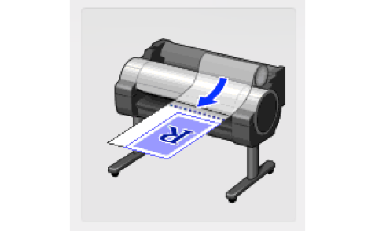
New "trimming-type" Keyword Value
®
Canon has requested the registration of a new "trimming-type" keyword value, e.g., 'draw-line', that instructs the printer to draw a line where the media should be cut.
Many vendors already support this feature through their printer drivers - important for feature parity with drivers.
It is necessary especially when printing on specific print media, e.g., Flame-Resistant Cloth, which cannot be cut by the built-in paper cutter.
JDF doesn't address cut lines specifically, but does have cut marks.
Copyright © 2016 The Printer Working Group. All rights reserved. The IPP Everywhere and PWG logos are registered trademarks of the IEEE-ISTO.

Slide 22
"Eco" Stapling
®
Canon has requested support for "eco" stapling which binds paper together without using metal staples.
Used in more and more offices as an eco- friendly and resource saving alternative to using conventional staples.
More vendors are supporting both conventional stapler and eco-stapler with their products.
We would like to request addition of eco-staple definitions.
Copyright © 2016 The Printer Working Group. All rights reserved. The IPP Everywhere and PWG logos are registered trademarks of the IEEE-ISTO.

Slide 23
"Eco" Stapling (con't)
®
Canon Proposal:
Add definition of eco-staple in "finishings” Job Template attribute: eco-staple-top-left eco-staple-top-right eco-staple-bottom-left eco-staple-bottom-right eco‐staple-dual-top eco-staple-dual-bottom eco-staple-dual-left eco-staple-dual-right
Copyright © 2016 The Printer Working Group. All rights reserved. The IPP Everywhere and PWG logos are registered trademarks of the IEEE-ISTO.

Slide 24
"Engineering Z" Fold
®
Xerox has requested explicit support for a variation of the 'fold-z' finishing template:
Fold the paper in half vertically, then fold half of that (the side with the non-binding edge) in half vertically again, resulting in the z or half z fold.
This fold is used to fold something like Tabloid (11x17) or A3 in half, to be the same size as Letter (8.5x11) or A4, and then folding the non-binding side in half again towards the midline. This can then be part of a bound (staple or punch) set, giving you a pull-out 11x17 or A3 sheet in the middle of your bound document.
Corresponds to JDF's "F8-2" in the fold catalog.
Copyright © 2016 The Printer Working Group. All rights reserved. The IPP Everywhere and PWG logos are registered trademarks of the IEEE-ISTO.

Slide 25
Media Orientation and Finishing Templates
®
HP has reported there is no way to differentiate between "finishing-template" values that vary based on media orientation ("orientation-requested")
Both "finishings-col-database" and "finishing-col-ready" allow specification of "media-size" or "media-size-name" member attributes describing the finishing values used for a given media size
"finishings-col-database/ready (1setOf collection)":
Add "orientation-requested (type2 enum)" for different "finishings-template" values based on orientation
Example: 'punch' template defaults to 3-hole punch in portrait and 2-hole punch in landscape
Copyright © 2016 The Printer Working Group. All rights reserved. The IPP Everywhere and PWG logos are registered trademarks of the IEEE-ISTO.

Slide 26
Origin, Shape, and Size of Punch Holes
®
HP has reported that the origin, shape, and size of punch holes is not defined in IPP Finishings 2.0
JDF (naturally) has Job Ticket elements for most of these things
Punching (HoleMaking): Center, CenterReference, Extent, HoleType, Shape
We don't want to make IPP finishings as complicated as JDF
Hole making capabilities are typically limited to the installed finisher and/or supplies
Focus on providing information to the Client for preview
Copyright © 2016 The Printer Working Group. All rights reserved. The IPP Everywhere and PWG logos are registered trademarks of the IEEE-ISTO.

Slide 27
Origin, Shape, and Size of Punch Holes (con't)
®
Specify the origin of the holes as the center of each hole (matches JDF @HoleMakingParams/Center definition)
Specify that holes are round (JDF @HoleMakingParams/Shape=Round)
Q: Are there any IPP printers or finishers that punch anything other than round holes?
Define an attribute that specifies the diameter of the installed hole punch (JDF @HoleMakingParams/Extent for /Shape=Round holes):
"punch-diameter-configured (integer(0:MAX))" Printer Description attribute
Specifies punch diameter in PWG units (hundredths of millimeters)
Copyright © 2016 The Printer Working Group. All rights reserved. The IPP Everywhere and PWG logos are registered trademarks of the IEEE-ISTO.

Slide 28
Origin, Angle, and Size of Staples
®
HP has reported that the origin, angle, and size of staples (stitches) is not defined in IPP Finishings 2.0
JDF (naturally) has Job Ticket elements for most of these things
Stitching: StapleShape, StitchWidth, WireBrand, WireGauge
We don't want to make IPP finishings as complicated as JDF
Staple making capabilities are typically limited to the installed finisher and/or supplies
Focus on providing information to the Client for preview
Copyright © 2016 The Printer Working Group. All rights reserved. The IPP Everywhere and PWG logos are registered trademarks of the IEEE-ISTO.

Slide 29
Origin, Angle, and Size of Staples (con't)
®
Specify the origin of the staples as the center of each staple (matches JDF @StitchingParams/StitchPositions definition)
Specify that the staple shape is implementation-defined with the staple width representing the exposed portion of the staple on the front side of the Impression (matches JDF definition)
Define an attribute that specifies the width of the installed/configured staples (matches JDF @StitchingParams/StitchWidth):
"stitch-size-configured (integer(0:MAX))" Printer Description attribute:
Specifies stitch (staple) width in PWG units (hundredths of millimeters)
Copyright © 2016 The Printer Working Group. All rights reserved. The IPP Everywhere and PWG logos are registered trademarks of the IEEE-ISTO.

Slide 30
Origin, Angle, and Size of Staples (con't)
®
Define an attribute that specifies the angle of the staples when applied (matches JDF @StitchingParams/Angle):
"stitch-angle-configured (integer(0:179))" Printer Description attribute
Specifies stitch (staple) orientation in degrees counter-clockwise from right edge (same as JDF and PostScript):
Only for corner stitches - edge and saddle stitch are assumed to be parallel to the binding edge
0
45
90
135
Copyright © 2016 The Printer Working Group. All rights reserved. The IPP Everywhere and PWG logos are registered trademarks of the IEEE-ISTO.

Slide 31
Implementation of "finishings-col-database"
®
HP has reported that the "finishings-col-database" attribute can be very large, just like "media-col-database"
Should we recommend against including '"finishings-col-database" in a Get-Printer-Attributes response unless it is listed in the "requested-attributes" operation attribute?
Can't make it a MUST like "media-col-database" since IPP Finishings 2.0 was already published
Could say: Printers SHOULD NOT return this attribute unless it is provided in the "requested-attributes" operation attribute and Clients SHOULD provide the "requested-attributes" operation attribute with the 'finishings-col-database' keyword when needed.
Copyright © 2016 The Printer Working Group. All rights reserved. The IPP Everywhere and PWG logos are registered trademarks of the IEEE-ISTO.

Slide 32
IPP Finishings 2.0 Errata
®
PWG 5100.1-2015: IPP Finishings 2.0
http://ftp.pwg.org/pub/pwg/candidates/cs-ippfinishings20-20141219-5100.1.pdf
Lots of proposed finishings additions/changes/clarifications
Do we publish them as an errata to IPP Finishings 2.0?
Develop "IPP Finishings 2.1" draft
PWG Last Call and PWG Call for Objections process or
Do we simply register the new attributes/values and ignore the other issues in IPP Finishings 2.0?
Post registration template to IPP WG list
Approve in IPP WG meeting
Copyright © 2016 The Printer Working Group. All rights reserved. The IPP Everywhere and PWG logos are registered trademarks of the IEEE-ISTO.

Slide 33
Next Steps
®
The Printer Working Group
Copyright © 2016 The Printer Working Group. All rights reserved. The IPP Everywhere and PWG logos are registered trademarks of the IEEE-ISTO.

Slide 34
Next Steps
®
Copyright © 2016 The Printer Working Group. All rights reserved. The IPP Everywhere and PWG logos are registered trademarks of the IEEE-ISTO.

Slide 35
Next Steps
®
IPP Everywhere Printer Self-Certification Manual 1.0
PWG Formal Vote concludes on February 19, 2016
Advance IPP/1.1 to IETF Proposed Standard
IETF Last Call in Q1 2016
IETF process to advance to Internet Standard once published...
IPP System Service
Prototype working draft in Q2 2016
IPP 3D Printing Extensions
Prototype working draft in Q3 2016
IPP Finishings 2.0 Errata?
IPP Transform Service v1.0?
Other errata (IPP State, etc.)?
Copyright © 2016 The Printer Working Group. All rights reserved. The IPP Everywhere and PWG logos are registered trademarks of the IEEE-ISTO.

Slide 36
More Information
®
We welcome participation from all interested parties
IPP Working Group web page
http://www.pwg.org/ipp/index.html
Subscribe to the IPP mailing list
https://www.pwg.org/mailman/listinfo/ipp
IPP WG holds weekly phone conferences announced on the IPP mailing list
Next conference calls February 22, 2016 at 4pm ET to discuss 3D Printing and February 29, 2016 at 3pm ET for IPP System Service
Copyright © 2016 The Printer Working Group. All rights reserved. The IPP Everywhere and PWG logos are registered trademarks of the IEEE-ISTO.

