Slide 1

IPP Workgroup Session, Day 1
®
The Printer Working Group
August 9, 2017
Copyright © 2017 The Printer Working Group. All rights reserved. The IPP Everywhere and PWG logos are registered trademarks of the IEEE-ISTO.

Slide 2

PWG IP Policy
®
"This meeting is being held in accordance with the PWG Intellectual Property Policy"
  http://www.pwg.org/chair/membership_docs/pwg-ip-policy.pdf
TL;DR: Anything you say in a PWG meeting or email to a PWG address can be used in a PWG standard
  (but please do read the IP policy above if you haven't done so)
Copyright © 2017 The Printer Working Group. All rights reserved. The IPP Everywhere and PWG logos are registered trademarks of the IEEE-ISTO.

Slide 3
Agenda
®
August 9, 2017
When | What
11:00 - 11:30 | IPP Workgroup Status and Updates
11:30 - 12:00 | Lunch Break
12:00 - 2:00 | IPP System Service v1.0
2:00 - 3:00 | IPP Get-User-Printer-Attributes
August 10, 2017
When | What
10:00 - 11:30 | IPP Authentication Methods
11:30 - 12:00 | Lunch Break
12:00 - 1:30 | IPP Presets
1:30 - 3:00 | 3D Topics and Next Steps
Copyright © 2017 The Printer Working Group. All rights reserved. The IPP Everywhere and PWG logos are registered trademarks of the IEEE-ISTO.

Slide 4
Charter
®
Current charter:
  http://ftp.pwg.org/pub/pwg/ipp/charter/ch-ipp-charter-20170615.pdf
The Internet Printing Protocol (IPP) workgroup is chartered with the maintenance of IPP, the IETF IPP registry, and support for new clients, network architectures (Cloud, SDN), service bindings for MFDs and Imaging Systems, and emerging technologies such as 3D Printing
In addition, we maintain the IETF Finisher MIB, Job MIB, and Printer MIB registries, and handle synchronization with changes in IPP
Copyright © 2017 The Printer Working Group. All rights reserved. The IPP Everywhere and PWG logos are registered trademarks of the IEEE-ISTO.

Slide 5
Officers
®
IPP WG Co-Chairs:
  Paul Tykodi (TCS)
  Ira McDonald (High North)
IPP WG Secretary:
  Michael Sweet (Apple)
IPP WG Document Editors:
  Ira McDonald (High North) – IPP System Service (SYSTEM)
  Michael Sweet (Apple) – IPP System Service (SYSTEM), PWG 3D Print Job Ticket and Associated Capabilities v1.0 (PJT3D)
  Smith Kennedy (HP Inc.) – Various white papers
Copyright © 2017 The Printer Working Group. All rights reserved. The IPP Everywhere and PWG logos are registered trademarks of the IEEE-ISTO.

Slide 6
Status (1/2)
®
PWG Specifications in development:
  PWG 3D Print Job Ticket and Associated Capabilities v1.0 (PJT3D)
  - PWG Formal Vote until Aug 18
  Mapping of CIP4 JDF to PWG Print Job Ticket (JDFMAP)
  - PWG Formal Vote until Aug 28
  IPP System Service v1.0 (SYSTEM) - Prototype Draft
Recent Candidate Standards:
  PWG 5100.1-2017: IPP Finishings 2.1 (FIN)
  PWG 5100.20-2016: IPP Everywhere Printer Self-Certification Manual v1.0 (SELFCERT)
  PWG 5100.21-2017: IPP 3D Printing Extensions v1.0 (3D)
Recent IETF RFCs:
  RFC 8010: Internet Printing Protocol/1.1: Encoding and Transport
  RFC 8011: Internet Printing Protocol/1.1: Model and Semantics
Copyright © 2017 The Printer Working Group. All rights reserved. The IPP Everywhere and PWG logos are registered trademarks of the IEEE-ISTO.

Slide 7
Status (2/2)
®
Up-to-date pending IANA registrations online:
  http://www.pwg.org/ipp/ipp-registrations.xml
  Continue to maintain this in parallel for new specifications
  Github repository: https://github.com/istopwg/ippregistry
IPP Everywhere Printer Self-Certifications:
  https://www.pwg.org/printers
  89 printers currently listed (almost doubled since May 2017)
  1.0 self-certification tools update released in October 2016
IPP Sample Code:
  Github repository:
    https://github.com/istopwg/ippsample
  Fork of CUPS code includes ippfind, ippproxy, ippserver, ipptool, ipptransform, and ipptransform3d
Copyright © 2017 The Printer Working Group. All rights reserved. The IPP Everywhere and PWG logos are registered trademarks of the IEEE-ISTO.

Slide 8
IETF IPP/1.1 Updates
®
RFCs 8010 and 8011 have been published which replace (obsolete) RFCs 2910, 2911, 3381 (deprecated job progress attributes), and 3382 (collection attribute syntax)
Published RFCs:
  http://tools.ietf.org/html/rfc8010
  http://tools.ietf.org/html/rfc8011
  Pending: Advance RFC 8010 and 8011 to IETF Internet Standard through status change
    IESG process described in RFCs 2026 and 6410
Proposed schedule:
  Request IESG change of status ASAP
Copyright © 2017 The Printer Working Group. All rights reserved. The IPP Everywhere and PWG logos are registered trademarks of the IEEE-ISTO.

Slide 9
IPP Everywhere Self-Certification
®
Resources:
  http://www.pwg.org/ipp/everywhere.html (for tools/info)
  https://www.pwg.org/ippeveselfcert (submission form)
  http://www.pwg.org/printers (printer list)
  https://github.com/istopwg/ippeveselfcert (Github repo)
Released v1.0 Update 1 of self-certification tools on October 28th, 2016
Planning future 1.1 errata update for manual and tools in 2017:
  More tests (Cancel-My-Jobs, Close-Job, Identify-Printer)
  Other necessary changes that are not simple bug fixes in the tools/submission portal
Proposed Schedule:
  1.0 Update 2 - Q4 2017
  1.1 errata update: Q4 2017 / Q1 2018
Copyright © 2017 The Printer Working Group. All rights reserved. The IPP Everywhere and PWG logos are registered trademarks of the IEEE-ISTO.

Slide 10
IPP System Service (SYSTEM)
®
Current prototype draft at:
  http://ftp.pwg.org/pub/pwg/ipp/wd/wd-ippsystem10-20170719-rev.pdf
Combines and implements a concrete IPP binding of the following abstract Semantic Model 2.0 services and objects:
  PWG 5108.06: System Object and System Control Service
  PWG 5108.03: Network Resource Service
  PWG 5109.1: Cloud Imaging Requirements and Model
Additional discussion:
  How to allow Users to discover/query resources (Get-Resources is admin only)
Proposed Schedule:
  Stable draft in Q4 2017
Copyright © 2017 The Printer Working Group. All rights reserved. The IPP Everywhere and PWG logos are registered trademarks of the IEEE-ISTO.

Slide 11
IPP Get-User-Printer-Attributes
®
Current white paper at:
  http://ftp.pwg.org/pub/pwg/ipp/whitepaper/tb-userop-20170801-rev.pdf
Get-User-Printer-Attributes Operation
  Provides a Get-Printer-Attributes response filtered by the most authenticated user
  Useful for things like limiting which users can print in color, use a particular letterhead, etc.
  Clients that support the operation will only show available print options to the user instead of reporting an error (or having the options silently overridden by the Printer) when the user submits the job
  Needed because Get-Printer-Attributes is not defined as an authenticated operation (so no clients support it), nor does it include the "most authenticated user identity" as a filter criteria (which isn't something we can expose using "printer-get-attributes-supported")
Additional discussion:
  Should this be a standards-track specification instead of a white paper?
Copyright © 2017 The Printer Working Group. All rights reserved. The IPP Everywhere and PWG logos are registered trademarks of the IEEE-ISTO.

Slide 12
IPP Workgroup Session, Day 2
®
The Printer Working Group
August 10, 2017
Copyright © 2017 The Printer Working Group. All rights reserved. The IPP Everywhere and PWG logos are registered trademarks of the IEEE-ISTO.

Slide 13
PWG IP Policy
®
"This meeting is being held in accordance with the PWG Intellectual Property Policy"
  http://www.pwg.org/chair/membership_docs/pwg-ip-policy.pdf
TL;DR: Anything you say in a PWG meeting or email to a PWG address can be used in a PWG standard
  (but please do read the IP policy above if you haven't done so)
Copyright © 2017 The Printer Working Group. All rights reserved. The IPP Everywhere and PWG logos are registered trademarks of the IEEE-ISTO.

Slide 14
Agenda
®
August 9, 2017
When | What
11:00 - 11:30 | IPP Workgroup Status and Updates
11:30 - 12:00 | Lunch Break
12:00 - 2:00 | IPP System Service v1.0
2:00 - 3:00 | IPP Get-User-Printer-Attributes
August 10, 2017
When | What
10:00 - 11:30 | IPP Authentication Methods
11:30 - 12:00 | Lunch Break
12:00 - 1:30 | IPP Presets
1:30 - 3:00 | 3D Topics and Next Steps
Copyright © 2017 The Printer Working Group. All rights reserved. The IPP Everywhere and PWG logos are registered trademarks of the IEEE-ISTO.

Slide 15
IPP Authentication Methods
®
Current white paper:
  http://ftp.pwg.org/pub/pwg/ipp/whitepaper/tb-ippauth-20170803.pdf
Provides an overview of how HTTP authentication methods are used with IPP
  Currently HTTP Basic, HTTP Digest, HTTP Bearer (OAuth), HTTP Negotiate (Kerberos)
  Maybe HTTP MutualAuth and others in the future
Copyright © 2017 The Printer Working Group. All rights reserved. The IPP Everywhere and PWG logos are registered trademarks of the IEEE-ISTO.

Slide 16
IPP Presets
®
Current white paper:
  http://ftp.pwg.org/pub/pwg/ipp/whitepaper/tb-ipp-preset-20170728.pdf
"job-presets-supported" and "job-triggers-supported" Printer Description attributes
Provides named presets (sets of Job Template attributes)
Provides a way for Clients to know that selection of one Job Template attribute value should also select others, e.g., selecting 4x6 media should also trigger "print-quality" getting set to 'high'.
Additional discussion:
  Using IPP System Service Job Template resources with Job Presets?
  Saving/exporting Client-side presets to Printer using Set-Printer-Attributes?
Copyright © 2017 The Printer Working Group. All rights reserved. The IPP Everywhere and PWG logos are registered trademarks of the IEEE-ISTO.

Slide 17
3D Printing Liaison Topics
®
See Plenary slides for status
Discuss any 3D issues that came up during the Plenary that need to be discussed in the IPP workgroup...
Copyright © 2017 The Printer Working Group. All rights reserved. The IPP Everywhere and PWG logos are registered trademarks of the IEEE-ISTO.

Slide 18
Next Steps
®
The Printer Working Group
Copyright © 2017 The Printer Working Group. All rights reserved. The IPP Everywhere and PWG logos are registered trademarks of the IEEE-ISTO.

Slide 19
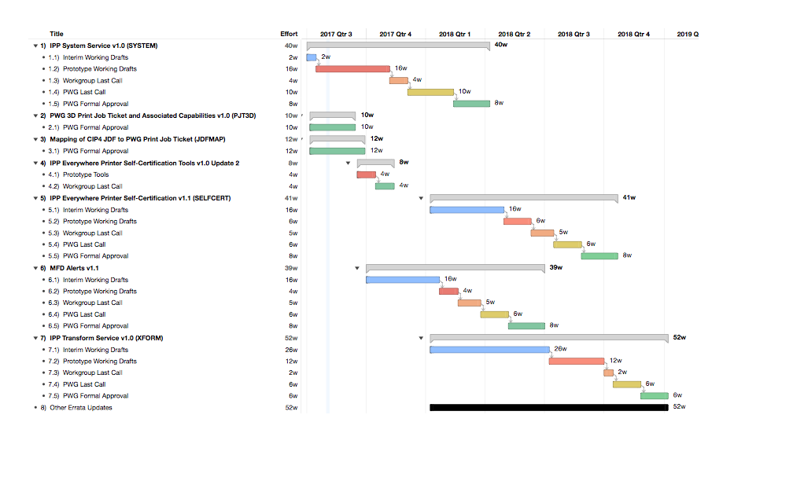
Next Steps
®
Copyright © 2017 The Printer Working Group. All rights reserved. The IPP Everywhere and PWG logos are registered trademarks of the IEEE-ISTO.

Slide 20
Next Steps
®
Advance IPP/1.1 to IETF Internet Standard
  Request change of status
PWG 3D Print Job Ticket and Associated Capabilities v1.0 (Mike)
  Complete formal vote (August 18, 2017)
Mapping CIP4 JDF to PWG Print Job Ticket (Ira/Rick)
  Complete formal vote (August 28, 2017)
IPP System Service (Ira/Mike)
  Stable working draft in Q4 2017
IPP Everywhere Printer Self-Certification v1.0 Update 2 (Mike/Smith)
  Beta in Q4 2017
IPP Everywhere Printer Self-Certification Manual v1.1 (Mike/Smith)
  Interim working draft in Q4 2017 / Q1 2018
MFD Alerts v1.1 (Ira/Mike - Errata Update)
  Initial working draft in Q4 2017
IPP Transform Service v1.0 (Ira/Paul)
  Initial working draft in Q1 2018
Copyright © 2017 The Printer Working Group. All rights reserved. The IPP Everywhere and PWG logos are registered trademarks of the IEEE-ISTO.

Slide 21
More Information
®
We welcome participation from all interested parties
IPP Working Group web page
  http://www.pwg.org/ipp/index.html
Subscribe to the IPP mailing list
  https://www.pwg.org/mailman/listinfo/ipp
IPP WG holds bi-weekly phone conferences announced on the IPP mailing list
  Next conference calls scheduled for Thursday, August 17, 2017 and August 31, 2017 at 3pm ET
Copyright © 2017 The Printer Working Group. All rights reserved. The IPP Everywhere and PWG logos are registered trademarks of the IEEE-ISTO.

