Slide 1
IPP Workgroup Session, Day 1
®
The Printer Working Group
April 27, 2016
PWG F2F Meeting
Boise, ID (HP)
Copyright © 2016 The Printer Working Group. All rights reserved. The IPP Everywhere and PWG logos are registered trademarks of the IEEE-ISTO.

Slide 2
Agenda
®
April 27, 2016
When | What
1:00 - 1:15 | IPP Workgroup Status
1:15 - 5:00 | IPP System Service
April 28, 2016
When | What
9:00 - 12:00 | IPP 3D Printing Extensions
12:00 - 1:00 | Lunch
1:00 - 2:00 | IPP Finishings 2.1
2:00 - 2:30 | Proposals
2:30 - 3:00 | Next Steps
Copyright © 2016 The Printer Working Group. All rights reserved. The IPP Everywhere and PWG logos are registered trademarks of the IEEE-ISTO.

Slide 3
Charter
®
Current charter:
http://ftp.pwg.org/pub/pwg/ipp/charter/ch-ipp-charter-20151225.pdf
The Internet Printing Protocol (IPP) workgroup is chartered with the maintenance of IPP, the IETF IPP registry, and support for new clients, network architectures (Cloud, SDN), service bindings for MFDs and Imaging Systems, and emerging technologies such as 3D Printing
In addition, we maintain the IETF Finisher MIB, Job MIB, and Printer MIB registries, and handle synchronization with changes in IPP
Copyright © 2016 The Printer Working Group. All rights reserved. The IPP Everywhere and PWG logos are registered trademarks of the IEEE-ISTO.

Slide 4
Officers
®
IPP WG Co-Chairs:
Paul Tykodi (TCS)
Ira McDonald (High North)
IPP WG Secretary:
Michael Sweet (Apple)
IPP WG Document Editors:
Ira McDonald (High North) – IPP System Service (SYSTEM), IETF IPP/1.1
Michael Sweet (Apple) – IPP System Service (SYSTEM), IETF IPP/1.1, IPP 3D Printing Extensions
Smith Kennedy (HP Inc.) – IPP Finishings 2.1
Copyright © 2016 The Printer Working Group. All rights reserved. The IPP Everywhere and PWG logos are registered trademarks of the IEEE-ISTO.

Slide 5
Status (1/3)
®
IETF RFCs in development:
IETF IPP/1.1: Encoding and Transport (obsoletes RFC 2910/3382) - Stable Draft, AD Sponsor
IETF IPP/1.1: Model and Semantics (obsoletes RFC 2911/3381/3382) - Stable Draft, AD Sponsor
PWG Specifications in development:
IPP 3D Printing Extensions (3D) - Interim Draft
IPP System Service (SYSTEM) - Interim Draft
IPP Finishings 2.1 (FIN) - Interim Draft
Copyright © 2016 The Printer Working Group. All rights reserved. The IPP Everywhere and PWG logos are registered trademarks of the IEEE-ISTO.

Slide 6
Status (2/3)
®
Recent Full Standard:
PWG 5100.12-2015: IPP 2.0, 2.1, and 2.2
Recent Candidate Standards:
PWG 5100.20-2016: IPP Everywhere Printer Self-Certification Manual v1.0 (SELFCERT)
PWG 5100.19-2015: IPP Implementor's Guide v2.0 (IG)
PWG 5100.18-2015: IPP Shared Infrastructure Extensions (INFRA)
Recent IETF RFCs:
RFC 7612: LDAP Schema for Printer Services
RFC 7472: IPP over HTTPS Transport Binding and “ipps” URI Scheme
Copyright © 2016 The Printer Working Group. All rights reserved. The IPP Everywhere and PWG logos are registered trademarks of the IEEE-ISTO.

Slide 7
Status (3/3)
®
Up-to-date pending IANA registrations online:
http://www.pwg.org/ipp/ipp-registrations.xml
Continue to maintain this in parallel for new specifications
Github repository:
https://github.com/istopwg/ippregistry
IPP Everywhere Printer Self-Certifications:
Submission page:
https://www.pwg.org/ippeveselfcert
Printer listing page:
https://www.pwg.org/printers
Still waiting for our first submission!
IPP Sample Code:
Github repository:
https://github.com/istopwg/ippsample
Fork of CUPS code includes ippfind, ippproxy, ippserver, and ipptool
Copyright © 2016 The Printer Working Group. All rights reserved. The IPP Everywhere and PWG logos are registered trademarks of the IEEE-ISTO.

Slide 8
IETF IPP/1.1 Updates
®
Developing two new RFCs to replace (obsolete) RFCs 2910, 2911, 3381 (deprecated job progress attributes), and 3382 (collection attribute syntax)
Stable drafts:
http://tools.ietf.org/html/draft-sweet-rfc2910bis
http://tools.ietf.org/html/draft-sweet-rfc2911bis
Drafts are being AD-sponsored by Barry Leiba, IETF ART Director, for publication as IETF Proposed Standard
RFCs will eventually be advanced to IETF Internet Standard through status change (IETF process)
Proposed schedule:
IETF Last Call - Q2/Q3 2016
IESG Approval - Q3/Q4 2016
Copyright © 2016 The Printer Working Group. All rights reserved. The IPP Everywhere and PWG logos are registered trademarks of the IEEE-ISTO.

Slide 9
IPP System Service (SYSTEM)
®
Current interim draft at:
http://ftp.pwg.org/pub/pwg/ipp/wd/wd-ippsystem10-20160228-rev.pdf
Proposed Schedule:
Prototype draft in Q2/Q3 2016
Copyright © 2016 The Printer Working Group. All rights reserved. The IPP Everywhere and PWG logos are registered trademarks of the IEEE-ISTO.

Slide 10
IPP Workgroup Session, Day 2
®
The Printer Working Group
April 27, 2016
PWG F2F Meeting
Boise, ID (HP)
Copyright © 2016 The Printer Working Group. All rights reserved. The IPP Everywhere and PWG logos are registered trademarks of the IEEE-ISTO.

Slide 11
Agenda
®
April 27, 2016
When | What
1:00 - 1:15 | IPP Workgroup Status
1:15 - 5:00 | IPP System Service
April 28, 2016
When | What
9:00 - 12:00 | IPP 3D Printing Extensions
12:00 - 1:00 | Lunch
1:00 - 2:00 | IPP Finishings 2.1
2:00 - 2:30 | Proposals
2:30 - 3:00 | Next Steps
Copyright © 2016 The Printer Working Group. All rights reserved. The IPP Everywhere and PWG logos are registered trademarks of the IEEE-ISTO.

Slide 12
IPP 3D Printing Extensions
®
Current draft (interim):
http://ftp.pwg.org/pub/pwg/ipp/wd/wd-ipp3d10-2016mmdd-rev.pdf
Proposed schedule:
Prototype draft (content complete) Q3 2016
Items for discussion:
How to best express print quality intent in job ticket (next slide)?
Copyright © 2016 The Printer Working Group. All rights reserved. The IPP Everywhere and PWG logos are registered trademarks of the IEEE-ISTO.

Slide 13
Print Quality Intent
®
IPP currently has some existing attributes:
print-quality (type2 enum): Simple numeric quality levels: 'draft', 'normal', and 'high' (best)
print-content-optimize (type2 keyword): Simple string describing print quality priority: 'auto', 'graphic', 'photo', 'text', 'text-and-graphic'
printer-resolution (resolution): Numeric output resolution
First pass of 3D extensions defined many attributes specific to FDM printing:
Fill percent, shell and layer thickness, print speed
Discussions at the last F2F lead us to remove these and re-think how to specify print quality differently
Copyright © 2016 The Printer Working Group. All rights reserved. The IPP Everywhere and PWG logos are registered trademarks of the IEEE-ISTO.

Slide 14
Print Quality Intent (con't)
®
Second pass of 3D extensions defines a single additional attribute:
print-quality-details (1setOf type2 keyword): List of strings describing desired output characteristics such as 'accuracy' for dimensional accuracy, 'material' for minimizing material usage, 'opacity' for maximizing the opacity of the print, 'speed' for maximum print speed.
Feedback on the "print-quality-details" attribute so far:
May be hard to implement - how to map to slicer parameters, some things are more design (object) details and not something that the printer could automatically for the current state of the art, etc.
'strength' (one of the proposed keywords) is really specifying an optimization of the strength-to-weight ratio
Need to review all keywords (naming and definitions)
How will this look in the Client UI?
What if the Client specifies all of the supported values?
Copyright © 2016 The Printer Working Group. All rights reserved. The IPP Everywhere and PWG logos are registered trademarks of the IEEE-ISTO.

Slide 15
Print Quality Intent (con't)
®
Is the "print-quality-details" approach viable?
What kinds of things do we want to specify for print quality intent?
Copyright © 2016 The Printer Working Group. All rights reserved. The IPP Everywhere and PWG logos are registered trademarks of the IEEE-ISTO.

Slide 16
Lunch Break
®
The Printer Working Group
Copyright © 2016 The Printer Working Group. All rights reserved. The IPP Everywhere and PWG logos are registered trademarks of the IEEE-ISTO.

Slide 17
IPP Finishings 2.1
®
Current draft (interim draft):
http://ftp.pwg.org/pub/pwg/ipp/wd/wd-ippfinishings21-20160411-rev.pdf
Issues to discuss:
How to handle finishings that are specific to media orientation/media path?
Angles: clockwise or counter-clockwise?
Proposals from Canon (following slides)
Proposed schedule:
Prototype draft (content complete) Q3 2016
Copyright © 2016 The Printer Working Group. All rights reserved. The IPP Everywhere and PWG logos are registered trademarks of the IEEE-ISTO.

Slide 18
Proposals
®
Multi-hole punch
Job account password
Copyright © 2016 The Printer Working Group. All rights reserved. The IPP Everywhere and PWG logos are registered trademarks of the IEEE-ISTO.

Slide 19
Multi-Hole Punch
®
The following are IPP finishings enum values defined for punch
Position and number of punches up to four: ‘punch-dual-left’, …, ‘punch-triple-left’, …, ‘punch-quad-bottom’
Issue
Lacking definition for multiple hole punching., e.g., 30 rings, 26 rings, etc.
Proposal
Instead of defining all possible number of punches, we request to add these ‘multi-hole’ finishings enum values.
‘punch-multi-hole-left’, ‘punch-multi-hole-top’, ‘punch-multi-hole-right’, ‘punch-multi-hole-bottom’
In addition, define ’punching-number’ attribute (integer) as a member of “finishings-col/punching”.
When a client specifies ‘punch-multi-hole-XX’ in a finishing-template, the client, at the same time, needs to specify the number of punch holes as “punching-number” (for example, “26”).
Copyright © 2016 The Printer Working Group. All rights reserved. The IPP Everywhere and PWG logos are registered trademarks of the IEEE-ISTO.

Slide 20
Job Account Password
®
Issue
The following are defined in PWG 5100.3 as attributes to associate print jobs with department account ID: job-account-id, job-account-id-default, job-account-id-supported
However, account-id itself is not confidential information. Therefore, any user who knows the account-id of other departments can print out documents by specifying those account ids.
Proposal
For security enhancement, define attributes to specify a password for using account-id.
job-account-password
job-account-password-supported（boolean）
job-account-password-repertoire-supported (1setOf (type2 keyword))
For printers with “job-account-password-supported” set to true, allow clients to set a password for their job-account-id to print out documents. Note that it is implementation dependent as to how the printer is configured with account IDs and account passwords.
Copyright © 2016 The Printer Working Group. All rights reserved. The IPP Everywhere and PWG logos are registered trademarks of the IEEE-ISTO.

Slide 21
Next Steps
®
The Printer Working Group
Copyright © 2016 The Printer Working Group. All rights reserved. The IPP Everywhere and PWG logos are registered trademarks of the IEEE-ISTO.

Slide 22
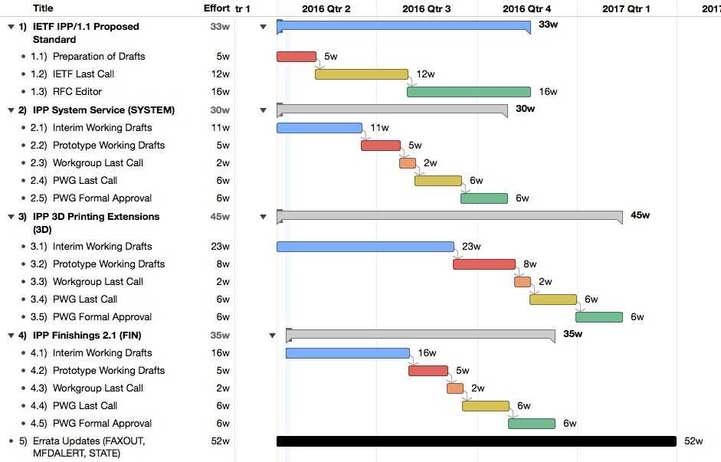
Next Steps
®
Copyright © 2016 The Printer Working Group. All rights reserved. The IPP Everywhere and PWG logos are registered trademarks of the IEEE-ISTO.

Slide 23
Next Steps
®
Advance IPP/1.1 to IETF Proposed Standard
IETF Last Call in Q2/Q3 2016
IETF process to advance to Internet Standard once published...
IPP System Service
Prototype working draft in Q2/Q3 2016
IPP 3D Printing Extensions
Prototype working draft in Q3 2016
IPP Finishings 2.1
Prototype working draft in Q3 2016
IPP Transform Service v1.0?
Other errata (IPP State, etc.)?
Copyright © 2016 The Printer Working Group. All rights reserved. The IPP Everywhere and PWG logos are registered trademarks of the IEEE-ISTO.

Slide 24
More Information
®
We welcome participation from all interested parties
IPP Working Group web page
http://www.pwg.org/ipp/index.html
Subscribe to the IPP mailing list
https://www.pwg.org/mailman/listinfo/ipp
IPP WG holds weekly phone conferences announced on the IPP mailing list
Next conference calls May 9, 2016 at 3pm ET and May 16, 2016 at 4pm ET to discuss 3D Printing
Copyright © 2016 The Printer Working Group. All rights reserved. The IPP Everywhere and PWG logos are registered trademarks of the IEEE-ISTO.

