Slide 1
New IPP Attributes Proposal
Rick Yardumian, Canon Inc.
Smith Kennedy, HP Inc.
2019-06-20

Slide 2
Attributes to be added to IPP standard
Following slides present new attributes that Canon proposes to add onto the Standard IPP attributes to give more control in IPP printing.
June 20, 2019 update (original April 17, 2019)

Slide 3
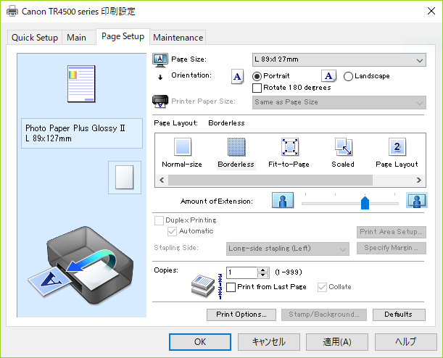
Borderless adjustment setting
Amount of extension
At the time of borderless printing, white margins may possibly be printed at the border area due to paper skew. This setting is to suppress that possible white margin. If it is set larger, more coverage is guaranteed. If you want to reduce the image loss, make it smaller.
The setting is valid only when the margin of media-col = 0 (no border).
Notes:
Smith Kennedy thinks the proposal to create a "media-overbleed (integer)" and "media-overbleed-supported (1setOf integer)" might do the trick. We need to be conscious of the semantics of this as it relates to other attributes that also affect the dimensions of the actual imaged area vs. the imageable area.
What would the units be for “media-overbleed (integer)“?
Do we need a "media-overbleed-type (type2 keyword)" that specifies "scaling" vs. "extension" so that the hint of how the printer should deal with the "negative margins" is handled?

Slide 4
Borderless adjustment setting
Solution from April F2F: The Printer perform the "borderless overbleed"
  Relieves the Client and App from having to deal with another (awkward) media size variant
New attributes
  "media-overbleed (integer)" / "media-overbleed-supported (1setOf integer)"
    How far to "overbleed"
      Units? "PWG Units" .01mm
  "media-overbleed-type (type2 keyword)"
    'scaling': Have the Printer scale up to reach the target overbleed value
    'extension': Have the Printer extend the border pixels to reach the target overbleed

Slide 5
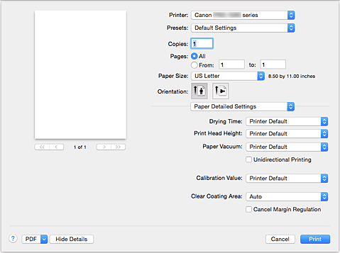
Unidirectional Printing
Unidirectional Printing
In long format printing, uneven coloring and line shifts may happen during printing.
Unidirectional printing works to avoid that problem.
Notes:
Smith Kennedy suggests this could be implemented using one of the new custom print quality extensions in my latest whitepaper. Canon agrees with this proposal.

Slide 6
Unidirectional Printing
Solution from April F2F: Map this to occur when one of the supported "print-quality" enums is chosen by the user
IPP Print Quality Customizations extensions to "print-quality" and related IPP additions would allow a custom label to be presented to the user.

Slide 7
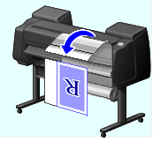
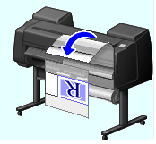
Eliminate Upper and Lower Margins
R
Eliminate the margins
When printing on roll paper, a user can save paper by eliminating the upper and lower margins when printing with this setting.
R
Notes:
- HP (Smith Kennedy) has their own vendor driver instruction to tell the printer to do this, but HP would like a standard IPP solution for this. It could be called "minimize-whitespace (integer)", where the integer is the new margin, and "minimize-whitespace-supported (rangeOfInteger)" or "minimize-whitespace-supported (1setOf integer)" could convey the margins to be added after the whitespace has been eliminated?
- What about the removal of left / right margins? That gets tricky? Is that important to Canon? (HP might like that but I'm worried about complexity...)

Slide 8
Eliminate Upper and Lower Margins
"minimize-whitespace (integer)"
  Value is the new margin after all whitespace has been trimmed
"minimize-whitespace-supported (rangeOfInteger)" or "minimize-whitespace-supported (1setOf integer)"
  Specifies the range or set of margin values selectable by the user
Q: What about the removal of left / right margins? Does that start to make things tricky and overly complex?
Canon does not need left/right margin removal.
Canon suggests making the attribute a boolean rather than integer, i.e. “eliminate-margins”. Please see the next three slides for a usage example. Note that both media-top-margin & media-bottom-margin are removed as well as media content margins.

Slide 9
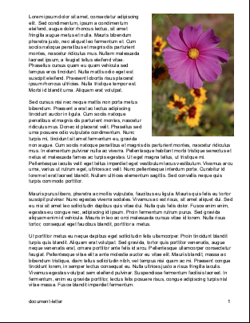
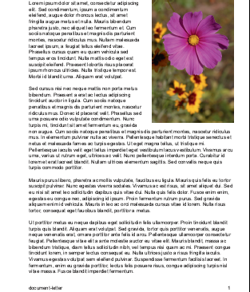
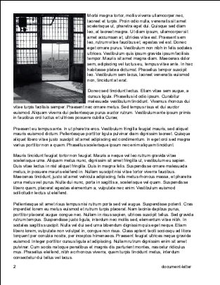
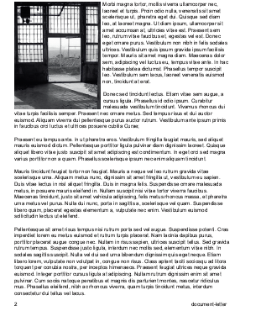
What “eliminate-margins” feature does?
“Eliminate Upper and Lower Margins” is to eliminate
role paper wasting. Client sends the command for job unit,
and the printer controls the paper feed in that manner
(to eliminate the white margins) for every page in the job.
Eliminate margins
Roll paper cut maybe controlled separately by another
IPP Attribute, likely finishing-col.
Similarly to Eliminate margins, the paper cut is performed
for every page once finishing-col is issued at the
beginning of the job. See the page 4.
Original
Document
Printed
pages

Slide 10
How it determines the margins to eliminate?
(In other words, how the printer controls paper feed.)
①
Stop paper feed for the white lines length which is specified by IPP standard protocol as Top margin.
(The length is notified from the printer by standard IPP protocol in advance.)
②
Stop paper feed for the following white lines until any non-white line comes.
③
Suspend paper feed for the white lines until the next non-white line comes. When the next non-white line comes, resume the suspended paper feed to fill the lines.
④
Original
Document
Printed
pages
Stop paper feed for the white lines length which is specified by IPP standard protocol as Bottom margin.

Slide 11
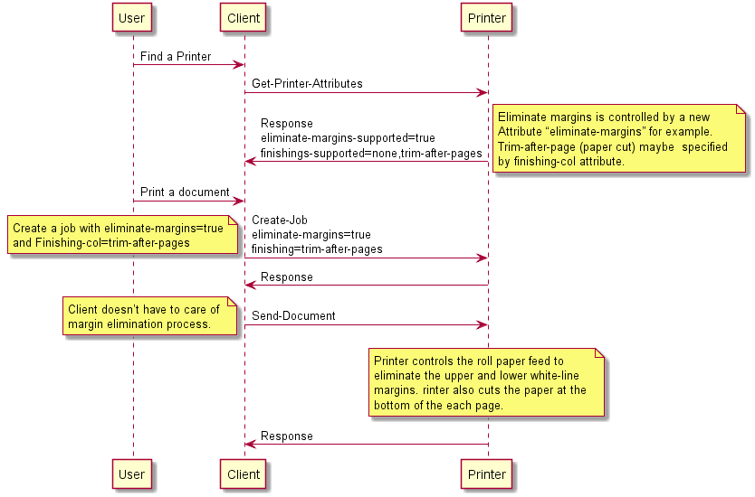
Expected new IPP attribute (example)
Expected new IPP attribute (example)

Slide 12
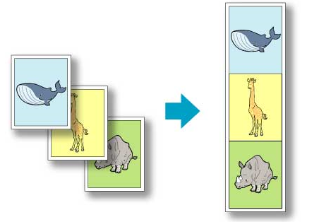
Banner printing
Banner printing
When printing on roll paper, a user can print multiple pages as a single continuous image without margins between pages with this setting.
Notes:
At the last F2F, Michael Sweet suggested using finishings-col/trimming/trimming-when and trimming-offset to adjust the border.
Smith Kennedy is not sure he agrees with the F2F assessment. Although the finishings-col stuff would work, it won't eliminate the whitespace gaps in between the pages if they have been imaged to a media size that has margins greater than zero. So I think a "banner-print-pages (boolean)" hint could tell the printer to collapse the top and/or bottom margins to zero for adjacent pages in a multi-page document. The problem isn't just about trimming, it is about the "media-size" and their margins as well, and how that is rendered to paper.

Slide 13
Banner printing
"banner-print-pages (boolean)"
  Hint instructing the Printer to collapse the top and/or bottom margins to zero for adjacent pages in a multi-page document.
Discussed solution at April F2F suggested that this could be solved using finishings-col and trimming. But this is more about collapsing adjacent pages' adjoining margins. Trimming or any finishing operation is orthogonal to this feature.
Banner Printing does not eliminate content margins like the Eliminate Top and Bottom Margins feature does. Banner Printing only eliminates IPP defined media-top-margin and media-bottom-margin between pages. Banner Printing keeps the media-top-margin of the first page and the media-bottom-margin of the last page in the job.

Slide 14

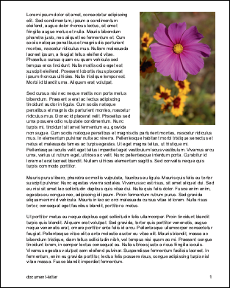
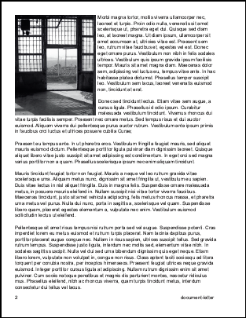
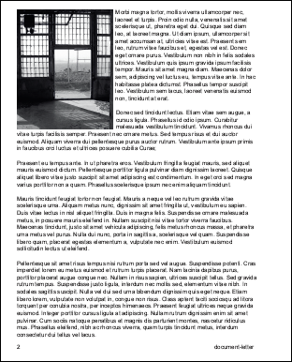
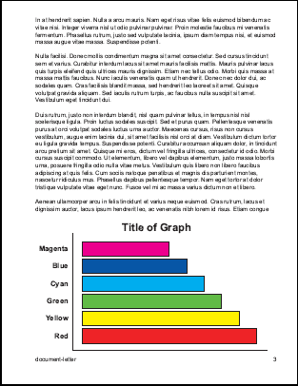
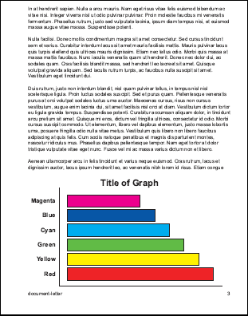
What “Banner Printing” feature does?
Leave the top margin
of 1st page.
join
Cut the white lines length which is specified by IPP standard protocol as top/bottom margin.
Original Document
Banner Printing
join
Leave the bottom margin
of the last page.

Slide 15
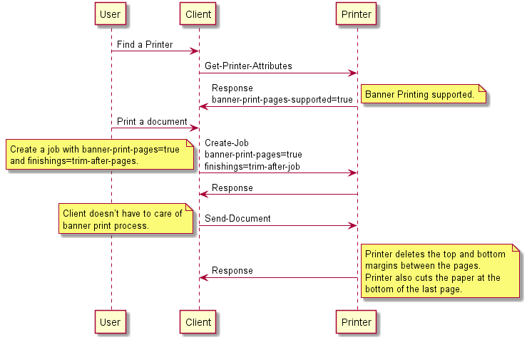
Expected new IPP attribute (example)

Slide 16



Image Composite print
Output
original
Stamp
Page
date
frame
IPP
Feb. 18th
Confidential
- 1 -
Image Composite print
This is to overlay other images, for example stamp, page number, date stamp, border line, onto the original image at the printer side before printing.
This function became a basic function recently so should be handled by IPP as well.
Notes:
At the last F2F it was suggested using IPP imposition-template but Canon does not understand how that helps. Current IPP imposition-template values are “none” and “signature” where signature means do a printer dependent function.
Does anyone do this in the printer or do most companies do this in the client driver (or content creating application?
Does anyone have suggestions for how to implement this?

Slide 17
Image Composite print
Printer vendors typically support this in their vendor drivers (or in content creating applications in some cases)
@ April F2F extending "imposition-template" was suggested as a possible solution but Canon and HP do not understand what that would look like.
  Current IPP imposition-template values are “none” and “signature” where signature means do a printer dependent function.
  How is this supposed to work? Contributions?

Slide 18
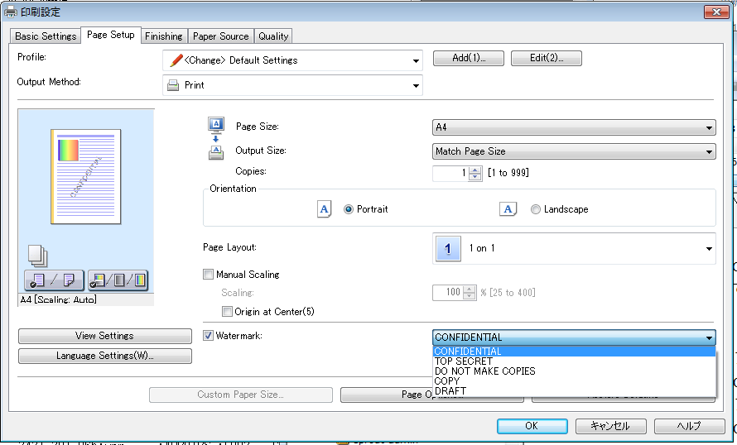
Example 1 of composite print
Stamp (Watermark)

Slide 19
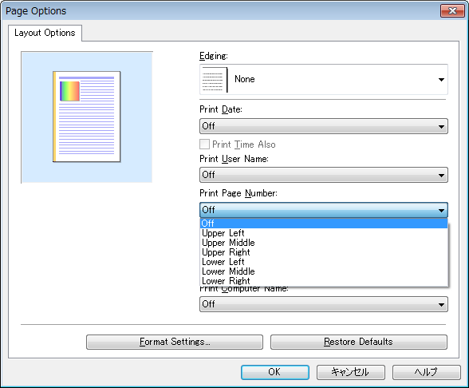
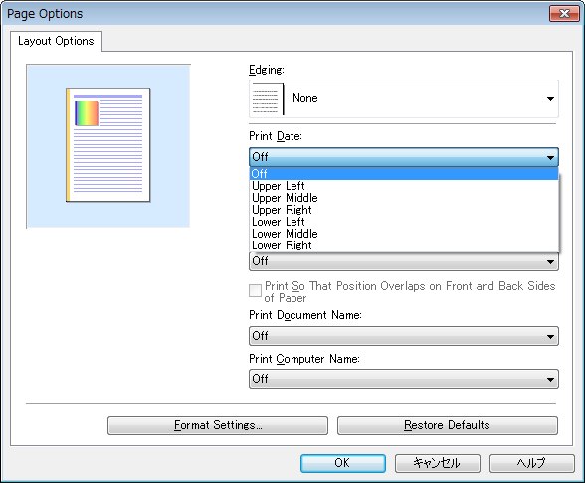
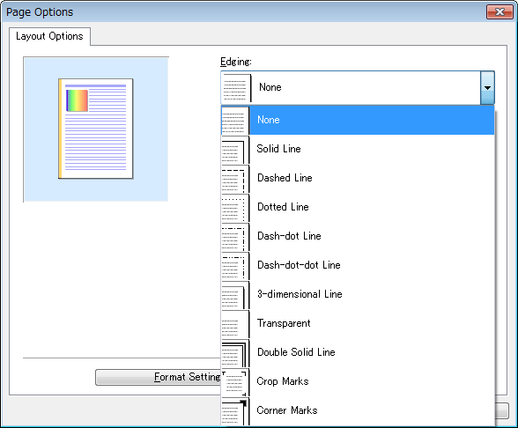
Example 2 of composite print
Page
Date
Frame(Edging)

Slide 20
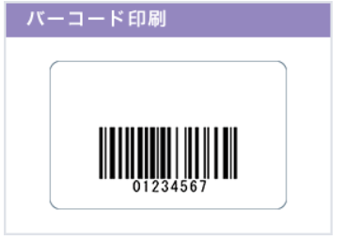
Special print mode
Special print mode
The printer setting includes a special print mode which adjusts print process at printer side according to the printing object. For example, there is a special process for correcting and printing thin lines, and a function used to print small characters and bar codes clearly. It is useful if this can be controlled by standard IPP attributes.
However, there are various print modes depending on the printers. So it would be useful if we could have one general attribute which can handle the variations (TBD).
Notes:
- This needs to be done on an object basis which is of course more complicated that doing it on a page basis. I think PDF supports object tagging but currently PWG Raster does not.
Canon agrees with Smith Kennedy’s suggestion that the proposed "print-quality-hints-supported" might be the best way to support vendor instructions for this and similar niche features.
Note that IPP already has a “print-content-optimize” attribute usable on a page or job basis. Current values are ‘photo’, ‘graphics’, ‘text’, and ‘text-and-graphics’ defined in “IPP: Job Extensions” (5100.7-2003) and ‘auto’ defined in “IPP: Job and Printer Extensions Set 3” (5100.13-2012).

Slide 21
Special print mode
Rendering different objects on a per-object basis (?)
  Do we need more examples?
  Document format needs to support "object tagging" to indicate different content types (already supported in PDF, not yet supported in PWG Raster or other raster image types)
  IPP needs to support attributes to indicate a "print-color-mode" (e.g. color, monochrome, process-monochrome) on a per-object granularity
    “print-content-optimize” attribute (5100.7 and 5100.13) works on a page or job basis
The "print-quality-hints-supported" proposed in IPP Print Quality Customizations might be the best way to support other unique vendor instructions for this and similar niche features
Canon is OK with applying special print mode on a page and/or job basis. Per-object basis not needed.

