Slide 1
Attributes to be added to IPP standard
Following slides present the attributes that Canon propose to add onto the Standard IPP attributes to give more control in IPP printing.
April 17, 2019

Slide 2
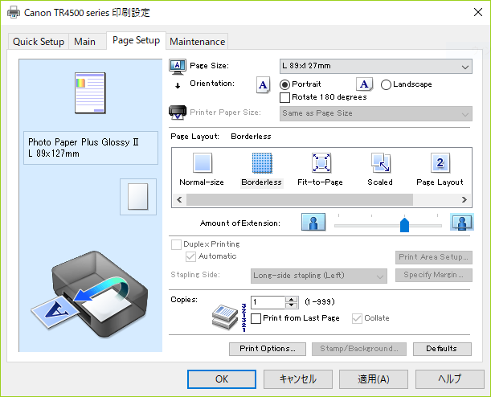
Borderless adjustment setting
Amount of extension
At the time of borderless printing, white margins may possibly be printed at the border area due to paper skew. This setting is to suppress that possible white margin. If it is set larger, more coverage is guaranteed. If you want to reduce the image loss, make it smaller.
The setting is valid only when the margin of media-col = 0 (no border).

Slide 3
Unidirectional Printing
Unidirectional Printing
In long format printing, uneven coloring and line shifts may happen during printing.
Unidirectional printing works to avoid that problem.

Slide 4
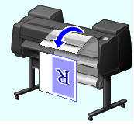
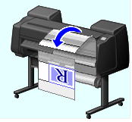
Eliminate Upper and Lower Margins
R
Eliminate the margins
When printing on roll paper, a user can save paper by eliminating the upper and lower margins when printing with this setting.
R

Slide 5
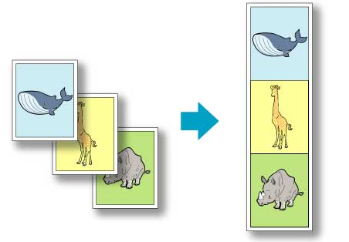
Banner printing
Banner printing
When printing on roll paper, a user can print multiple pages as a single continuous image without margins between pages with this setting.

Slide 6
Image Composite print
Output
original
Stamp
Page
date
frame
IPP
Feb. 18th
Confidential
- 1 -
Image Composite print
This is to overlay other images, for example stamp, page number, date stamp, border line, onto the original image at the printer side before printing.
This function became a basic function recently so should be handled by IPP as well.

Slide 7
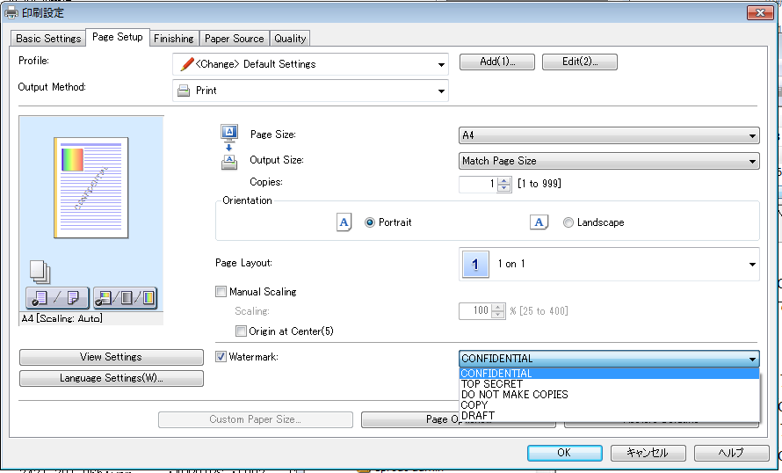
Example 1 of composite print
Stamp (Watermark)

Slide 8
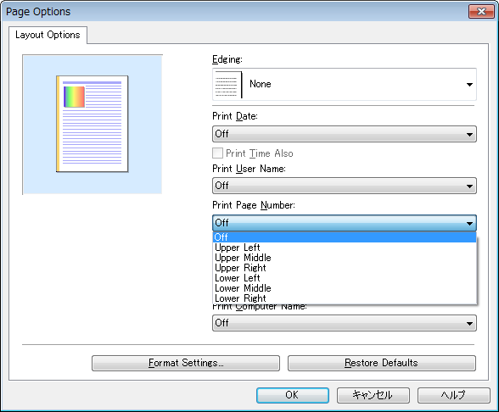
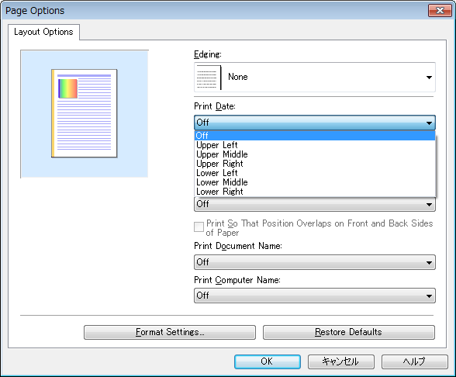
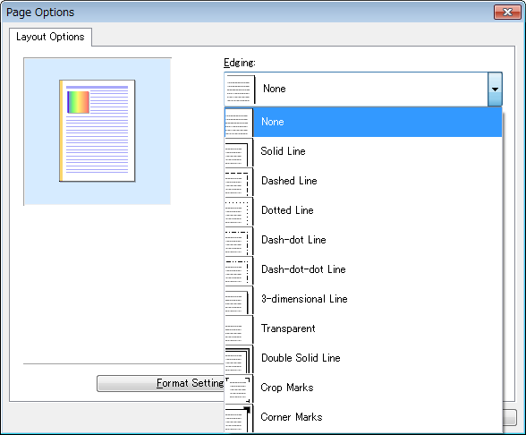
Example 2 of composite print
Page
Date
Frame(Edging)

Slide 9
Special print mode
Special print mode
The printer setting includes a special print mode which adjusts print process at printer side according to the printing object. For example, there is a special process for correcting and printing thin lines, and a function used to print small characters and bar codes clearly. It is useful if this can be controlled by standard IPP attributes.
However, there are various print modes depending on the printers. So it would be useful if we could have one general attribute which can handle the variations (TBD).

