Slide 1

Imaging Device Security
The Printer Working Group
August 12, 2015
Sharp
Camas, WA
Copyright © 2015 The Printer Working Group. All rights reserved.
1

Slide 2

Agenda
When | What
August 12
1:30 – 1:45 | Introductions, Agenda review, Status (Alan)
1:45 – 2:00 2:00 – 2:30 2:30 – 3:00 3:00 – 3:15 3:15 – 3:30 | Review Action Item List (Alan) Prototype Overview (Dr. Andreas Steffen, HSR) HCD-TNC Stable draft WG Review (Ira) Break TGC Spec Overview/Developments (Ira)
3:30 – 4:00 | Common Criteria Update (Brian)
4:00 – 5:00 | Future of IDS WG, Next Steps and Wrap-Up
Copyright © 2015 The Printer Working Group. All rights reserved.
2

Slide 3
Intellectual Property Policy
  “This meeting is conducted under the rules of the PWG IP policy”.
    Refer to the IP statements in the plenary slides
    If you don’t agree, you can visit historic Downtown Camas
Copyright © 2015 The Printer Working Group. All rights reserved.
3

Slide 4
Officers
Chair:
  Alan Sukert (Xerox)
Vice-Chair:
  Currently: Vacant
Secretary:
  Alan Sukert (Xerox)
Document Editors:
  Ira McDonald (High North): HCD-TNC
  IDS-Model
  Alan Sukert (Xerox): IDS-Model
  IDS-IAA
Copyright © 2015 The Printer Working Group. All rights reserved.
4

Slide 5
Document Status
Active Documents
HCD-TNC Binding (Stable)
  Updated Stable Draft
http://ftp.pwg.org/pub/pwg/ids/wd/wd-idstnc10-20150803.pdf
IDS-Model (Interim)
  Define core IDS security model and integrate into SM3
    Security Actors, Objects, Roles and Types
    Define Security Ticket XML Schema
    Define Security operations (WSDL)
ftp://ftp.pwg.org/pub/pwg/ids/wd/wd-ids-model10-20150429.pdf
IDS-IAA (Interim)
  Phase 1 - Subset version to address Actor an Object privileges and permissions
ftp://ftp.pwg.org/pub/pwg/ids/wd/wd-ids-iaa10-20150201.pdf
Copyright © 2015 The Printer Working Group. All rights reserved.
5

Slide 6
Document Status
Pending Documents
IDS Health Remediation (Interim)
ftp://ftp.pwg.org/pub/pwg/ids/wd/wd-ids-remediation10-20100930.pdf
Copyright © 2015 The Printer Working Group. All rights reserved.
6

Slide 7
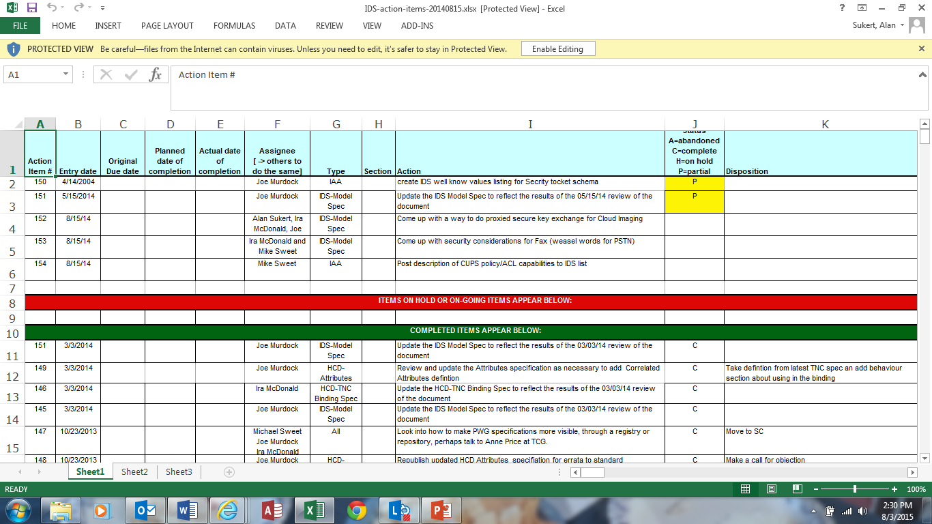
Action Item Review
Copyright © 2015 The Printer Working Group. All rights reserved.
7

Slide 8
Document Review/Status
HCD-TNC (Stable for Final WG Review)
http://ftp.pwg.org/pub/pwg/ids/wd/wd-idstnc10-20150803.pdf
NCD-TNC Prototype Report (Dr. Andreas Steffan, HSR)
HCD-TNC Stable Draft WG Review (Ira)
Copyright © 2015 The Printer Working Group. All rights reserved.
8

Slide 9
Common Criteria Update
PP development status and schedule:
  We are resolving the last two dozen open issues, through August 21.
  August 24~28: Final edits before consistency review.
  August 31~September 4: NIAP consistency review.
  September 8~10: Final edits after consistency review.
  September 11: Publish.
TC Meetings:
  There are two scheduled F2F meetings in Windsor, Friday September 18 (1 hour, planning), and Monday, September 21 (3 hours, technical).
    Had hoped that the planning session would include US, JP, and KR schemes, but due to CCRA meeting schedules, they may need to meet sometime during ICCC instead of during the CCUF Workshops. Purpose would be about creating an iTC for developing a HCD cPP.
    Don't know what we will discuss during the technical session.
  Sometime after ICCC, will report on CC status during an IDS teleconference.
Copyright © 2015 The Printer Working Group. All rights reserved.
9

Slide 10
Future of IDS Working Group
Should IDS WG remain as a separate working group or be folded into one of the other working groups (e.g., IPP or SM)?
  What value are we bringing to the companies we represent?
  What do the companies we represent expect from us?
  Do we have sufficient work to stay as a separate WG?
If we remain as a separate WG:
  What projects/specs should we or do we need to take on?
  Who will edit any new/updated specs (goal is 2 editors/spec)?
  Who will take on the leadership roles for the WG?
  How will we prototype any new/updated specs?
Copyright © 2015 The Printer Working Group. All rights reserved.
10

Slide 11
Future Activities
Future of the IDS Working Group
IDS TNC Binding Specification
      Start PWG Last Call
Obtain new IDS Vice-Chair and Secretary
Update IDS Charter
IDS Model specification
  Finalize Actor and Object roles
  Complete documentation of Security Ticket top-level elements
  Complete specification
IDS Identification, Authentication and Authorization specification
  Phase 1 - Definition of core set of Policy Attributes
    Access control values
MFP Technical Community - monitor progress of Protection Profile work
Resume IDS Health Remediation ????
Copyright © 2015 The Printer Working Group. All rights reserved.
11

Slide 12
Wrap Up
Review of new action items and open issues
IDS Conference Call schedule
  Next IDS Conference Call tentatively August 31, 2015
  Next IDS Face-to-Face Nov 3-5, 2015 in Lexington KY (Lexmark)
Copyright © 2015 The Printer Working Group. All rights reserved.
12

