Slide 1

Imaging Device Security
The Printer Working Group
November 17, 2022
PWG November 2022 Virtual Face-to-Face
Copyright © 2022 The Printer Working Group. All rights reserved.
1

Slide 2

Agenda
When | What
10:00 – 10:05 | Introductions, Agenda review
10:05 – 11:00 | Discuss results of latest HCD iTC Meetings and HCD cPP/SD v1.0 status
11:00 – 11:25 | ASTM ICAM 2022 Presentation Summary
11:25 – 11:30 | HCD Security Guidelines v1.0 Status
11:30 – 11:55 | TCG/IETF Liaison Reports
11:55 – 12:00 | Wrap Up / Next Steps
Copyright © 2022 The Printer Working Group. All rights reserved.
2

Slide 3
Antitrust and Intellectual Property Policies
  “This meeting is conducted under the rules of the Antitrust and PWG IP policies”.
    Refer to the Antitrust and IP statements in the plenary slides
Copyright © 2022 The Printer Working Group. All rights reserved.
3

Slide 4
Officers
Chair:
  Alan Sukert
Vice-Chair:
  TBD
Secretary:
  Alan Sukert
Document Editor:
  Ira McDonald (High North) – HCD Security Guidelines
Copyright © 2022 The Printer Working Group. All rights reserved.
4

Slide 5
HCD international Technical Community (iTC) Status
Copyright © 2022 The Printer Working Group. All rights reserved.
5

Slide 6
HCD international Technical Community (iTC)
Since last IDS F2F on August 18, 2022 HCD iTC meetings have been held on:
  August 22nd, 29th
  September 12th, 19th, 21st, 26th, 28th
  October 3rd, 10th, 17th, 24th, 26th, 31st
  November 7th, 10th
Copyright © 2022 The Printer Working Group. All rights reserved.
6

Slide 7
HCD cPP/SD Status
HCD cPP V1.0 published on October 31, 2022
 | Internal Drafts | 1st Public Draft | 2nd Public Draft | Final Draft | Total
Comments against Security Problem Definition - 19 All were accepted |  |  |  |  | 19
Accepted | 161 | 70 | 56 | 52 | 339
Accepted in Principle | 3 | 0 | 0 | 1 | 4
Deferred | 16 | 1 | 10 | 2 | 29
Not Accepted | 11 | 14 | 17 | 3 | 45
Not Adjudicated | 0 | 0 | 0 | 0 | 0
Total | 191 | 85 | 83 | 58 | 436
Copyright © 2022 The Printer Working Group. All rights reserved.
7

Slide 8
HCD cPP/SD Status
HCD SD V1.0 published on October 31, 2022
 | Internal Drafts | 1st Public Draft | 2nd Public Draft | Final Draft | Total
Accepted | 57 | 24 | 25 | 34 | 140
Accepted in Principle | 1 | 0 | 1 | 1 | 3
Deferred | 15 | 2 | 0 | 1 | 18
Not Accepted | 1 | 2 | 3 | 2 | 8
Not Adjudicated | 0 | 0 | 0 | 0 | 0
Total | 74 | 28 | 29 | 38 | 169
Copyright © 2022 The Printer Working Group. All rights reserved.
8

Slide 9
HCD cPP/SD Status
Key Issues Resolved in HCD cPP V1.0 from Final Draft
Added missing Auditable Events for the Selection-Based SFRs
Corrected the Auditable Events table for SFR FAU_GEN.1 Audit data generation to indicated there is no additional information needed for SFR FMT_SMF.1 Specification of Management Functions
Corrected the description of Required Use Cases of HCDs to indicate that, for auditing purposes, the HCD has the capability to protect audit logs for unauthorized disclosure or alteration” while in transit to an external IT product and, if stored in the HCD, while stored
Corrected the description of the Optional Use Cases of HCDs to clarify that (1) this section is about wiping data and (2) that the capability to make all customer data that may be present in the HCD unavailable for recovery if it is removed from the Operational Environment is not dependent on fata being encrypted and its cryptographic keys destroyed
Clarified that for the Storage Encryption Organizational Security Policy, destroying keys is mandatory
Corrected the Security Objectives Tables to add the missing threats for security objective O.AUTH_FAILURES and the missing mapping between T.UNAUTHORIZED_ACCESS and O.AUTH_FAILURES
Copyright © 2022 The Printer Working Group. All rights reserved.
9

Slide 10
HCD cPP/SD Status
Key Issues Resolved in HCD cPP V1.0 from Final Draft
Moved SFR FCS_CKM.1/AKG Cryptographic Key Generation (Asymmetric Keys) from an Optional to a Mandatory SFR
Made ‘remote audit server’ a mandatory selection in SFR FTP_ITC.1 Inter-TSF trusted channel, elements FTP_ITC.1.1 and FTP_ITC.1.3
Removed ‘AES GCM-192’ as a selection option in SFR FCS_IPSEC_EXT.1.6 to comply with NIAP Technical Decision TD0657
Modified SFR FPT_KYP_EXT.1 Extended: Protection of Key and Key Material to clarify what the requirements and Application Note should be for an initial key and clarify what some of the conditions where keys can be stored are
Removed references to “Distributed TOEs” in the document because the HCD cPP does not include any requirements for Distributed TOEs
Included the SFR Dependencies Analysis requested by the Japanese Scheme JISEC
Corrected multiple uses of improper SFR nomenclature throughout the document
Implemented a consistent convention for bolding of SFRs, a consistent use of the term “Extended” for the Extended Components throughout the document and a consistent convention for listing and linking references
Copyright © 2022 The Printer Working Group. All rights reserved.
10

Slide 11
HCD cPP/SD Status
Key Issues Resolved in HCD SD V1.0 from Final Draft
Provided necessary clarifications to the KMD, Guidance and Test Assurance Activities, as applicable, for the following SFRs:
FCS_CKM.4 Cryptographic key destruction regarding selections mentioned in the text
FCS_COP.1/CMAC Cryptographic Operation (for cipher-based message authentication) regarding no KMD and Guidance assurance activities required for this SFR
FPT_WIPE_EXT.1 Data Wiping regarding cryptographic erasing of data and in Test 6 to add clarification that searches for test strings are being performed on storage in unlocked state (i.e., on plaintext data being decrypted on access) and not in ciphertext data
FCS_COP.1/DataEncryption Cryptographic Operation (Data
Encryption/Decryption) regarding the content of the AES-CTR Monte-Carlo Test tests
FCS_TLSS_EXT.2.1 and FCS_TLSS_EXT.2.2 regarding the contents of Test 1b
FCS_CKM.4 Cryptographic key destruction regarding the contents of Test 1
FDP_DSK_EXT.1 Extended: Protection of Data on Disk to provide a better description of what is meant by “special tools which allow inspection of the encrypted drive either in-band or out-of-band” in the Tests
Copyright © 2022 The Printer Working Group. All rights reserved.
11

Slide 12
HCD cPP/SD Status
Key Issues Resolved in HCD SD V1.0 from Final Draft
Provided necessary clarifications to the KMD, Guidance and Test Assurance Activities, as applicable, for the following SFRs:
FPT_TST_EXT.1 Extended: TSF testing to provide additional clarification of how to induce self-test errors to the TOE as part of the tests so an evaluator can use debug version or modified firmware to achieve a failing verdict.
FPT_SBT_EXT.1 Extended: Secure Boot to clarify that the tests are modifying each stage in the boot process, not each link in the Chain of Trust.
FPT_KYP_EXT.1 Extended: Protection of Key and Key Material to clarify (1) what is required of the evaluator (and how it can be done) for determining that the key is not in the key chain and (2) what is required of the evaluator for determining that the key is stored in the protected storage device
Moved assurance activities that were improperly placed into their proper Assurance Activity category (TSS, KMD, Guidance or Test as appropriate) for the following SFRs:
FDP_DSK_EXT.1 Extended: Protection of Data on Disk
FCS_CKM.1/SKG Cryptographic key generation (Symmetric Keys)
Copyright © 2022 The Printer Working Group. All rights reserved.
12

Slide 13
HCD cPP/SD Status
Key Issues Resolved in HCD SD V1.0 from Final Draft
For SFR FCS_CKM.1/SKG Cryptographic key generation (Symmetric Keys), modified the Test assurance activities so that they are consistent with the SFR and require that the evaluator follows the operational guidance to ensure that a communication channel can be initiated from authorized IT entities as well as from the TOE
Modified SFR names for the extended components to be consistent with the nomenclature used in the HCD cPP
Added a note to the SFR FPT_SBT_EXT.1 Extended: Secure Boot Test assurance activities saying that the algorithm verification for Root of Trust should be avoided, because authenticity check in Root of Trust should be performed by some kind of immutable code, so the algorithm verification tests should be difficult to perform
Added the following note to the Test assurance activities section for all the cryptographic SFRs that are dependencies to the FPT_SBT_EXT.1 Extended: Secure Boot SFR - “NOTE: The tests detailed below are not required to be performed for cryptographic functions implemented in the Root of Trust for Secure Boot (FPT_SBT_EXT.1).”
Copyright © 2022 The Printer Working Group. All rights reserved.
13

Slide 14
HCD iTC Status
Original Proposed HCD cPP/SD Schedule – 2/9/21
Phase | Timeframe | Description
Resolve ESR Issue and Approve SPD | Resolve ESR issue: 2/26 Update ESR: 3/1 – 3/12 Update SPD: 3/1 – 3/12 Submit ESR changes to HCD WG (if needed): 3/15 HCD WG Review and comment: 3/15 – 4/9 Submit SPD for public review: 3/15 SPD Public review: 3/15 – 4/16 Update SPD and update cPP/SD: 3/29 – 4/16 | Assume get response back from HCD WG in no more that 30 days
Internal Draft | Submit 3rd internal draft: 4/19 Review 3rd internal draft: 4/19 – 5/14 Review comments & update documents: 5/17 – 6/11 | Assume approval of ESR changes
Public Review Draft 1 | Submit 1st Public Draft: 6/14 Review 1st Public Draft: 6/14 – 7/23 Review comments and update documents: 7/26- 9/17 | Must include all new SFRs that want to include in v1.0
Public Review Draft 2 | Submit 2nd Public Draft: 9/20 Review 2nd Public Draft: 9/20 – 10/29 Review comments and update documents: 11/1 – 12/3
Final Draft | Submit Final Draft: 12/6 Review 2nd Public Draft: 12/6/21 – 1/14/22 Review comments and update documents: 1/17/22 – 2/11/22
Final Document Published | Publish Version 1.0: 2/14/22
Copyright © 2022 The Printer Working Group. All rights reserved.
14

Slide 15
HCD iTC Status
HCD cPP/SD Schedule Status Update
Phase | Timeframe | Status Updates
Resolve ESR Issue and Approve SPD | Resolve ESR issue: 2/26 DONE Update ESR: 3/1 – 3/12 NOT NEEDED Update SPD: 3/1 – 3/12 DONE Submit ESR changes to HCD WG (if needed): 3/15 NOT NEEDED HCD WG Review and comment: 3/15 – 4/9 NOT NEEDED Submit SPD for public review: 5/10 DONE SPD Public review: 5/10 – 6/4 DONE Update SPD: 6/7 – 6/25 DONE
Internal Draft | New Proposed Schedule Submit 3rd internal draft: 6/1 DONE Review 3rd internal draft: 6/1 – 6/18 DONE Review comments & update documents: 6/21 – 7/16 DONE
Public Review Draft 1 | New Proposed Schedule Submit 1st Public Draft: 8/18 (cPP); 8/30 (SD) Review 1st Public Draft: 8/18 – 10/12 (45d) Review comments and update documents: 10/13-12/10 (60d) | Was 7/19 on original schedule Note: 1st Public Draft of HCD cPP released on 8/30 – Comment end date 10/8 DONE 1st Public Draft of HCD SD released on 10/13 – Comment end date 11/15 DONE
Copyright © 2022 The Printer Working Group. All rights reserved.
15

Slide 16
HCD iTC Status
Updated Proposed HCD cPP/SD Schedule
Phase | Timeframe | Status Updates
Public Review Draft 2 | New Proposed Schedule (3/29/2022) Submit 2nd Public Draft: 12/14 DONE Review 2nd Public Draft: 12/15 – 1/31/22 (49d) DONE Review comments and update documents: 1/31/1/22 – 5/13/22(60d) DONE | HCD cPP 2nd Public Draft released 12/14 - DONE Comments Received by 1/31/22 - DONE HCD SD 2nd Public Draft Planned Release 12/13 – Released 2/24/22 DONE Comments due by 3/18/22 (~one month)
Final Draft | New Proposed Schedule (as of 7/14/22) Submit Final Draft: 6/13/22 -> 7/18/22 DONE Review Final Public Draft: 7/19/ – 8/22 (28d) DONE Review comments and update documents: 8/23/22 – 9/6/22 (10d) DONE | Final Drafts of HCD cPP and HCD SD submitted for Public Review on 8/1/22; Comments received by 9/15/22 All comments received were addressed and several updated drafts of each document were created up through 10/28/22
Final Document Published | New Proposed Schedule (as of 7/14/22) Publish Version 1.0: 8/2/22 -> 9/7/22 DONE | Was 3/25/22 on original schedule Because of the technical nature of some of the Final Draft comments it took 1-1/2 months to address all the issues raised. “Final” version of each document was created dated 10/31/22 and published on 10/31/22
Copyright © 2022 The Printer Working Group. All rights reserved.
16

Slide 17
HCD cPP/SD
Current Parking Lot Issues – HCD cPP
Addressing hardware-based Roots of Trust stored in mutable memory as well as immutable memory
Clarification that the Secure Boot SFR only requires verification of firmware/software that is stored in mutable memory at boot time and does not require verification of firmware/software stored in immutable memory
Comments that require implementation of TLS 1.3 to resolve
Support for NTP
  Addition of 3 TLS cipher suites required per NIAP Technical Decision TD422
  Add a selection in FCS_COP.1/SigGen for IKEv1 RSA schemes
  Removal of support for:
    TLS 1.1
    SHA-1 support
    Cipher suites with RSA Key Generation with keys < 2048 bits
    All RSA and DHE Key Exchanges
Copyright © 2022 The Printer Working Group. All rights reserved.
17

Slide 18
HCD cPP/SD
Current Parking Lot Issues – HCD SD
Correcting TSS Assurance Activities for SFR FCS_CKM.4 Key Destruction
Correcting Test 2 for SFR FCS_CKM.4 Key Destruction to provide a valid test for where the data read operation would fail
Clarification of TSS Assurance Activities for SFR FIA_X509_EXT.2 X.509 Certificate Authentication
Copyright © 2022 The Printer Working Group. All rights reserved.
18

Slide 19
HCD cPP/SD Issues Post-Version 1.0
Implementing the HCD Interpretation Team (HIT)
Agree on the HIT process and the HIT procedures which will describe how the HIT will operate
  Draft procedures under review by the full HCD iTC
  Need to create any necessary artifacts such as the Request for Interpretation (RfI) form and how to track RfI status
Agree on who will initially be on the HIT
Agree on the various roles needed for the HIT and who will fill those roles, especially who will be the Chair and Deputy Chair
Based on the agreed HIT process and procedures and the HIT members begin actual HIT activities
  Looking to have HIT implemented by end of February 2023
Copyright © 2022 The Printer Working Group. All rights reserved.
19

Slide 20
HCD cPP/SD Issues Post-Version 1.0
Developing release plan for future updates of the HCD cPP and HCD SD
      We will have major and minor releases
      What is the time frame between minor releases – every 9 -12 months, as needed, etc.
      What is the time frame between major releases – is it based on time (e.g., every 2 or 3 years), number of minor releases (e.g., a major release every 4 minor releases), volume of changes, number of new requirements/features added, a combination of these factors or something else
      What goes into a major or minor release – could be any or all of:
        Technical Decisions (TDs) approved by the HIT or Technical Recommendations (TRs) from the Interpretation Team that are approved by the full HCD iTC
        Applicable NIAP TDs
        Changes resulting from syncing with ND and FDE cPPs/SDs
        Requests from Schemes, especially JISEC, ITSCC and NIAP
        Response to new technologies, new crypto algorithms, new or updated standards or NIST SPs
        New or updated requirements/features
Copyright © 2022 The Printer Working Group. All rights reserved.
20

Slide 21
HCD cPP/SD Content Post-Version 1.0
Will very likely be in next version
Inclusion of support for TLS 1.3 and deprecation of TLS 1.1
Inclusion of NTP
Inclusion of AVA_VAN and ALC_FLR
Sync with key changes in ND cPP/SD v3.0 to be published in Oct 2022
  Incorporate NIAP SSH Package
Changes to comply with Commercial National Security Algorithm (CNSA) Suite 2.0 to address cryptanalytically relevant quantum computers (CRQCs)
Changes due to HCD Integration Team (HIT) responses to comments/questions to HCD cPP/SD v1.0
Changes due to requests from JISEC, ITSCC or NIAP
Updates to ISO/IEC 15408/18045 to be published by EOY 2022
  Adds new SFRs in Part 2 and pre-packaged PP and ST Assurance Activities in new Part 4
Incorporate NIAP IPsec and X.509 packages if they are available in time
Any implications of potential mutual recognition between CC and EUCC
Copyright © 2022 The Printer Working Group. All rights reserved.
21

Slide 22
HCD cPP/SD Content Post-Version 1.0
Potential for inclusion in next or later versions
Support for Wi-Fi and maybe Bluetooth
Support for Security Information and Event Monitoring (SIEM) and related systems
Updates due to changes from other ISO, FIPS or NIST Standards/Guidelines, NIAP TDs
CCDB Crypto WG, other CCUF Crypto WG Packages or NIAP TLS Package
Support for SNMPv3
Support for NFC
Support for new crypto algorithms
Indirect updates based on new technologies or customer requests
Expand to address 3D printing
Copyright © 2022 The Printer Working Group. All rights reserved.
22

Slide 23
HCD iTC Status
Key Next Steps
  Implement the HIT for maintaining HCD cPP/SD v1.0
  Agree on the HCD cPP/HCD SD release plan
  Determine the content for and then create the next HCD cPP/SD release (v1.1)
  Ensure that the HCD iTC continues to be fully engaged now that HCD cPP v1.0 and HCD SD v1.0 have been published
Copyright © 2022 The Printer Working Group. All rights reserved.
23

Slide 24
HCD iTC Status
More Lessons Learned to Date (My Take)
  I have said this before, but developing v1.0 of the HCD cPP and HCD SD in 2 years, 8 months is an accomplishment worth celebrating
  Input from Stakeholders is critical for success
  Feedback and buy-in from all vendor communities is also critical for success
  Setting an initial aggressive schedule is not advisable because it will never be met. Better to set a realistic schedule, and even that one will likely not be met
Copyright © 2022 The Printer Working Group. All rights reserved.
24

Slide 25
ASTM International Conference on Additive Manufacturing (ICAM) 2022 Presentation
Developing Common Criteria Based 3D Printing Equipment Cybersecurity Certification
Copyright © 2022 The Printer Working Group. All rights reserved.
25

Slide 26
What is Common Criteria?
The Common Criteria for Information Technology Security Evaluation (generally shortened to just Common Criteria (CC)) is an international standard (ISO/IEC Standard 15408-1:2009) for security certification of information security products.
Common Criteria standard is broken into 3 Parts:
      General Process Model (Part 1)
      Security Functional Requirements (SFRs) (Part 2)
      Security Assurance Requirements (SARs) (Part 3)
Is a Common Evaluation Methodology (CEM) document that defines how to apply CC to evaluate a product
CC is governed by a Common Criteria Recognition Arrangement (CCRA) signed by 31 countries
Copyright © 2022 The Printer Working Group. All rights reserved.
26

Slide 27
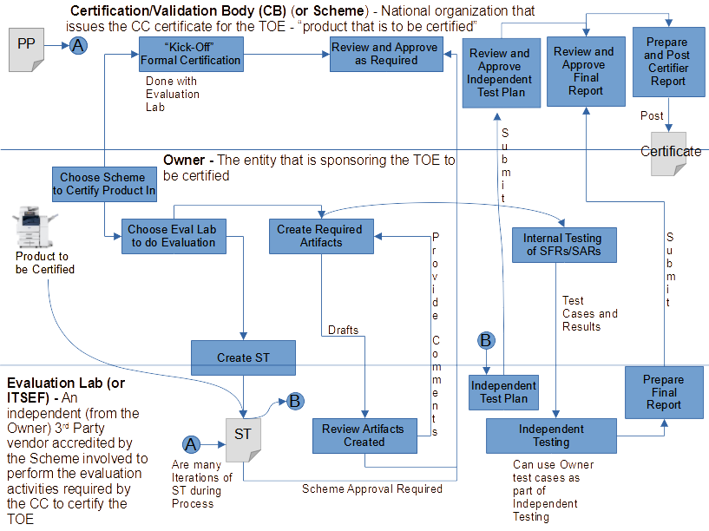
Common Criteria Certification Process
Copyright © 2020 The Printer Working Group. All rights reserved.
27

Slide 28
Results of the Common Criteria Process
Common Process is based on protection of assets. The concept is that:
    You determine what assets need to be protected
    Determine what are the threats that result in risks to these assets that need to be protected
    Determine what countermeasures in terms or security requirements and associated assurance activities are needed to either counteract or minimize the risks caused by the threats
The Common Criteria process is driven by three major components:
  Protection Profile (PP): Defines security a standard set of security functional requirements for a general type of product
  Security Target (ST): Defines a set of security functional requirements for a specific product to be certified
  Supporting Document (SD): Defines how the product is to be inspected and evaluated to determine it meets the security functional requirements defined in the PP or ST as applicable
End result of a CC Certification is assuring that the product being evaluated meets its requirements specification
Copyright © 2022 The Printer Working Group. All rights reserved.
28

Slide 29
HOW CAN COMMON CRITERIA BE APPLIED TO THE ADDITIVE MANUFACTURING PROCESS AND 3D PRINTING?
Copyright © 2022 The Printer Working Group. All rights reserved.
29

Slide 30
Common Criteria Certification of 2D Printers
    The industry has spent the last 17+ years developing the necessary infrastructure to perform Common Criteria Certifications on 2D printers – mostly Hardcopy Devices (HCDs) - that perform some combination of print/scan/copy/fax
    As part of this process we have identified the:
      Key Security Threats to HCDs (and 2D printers in general)
      Key Assumptions about the Operational Environment necessary so Key Threats can be mitigated
      Key Organizational Security Policies (OSPs) that have to be in place in an organization to support the security of HCDs
      Key security functions that the HCD has to perform to support the security of HCDs
Copyright © 2022 The Printer Working Group. All rights reserved.
30

Slide 31
Digital Thread for Additive Manufacturing
Copyright © 2022 The Printer Working Group. All rights reserved.
31

Slide 32
Digital Thread for Additive Manufacturing and Common Criteria Certification
Could the Common Criteria Certification process that was used to certify Hardcopy Devices be used to perform a similar security certification for the Digital Thread for Additive Manufacturing?
Paul and I think the answer is ‘YES IT CAN BE’
Copyright © 2022 The Printer Working Group. All rights reserved.
32

Slide 33
Digital Thread vs. HCDs
    From a security certification perspective, at the 10,000 foot Level, the Digital Thread and HCDs are not that dissimilar
    Both have major assets that must be protected from unauthorized disclosure or modification. In the case of the Digital Thread, assets can include things like:
      CAD model
      Build Simulations
      STL file the CAD model is transformed into
    Both have similar security threats that these assets must be protected from such as:
Unauthorized access to the CAD model and build simulations
Unauthorized access to the STL file created from the CAD file
Unauthorized access to the STL file while in transit between the computer hosting the CAD model and the 3D printer if stored on separate computers
Unauthorized access to the build simulation and slicer software stored on the 3D printer
Unauthorized software upgrade of either the computer hosting the CAD model or the 3D printer
Copyright © 2022 The Printer Working Group. All rights reserved.
33

Slide 34
Digital Thread and Common Criteria Certification
Similarly, the following HCD Security Objectives might also apply in total or in part to the Digital Thread for Additive Manufacturing:
  User Authorization
  User Identification and Authentication
  Access Control
  Communications Protection
  Auditing
  Storage Encryption
  Firmware/Software Update Verification
  Protection of Key Material
  Authentication Failures
  Strong Cryptography
Copyright © 2022 The Printer Working Group. All rights reserved.
34

Slide 35
Digital Thread and Common Criteria Certification Next Steps
Identify one or more National Bodies to sponsor and then create a 3D Printing Technical Community (TC) to develop a Protection Profile (PP) for the Digital Thread (or separately for 3D Printers)
Determine who the customers/audience for this TC would be
Determine what are the following for the Digital Thread (or for 3D printers alone):
  Threats
  Key assumptions that must be upheld
  Organizational Security Policies that must be upheld
  Security Objectives
Generate an approved Digital Thread/3D Printing Protection Profile. Our initial thought is that it could be a PP-Module based off of the HCD collaborative PP that is currently being developed for publication in 4Q 2022
Recognize this will take a minimum of two – four years to complete
Once we have a Digital Thread/3D Printing PP we can start certifying 3D Printers or the entire Digital Thread against that PP
Copyright © 2022 The Printer Working Group. All rights reserved.
35

Slide 36
HCD Security Guidelines
Copyright © 2022 The Printer Working Group. All rights reserved.
36

Slide 37
Liaison Status
Copyright © 2022 The Printer Working Group. All rights reserved.
37

Slide 38

Trusted Computing Group (TCG)
®
Next TCG Members Meetings
  TCG Hybrid F2F (Vancouver, BC) – 21-23 February 2022 – Ira to call in
Trusted Mobility Solutions (TMS) – Ira is co-chair and co-editor
  Formal – GP (TEE, SE), ETSI (NFV/MEC/SAI)
  Informal – 3GPP, GSMA, IETF, ISO, ITU-T, SAE, US NIST
  TCG TMS Use Cases v2 – published September 2018
Mobile Platform (MPWG) – Ira is co-editor
  Formal – GP (TEE, SE), ETSI (NFV/MEC/SAI)
  Informal – 3GPP, GSMA, IETF, ISO, ITU-T, SAE, US NIST
  TCG Mobile Reference Architecture v2 – work-in-progress for review Q4 2022
  TCG TPM 2.0 Mobile Common Profile – work-in-progress for review Q4 2022
  TCG MARS 1.0 Mobile Profile – new work-in-progress Q4 2021
  TCG Runtime Integrity Preservation for Mobile Devices – Nov 2019
  GP TPS Client API / Entity Attestation Protocol / COSE Keystore – joint work
Recent Specifications
  http://www.trustedcomputinggroup.org/resources
  TCG Measurement and Attestation RootS Library – publication Q4 2022
  TCG Component Class Registry – review October 2022
  TCG Storage Component Class Registry – review October 2022
  TCG PC Client Platform Physical Presence Interface – review July 2022
  DICE Endorsement Architecture for Devices – review May 2022
Copyright © 2022 The Printer Working Group. All rights reserved. The IPP Everywhere and PWG logos are registered trademarks of the IEEE-ISTO.

Slide 39
Internet Engineering Task Force (IETF) (1 of 4)
®
Next IETF Members Meetings
  IETF 116 Hybrid F2F (Yokohama, Japan) – 27-31 March 2023 – Ira to call in
  IETF 117 Hybrid F2F (San Francisco, CA) – 24-28 July 2023 – Ira to call in
Transport Layer Security (TLS)
  IETF Exported Authenticators in TLS – RFC 9261 – July 2022
  https://datatracker.ietf.org/doc/rfc9261/
  IETF Importing External Pre-Shared Keys (PSKs) for TLS 1.3 – RFC 9258 – July 2022
  https://datatracker.ietf.org/doc/rfc9258/
  IETF Guidance for External Pre-Shared Key (PSK) Usage in TLS – RFC 9257 – July 2022
  https://datatracker.ietf.org/doc/rfc9257/
  IETF TLS Ticket Requests – RFC 9149 – April 2022
  https://datatracker.ietf.org/doc/rfc9149/
  IETF DTLS Protocol Version 1.3 – RFC 9147 – April 2022
  https://datatracker.ietf.org/doc/rfc9147/
  IETF TLS 1.3 (errata update) – draft-05 – October 2022
  https://datatracker.ietf.org/doc/draft-ietf-tls-rfc8446bis/
  IETF IANA Registry Updates for TLS/DTLS – draft-02 – October 2022
  https://datatracker.ietf.org/doc/draft-ietf-tls-rfc8447bis/
  IETF IETF Using Attestation in TLS and DTLS - draft-02 – October 2022
  https://datatracker.ietf.org/doc/draft-fossati-tls-attestation/
  IETF Well-known URI for Publishing ECHConfigList Values – draft-01 – October 2022
  https://datatracker.ietf.org/doc/draft-ietf-tls-wkech/
  IETF Quantum Relief with TLS and Kerberos - draft-08 - October 2022
  https://datatracker.ietf.org/doc/draft-vanrein-tls-kdh/
  IETF TLS Encrypted Client Hello - draft-15 – October 2022
  https://datatracker.ietf.org/doc/draft-ietf-tls-esni/
  IETF Secure Element for TLS Version 1.3 - draft-05 - September 2022
  https://datatracker.ietf.org/doc/draft-urien-tls-se/
Copyright © 2022 The Printer Working Group. All rights reserved. The IPP Everywhere and PWG logos are registered trademarks of the IEEE-ISTO.

Slide 40
Internet Engineering Task Force (IETF) (2 of 4)
®
Security Automation and Continuous Monitoring (SACM)
  IETF SACM WG – closed July 2022 – IETF Security ADs
  https://mailarchive.ietf.org/arch/msg/sacm/3UYKoLiQWA2h6CbIxBbCXGG6Qi4/
  IETF Concise Software Identifiers – draft-22 – Sept 2022 – RFC Editor
  https://datatracker.ietf.org/doc/draft-ietf-sacm-coswid/
Concise Binary Object Representation (CBOR)
  IETF Additional Control Ops for CDDL – RFC 9165 – December 2021
  https://datatracker.ietf.org/doc/rfc9165/
  IETF CBOR tags for IPv4/v6 Adresses – RFC 9164 – December 2021
  https://datatracker.ietf.org/doc/rfc9164/
  IETF CBOR Tags for OIDs – RFC 9090 – July 2021
  https://datatracker.ietf.org/doc/rfc9090/
  IETF Feature Freezer for CDDL – draft-10 – October 2022
  https://datatracker.ietf.org/doc/draft-bormann-cbor-cddl-freezer/
  IETF CDDL 2.0 -- a draft plan - draft-00 - October 2022
  https://datatracker.ietf.org/doc/draft-bormann-cbor-cddl-2-draft/
  IETF CBOR Tags for Time, Duration, and Period – draft-02 – October 2022
  https://datatracker.ietf.org/doc/draft-ietf-cbor-time-tag/
  IETF Using CDDL for CSVs – draft-01 – August 2022
  https://datatracker.ietf.org/doc/draft-bormann-cbor-cddl-csv/
  IETF Packed CBOR – draft-07 – July 2022
  https://datatracker.ietf.org/doc/draft-ietf-cbor-packed/
  IETF Notable CBOR Tags – draft-07 – July 2022
  https://datatracker.ietf.org/doc/draft-bormann-cbor-notable-tags/
  IETF Storing CBOR on Stable Storage – draft-12 – May 2022 – RFC Editor
  https://datatracker.ietf.org/doc/draft-ietf-cbor-file-magic/
Copyright © 2022 The Printer Working Group. All rights reserved. The IPP Everywhere and PWG logos are registered trademarks of the IEEE-ISTO.

Slide 41
Internet Engineering Task Force (IETF) (3 of 4)
®
Remote ATtestation ProcedureS (RATS)
  IETF Entity Attestation Token (EAT) – draft-17 – October 2022 – WG LC
  https://datatracker.ietf.org/doc/draft-ietf-rats-eat/
  IETF EAT-based Key Attestation Token - draft-00 - October 2022
  https://datatracker.ietf.org/doc/draft-bft-rats-kat/
  IETF RATS Conceptual Messages Wrapper – October 2022
  https://datatracker.ietf.org/doc/draft-ftbs-rats-msg-wrap/
  IETF EAT Media Types – draft-01 – October 2022
  https://datatracker.ietf.org/doc/draft-ietf-rats-eat-media-type/
  IETF Concise TA Stores (CoTS) – draft-01 – October 2022
  https://datatracker.ietf.org/doc/draft-wallace-rats-concise-ta-stores/
  IETF RATS Architecture – draft-22 – September 2022 – RFC Editor
  https://datatracker.ietf.org/doc/draft-ietf-rats-architecture/
  IETF Direct Anonymous Attestation for RATS – draft-02 – September 2022
  https://datatracker.ietf.org/doc/draft-ietf-rats-daa/
  IETF Attestation Event Stream Subscription - draft-02 - September 2022
  https://datatracker.ietf.org/doc/draft-ietf-rats-network-device-subscription/
  IETF Reference Interaction Models for RATS - draft-06 - September 2022
  https://datatracker.ietf.org/doc/draft-ietf-rats-reference-interaction-models/
  IETF Attestation Results for Secure Interactions - draft-03 - September 2022
  https://datatracker.ietf.org/doc/draft-ietf-rats-ar4si/
  IETF CBOR Tag for Unprotected CWT Claims Sets – draft-03 – July 2022
  https://datatracker.ietf.org/doc/draft-ietf-rats-uccs/
  IETF Concise Reference Integrity Manifest – draft-00 – September 2022 – WG adopted
  https://datatracker.ietf.org/doc/draft-ietf-rats-corim/
  IETF ARM's PSA Attestation Token - draft-10 – September 2022
  https://datatracker.ietf.org/doc/draft-tschofenig-rats-psa-token/
  IETF Trusted Path Routing - draft-06 - September 2022
  https://datatracker.ietf.org/doc/draft-voit-rats-trustworthy-path-routing/
Copyright © 2022 The Printer Working Group. All rights reserved. The IPP Everywhere and PWG logos are registered trademarks of the IEEE-ISTO.

Slide 42
Internet Engineering Task Force (IETF) (4 of 4)
®
IRTF Crypto Forum Research Group (CFRG) – future algorithms
  IRTF Hybrid Public Key Encryption – RFC 9180 – February 2022
  https://datatracker.ietf.org/doc/rfc9180/
  IRTF Argon2 password hash and proof-of-work – RFC 9106 – September 2021
  https://datatracker.ietf.org/doc/rfc9106/
  IRTF BBS Signature Scheme – draft-01 – October 2022 – WG adopted
  https://datatracker.ietf.org/doc/draft-irtf-cfrg-bbs-signatures/
  IRTF NTRU Key Encapsulation - draft-00 - October 2022
  https://datatracker.ietf.org/doc/draft-fluhrer-cfrg-ntru/
  IRTF Ristretto255 and Decaf448 Groups - draft-04 - October 2022
  https://datatracker.ietf.org/doc/draft-irtf-cfrg-ristretto255-decaf448/
  IRTF Properties of AEAD algorithms - draft-01 - October 2022
  https://datatracker.ietf.org/doc/draft-bozhko-cfrg-aead-properties/
  IRTF Two-Round Threshold Schnorr Signatures with FROST – draft-11 – October 2022
  https://datatracker.ietf.org/doc/draft-irtf-cfrg-frost/
  IRTF Oblivious PRFs w/ Prime-Order Groups – draft-14 – October 2022
  https://datatracker.ietf.org/doc/draft-irtf-cfrg-voprf/
  IRTF RSA Blind Signatures - draft-05 - October 2022
  https://datatracker.ietf.org/doc/draft-irtf-cfrg-rsa-blind-signatures/
  IRTF Verifiable Distributed Aggregation Functions – draft-03 – August 2022
  https://datatracker.ietf.org/doc/draft-irtf-cfrg-vdaf/
  IRTF Additional Parameter sets for LMS Hash-Based Signatures - draft-08 - August 2022
  https://datatracker.ietf.org/doc/draft-fluhrer-lms-more-parm-sets/
  IRTF KangarooTwelve - draft-08 - to CFRG Last Call - August 2022
  https://datatracker.ietf.org/doc/draft-irtf-cfrg-kangarootwelve/
  IRTF Verifiable Random Functions (VRFs) – draft-15 – August 2022
  https://datatracker.ietf.org/doc/draft-irtf-cfrg-vrf/
Copyright © 2022 The Printer Working Group. All rights reserved. The IPP Everywhere and PWG logos are registered trademarks of the IEEE-ISTO.

Slide 43
Next Steps – IDS WG
Next IDS WG Meeting– December 1, 2022
Next IDS Face-to-Face Meeting February TBD, 2023 at next PWG F2F
Start looking at involvement in some of these other standards activities individually and maybe as a WG
Copyright © 2022 The Printer Working Group. All rights reserved.
43

Slide 44
Backup
Copyright © 2022 The Printer Working Group. All rights reserved.
44

Slide 45
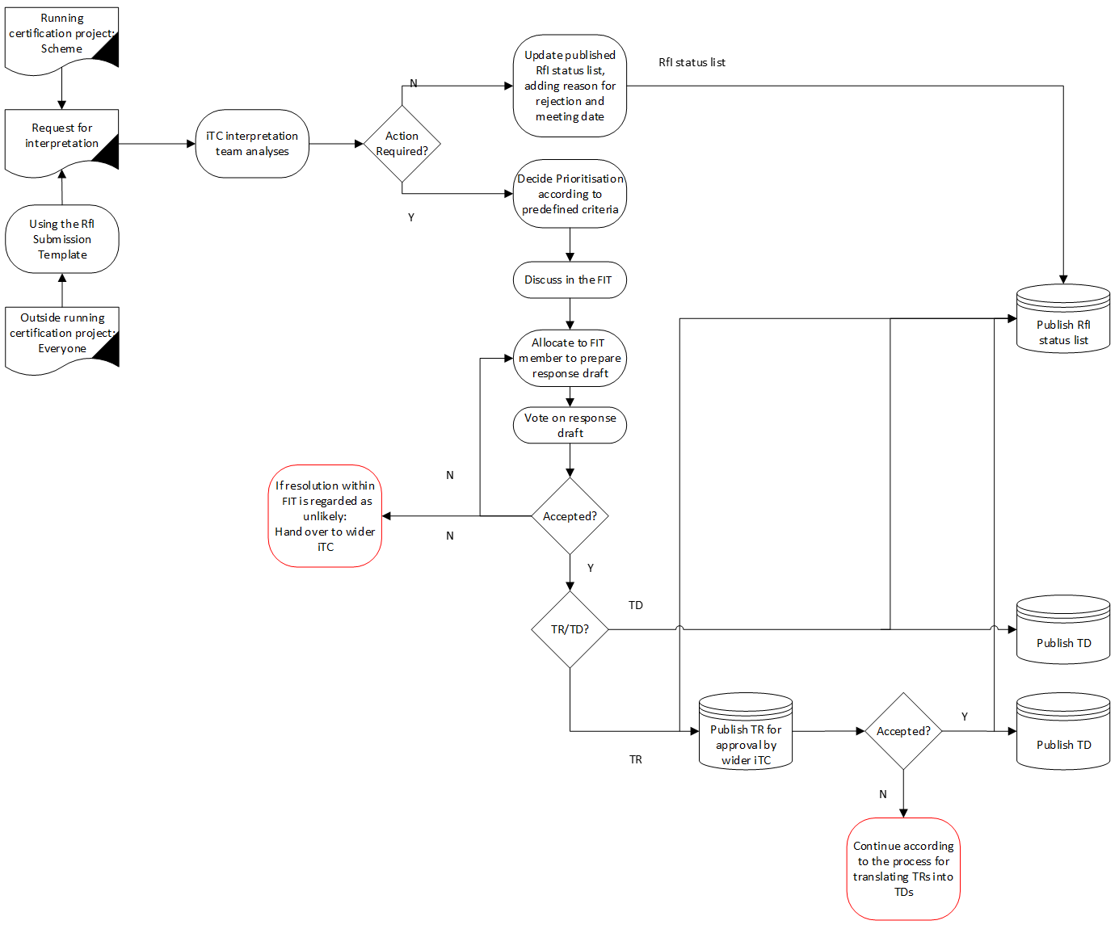
HCD Implementation Team Process
Copyright © 2022 The Printer Working Group. All rights reserved.
45

