Slide 1

Imaging Device Security
The Printer Working Group
May 19, 2022
PWG May 2022 Virtual Face-to-Face
Copyright © 2022 The Printer Working Group. All rights reserved.
1

Slide 2

Agenda
When | What
12:45 – 12:55 | Introductions, Agenda review
12:55 – 1:50 | Discuss results of latest HCD iTC Meetings and HCD cPP/SD v1.0 status
1:50 – 2:10 | IPP Encrypted Jobs and Documents
2:10 – 2:15 | HCD Security Guidelines v1.0 Status
2:15 – 2:40 | TCG/IETF Liaison Reports
2:40 – 2:45 | Wrap Up / Next Steps
Copyright © 2022 The Printer Working Group. All rights reserved.
2

Slide 3
Antitrust and Intellectual Property Policies
  “This meeting is conducted under the rules of the Antitrust and PWG IP policies”.
    Refer to the Antitrust and IP statements in the plenary slides
Copyright © 2022 The Printer Working Group. All rights reserved.
3

Slide 4
Officers
Chair:
  Alan Sukert
Vice-Chair:
  TBD
Secretary:
  Alan Sukert
Document Editor:
  Ira McDonald (High North) – HCD Security Guidelines
Copyright © 2022 The Printer Working Group. All rights reserved.
4

Slide 5
HCD international Technical Community (iTC) Status
Copyright © 2022 The Printer Working Group. All rights reserved.
5

Slide 6
HCD international Technical Community (iTC)
Since last IDS F2F on February 17, 2022 HCD iTC meetings have been held on:
  February 21st, 28th
  March 7th, 14th, 21st, 28th
  April 4th, 11th, 18th, 25th
  May 2nd, 9th, 16th
Copyright © 2022 The Printer Working Group. All rights reserved.
6

Slide 7
HCD cPP/SD Status
Released 2nd Public Review draft of the HCD cPP (v0.11 dated 12/14/2021) on 12/14/2021
 | Internal Drafts | 1st Public Draft | 2nd Public Draft
Accepted | 156 | 70 | 56
Accepted in Principle | 5 | 0 | 0
Deferred | 33 | 1 | 10
Not Accepted | 10 | 14 | 17
Not Adjudicated | 0 | 0 | 1
Copyright © 2022 The Printer Working Group. All rights reserved.
7

Slide 8
HCD cPP/SD Status
Released 2nd Public Draft of the HCD SD (v0.98 dated 2/24/2022) released on 2/24/2022
 | Internal Drafts | 1st Public Draft | 2nd Public Draft
Accepted | 57 | 24 | 25
Accepted in Principle | 1 | 0 | 1
Deferred | 15 | 2 | 0
Not Accepted | 1 | 2 | 3
Not Adjudicated | 0 | 0 | 0
Copyright © 2022 The Printer Working Group. All rights reserved.
8

Slide 9
HCD cPP/SD Status
Key Issues Resolved in 2nd Public Draft of HCD SD
Added a Test Assurance Activity for SFR FPT_TST_EXT: TSF testing where one was not present in previous drafts
Moved the Assurance Activities for the following:
  All of the Audit Log related SFRs to under “Security Audit (FAU)” rather than because they are all mandatory SFRs
  SFR FCS_CKM.1/AKG Cryptographic Key Generation (for asymmetric keys) to Chapter 3. Evaluation Activities for Conditionally Mandatory Requirements as required by NIAP Technical Decision TD 0074
  SFR FCS_CKM.2 Cryptographic Key Establishment to Chapter 3. Evaluation Activities for Conditionally Mandatory Requirements because it refers to the conditional requirement SFR FCS_CKM.1.1/AKG Cryptographic Key Generation (for asymmetric keys)
Added ISO/IEC 11770-6:2016 to the list of references an evaluator shall verify the approved derivation mode and key expansion algorithm for in the TSS Assurance Activity for SFR FCS_KDF_EXT.1: Cryptographic Key Derivation
Corrected an incorrect CEM paragraph reference in Section 6.2.1. Basic Functional Specification (ADV_FSP.1) Table 2. Mapping of ADV_FSP.1 CEM Work Units to Evaluation Activities
Copyright © 2022 The Printer Working Group. All rights reserved.
9

Slide 10
HCD cPP/SD Status
Key Issues Resolved in 2nd Public Draft of HCD SD
Corrected several unreachable URLs in Appendix C: Public Vulnerability Sources.
Removed redundant Operator User Guidance Evaluation Activities related to the evaluator ensuring that the Operational guidance contains instructions for configuring any cryptographic engine associated with the evaluated configuration of the TOE and providing a warning to the administrator that use of other cryptographic engines was not evaluated nor tested during the CC evaluation of the TOE
Corrected two incorrect paragraph references in Section 6.6.1. Vulnerability Survey (AVA_VAN.1) Table 3. Mapping of AVA_VAN.1 CEM Work Units to Evaluation Activities
Added the missing content of the Evaluation Activity (Documentation) and Evaluation Activity sections under Section 6.6.1. Vulnerability Survey (AVA_VAN.1)
Copyright © 2022 The Printer Working Group. All rights reserved.
10

Slide 11
HCD cPP/SD Status
Key Issues Resolved in 2nd Public Draft of HCD SD
Implemented the significant updates to the Assurance Activities (mostly in the Test Assurance Activities) requested by ITSCC (the Korean Common Criteria Scheme) for the following SFRs:
  FCS_CKM.1/SKG Cryptographic key generation (Symmetric Keys)
  FCS_COP.1/DataEncryption Cryptographic Operation (Data Encryption/Decryption)
  FCS_COP.1/SigGen Cryptographic Operation (Signature Generation and Verification)
  FCS_RBG_EXT.1 Extended: Cryptographic Operation (Random Bit Generation)
  FCS_COP.1/StorageEncryption Cryptographic operation (Data Encryption/Decryption)
  FCS_COP.1/KeyWrap Cryptographic operation (Key Wrapping)
  FCS_CKM.1/AKG Cryptographic Key Generation (for asymmetric keys)
  FCS_KDF_EXT.1 Extended: Cryptographic Key Derivation
Copyright © 2022 The Printer Working Group. All rights reserved.
11

Slide 12
Current HCD cPP/SD Issues Affecting Final Drafts of HCD cPP/SD
Inclusion of Cryptographic Erase in HCD cPP
Initial Comments that raised the issue:
  JISEC felt Cryptographic Erase covered by the two Key Destruction SFRs (FCS_CKM.4 & FCS_CKM_EXT.4) already in the HCD cPP
  ITSCC felt Image Overwrite and Cryptographic Erase are two different things and agreed with JISEC; suggested HCD iTC create optional requirements for Cryptographic Erase
HCD iTC created a subgroup to address the Cryptographic Erase requirement
Result was creation of a new Data Wiping SFR FPT_WIPE_EXT and associated Assurance Activities (AAs) to replace the current FDP_RIP.1/PURGE SFR that is still undergoing HCD iTC review
  FPT_WIPE_EXT originally required D.USER and D.TSF data stored on non-volatile storage to be made unavailable upon the request of an Administrator using one or more of the following methods: (1) overwrite, (2) block erase, (3) Cryptographic Erase, (4) [assignment: media-specific method(s)]
  Note: In this context, “Cryptographic Erase” encompasses any method that destroys the decryption key while leaving encrypted D.USER and/or D.TSF on the storage media. This would include, for example, some ATA commands that only destroy the key
Copyright © 2022 The Printer Working Group. All rights reserved.
12

Slide 13
Current HCD cPP/SD Issues Affecting Final Drafts of HCD cPP/SD
Inclusion of Cryptographic Erase in HCD cPP
Received key comments against FPT_WIPE_EXT SFR and associated AAs from NIAP, ITSCC and JISEC:
  NIAP
  Not clear whether the concern for this is related to cryptographic erase, overwrite in general on SSDs, or both
  Inclusion "[assignment: media-specific method(s)]" seems overly broad
  Wanted some wording changes in the Application Notes to the FPT_WIPE_EXT SFR
  ITSSC
  Unclear whether the FDP_RIP.1/Overwrite SFR applies to cryptographic erase or not
  In SFR FDP_RIP.1.1/Overwrite, the option "by destroying its cryptographic key" seems to be for "wear-leveled storage device", while the other option "by overwriting data" seems to be for "non-wear-leveled storage device". Is it possible to select "by overwriting data" for "wear-leveled storage device"? It is possible to overwrite data on a wear-leveled storage device such as SSDs?
Copyright © 2022 The Printer Working Group. All rights reserved.
13

Slide 14
Current HCD cPP/SD Issues Affecting Final Drafts of HCD cPP/SD
Inclusion of Cryptographic Erase in HCD cPP
  JISEC
  The proposal of FDP_RIP.1.1/Overwrite does not meet the requirements of original FDP_RIP.1 defined in the CC part2, nor the allowed refinement operation defined in the CC part1
  We are not sure why NIAP and HCD iTC want to include a mandatory requirement, cryptographic erase (destroying cryptographic key), as an optional requirement (i.e., cryptographic erase should be a mandatory requirement)
To address comments from the three Schemes, the HCD iTC Secure Erase Subgroup agreed on the following:
  Replace FDP_RIP.1/Overwrite with a new Extended User.Doc Unavailability SFR FDP_UDU_EXT that contains what was in FDP_RIP.1/Overwrite with some modifications to address Scheme (especially JISEC) comments
  Update FPT_WIPE_EXT to make cryptographic erase a mandatory method for making data unavailable and to delineate specific allowable media-methods to select from
  Added additional TSS and Guidance elements to ensure types of overwrite and medium being overwritten are identified
  Make the requested changes to the FPT_WIPE_EXT Application Notes
Copyright © 2022 The Printer Working Group. All rights reserved.
14

Slide 15
Current HCD cPP/SD Issues Affecting Final Drafts of HCD cPP/SD
Addressing changes to ND SFRs and Assurance Activities documented in NIAP Technical Decisions (TDs) by the ND Integration Team (NIT) that affect corresponding SFRs and Assurance Activities in the HCD cPP and HCD SD
  These may end up as “Parking Lot” issues
Update of spec/standard versions
  Addressed version update comments from Korean Scheme
Resolving all open comments to prepare and release of Final Drafts of both the HCD cPP and HCD SD
  Final Drafts will have “full content” for both documents
Copyright © 2022 The Printer Working Group. All rights reserved.
15

Slide 16
Other HCD cPP/SD Issues Affecting Final Drafts of the HCD cPP/SD
  Issues HCD iTC still need to be resolved (in order of priority):
  Closure of “deferred” comments
    Need to be concerned about implications of updating versions
    Update of spec/standard versions
      Did we miss anything?
    Agreement on removal of support for:
      TLS 1.1
      SHA-1 support
      Cipher suites with RSA Key Generation with keys < 2048 bits
      All RSA and DHE Key Exchanges
Copyright © 2022 The Printer Working Group. All rights reserved.
16

Slide 17
Other HCD cPP/SD Issues Affecting Final Drafts of the HCD cPP/SD
  Issues HCD iTC still needs to resolve (in order of priority):
What” issues will be moved to the “parking lot” for inclusion in later versions of the HCD cPP/SD.
  Current Parking Lot Issues
  Addressing hardware-based Roots of Trust stored in mutable memory as well as immutable memory
  Clarification that the Secure Boot SFR only requires verification of firmware/software that is stored in mutable memory at boot time and does not require verification of firmware/software stored in immutable memory
  Comments that require implementation of TLS 1.3 to resolve
Copyright © 2022 The Printer Working Group. All rights reserved.
17

Slide 18
Other HCD cPP/SD Issues
Additional New Content (SFRs)
At this point do not expect any additional new requirements for the HCD cPP/SD beyond what already been discussed unless either:
  They are requested by JISEC or ITSCC or NIAP
  They are suggested by JBMIA
  Necessitated by comments to 2nd Public Drafts or Final Drafts
  Necessitated by any new NIAP TDs to either the HCD PP or any applicable SFRs in the ND & FDE cPPs/SDs
Given the current known schedules, syncing with applicable updates to ND cPP/SD and FDE cPPs/SDs is not likely to happen within the time frame for HCD cPP/SD v1.0.
Don’t expect any applicable ISO, FIPS or NIST Standards/Guidelines updates within this time frame either
Copyright © 2022 The Printer Working Group. All rights reserved.
18

Slide 19
HCD iTC Status
HCD cPP/SD Schedule Status Update
Phase | Timeframe | Status Updates
Resolve ESR Issue and Approve SPD | Resolve ESR issue: 2/26 DONE Update ESR: 3/1 – 3/12 NOT NEEDED Update SPD: 3/1 – 3/12 DONE Submit ESR changes to HCD WG (if needed): 3/15 NOT NEEDED HCD WG Review and comment: 3/15 – 4/9 NOT NEEDED Submit SPD for public review: 5/10 DONE SPD Public review: 5/10 – 6/4 DONE Update SPD: 6/7 – 6/25 DONE
Internal Draft | New Proposed Schedule Submit 3rd internal draft: 6/1 DONE Review 3rd internal draft: 6/1 – 6/18 DONE Review comments & update documents: 6/21 – 7/16 DONE
Public Review Draft 1 | New Proposed Schedule Submit 1st Public Draft: 8/18 (cPP); 8/30 (SD) Review 1st Public Draft: 8/18 – 10/12 (45d) Review comments and update documents: 10/13-12/10 (60d) | Was 7/19 on original schedule Note: 1st Public Draft of HCD cPP released on 8/30 – Comment end date 10/8 DONE 1st Public Draft of HCD SD released on 10/13 – Comment end date 11/15 DONE
Copyright © 2022 The Printer Working Group. All rights reserved.
19

Slide 20
HCD iTC Status
Updated Proposed HCD cPP/SD Schedule
Phase | Timeframe | Status Updates
Public Review Draft 2 | New Proposed Schedule (3/29/2022) Submit 2nd Public Draft: 12/14 Review 2nd Public Draft: 12/15 – 1/31/22 (49d) Review comments and update documents: 1/31/1/22 – 5/13/22(60d) | HCD cPP 2nd Public Draft released 12/14 - DONE Comments Received by 1/31/22 - DONE HCD SD 2nd Public Draft Planned Release 12/13 – Released 2/24/22 DONE Comments due by 3/18/22 (~one month)
Final Draft | New Proposed Schedule (as of 5/16/22) Submit Final Draft: 6/13/22 Review Final Public Draft: 6/14/ – 7/17 (28d) Review comments and update documents: 7/18/22 – 8/1/22 (10d) | Was 1/17/22 on original schedule As of 7/9 HCD iTC Meeting was on track to meet 5/16 date. However, at 7/16 meeting agreed on new schedule to get full iTC and Scheme buy-in on final WIPE proposal
Final Document Published | New Proposed Schedule (as of 5/16/22) Publish Version 1.0: 8/2/22 | Was 3/25/22 on original schedule If past history is a guide, Publish date will likely be closer to end of August 2022
Copyright © 2022 The Printer Working Group. All rights reserved.
20

Slide 21
Potential HCD cPP Content
Post-Version 1.0
Inclusion of support for TLS 1.3 and deprecation of TLS 1.1
Inclusion of NTP if it doesn’t make v1.0
Coordination with EUCC
Inclusion of AVA_VAN and ALC_FLR.*
  May require a PP Module to avoid duplicate certifications in EU
Changes due to HCD Integration Team responses to comments/questions
Support for Wi-Fi and maybe Bluetooth
Support for Security Information and Event Monitoring (SIEM) and related systems
Expand to address 3D printing
Update to ISO/IEC 15408/18045
  Will be published in Oct 2022
  Adds new SFRs and pre-packaged PP and ST Assurance Activities in new Part 4
Copyright © 2022 The Printer Working Group. All rights reserved.
21

Slide 22
Potential HCD cPP Content
Post-Version 1.0
Incorporation of CCDB Crypto WG Packages
Syncing with upcoming ND CPP Version 2.0 planned for Oct 2022
Updates due to requests from JISEC, ITSCC or NIAP
Updates due to changes from other ISO, FIPS or NIST Standards/Guidelines, NIAP TDs, or CCDB Crypto WG
Incorporate, as applicable, the changes to ISO 15408, particularly any relevant new SFRs in the updated Part 2
Support for SNMPv3
Support for NFC
Support for new crypto algorithms
Indirect updates based on new technologies or customer requests
Copyright © 2022 The Printer Working Group. All rights reserved.
22

Slide 23
HCD iTC Status
Key Next Steps
  Finalize all new content for v1.0
  Address all the comments against the 2nd Public Drafts and Final Drafts
  Determine “parking lot” issues for later versions of the HCD cPP/SD
  Add all agreed-upon SFRs and Assurance Activities into the HCD cPP and SD
  Submit Final Draft HCD cPP and HCD SD per the updated schedule
  Review and resolve all comments and update the HCD cPP and HCD SD drafts per the agreed schedule
  Publish HCD cPP/SD v1.0 per the agreed schedule
  Start planning for and creating an Interpretation Team for maintaining HCD cPP/SD v1.0 and start planning for the next HCD cPP/SD update (whether it is v1.x or v2.0)
Copyright © 2022 The Printer Working Group. All rights reserved.
23

Slide 24
HCD iTC Status
More Lessons Learned to Date (My Take)
  The end game is always the hardest part, because every time you think you’re close to the end your not
  It’s never too early to start planning for what comes after initial release because you always think you have more time to plan for what comes next than you actually do
  It is critical that you avoid “reinventing the wheel” whenever possible – or in other words plagiarize what others have done before you whenever you can
  Considering we started in February 2020, getting a new iTC established and creating/publishing a major cPP and SD within 2-1/2 years is still quite a feat
Copyright © 2022 The Printer Working Group. All rights reserved.
24

Slide 25
IPP Encrypted Jobs and Documents
Copyright © 2022 The Printer Working Group. All rights reserved.
25

Slide 26

IPP Encrypted Jobs and Documents
®
Current prototype draft (needs prototyping):
  https://ftp.pwg.org/pub/pwg/ipp/wd/wd-ipptrustnoone10-20210519.pdf
Implements an S/MIME container for Print Jobs and Job Receipts (attributes containing accounting info)
  PGP container was also proposed but ultimately was shelved due to lack of interest
Works for both direct and cloud/local server printing solutions
One new Client operation to query encrypted Job attributes/receipts
Two new Proxy operations to return encrypted Job attributes/receipts
Copyright © 2022 The Printer Working Group. All rights reserved. The IPP Everywhere and PWG logos are registered trademarks of the IEEE-ISTO.

Slide 27
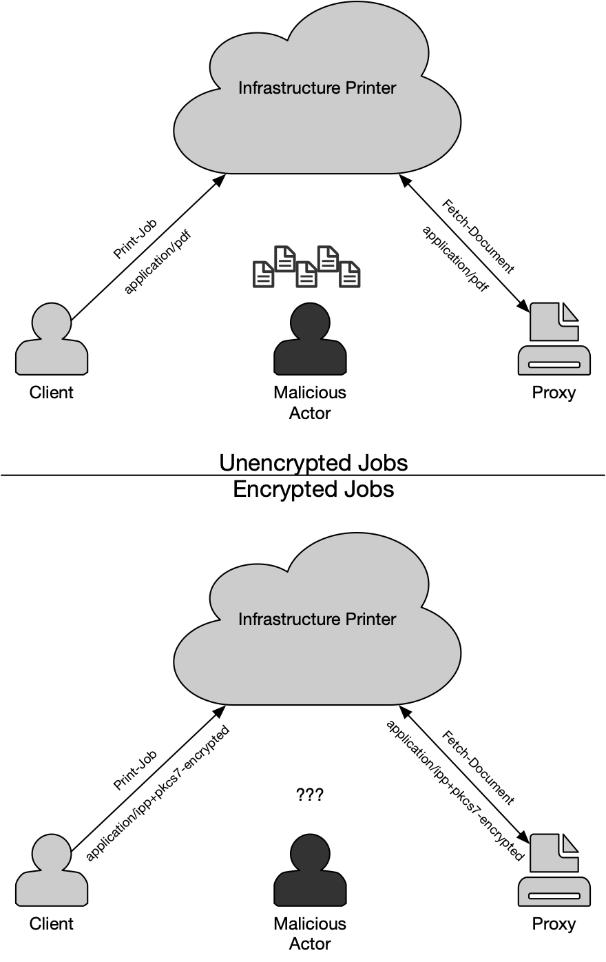
Architecture
®
Copyright © 2022 The Printer Working Group. All rights reserved. The IPP Everywhere and PWG logos are registered trademarks of the IEEE-ISTO.

Slide 28
Encrypted Print-Job
®
Printer/Proxy advertises an X.509 certificate and public key to use for encrypted printing
Client encrypts an IPP Print-Job request with document data in an S/MIME container using the Printer's X.509 certificate, signed using the Client's X.509 certificate
  Job ticket and document data are both protected and signed to prevent modification
  An additional password/passcode can be set for release at the printer's console
Printer/Proxy decrypts the S/MIME message, validates the Client signature, and processes the Print-Job request and document data
Copyright © 2022 The Printer Working Group. All rights reserved. The IPP Everywhere and PWG logos are registered trademarks of the IEEE-ISTO.

Slide 29
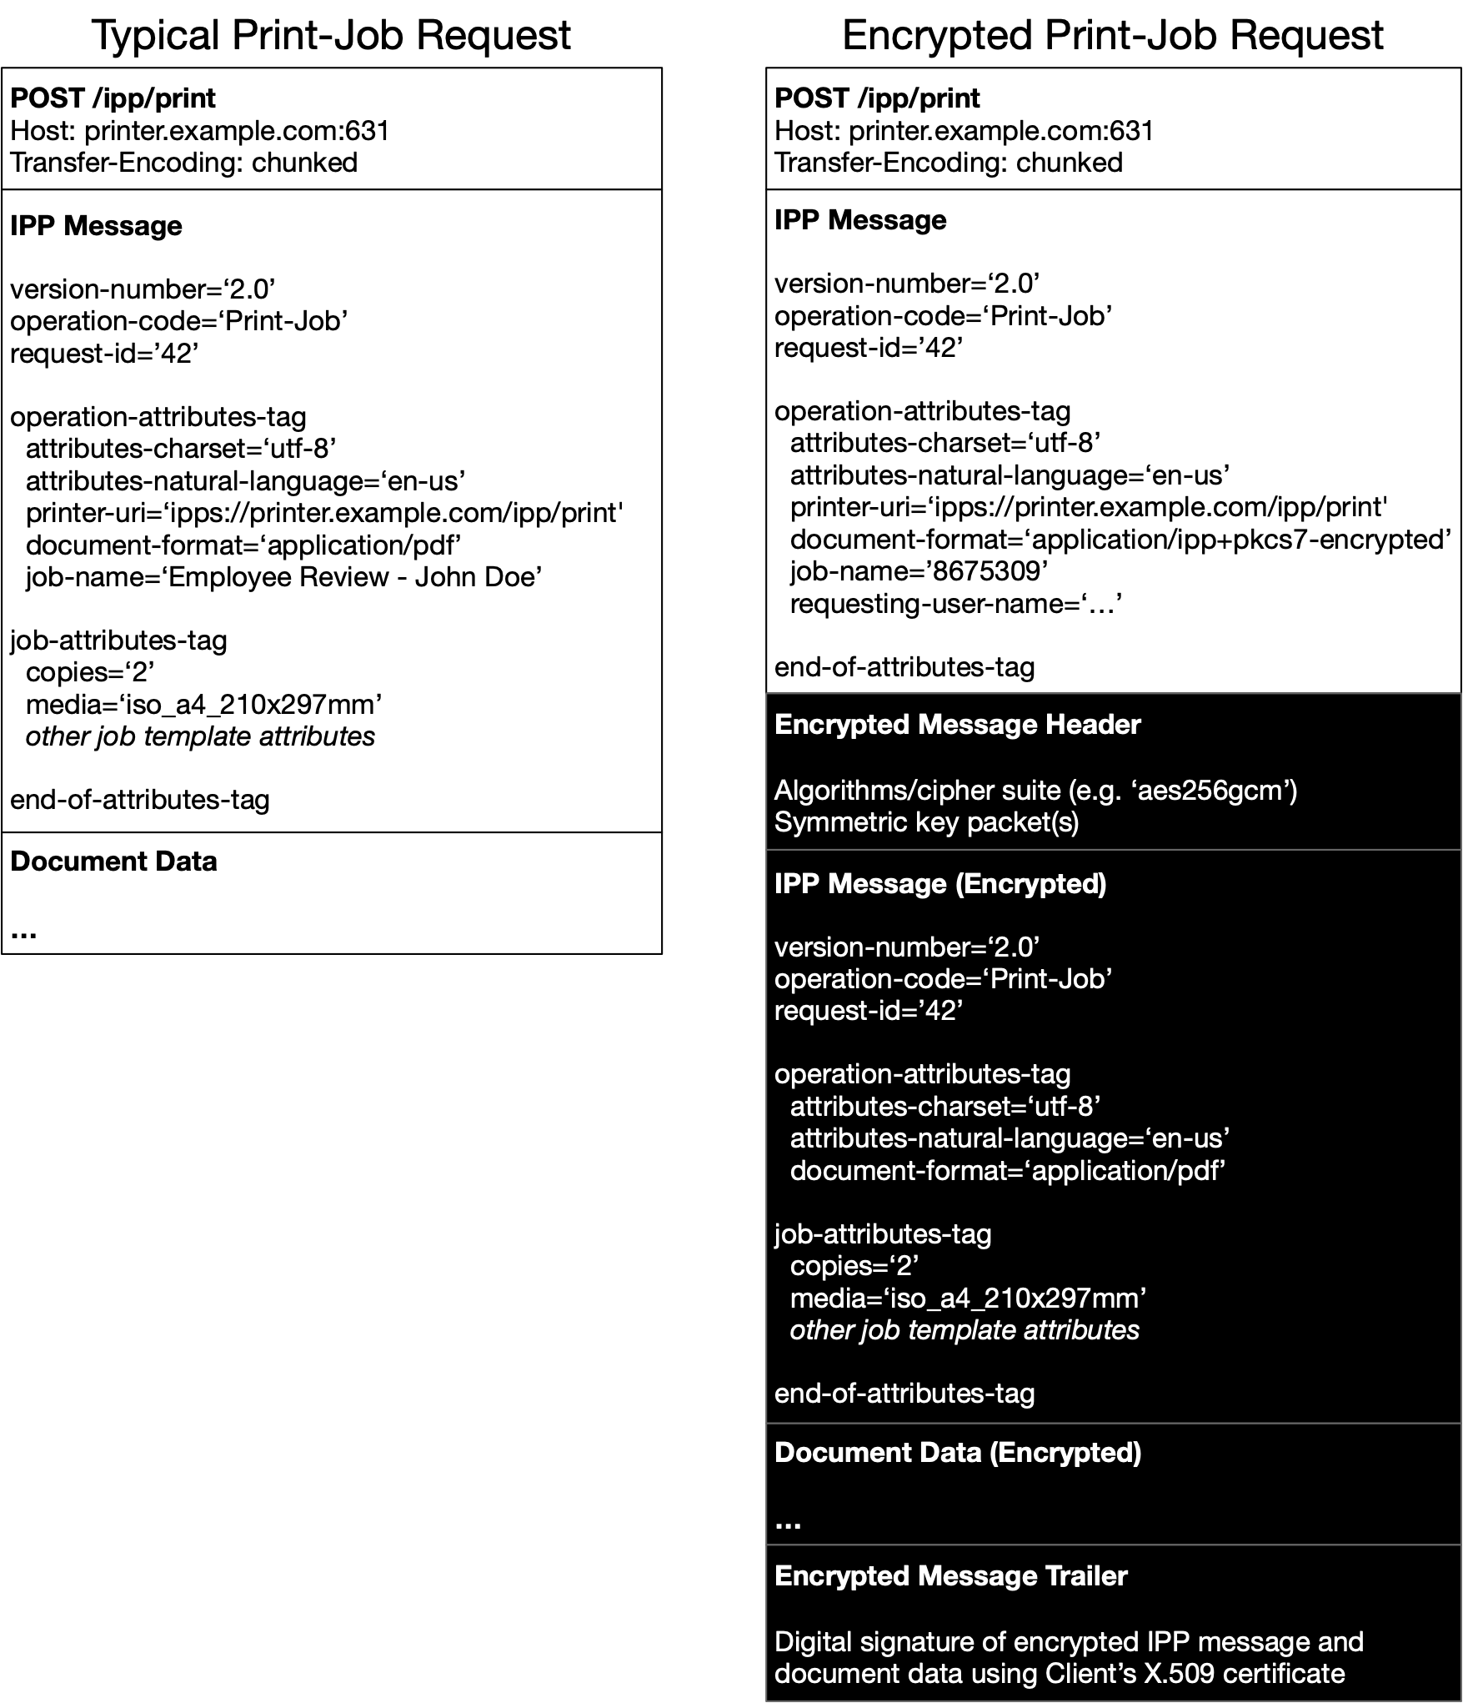
Encrypted Print-Job
®
Copyright © 2022 The Printer Working Group. All rights reserved. The IPP Everywhere and PWG logos are registered trademarks of the IEEE-ISTO.

Slide 30
Get-Encrypted-Job-Attributes
®
Client send a Get-Encrypted-Job-Attributes request with its own X.509 certificate and public key
  Client certificate must match Print-Job request's signature
  An ordinary Get-Job-Attributes request will only return basic state information
Printer/Proxy encrypts a Get-Encrypted-Job-Attributes response in an S/MIME container using the Client's X.509 certificate, signed using the Printer's X.509 certificate
Client decrypts the S/MIME message, verifies the Printer's signature, and processes the response attributes as needed
Copyright © 2022 The Printer Working Group. All rights reserved. The IPP Everywhere and PWG logos are registered trademarks of the IEEE-ISTO.

Slide 31
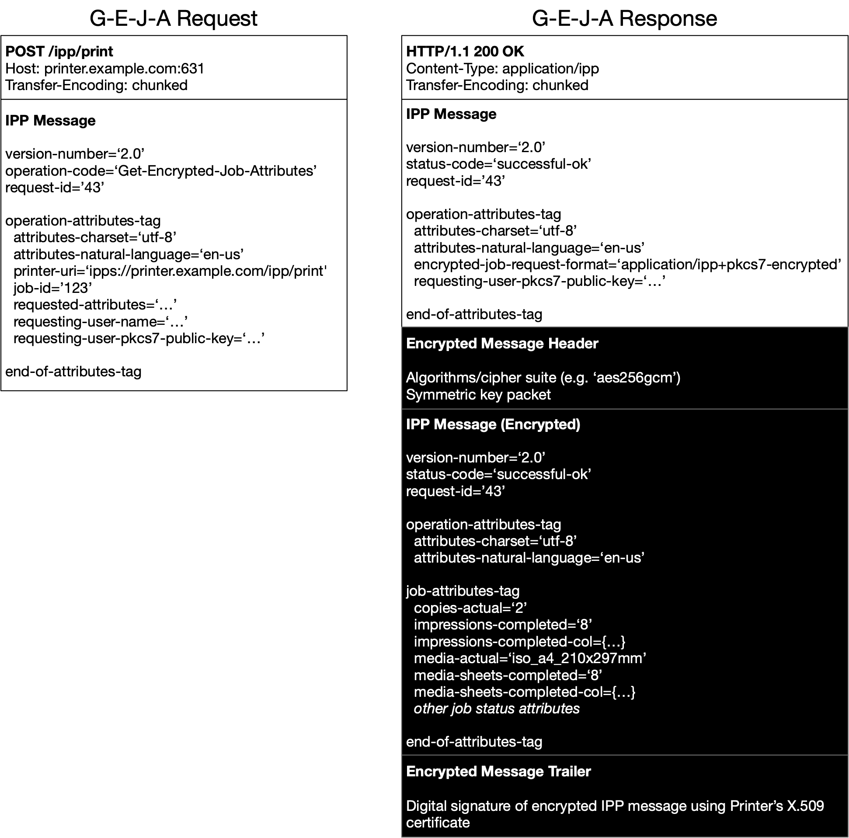
Get-Encrypted-Job-Attributes
®
Copyright © 2022 The Printer Working Group. All rights reserved. The IPP Everywhere and PWG logos are registered trademarks of the IEEE-ISTO.

Slide 32
Discussion
®
Should we talk about using separate certificates and keys for signing and encryption?
  Separate certificates sometimes used in email, where any validation seems to be limited to matching the common names of the certificates and "are the CAs that issued the certificates trusted?"
What should the common name be for Printer certificates?
  Should be something the Client can use for validation
  "printer-uuid" value?
Copyright © 2022 The Printer Working Group. All rights reserved. The IPP Everywhere and PWG logos are registered trademarks of the IEEE-ISTO.

Slide 33
HCD Security Guidelines
Copyright © 2022 The Printer Working Group. All rights reserved.
33

Slide 34
Trusted Computing Group (TCG)
®
Next TCG Members Meetings
  TCG Hybrid F2F (Chevy Chase, MD) – 18-22 July 2022 – Ira to call in
  TCG Hybrid F2F (New Orleans, LA) – 24-28 October 2022 – Ira to call in
Trusted Mobility Solutions (TMS) – Ira is co-chair and co-editor
  Formal – GP (TEE, SE), ETSI (NFV/MEC/SAI)
  Informal – 3GPP, GSMA, IETF, ISO, ITU-T, SAE, US NIST
  TCG TMS Use Cases v2 – published September 2018
Mobile Platform (MPWG) – Ira is co-editor
  Formal – GP (TEE, SE), ETSI (NFV/MEC/SAI)
  TCG Mobile Reference Architecture v2 – work-in-progress for review Q3 2022
  TCG TPM 2.0 Mobile Common Profile – work-in-progress for review Q3 2022
  TCG MARS 1.0 Mobile Profile – new work-in-progress Q4 2021
  TCG Runtime Integrity Preservation for Mobile Devices – Nov 2019
  GP TPS Client API / Entity Attestation Protocol / COSE Keystore – joint work
Recent Specifications
  http://www.trustedcomputinggroup.org/resources
  TCG DICE Endorsement Architecture for Devices – review May 2022
  TCG EK Credential Profile for TPM 2.0 – review March 2022
  TCG Cyber Resilient Module and Building Block Requirements – March 2022
  TCG Canonical Event Log Format – published February 2022
Copyright © 2022 The Printer Working Group. All rights reserved. The IPP Everywhere and PWG logos are registered trademarks of the IEEE-ISTO.

Slide 35
Liaison Status
Copyright © 2022 The Printer Working Group. All rights reserved.
35

Slide 36
Trusted Computing Group (TCG)
®
Next TCG Members Meetings
  TCG Hybrid F2F (Chevy Chase, MD) – 18-22 July 2022 – Ira to call in
  TCG Hybrid F2F (New Orleans, LA) – 24-28 October 2022 – Ira to call in
Trusted Mobility Solutions (TMS) – Ira is co-chair and co-editor
  Formal – GP (TEE, SE), ETSI (NFV/MEC/SAI)
  Informal – 3GPP, GSMA, IETF, ISO, ITU-T, SAE, US NIST
  TCG TMS Use Cases v2 – published September 2018
Mobile Platform (MPWG) – Ira is co-editor
  Formal – GP (TEE, SE), ETSI (NFV/MEC/SAI)
  TCG Mobile Reference Architecture v2 – work-in-progress for review Q3 2022
  TCG TPM 2.0 Mobile Common Profile – work-in-progress for review Q3 2022
  TCG MARS 1.0 Mobile Profile – new work-in-progress Q4 2021
  TCG Runtime Integrity Preservation for Mobile Devices – Nov 2019
  GP TPS Client API / Entity Attestation Protocol / COSE Keystore – joint work
Recent Specifications
  http://www.trustedcomputinggroup.org/resources
  TCG DICE Endorsement Architecture for Devices – review May 2022
  TCG EK Credential Profile for TPM 2.0 – review March 2022
  TCG Cyber Resilient Module and Building Block Requirements – March 2022
  TCG Canonical Event Log Format – published February 2022
Copyright © 2022 The Printer Working Group. All rights reserved. The IPP Everywhere and PWG logos are registered trademarks of the IEEE-ISTO.

Slide 37
Internet Engineering Task Force (IETF) (1 of 4)
®
Next IETF Members Meetings
  IETF 114 Hybrid F2F (Philadelphia, US) – 25-29 July 2022 – Ira to call in
  IETF 115 Hybrid F2F (London, UK) 7-11 November 2022 – Ira to call in
Transport Layer Security (TLS)
  IETF TLS Ticket Requests – RFC 9149 – April 2022
  https://datatracker.ietf.org/doc/rfc9149/
  IETF DTLS Protocol Version 1.3 – RFC 9147 – April 2022
  https://datatracker.ietf.org/doc/rfc9147/
  IETF Connection Identifier for DTLS 1.2 – RFC 9146 – March 2022
  https://datatracker.ietf.org/doc/rfc9146/
  IETF Delegated Credentials for (D)TLS – draft-13 – May 2022 – IETF LC
  https://datatracker.ietf.org/doc/draft-ietf-tls-subcerts/
  IETF Importing External PSKs for TLS – draft-08 – April 2022 – RFC Editor
  https://datatracker.ietf.org/doc/draft-ietf-tls-external-psk-importer/
  IETF IANA Registry Updates for TLS/DTLS – draft-00 – March 2022
  https://datatracker.ietf.org/doc/draft-ietf-tls-rfc8447bis/
  IETF Secure Element for TLS 1.3 – draft-04 – March 2022
  https://datatracker.ietf.org/doc/draft-urien-tls-se/
  IETF Compact TLS 1.3 – draft-05 – March 2022
  https://datatracker.ietf.org/doc/draft-ietf-tls-ctls/
  IETF Return Routability Check for DTLS 1.2/1.3 – draft-05 – March 2022
  https://datatracker.ietf.org/doc/draft-ietf-tls-dtls-rrc/
  IETF TLS 1.3 – draft-04 – March 2022
  https://datatracker.ietf.org/doc/draft-ietf-tls-rfc8446bis/
  IETF Flags Extension for TLS 1.3 – draft-09 – March 2022
  https://datatracker.ietf.org/doc/draft-ietf-tls-tlsflags/
  IETF Exported Authenticators in TLS – draft-15 – March 2022 – RFC Editor
  https://datatracker.ietf.org/doc/draft-ietf-tls-exported-authenticator/
  IETF Suppressing CA Certificates in TLS 1.3 – draft-01 – March 2022
  Suppressing CA Certificates in TLS 1.3
Copyright © 2022 The Printer Working Group. All rights reserved. The IPP Everywhere and PWG logos are registered trademarks of the IEEE-ISTO.

Slide 38
Internet Engineering Task Force (IETF) (2 of 4)
®
Security Automation and Continuous Monitoring (SACM)
  IETF Concise Software Identifiers – draft-21 – March 2022 – IETF LC
  https://datatracker.ietf.org/doc/draft-ietf-sacm-coswid/
Concise Binary Object Representation (CBOR)
  IETF Additional Control Ops for CDDL – RFC 9165 – December 2021
  https://datatracker.ietf.org/doc/rfc9165/
  IETF CBOR tags for IPv4/v6 Adresses – RFC 9164 – December 2021
  https://datatracker.ietf.org/doc/rfc9164/
  IETF CBOR Tags for OIDs – RFC 9090 – July 2021
  https://datatracker.ietf.org/doc/rfc9090/
  IETF Storing CBOR Items on Stable Storage – draft-12 – May 2022
  https://datatracker.ietf.org/doc/draft-ietf-cbor-file-magic/
  IETF Packed CBOR – draft-05 – April 2022
  https://datatracker.ietf.org/doc/draft-ietf-cbor-packed/
  IETF Using CDDL for CSVs – draft-00 – February 2022
  https://datatracker.ietf.org/doc/draft-bormann-cbor-cddl-csv/
  IETF Notable CBOR Tags – draft-06 – February 2022
  https://datatracker.ietf.org/doc/draft-bormann-cbor-notable-tags/
  IETF Feature Freezer for CDDL – draft-09 – December 2021
  https://datatracker.ietf.org/doc/draft-bormann-cbor-cddl-freezer/
Copyright © 2022 The Printer Working Group. All rights reserved. The IPP Everywhere and PWG logos are registered trademarks of the IEEE-ISTO.

Slide 39
Internet Engineering Task Force (IETF) (3 of 4)
®
Remote ATtestation ProcedureS (RATS)
  IETF ARM PSA Attestation Verifier Endorsements – draft-01 – May 2022
  https://datatracker.ietf.org/doc/draft-fdb-rats-psa-endorsements/
  IETF Epoch Markers – draft-01 – May 2022
  https://datatracker.ietf.org/doc/draft-birkholz-rats-epoch-markers/
  IETF Automatic Integration of Secure Silicon Attestation Token – draft-01 – April 2022
  https://datatracker.ietf.org/doc/draft-tschofenig-rats-aiss-token/
  IETF YANG Data Model for CHARRA using TPMs – draft-19 – April 2022 – IETF LC
  https://datatracker.ietf.org/doc/draft-ietf-rats-yang-tpm-charra/
  IETF TPM-based Network Device RIV – draft-14 – March 2022 – RFC Editor
  https://datatracker.ietf.org/doc/draft-ietf-rats-tpm-based-network-device-attest/
  IETF Attestation Results for Secure Interactions – draft-02 – March 2022 https://datatracker.ietf.org/doc/draft-ietf-rats-ar4si/
  IETF Attestation Event Stream Subscription – draft-01 – March 2022
  https://datatracker.ietf.org/doc/draft-ietf-rats-network-device-subscription/
  IETF ARM PSA Attestation Token – draft-09 – March 2022
  https://datatracker.ietf.org/doc/draft-tschofenig-rats-psa-token/
  IETF Trusted Path Routing – draft-05 – March 2022
  https://datatracker.ietf.org/doc/draft-voit-rats-trustworthy-path-routing/
  IETF Entity Attestation Token (EAT) – draft-12 – February 2022
  https://datatracker.ietf.org/doc/draft-ietf-rats-eat/
  IETF RATS Architecture – draft-15 – February 2022 – IETF LC
  https://datatracker.ietf.org/doc/draft-ietf-rats-architecture/
  IETF Reference Interaction Models for RATS – draft-05 – January 2022
  https://datatracker.ietf.org/doc/draft-ietf-rats-reference-interaction-models/
  IETF Concise Reference Integrity Manifest – draft-02 – January 2022
  https://datatracker.ietf.org/doc/draft-birkholz-rats-corim/
Copyright © 2022 The Printer Working Group. All rights reserved. The IPP Everywhere and PWG logos are registered trademarks of the IEEE-ISTO.

Slide 40
Internet Engineering Task Force (IETF) (4 of 4)
®
IRTF Crypto Forum Research Group (CFRG) – future algorithms
  IRTF Hybrid Public Key Encryption – RFC 9180 – February 2022
  https://datatracker.ietf.org/doc/rfc9180/
  IRTF Argon2 password hash and proof-of-work – RFC 9106 – September 2021
  https://datatracker.ietf.org/doc/rfc9106/
  IRTF SPAKE2+, an Augmented PAKE – draft-08 – May 2022
  https://datatracker.ietf.org/doc/draft-bar-cfrg-spake2plus/
  IRTF Key Blinding for Signature Schemes – draft-02 – May 2022
  https://datatracker.ietf.org/doc/draft-dew-cfrg-signature-key-blinding/
  IRTF Verifiable Distributed Aggregation Functions – draft-00 – April 2022
  https://datatracker.ietf.org/doc/draft-irtf-cfrg-vdaf/
  IRTF Two-Round Threshold Schnorr Signatures with FROST – draft-04 – March 2022
  https://datatracker.ietf.org/doc/draft-irtf-cfrg-frost/
  IRTF Usage Limits on AEAD Algorithms – draft-04 – March 2022
  https://datatracker.ietf.org/doc/draft-irtf-cfrg-aead-limits/
  IRTF OPAQUE Asymmetric PAKE Protocol – draft-08 – March 2022
  https://datatracker.ietf.org/doc/draft-irtf-cfrg-opaque/
  IRTF Ristretto255 and Decaf448 Groups – draft-03 – February 2022
  https://datatracker.ietf.org/doc/draft-irtf-cfrg-ristretto255-decaf448/
  IRTF Deterministic Nonce-less Hybrid PKE – draft-01 – February 2022
  https://datatracker.ietf.org/doc/draft-harkins-cfrg-dnhpke/
  IRTF KangarooTwelve – draft-07 – February 2022 – RG LC
  https://datatracker.ietf.org/doc/draft-irtf-cfrg-kangarootwelve/
  IRTF Hashing to Elliptic Curves – draft-14 – February 2022 – IRSG Poll
  https://datatracker.ietf.org/doc/draft-irtf-cfrg-hash-to-curve/
  IRTF Deterministic ECDSA and EdDSA Signatures with Additional Randomness – draft-04 – February 2022
  https://datatracker.ietf.org/doc/draft-mattsson-cfrg-det-sigs-with-noise/
  IRTF SPAKE2, a PAKE – draft-26 – February 2022 – RFC Editor
  https://datatracker.ietf.org/doc/draft-irtf-cfrg-spake2/
Copyright © 2022 The Printer Working Group. All rights reserved. The IPP Everywhere and PWG logos are registered trademarks of the IEEE-ISTO.

Slide 41
Next Steps – IDS WG
Next IDS WG Meeting– May 26, 2022
Next IDS Face-to-Face Meeting August 16-18, 2022 (probably August 18th) at next PWG F2F
Start looking at involvement in some of these other standards activities individually and maybe as a WG
Copyright © 2022 The Printer Working Group. All rights reserved.
41

Slide 42
Backup
Copyright © 2022 The Printer Working Group. All rights reserved.
42

