Slide 1

Imaging Device Security
The Printer Working Group
November 4, 2020
PWG November 2020 Virtual Face-to-Face
Copyright © 2020 The Printer Working Group. All rights reserved.
1

Slide 2

Agenda
When | What
10:00 – 10:05 | Introductions, Agenda review
10:05 – 10:50 | Discuss results of latest HCD iTC Meetings and potential HCD cPP v1.0 content
10:50 – 11:10 | HCD Security Guidelines 1.0 Status
11:10 – 11:55 | CCC and 3D Printing Presentation
11:55 – 12:00 | Wrap Up / Next Steps
Copyright © 2020 The Printer Working Group. All rights reserved.
2

Slide 3
Intellectual Property Policy
  “This meeting is conducted under the rules of the PWG IP policy”.
    Refer to the IP statements in the plenary slides
Copyright © 2020 The Printer Working Group. All rights reserved.
3

Slide 4
Officers
Chair:
  Alan Sukert
Vice-Chair:
  TBD
Secretary:
  Alan Sukert
Document Editor:
  Ira McDonald (High North) – HCD Security Guidelines
Copyright © 2020 The Printer Working Group. All rights reserved.
4

Slide 5
HCD international Technical Community (iTC) Status
Copyright © 2020 The Printer Working Group. All rights reserved.
5

Slide 6
HCD international Technical Community (iTC)
HCD iTC formally approved by Common Criteria Management Committee in Feb 2020
Key HCD iTC Officers:
  Chairperson – Kwangwoo Lee, HP
  Deputy Chairperson – Alan Sukert
  CCDB Liaison - Eunkyoung Yi, Korean Scheme
  Editors – Alan Sukert; Brian Volkoff, Ricoh; Geraldo Colunga, HP
  Record Manager – TBD (Kwangwoo Lee acting for now)
Copyright © 2020 The Printer Working Group. All rights reserved.
6

Slide 7
HCD international Technical Community (iTC)
Agreed to hold bi-weekly meetings. However, to resolve comments against the draft HCD collaborative PP (cPP) and Supporting Document (SD), went to weekly meeting.
Since last IDS F2F on August 19th, meetings have been held on:
  August 24th & 31st
  September 7th, 14th & 21st
  October 5th, 12th, 19th & 26th
  November 2nd
Copyright © 2020 The Printer Working Group. All rights reserved.
7

Slide 8
HCD cPP/SD Status
Released first internal draft of the HCD cPP v1.0 on July 21,2020
  Received 68 comments against that draft version
  All comments have been adjudicated by the HCD iTC
  Final tally:
    59 Comments Accepted
    4 Comments Accepted in Principle but will be addressed in a later v1.0 draft
    5 Comments Deferred to be addressed by the HCD iTC at a later point in time
Copyright © 2020 The Printer Working Group. All rights reserved.
8

Slide 9
HCD cPP/SD Status
Released first internal draft of the HCD SD v1.0 on 8/26/20
  Received 28 comments against that draft version
  All comments have been adjudicated by the HCD iTC
  Final tally:
    12 Comments Accepted
    9 Comments Accepted in Principle but will be addressed in a later v1.0 draft
    6 Comments Deferred to be addressed by the HCD iTC at a later point in time
    1 Comment Not Accepted
Copyright © 2020 The Printer Working Group. All rights reserved.
9

Slide 10
HCD cPP/SD Status
HCD iTC Network Subgroup
Is a Network Subgroup of the HCD iTC looking at what to do with the functional and assurance requirements for the four Secure Protocols – IPsec, TLS, SSH and HTTPS – in HCD cPP/SD v1.0
Key points from the Network Subgroup meetings so far:
  The Network Device (ND) TLS subgroup is addressing TLS 1.3 and DTLS but there is no ND SSH subgroup.
    We should include TLS 1.3 in HCD cPP/SD v1.0 if ND does incorporate TLS 1.3 into the next published ND cPP/SD updates within the next year as the ND TLS Subgroup indicates it plans to do
  SSH requirements are being addressed by the CCUF Crypto Working Group which has released an SSH package
  The Network SG clearly agrees that both TLS and SSH should split requirements into separate client and server requirements
Copyright © 2020 The Printer Working Group. All rights reserved.
10

Slide 11
HCD cPP/SD Status
HCD iTC Network Subgroup
It is recommended that IPP should be considered from later versions of the HCD cPP/SD beyond v1.0.
The current Network SG recommendation is that the HCD iTC use the IPsec, TLS, SSH and HTTPS requirements taken from ND cPP/SD v2.2e as the basis for the SFRs/assurance activities in HCD cPP/SD v1.0
  However, in long term goal is to establish cross-functional teams to develop packages for each of the four Secure Protocols that can be referenced by any cPP or SD that needs to use any of the protocols
  Need to determine if that also includes any of the FIA_X509_EXT.* SFRs/Assurance Activities related to certificate evaluation
Regarding DTLS, the current Network SG position is that HCD cPP/SD v1.0 will not include requirements for DTLS unless vendors indicate that they need to support it
Copyright © 2020 The Printer Working Group. All rights reserved.
11

Slide 12
HCD iTC Status
Key Issues Raised Since August F2F
  Ricoh Proposal on Non-Field Replaceable Non-Volatile Storage that non-field replaceable non-volatile storage be allowed to store key material in clear text rather than encrypted as long as the HCD had some type of “purge” function that would allow the key material to be deleted when the HCD was ready to be decommissioned or moved to another location
Issue was that the Essential Security Requirements (ESR) document approved by the Common Criteria Development Board (CCDB) contained the following requirement:
  “The HCD shall encrypt user document data and/or the HCD critical data (for confidentiality protection) stored on the nonvolatile storage device if it uses nonvolatile storage device for the purpose of storing those data. To support encryption, the HCD shall maintain key chains in such a way that keys and key materials are protected. Note that the initial data of the key chain stored on the nonvolatile storage device without protection do not meet the requirement”
Copyright © 2020 The Printer Working Group. All rights reserved.
12

Slide 13
HCD iTC Status
Key Issues Raised Since August F2F
The bolded text would seem to imply, depending on how you interpreted what “protected” meant, that the ESR would not allow such a proposal, so if we agreed on this proposal the ESR would have to be changed
Any change to the ESR would have to be approved by the CCDB so ESR changes cannot be taken lightly
If we are going to make this change, assuming this proposal is eventually accepted, that there will likely be other ESR changes required as we develop the HCD cPP/SD v1.0 so we should submit all the ESR changes at one time
Are several arguments for and against this proposal. For example, it was pointed out that if the HCD become broken and the purge cannot be performed that the key material is still vulnerable.
Formed an iTC subcommittee to come up off-line with a recommendation to the full iTC
  Recommended to ‘Defer’ proposal because would require an ESR change to implement
  Need HCD iTC to agree whether to ask HCD WG to change ESR to allow this change
Copyright © 2020 The Printer Working Group. All rights reserved.
13

Slide 14
HCD iTC Status
JBMIA Issue on Key Material Collection
HCD cPP ESR v0.7 requires that the initial data of the key chain stored on the nonvolatile storage device should be "protected".
But, since the initial value of the key chain is unquestionably plaintext, depending on the definition of "protection", it is not allowed to store the initial value in TOE. It would force users having a big trouble to get the key for storage encryption.
We have to find a means to get the plaintext initial value of the key chain from outside of the HCD, or to store the initial value protected with some methods in HCD.
Copyright © 2020 The Printer Working Group. All rights reserved.
14

Slide 15
HCD iTC Status
JBMIA Issue on Key Material Collection
 | Options to get Intial Value | Consideration
1 | Define the SFRs(*) so that they require the initial value of the key chain to be provided from the external entities (e.g. the external server, passcode input by the user). | The operation of the SFRs seems not practical for multifunction device. In the case of passcode entry, the entropy acquisition might be a concern.
2 | Define a concept of "protected memory", and define the SFRs so that it allows TOE to store the plaintext initial value in the "protected memory". | How to define the "protected memory" which can be evaluated objectively is an issue. Is it acceptable if the protected memory product is CC certificated?
(*) e.g. FPT_KYP_EXT.1
Data Encryption Key should be reproducible after HCD restarting.
  HCD cPP requires that user document data and HCD critical data stored in the non-volatile storage are encrypted, and that the data encryption key (DEK) is not stored in the non-volatile storage with plaintext format. That’s why, DEK should be derived from some kind of the key materials. It means that the key materials should be the same whenever HCD restarts.
Copyright © 2020 The Printer Working Group. All rights reserved.
15

Slide 16
HCD iTC Status
JBMIA Issue on Key Material Collection
Requirements Gap in FDE cPP 2.0e
Even in FDE cPP 2.0e, there is a gap between the component definition and the detailed SFR for Key and Key Material Protection.
In the component definition of FPT_KYP_EXT.1, the definition does not allow TSF to store the plaintext key or key material NV storage.
# refer to the next page.
On the other hand, SFR of FPT_KYP_EXT.1.1 does allow TSF to store the plaintext key or key material within some conditions.
# refer to the next page.
Copyright © 2020 The Printer Working Group. All rights reserved.
16

Slide 17
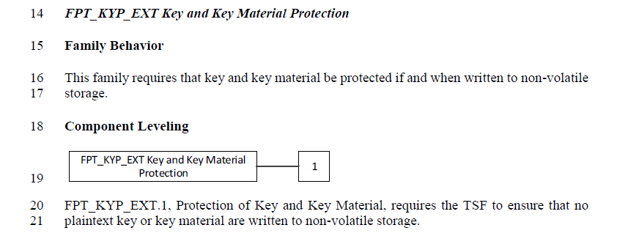
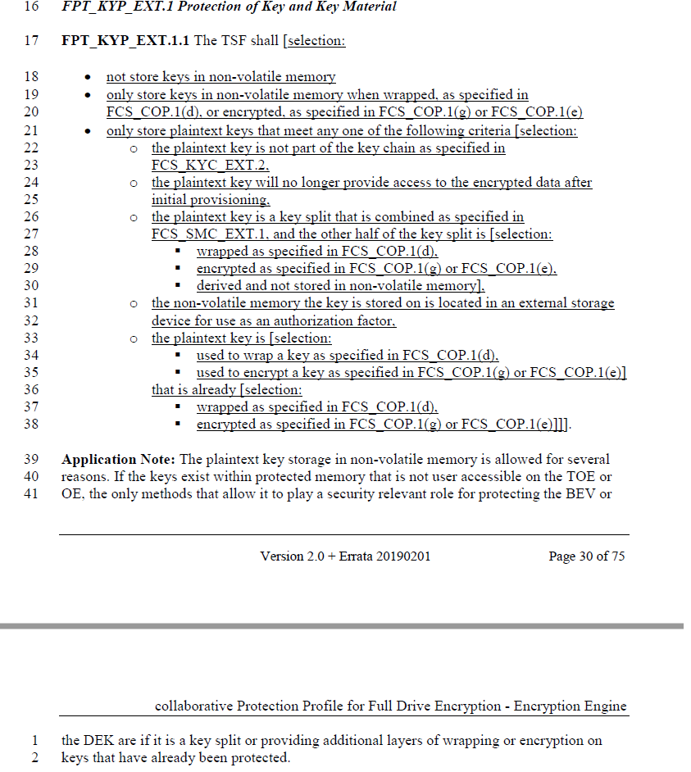
HCD iTC Status
JBMIA Issue on Key Material Collection
C.2 Extended Component Definitions
5. Security Functional Requirements
Reference: FDE cPP 2.0e
Copyright © 2020 The Printer Working Group. All rights reserved.
17

Slide 18
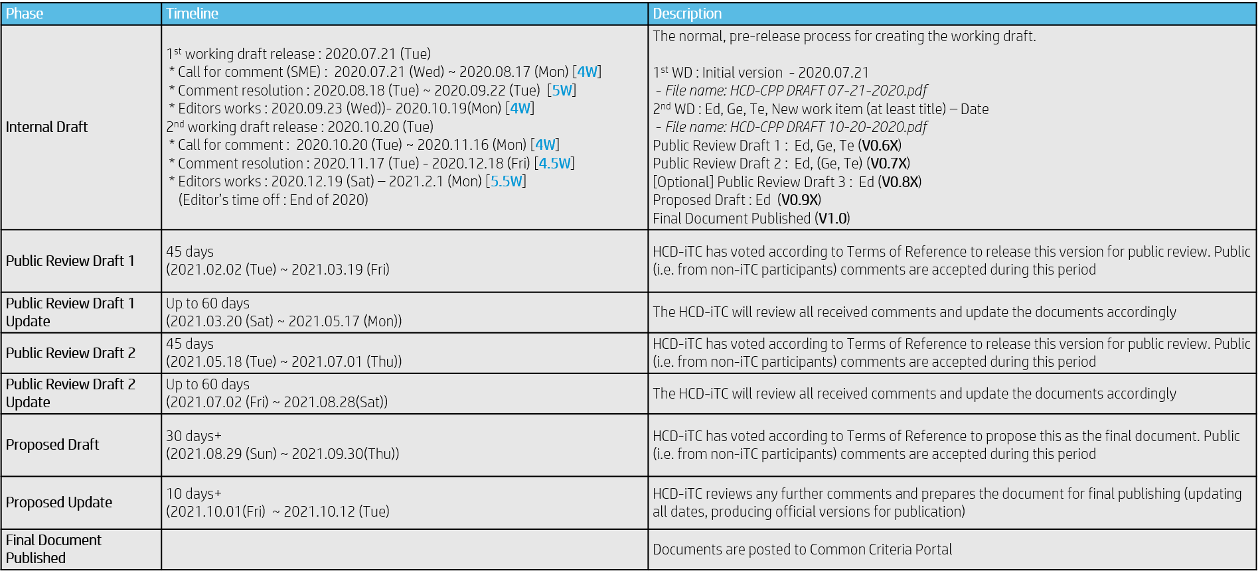
HCD iTC Status
Proposed Public Review Process for HCD cPP Documentation
Copyright © 2020 The Printer Working Group. All rights reserved.
18

Slide 19
HCD iTC Status
Changes to the Schedule
    Release of 2nd Internal Draft HCD cPP delayed until week of 10/26/2020
      Comments due by Nov 23rd
      Comments resolved by Dec 15th
      Updates to HCD cPP to be completed by Jan 6, 2021
    Release of 2nd Internal Draft HCD SD delayed until 11/09/2020
      Comments due by Dec 7th
      Comment resolution date now scheduled for Dec 23rd, but may be moved to early Jan
      Updates to HCD SD now scheduled to be completed by Jan 13, 2021
    Added 3rd Internal Draft of both HCD cPP and HCD SD for sometime in Jan 2021 (date TBD)
      Will only review changes; not full text
    Date of 1st Public Review Drafts still scheduled for 2/2/21
Copyright © 2020 The Printer Working Group. All rights reserved.
19

Slide 20
HCD iTC Status
Other Issues
  Need to get Security Problem Definition publicly reviewed and approved
  Inclusion of ALC_FLR is still a possibility
    Problem will be developing Assurance Activities for ALC_FLR that will meet NIAP’s requirements of being “achievable”, “repeatable”, “testable” & “consistent”
  When to start adding new SFRs and Assurance Activities into the HCD cPP and SD drafts
    Could be a soon as the 3rd Internal Draft
  How much of what is in ND cPP v2.2e for the Secure Protocol SFRs/Assurance Activities will be included?
  What other current SFRs and associated assurance activities in the draft HCD cPP other than the Secure Protocol ones may need to be updated to sync with their corresponding SFRs and Assurance Activities in ND cPP v2.2e and ND SD v2.2
Copyright © 2020 The Printer Working Group. All rights reserved.
20

Slide 21
HCD iTC Status
Other Issues
  From the August 19th IDS F2F, it was stated that the following SFRs and Assurance Activities should be included in HCD cPP/SD v1.0:
    Support for FIPS 140-3
    Removal of all SHA-1 support
    Removal of support for TLS 1.0 and TLS 1.1
    “Hardware-anchored integrity of hardware/software”
  What else might be considered “absolutely necessary” for HCD cPP/SD v1.0:
      Expansion of network-fax separation to “no bridging”
      Syncing with applicable updates to ND cPP and FDE cPPs
      Syncing with any applicable NIST SP updates
      Inclusion of any applicable NIAP TDs to HCD PP and ND & FDE cPPs
      Syncing with ENISA and the new proposed European cybersecurity certification scheme (EUCC) and NIST Cybersecurity Framework
      Changes to ISO/IEC 15408 if they come out in the v1.0 time frame
Copyright © 2020 The Printer Working Group. All rights reserved.
21

Slide 22
HCD Security Guidelines Status
Copyright © 2020 The Printer Working Group. All rights reserved.
22

Slide 23
INCITS Presentation – Common Criteria and How It Could Be Applied to 3D Printing
Copyright © 2020 The Printer Working Group. All rights reserved.
23

Slide 24
Common Criteria Certification
Security Concept
Security is concerned with protection of assets
The concept is that:
You determine what assets need to be protected
Determine what are the threats that result in risks to these assets that need to be protected
Determine what countermeasures are needed to either counteract or minimize the risks caused by the threats
The basic security triad is CIA:
Confidentiality – Prevent unauthorized access
Integrity – Prevent unauthorized change/destruction
Availability – Have access when requested
Copyright © 2020 The Printer Working Group. All rights reserved.
24

Slide 25
WHAT IS COMMON CRITERIA CERTIFICATION?
Copyright © 2020 The Printer Working Group. All rights reserved.
25

Slide 26
What is Common Criteria Certification?
Common Criteria Certification is the international computer security certification process defined by ISO/IEC Standard 15408-1:2009 Information technology — Security techniques — Evaluation criteria for IT security.
It consists of three parts:
Part 1: Introduction and general model
Part 2: Security functional requirements (SFRs)
Part 3: Security assurance requirements (SARs)
There also is an accompanying Common Methodology
for Information Technology Security Evaluation (CEM) document that describes how the SFRs and SARs in Parts 2 and 3, respectively, are to be evaluated.
Copyright © 2020 The Printer Working Group. All rights reserved.
26

Slide 27
Common Criteria Certification
Key Terminology
Target of Evaluation (TOE): A set of software, firmware and/or hardware possibly accompanied by guidance.
  The TOE is what gets certified. It can be anything from a piece of hardware, a software application, part of a product, an operation system to a complete software/hardware/system product
Protection Profile: Implementation-independent statement of security needs for a TOE type (in this case the TOE type will be “3D printers”)
Security Target: Implementation-dependent statement of security needs for a specific identified TOE
Evaluation Scheme: Administrative and regulatory framework under which the CC is applied by an evaluation authority within a specific community
Copyright © 2020 The Printer Working Group. All rights reserved.
27

Slide 28
Common Criteria Certification
TOE Specifications
The two main specifications that will define the requirements for a product to be certified are the Protection Profile and the Security Target.
Protection Profile (PP): Implementation-independent statement of security needs for a TOE type (i.e. generic class of products like HCDs)
Security Target (ST): Implementation-dependent statement of security needs for a specific identified TOE (i.e., a specific product)
The process is that most Evaluation Schemes will require that any product to be certified by that Scheme must be certified against a PP approved by that Scheme
The PP contains the minimum set of SFRs and Assurance Activities that every product of the type the PP covers must meet.
When a product of the type covered by a PP is certified, an ST based on that PP that claims that PP will be created that uses the applicable SFRs and corresponding Assurance Activities from the PP tailored to the specific implementation details for the product being certified.
It is this resultant ST that the product will be evaluated against
Copyright © 2020 The Printer Working Group. All rights reserved.
28

Slide 29
Common Criteria Certification
PP and ST Content
Protection Profile | Security Target
For the generic class of products, the PP includes: | For a specific product in the generic class covered by the PP, the ST includes for the product being certified:
Overview of the class of products Conformance claim (i.e., what EAL is being claimed if any) Security Problem Definition for the general class of products covered by the PP Security Objectives for the class of products Definition of any components modified from CC Part 2 Security Requirements Security Functional Requirements (SFRs) Assurance Activities for each SFR plus additional Security Assurance Requirements taken from CC Part 3 Rationale for both sets of Security Requirements Note: The Security Requirements listed in this PP must be applied as appropriate to any products that are certified against this Protection Profile | Overview of the product Conformance Claim – Usually this will be Exact Conformance to the applicable PP (i.e., per the PP with no deviations) Security Problem Definition (usually same as what is in the PP) Security Objectives (usually same as what is in the PP but can differ if necessary) Definition of any components modified from CC Part 2 Security Requirements Security Functional Requirements (SFRs) included from the PP Assurance Activities for the SFRs included from the PP and the SARs from the PP Rationale for the Security Requirements included in the ST TOE Summary Specification – Provides a technical description how the SFRs included in the ST are satisfied
Copyright © 2020 The Printer Working Group. All rights reserved.
29

Slide 30
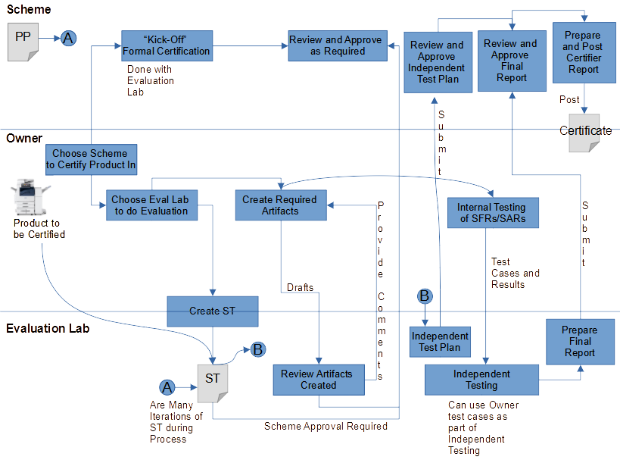
Common Criteria Certification
Process
Note: There are constant communications between the Scheme and the Evaluation Lab and between the Owner and the Evaluation Lab throughout the process
Copyright © 2020 The Printer Working Group. All rights reserved.
30

Slide 31
Common Criteria Certification
End result of a Common Criteria Certification is NEVER that the product being evaluated is secure
It is that the product being evaluated meets or does not meet its specification (either the PP or the ST as appropriate)
Copyright © 2020 The Printer Working Group. All rights reserved.
31

Slide 32
HCD SECURITY PROBLEM DEFINITION
Copyright © 2020 The Printer Working Group. All rights reserved.
32

Slide 33
What is a Hardcopy Device?
A Hardcopy Device is defined as “A system producing or utilizing a physical embodiment of an electronic document or image. These systems include printers, scanners, fax machines, digital copiers, MFPs (multifunction peripherals), MFDs (multifunction devices), “all-in-ones,” and other similar product”
Although the definition “technically” could embrace 3D printers, all the security work to date has been around 2D printers and has focused on two main areas:
Single Function Printers that can only print
Multi-Function Devices (devices that can do two or more of print, scan, copy, PSTN fax and many other functions)
Copyright © 2020 The Printer Working Group. All rights reserved.
33

Slide 34
Typical 2D Hardcopy Device Use Cases
Principally performing one or more of the following functions:
Printing
Copying
Scanning
Other important security-related functions that Hardcopy devices perform are:
Configuration of security settings by authorized administrators
Monitoring security-related events in audit logs by authorized personnel
Verifying the integrity and authenticity of software updates
Checking for malfunctions via self-tests during power-up sequences
Copyright © 2020 The Printer Working Group. All rights reserved.
34

Slide 35
Typical 2D Hardcopy Device Use Cases
Hardcopy Devices may also perform the following optional functions:
Send and receive fax over PSTN
Store electronic documents temporarily or permanently in volatile or non-volatile memory on the device
Overwrite temporary user image data stored on the device
Store audit log data on the device
Purge customer data on the device to aid redeployment or decommissioning of a device
Copyright © 2020 The Printer Working Group. All rights reserved.
35

Slide 36
2D Hardcopy Devices
Key Security Threats
Unauthorized Access to user document data stored in the HCD (primarily in non-volatile storage)
Unauthorized Access to TSF data stored in the HCD
Unauthorized Access to User and TSF data transmitted to/from the HCD over a network
Unauthorized Software Update
Failure of the TSF
Copyright © 2020 The Printer Working Group. All rights reserved.
36

Slide 37
2D Hardcopy Devices
Key Security Assumptions
Title | Assumption
Physical Security | Physical security, commensurate with the value of the TOE and the data it stores or processes, is assumed to be provided by the environment
Network Security | The Operational Environment is assumed to protect the HCD from direct, public access to its LAN interface
Administrator Trust | The HCD Owner shall establish trust that Administrators will not use their privileges for malicious purposes
Trained Users | Authorized Users are trained to use the HCD according to site security policies
Copyright © 2020 The Printer Working Group. All rights reserved.
37

Slide 38
2D Hardcopy Devices
Key Organizational Security Policies
Title | Policy
User Authorization | Users must be authorized before performing Document Processing and administrative functions
Auditing | Security-relevant activities must be audited and the log of such actions must be protected and transmitted to an External IT Entity
Protected Communications | The HCD must be able to identify itself to other devices on the LAN
PSTN Fax-Network Separation | If the HCD includes a PSTN fax function, it will ensure separation between the PSTN fax line and the LAN
Storage Encryption | If the HCD stores User Document Data or Confidential TSF Data on Nonvolatile Storage Devices, it will encrypt such data on those devices
Copyright © 2020 The Printer Working Group. All rights reserved.
38

Slide 39
2D Hardcopy Devices
Key Organizational Security Policies
Title | Policy
Key Material | Cleartext keys, submasks, random numbers, or any other values that contribute to the creation of encryption keys for Nonvolatile Storage of User Document Data or Confidential TSF Data must be protected from unauthorized access and must not be stored on that storage device
Image Overwrite | Upon completion or cancellation of a Document Processing job, the TOE shall overwrite residual image data from its Nonvolatile Storage Devices
Purge Data | The HCD shall provide a function that an authorized administrator can invoke to make all customer-supplied User Data and TSF Data permanently irretrievable from Nonvolatile Storage Devices
Copyright © 2020 The Printer Working Group. All rights reserved.
39

Slide 40
2D Hardcopy Devices
Key Security Objectives of the HCD
Title | Objective
User Identification and Authentication | Perform identification and authentication of Users for operations that require access control, User authorization, or Administrator roles
User Authorization | Perform authorization of Users in accordance with security policies
Access Control | The HCD shall enforce access controls to protect User Data and TSF Data in accordance with security policies
Administrator Roles | The HCD shall ensure that only authorized Administrators are permitted to perform administrator functions
Software Update Verification | The HCD shall provide mechanisms to verify the authenticity of software updates
Self-Test | The HCD shall test some subset of its security functionality to help ensure that subset is operating properly
Auditing | The HCD shall generate audit data, and be capable of sending it to a trusted External IT Entity. Optionally, it may store audit data in the TOE
Copyright © 2020 The Printer Working Group. All rights reserved.
40

Slide 41
2D Hardcopy Devices
Key Security Objectives of the HCD
Title | Objective
Communications Protection | The HCD shall have the capability to protect LAN communications of User Data and TSF Data from Unauthorized Access, replay, and source/destination spoofing
Storage Encryption | If the HCD stores User Document Data or Confidential TSF Data in Nonvolatile Storage devices, then the HCD shall encrypt such data on those devices
Image Overwrite | Upon completion or cancellation of a Document Processing job, the HCD shall overwrite residual image data in its Nonvolatile Storage Devices
Protection of Key Material | The HCD shall protect from unauthorized access any cleartext keys, submasks, random numbers, or other values that contribute to the creation of encryption keys for storage of User Document Data or Confidential TSF Data in Nonvolatile Storage Devices; The HCD shall ensure that such key material is not stored in cleartext on the storage device that uses that material
Purge Data | The HCD provides a function that an authorized administrator can invoke to make all customer-supplied User Data and TSF Data permanently irretrievable from Nonvolatile Storage Devices
PSTN Fax-Network Separation | If the HCD provides a PSTN fax function, then the HCD shall ensure separation of the PSTN fax telephone line and the LAN, by system design or active security function
Copyright © 2020 The Printer Working Group. All rights reserved.
41

Slide 42
2D Hardcopy Devices
Key Security Objectives of the Operating Environment
Title | Objective
Physical Protection | The Operational Environment shall provide physical security, commensurate with the value of the HCD and the data it stores or processes
Network Protection | The Operational Environment shall provide network security to protect the HCD from direct, public access to its LAN interface
Trusted Administrators | The HCD Owner shall establish trust that Administrators will not use their privileges for malicious purposes
Trained Users | The HCD Owner shall ensure that Users are aware of site security policies and have the competence to follow them
Trained Administrators | The HCD Owner shall ensure that Administrators are aware of site security policies and have the competence to use manufacturer’s guidance to correctly configure the HCD and protect passwords and keys accordingly
Copyright © 2020 The Printer Working Group. All rights reserved.
42

Slide 43
WHAT ABOUT 3D PRINTERS?
Copyright © 2020 The Printer Working Group. All rights reserved.
43

Slide 44
2D Printing vs 3D Printing
    At the 10,000 foot Level, 2D Printing and 3D Printing are not that dissimilar.
    Essentially 2D Printing is converting a document from an electronic representation of the document stored on an IT device or some other type of media to a physical representation of the document on some type of paper
    Similarly, 3D printing is essentially converting an object that is desired to be printed from an electronic representation of the object in terms of a CAD file and later an STL/3MF file to a physical representation of the object in terms of the final 3D printed object
Copyright © 2020 The Printer Working Group. All rights reserved.
44

Slide 45
Digital Thread for Additive Manufacturing
Process Steps
  Product Inception
    Requirements Definition
    Concept generation/evaluation
    Design intent
  Design/Scan and Analyze
    CAD file created (asset that needs to be protected?)
    Traditional analysis
    Advanced multi-physics modeling and simulation (asset that might need to be protected?)
  Build and Monitor
    Simulation of build (asset that needs to be protected?)
    Detailed Build Plan and Machine Data
    Part Fabrication (includes Slicer software which may be an asset that needs to be protected)
    Per part post processing and finishing
Copyright © 2020 The Printer Working Group. All rights reserved.
45

Slide 46
Digital Thread for Additive Manufacturing
Other Assets That Might Need to Be Protected
  Software on the computer storing the CAD File
  Software of the 3D Printer that controls the 3D printer
  STL or 3MF file the CAD file is transformed into
Copyright © 2020 The Printer Working Group. All rights reserved.
46

Slide 47
Digital Thread for Additive Manufacturing
Some Data and IT Security Concerns
    Cybersecurity Threats
      Espionage
      Tampering / Hacking / Mischief / Extortion / Terrorism
      Privacy
      Intellectual Property / Trade Secrets
    Data Integrity along the entire Digital Thread
    Protect Data Confidentiality
    Ensure/Protect Data Integrity
    Verify Data Integrity
    Protect Intellectual Property
Copyright © 2020 The Printer Working Group. All rights reserved.
47

Slide 48
3D Printers and Common Criteria Certification
Could the Common Criteria Certification process that was used to certify 2D Hardcopy Devices be used to perform a similar security certification for the Digital Thread for Additive Manufacturing?
Remember – The high-level goal of a Common Criteria Certification is to provide confidence to the owner for the product in question that the mitigations they have put in place to protect the assets that need to be protected from the identified security threats are correct and sufficient.
It does that by determining that the product meets its specification of the security requirements as stated in the Security Target by evaluating that the product passes the assurance requirements stated in the Security Target.
Copyright © 2020 The Printer Working Group. All rights reserved.
48

Slide 49
3D Printers and Common Criteria Certification
Could the Common Criteria Certification process that was used to certify 2D Hardcopy Devices be used to perform a similar security certification for the Digital Thread for Additive Manufacturing?
Paul and I think the answer is ‘YES IT CAN BE’
Fundamentally what would be needed is to define:
What are the assets that need to be protected in the Digital Thread for Additive Manufacturing
  CAD and STL/3MF files
  Software
  Simulations
  Slicer software
  etc.
Copyright © 2020 The Printer Working Group. All rights reserved.
49

Slide 50
3D Printers
Security Problem Definition
Need to determine what the Security Problem Definition (SPD) for the Digital Thread is:
What are the key security threats to those assets?
What key assumptions need to be made around protection of these key assets
What key organizational security policies need to be in place to assure that the key assets are protected
What security objectives does the 3D printer and its operating environment have to meet to ensure that the key threats identified above are either mitigated or eliminated?
Copyright © 2020 The Printer Working Group. All rights reserved.
50

Slide 51
3D Printers
Some Thoughts on Threats to the Digital Thread
Recall the 5 Threats to 2D Printers
    Unauthorized Access to user document data stored in the HCD (primarily in non-volatile storage)
    Unauthorized Access to TSF data stored in the HCD
    Unauthorized Access to User and TSF data transmitted to/from the HCD over a network
    Unauthorized Software Update
    Failure of the TSF
We think some of same threats might apply to the Digital Thread:
  Unauthorized access to the CAD file and model/simulations while stored on the computer hosting the CAD file/models/simulations (even if it is the 3D printer)
  Unauthorized access to the STL/3MF file created from the CAD file while stored in either on the computer hosting the CAD file or on the 3D printer itself
  Unauthorized access to the STL/3MF file while in transit between the computer hosting the CAD filer and the 3D printer if stored on separate computers
  Unauthorized access to the build simulation and slicer software stored on the 3D printer
  Unauthorized software upgrade of either the computer hosting the CAD file or the 3D printer
Copyright © 2020 The Printer Working Group. All rights reserved.
51

Slide 52
3D Printers
Answers to the key security questions (in our view)
As far as Assumptions and Security Policies that is something that would have to be determined
Regarding Security Objectives, we think the following 2D Security Objectives might also apply in total or in part to the Digital Thread:
  User Identification and Authentication
  Access Control
  Software Update Verification
  Self-Test
  Communications Protection
  Storage Encryption
  Protection of Key Material
Once you have an SPD then you can start determining what Security Requirements from CC Part 2 and what associated Security Assurance Requirements will be necessary to meet the security objectives of the Digital Thread for Additive Manufacturing
Copyright © 2020 The Printer Working Group. All rights reserved.
52

Slide 53
3D Printers
Common Criteria Certification Next Steps
If the SPD for 3D Printers is similar enough to the SPD for 2D Printers, and we think it is based on the previous slides, then the Common Criteria Certification approach could work for providing a level of security assurance to the Digital Thread for Additive Manufacturing
Next Steps would be to:
  Create of a 3D Printing Technical Community (TC) to work this problem in coordination with the HCD international TC
  Determine who the customers/audience for this TC would be
  Generate an approved 3D Printing Protection Profile. Our initial thought is that it could be a PP-Module based off of the HCD collaborative PP that is currently being developed for publication sometime in 4Q 2021
  Recognize this will take time; realistically we are probably talking end of 2022 at the earliest before we would have a PP
  Once we have a 3D Printing PP we can start certifying 3D Printers against that PP
Copyright © 2020 The Printer Working Group. All rights reserved.
53

Slide 54
Next Steps – IDS WG
Next IDS Conference Call – Nov 12, 2020
Next IDS Face-to-Face Meeting Feb 9-11, 2021 (probably Feb 10) at next PWG Virtual F2F
Start looking at involvement in some of these other standards activities individually and maybe as a WG
Copyright © 2020 The Printer Working Group. All rights reserved.
54

