Slide 1

Imaging Device Security
The Printer Working Group
August 19, 2020
PWG August 2020 Virtual Face-to-Face
Copyright © 2020 The Printer Working Group. All rights reserved.
1

Slide 2

Agenda
When | What
10:00 – 10:05 | Introductions, Agenda review
10:05 – 10:45 | Discuss results of latest HCD iTC Meetings and potential HCD cPP v1.0 content
10:45 – 11:10 | Review of new ETSI IoT Security Standard
11:10 – 11:35 | HCD Security Guidelines 1.0 Status
11:35 – 11:55 | Status of other HCD Security Standards Efforts
11:55 – 12:00 | Wrap Up / Next Steps
Copyright © 2020 The Printer Working Group. All rights reserved.
2

Slide 3
Intellectual Property Policy
  “This meeting is conducted under the rules of the PWG IP policy”.
    Refer to the IP statements in the plenary slides
Copyright © 2020 The Printer Working Group. All rights reserved.
3

Slide 4
Officers
Chair:
  Alan Sukert (Xerox)
Vice-Chair:
  TBD
Secretary:
  Alan Sukert (Xerox)
Document Editor:
  Ira McDonald (High North) – HCD Security Guidelines
Copyright © 2020 The Printer Working Group. All rights reserved.
4

Slide 5
HCD international Technical Community (iTC) Status
Copyright © 2020 The Printer Working Group. All rights reserved.
5

Slide 6
HCD international Technical Community (iTC)
HCD iTC formally approved by Common Criteria Management Committee in Feb 2020
Key HCD iTC Officers:
  Chairperson – Kwangwoo Lee, HP
  Deputy Chairperson – Alan Sukert
  CCDB Liaison - Eunkyoung Yi, Korean Scheme
  Editors – Alan Sukert; Brian Volkoff, Ricoh; Geraldo Colunga, HP
  Record Manager – TBD (Kwangwoo Lee acting for now)
Copyright © 2020 The Printer Working Group. All rights reserved.
6

Slide 7
HCD international Technical Community (iTC)
Agreed to hold bi-weekly meetings. Since last IDS F2F in May, meetings have been held on:
  5/28/2020
  6/11/2020
  6/25/2020
  7/9/2020
  7/23/2020
  8/6/2020
Also held Editor’s Meetings on the off-weeks between the bi-weekly HCD iTC meetings
Copyright © 2020 The Printer Working Group. All rights reserved.
7

Slide 8
HCD iTC Status
  Key Status:
  First internal draft of the HCD collaborative Protection Profile (cPP) released for HCD iTC review on 7/21; comments due by August 17th
    Contains all the SFRs from HCD PP v1.0 and v1.1
  First internal draft of the HCD Supporting Document (SD) should be released for HCD iTC review on 8/17
    Contains all the Assurance Activities from HCD PP
  Both internal drafts are to contain the contents of what would have been HCD PP v1.1, which should include:
    HCD PP v1.0 as approved by NIAP and JISEC
    HCD PP Errata #1
    All NIAP Technical Decisions against the HCD PP
    All changes to HCD PP v1.0 approved by the HCD Technical Committee before it became the HCD iTC
Copyright © 2020 The Printer Working Group. All rights reserved.
8

Slide 9


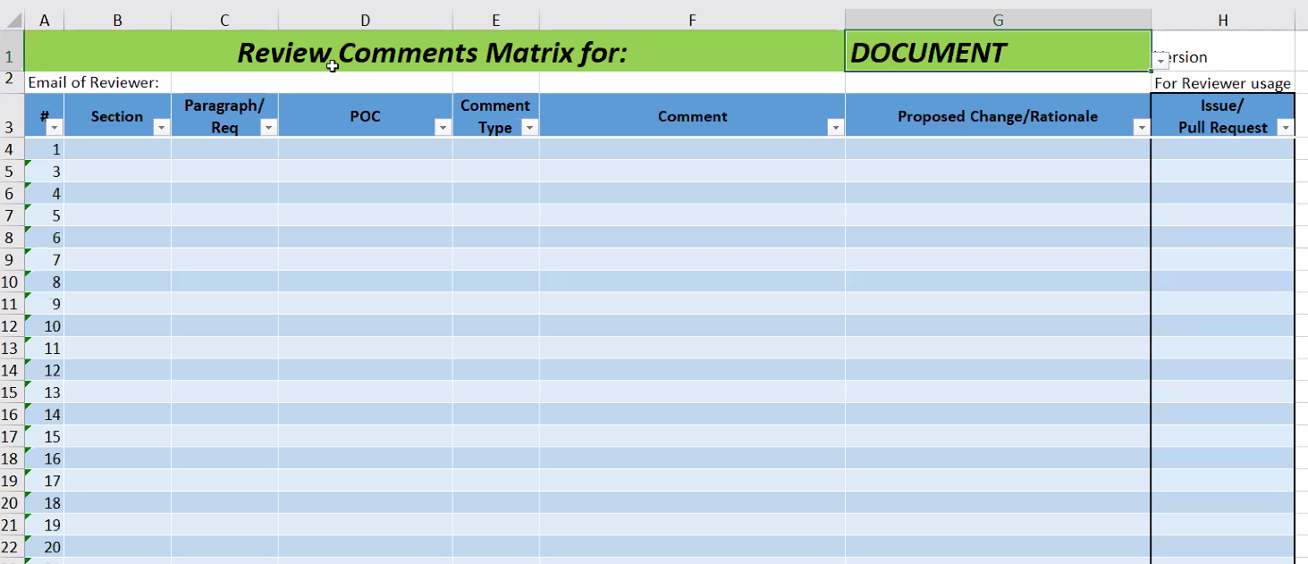
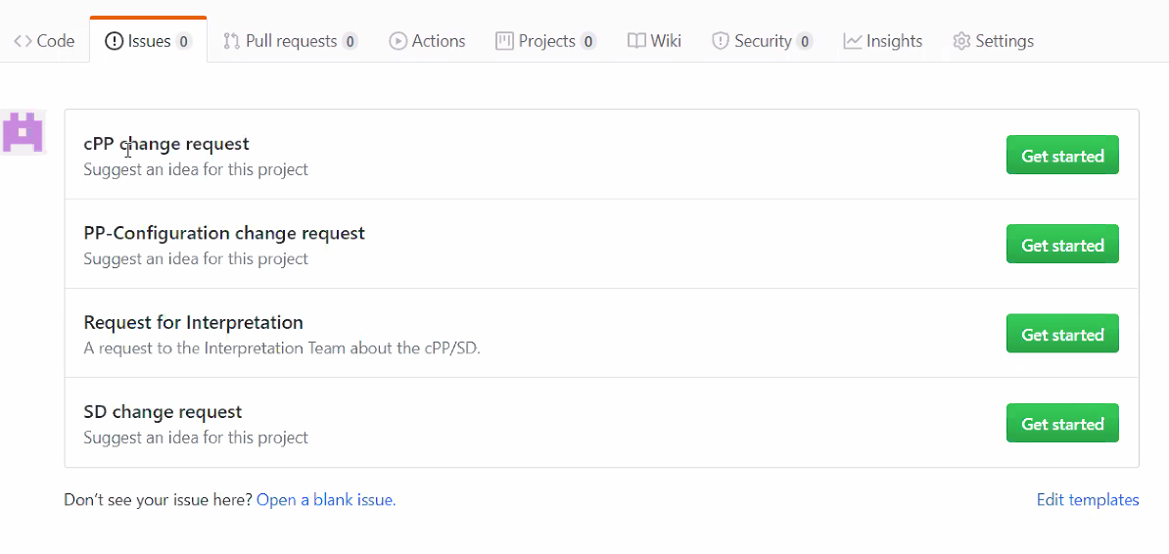
HCD-iTC-Admin-template/Review_Process.adoc
HCD iTC will publish the draft cPP (file format : .pdf)
w/o page number
Update the PR Status
Editors
HCD iTC SMEs
Submit Review comment
- Github “New issue”
Implementation
Create the Master spreadsheet
(Review Comments Matrix)
cPP (Brian)
SD (Jerry)
cPP (Alan)
SD (Jerry)
Sanity Check
Triage
(Editorial, General, Technical)
Review the proposal
Decision Making - Vote
Chair
HCD iTC Editors meeting
→ HCD iTC biweekly meeting
9
Copyright © 2020 The Printer Working Group. All rights reserved.
9

Slide 10
EAL Claim for HCD cPP
Option 1 : No EAL Claim (SARs of EAL2 without ALC_FLR)
  Pro
    Reduces the risk for requiring vendors to double-certify (which is the current situation for some vendors).
  Cons :
    Longer timeline for developing the cPP/SD due to the additional work needed to implement EAs for SARs of EAL2.
    Longer timeline for evaluations due to the additional SARs which require a vendor to generate additional evaluation evidence (e.g. TOE Design, Delivery, etc.).
    Risk for NIAP to not endorse the cPP/SD.
Option 4 : No EAL Claim (SARs of EAL1 without ALC_FLR)
  Pros
    Shorter timeline for developing cPP/SD.
    Shorter timeline for evaluations.
    Lower risk for NIAP not to endorse the cPP/SD.
  Con
    Higher risk for requiring vendors to double-certify
Copyright © 2020 The Printer Working Group. All rights reserved.
10

Slide 11
EAL Claim for HCD cPP
Could not achieve consensus so it was agreed to put it to a vote of the entire HCD iTC
Voting Rules: Vote is for either
  Option 1 : No EAL Claim (SARs of EAL2 without ALC_FLR)
  Option 4 : No EAL Claim (SARs of EAL1 without ALC_FLR)
Voting Rules
  One vote is allowed for each member organization, not for each individual member.
  “Organization” is defined according to the definition adopted by the CC Users Forum; for commercial enterprises, a parent company and all of its divisions and subsidiaries constitute one organization.
  Votes submitted shall be explicit: Option 1, Option 4.
  At the end of the voting period, ballots are tabulated and reviewed by the Chair or the Technical Editor. Results of voting are posted, including a summary of the vote and the votes cast by each organization.
  An approval criteria will be simple majority for this voting.
Copyright © 2020 The Printer Working Group. All rights reserved.
11

Slide 12
EAL Claim for HCD cPP
Results
Candidate | Total Votes
Option 1 | 7
Option 4 | 15
Total Votes | 22
There were 22 votes cast in all, by a total of 22 of different entities.
7 entities votes for a option 1, while 15 entities votes for a option 4
If anyone has any questions relating to the results then please feel free to ask.
Total Organizations in HCD iTC | 31
Copyright © 2020 The Printer Working Group. All rights reserved.
12

Slide 13
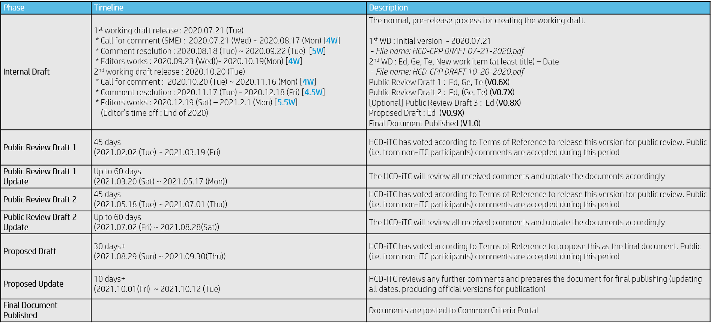
HCD iTC Status
Proposed Public Review Process for HCD cPP Documentation
Copyright © 2020 The Printer Working Group. All rights reserved.
13

Slide 14
HCD iTC Status
Other Issues
  Inclusion of ALC_FLR
    Problem will be developing assurance activities for ALC_FLR that will meet NIAP’s requirements of being “achievable”, “repeatable”, “testable” & “consistent”
  When to start adding new SFRs and Assurance Activities into the HCD cPP and SD drafts
    Should be ASAP
  What new SFRs and Assurance Activities should we include in HCD cPP/SD v1.0:
    Split TLS (and maybe SSH) requirements into separate server and client requirements (a must have)
      Problem is which version of the split requirements to use – are different TLS packages and the version in ND cPP v2.2e
    Reflect any new NIAP/JISEC Technical Decisions (a must have)
Copyright © 2020 The Printer Working Group. All rights reserved.
14

Slide 15
HCD iTC Status
Other Issues
  What new SFRs and Assurance Activities should we include in HCD cPP/SD v1.0 (cont’d):
    Support for FIPS 140-3 (a must have)
    Removal of all SHA-1 support (a must have)
    Removal of support for TLS 1.0 and TLS 1.1 (a must have)
    Support for TLS 1.3 (If requirements are included in ND cPP/SD in time)
    Anything that the HCD iTC as a group determines over the next 6-9 months is an “absolute must have” in v1.0; anything less has to go in v1.1 or later. Possible candidates include:
      Expansion of network-fax separation to “no bridging”
      Syncing with ENISA and the new proposed European cybersecurity certification scheme (EUCC)
      Syncing with applicable updates to ND cPP and FDE cPPs
      Syncing with any applicable NIST SP updates
Copyright © 2020 The Printer Working Group. All rights reserved.
15

Slide 16
ETSI EN 303 645 V2.1.1 (2020-06)
Cyber Security for Consumer Internet of Things
Copyright © 2020 The Printer Working Group. All rights reserved.
16

Slide 17
ETSI EN 303 645 V2.1.1 (2020-06)
Cyber Security for Consumer Internet of Things
Scope
Consumer IoT devices that are connected to network infrastructure (such as the Internet or home network)
Note: The standard defines a consumer IoT device as a “network-connected (and network-connectable) device that has relationships to associated services and are used by the consumer typically in the home or as electronic wearables”
Examples given in the standard would suggest the standard only applies to what we would typically consider consumer products – toys, TVs, smart phones, computers, home appliances, etc. However, the definition of consumer IoT device in this standard could be interpreted to apply to a home printer or desktop MFP purchased strictly for home use, so this standard could apply to HCDs.
Copyright © 2020 The Printer Working Group. All rights reserved.
17

Slide 18
ETSI EN 303 645 V2.1.1 (2020-06)
Cyber Security for Consumer Internet of Things
Requirements Categories:
Passwords
  Where passwords are used and in any state other than the factory default, all consumer IoT device passwords shall be unique per device or defined by the user
  Authentication mechanisms used to authenticate users against a device shall use best practice cryptography, appropriate to the properties of the technology, risk and usage
  Constrained Device - device which has physical limitations in either the ability to process data, the ability to communicate data, the ability to store data or the ability to interact with the user, due to restrictions that arise from its intended use
Copyright © 2020 The Printer Working Group. All rights reserved.
18

Slide 19
ETSI EN 303 645 V2.1.1 (2020-06)
Cyber Security for Consumer Internet of Things
Requirements Categories:
Vulnerability Management
  The manufacturer shall make a vulnerability disclosure policy publicly available. This policy shall include, at a minimum:
    initial acknowledgement of contact information for the reporting of issues; and
    information on timelines for:
      receipt; and
      status updates until the resolution of the reported issues.
Software Update
  Many Software Update requirements (more than any other category)
  Automatic mechanisms should be used for software updates.
  The device should check after initialization, and then periodically, whether security updates are available.
  The manufacturer should inform the user in a recognizable and apparent manner that a security update is required together with information on the risks mitigated by that update
  The manufacturer shall publish, in an accessible way that is clear and transparent to the user, the defined support period
Copyright © 2020 The Printer Working Group. All rights reserved.
19

Slide 20
ETSI EN 303 645 V2.1.1 (2020-06)
Cyber Security for Consumer Internet of Things
Requirements Categories:
Secure Parameter Storage
  Sensitive security parameters in persistent storage shall be stored securely by the device
  Hard-coded critical security parameters in device software source code shall not be used
Secure Communication
  The consumer IoT device shall use best practice cryptography to communicate securely
  Cryptographic algorithms and primitives should be updateable (“cryptoagility”)
  Critical security parameters should be encrypted in transit, with such encryption appropriate to the properties of the technology, risk and usage
Copyright © 2020 The Printer Working Group. All rights reserved.
20

Slide 21
ETSI EN 303 645 V2.1.1 (2020-06)
Cyber Security for Consumer Internet of Things
Requirements Categories:
Minimize Attack Surface
  All unused network and logical interfaces shall be disabled
  In the initialized state, the network interfaces of the device shall minimize the unauthenticated disclosure of security-relevant information
  Device hardware should not unnecessarily expose physical interfaces to attack
Software Integrity
  The consumer IoT device should verify its software using secure boot mechanisms
  If an unauthorized change is detected to the software, the device should alert the user and/or administrator to the issue and should not connect to wider networks than those necessary to perform the alerting function
Copyright © 2020 The Printer Working Group. All rights reserved.
21

Slide 22
ETSI EN 303 645 V2.1.1 (2020-06)
Cyber Security for Consumer Internet of Things
Requirements Categories:
Securing Personal Data
  The confidentiality of personal data transiting between a device and a service, especially associated services, should be protected, with best practice cryptography
  The confidentiality of sensitive personal data communicated between the device and associated
  services shall be protected, with cryptography appropriate to the properties of the technology and usage
System Resiliency
  Resilience should be built in to consumer IoT devices and services, taking into account the possibility of outages of data networks and power
  Consumer IoT devices should remain operating and locally functional in the case of a loss of network access and should recover cleanly in the case of restoration of a loss of power
Copyright © 2020 The Printer Working Group. All rights reserved.
22

Slide 23
ETSI EN 303 645 V2.1.1 (2020-06)
Cyber Security for Consumer Internet of Things
Requirements Categories:
System Telemetry Data
  If telemetry data is collected from consumer IoT devices and services, such as usage and measurement
  data, it should be examined for security anomalies
Data Deletion
  The user shall be provided with functionality such that user data can be erased from the device in a simple manner
  Users should be given clear instructions on how to delete their personal data
Installation and Maintenance
  Installation and maintenance of consumer IoT should involve minimal decisions by the user and should follow security best practice on usability
  The manufacturer should provide users with guidance on how to securely set up their device
  The manufacturer should provide users with guidance on how to check whether their device is securely set up
Copyright © 2020 The Printer Working Group. All rights reserved.
23

Slide 24
ETSI EN 303 645 V2.1.1 (2020-06)
Cyber Security for Consumer Internet of Things
Requirements Categories:
Input Data Validation
  The consumer IoT device software shall validate data input via user interfaces or transferred via Application Programming Interfaces (APIs) or between networks in services and devices
Data Protection
  The manufacturer shall provide consumers with clear and transparent information about what personal data is processed, how it is being used, by whom, and for what purposes, for each device and service. This also applies to third parties that can be involved, including advertisers
  If telemetry data is collected from consumer IoT devices and services, consumers shall be provided with information on what telemetry data is collected, how it is being used, by whom, and for what purposes
Copyright © 2020 The Printer Working Group. All rights reserved.
24

Slide 25
ETSI EN 303 645 V2.1.1 (2020-06)
Cyber Security for Consumer Internet of Things
Some Ideas on Enforcement of the Standard*
The new EN 303 645 standard set by ETSI doesn’t necessarily indicate enforcement, it paves the way for certifications that help towards that under various other regulatory enforcement. For example, ENISA, under its EU cybersecurity Act, is likely to pick up the EN 303 645 standard and then enforce it.
In another scenario, where there is a security breach in an internet-connected device which involves a data compromise under GDPR regulations. “If as a manufacturer you can say you followed every recommendation in the EN, the data commissioner may look on your case more favorably. But if you simply said you thought about it but did nothing about following the recommendations, then there is no case to answer and there could be significant financial penalties under GDPR rules.”
*From EE Times Europe, July 3, 2020
Copyright © 2020 The Printer Working Group. All rights reserved.
25

Slide 26
ETSI EN 303 645 V2.1.1 (2020-06)
Cyber Security for Consumer Internet of Things
Some Ideas on Enforcement of the Standard*
On another dimension, the new standard also helps with consumer confidence in the security of everyday products that connect to the internet. You could then have a scheme which certifies products under a traffic light system – green means it meets the standard. For consumers who are unlikely to understand the technicalities of their connected wearables or connected products, this will help in identifying which products they can buy with assurance that it meets some cybersecurity standards
*From EE Times Europe, July 3, 2020
Note: ETSI is also developing a test specification and an implementation guide to complement this standard which may provide additional guidance on enforcement of the standard; no dates for completion of these documents have been provided
Copyright © 2020 The Printer Working Group. All rights reserved.
26

Slide 27
HCD Security Guidelines Status
Copyright © 2020 The Printer Working Group. All rights reserved.
27

Slide 28
Other HCD Security Standards Activities
Copyright © 2020 The Printer Working Group. All rights reserved.
28

Slide 29
Potential Standards Activities To Be Watched
(3) US NIST - FREE!
* LWC (Lightweight Cryptography)
-- https://www.nist.gov/programs-projects/lightweight-cryptography
-- for resource-constrained devices (including mobile phones)
* TC (Threshold Cryptography)
-- https://csrc.nist.gov/Projects/Threshold-Cryptography
-- multi-party signatures and encryption algorithms - hot stuff!
* CF (Cybersecurity Framework)
-- https://www.nist.gov/cyberframework
* PQC (Post-Quantum Crypto)
-- https://csrc.nist.gov/Projects/Post-Quantum-Cryptography
* SWID (Software Identification Tags)
-- https://csrc.nist.gov/Projects/Software-Identification-SWID
-- see also https://datatracker.ietf.org/doc/draft-ietf-sacm-coswid/
-- underlies runtime integrity and remote attestation work
* SWA (Software Assurance)
-- https://www.nist.gov/itl/ssd/software-assurance
Copyright © 2020 The Printer Working Group. All rights reserved.
29

Slide 30
NIST CYBERSECURITY FRAMEWORK
Copyright © 2020 The Printer Working Group. All rights reserved.
30

Slide 31
NIST CyberSecurity Framework
Risk-based approach to managing cybersecurity risk
Composed of three parts:
  Framework Core -- Set of cybersecurity activities, desired outcomes, and applicable references that are common across critical infrastructure sectors
    Desired cybersecurity outcomes organized in a hierarchy and aligned to more detailed guidance and controls
  Framework Implementation Tiers -- Provide context on how an organization views cybersecurity risk and the processes in place to manage that risk
    Alignment of an organization’s requirements and objectives, risk appetite and resources using the desired outcomes of the Framework Core
  Framework Profiles -- Represents the outcomes based on business needs that an organization has selected from the Framework Categories and Subcategories
    A qualitative measure of organizational cybersecurity risk management practices
Copyright © 2020 The Printer Working Group. All rights reserved.
31

Slide 32
NIST CyberSecurity Framework
Framework Core Elements
Functions: Organize basic cybersecurity activities at their highest level
  Functions are Identify, Protect, Detect, Respond, and Recover
Categories: Subdivisions of a Function into groups of cybersecurity outcomes closely tied to programmatic needs and particular activities.
  Examples of Categories include “Asset Management,” “Identity Management and Access Control,” and “Detection Processes.”
Subcategories: Further divide a Category into specific outcomes of technical and/or management activities.
  Provide a set of results that, while not exhaustive, help
  support achievement of the outcomes in each Category
Informative References: Specific sections of standards, guidelines, and practices common among critical infrastructure sectors that illustrate a method to achieve the outcomes associated with each Subcategory
Copyright © 2020 The Printer Working Group. All rights reserved.
32

Slide 33
NIST CyberSecurity Framework
Framework Core
Function
Identify
Protect
Detect
Respond
Recover
Develop an organizational understanding to manage cybersecurity risk to systems, people, assets, data, and capabilities
Develop and implement appropriate safeguards to ensure delivery of critical services.
Develop and implement appropriate activities to identify the occurrence of a cybersecurity event
Develop and implement appropriate activities to take action regarding a detected cybersecurity incident
Develop and implement appropriate activities to maintain plans for resilience and to restore any capabilities or services that were impaired due to a cybersecurity incident
Copyright © 2020 The Printer Working Group. All rights reserved.
33

Slide 34
NIST CyberSecurity Framework
Functions and Categories
Function | Category
Identity | Asset Management
 | Business Environment
 | Governance
 | Risk Assessment
 | Risk Management Strategy
 | Supply Chain Risk Management
Protect | Identity Management and Access Control
 | Awareness and Training
 | Data Security
 | Information Protection Processes and Procedures
 | Maintenance
 | Protective Technology
Detect | Anomalies and Events
 | Security Continuous Monitoring
 | Detection Processes
Response | Response Planning
 | Communications
 | Analysis
 | Mitigation
 | Improvements
Recover | Recovery Planning
 | Improvements
 | Communications
Copyright © 2020 The Printer Working Group. All rights reserved.
34

Slide 35
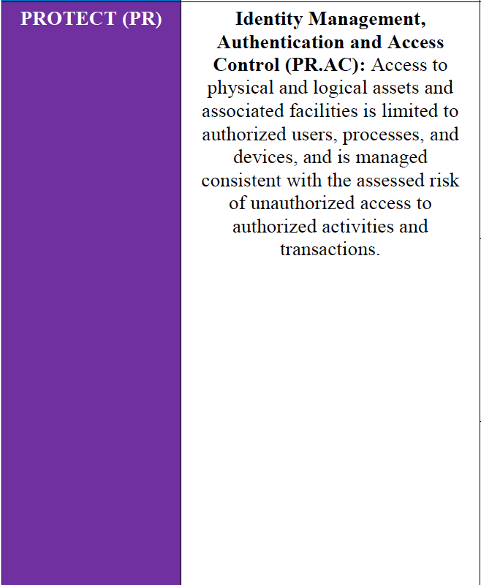
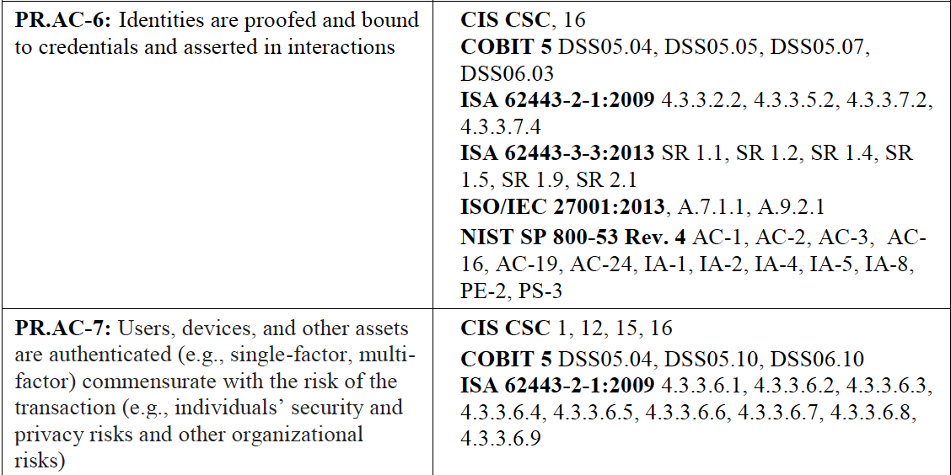

NIST CyberSecurity Framework
Framework Core Excerpt
5 Functions
23 Categories
108 Subcategories
6 Informative References
Copyright © 2020 The Printer Working Group. All rights reserved.
35

Slide 36
NIST CyberSecurity Framework
Implementation Tiers
 | Risk Management Process | Integrated Risk Management Program | External Participation
Tier 1 Partial | Ad hoc Not formalized Reactive | Limited risk awareness Implementation uneven | No collaboration with other entities
Tier 2 Risk Informed | Risks prioritized by needs No organizational policy | No organizational-wide approach or implementation | Is some collaboration with others, but doesn’t always act on info
Tier 3 Repeatable | Formal policy Practices updated as needed | Organization-wide approach Processes/practices in place | Regularly collaborates & shares info with other entities
Tier 4 Adaptive | Adapts practices based on lessons learned, changing threats | Becomes part of organizational culture | Regularly uses and shares risk info with external entities
Copyright © 2020 The Printer Working Group. All rights reserved.
36

Slide 37
Next Steps – IDS WG
Next IDS Conference Call – Sep 3, 2020
Next IDS Face-to-Face Meeting Nov 10-12 (probably Nov 12), 2020 at next Virtual PWG F2F
Start looking at involvement in some of these other standards activities individually and maybe as a WG
Copyright © 2020 The Printer Working Group. All rights reserved.
37

Slide 38
BACKUP
Copyright © 2020 The Printer Working Group. All rights reserved.
38

Slide 39
Trusted Computing Group (TCG)
Next TCG Members Meetings
  TCG Virtual F2F – 12-16 October 2020 –Ira to call in
  TCG Virtual F2F – TBD dates February 2021 –Ira to call in
Trusted Mobility Solutions (TMS) – Ira is co-chair and co-editor
  Formal – GP (TEE, SE), ETSI (NFV/MEC), ATIS (5G Security)
  Informal – 3GPP, GSMA, IETF, ISO, ITU-T, SAE, US NIST
  TCG TMS Use Cases v2 – published September 2018
Mobile Platform (MPWG) – Ira is co-editor
  Formal – GP (TEE, SE), ETSI (NFV/MEC), ATIS (5G Security)
  TCG Runtime Integrity Preservation for Mobile Devices – Nov 2019
  TCG Mobile Reference Architecture v2 – work-in-progress
  TCG TPM 2.0 Mobile Common Profile – work-in-progress
Recent Specifications
  http://www.trustedcomputinggroup.org/resources
  TCG Algorithm Registry r1.32 – June 2020
  TCG TSS 2.0 Feature API (FAPI) – June 2020
  TCG TSS 2.0 Enhanced System Level API (ESAPI) – May 2020
  TCG TPM 2.0 Library r1.62 – review May 2020 – not for publication
  TCG TPM 2.0 Library r1.59 – March 2020
Copyright © 2020 The Printer Working Group. All rights reserved.
39

Slide 40
Internet Engineering Task Force (IETF) (1 of 4)
Next IETF Members Meetings
  IETF 109 Virtual F2F – 16-20 November 2020 – Ira to call in
  IETF 110 Virtual F2F – 8-12 March 2021 – Ira to call in
Transport Layer Security (TLS)
  TLS 1.3 Extension Cert-Based Auth w/ Ext PSK – RFC 8773 – March 2020
  https://tools.ietf.org/html/rfc8773
  Applying GREASE to TLS Extensibility – RFC 8701 – January 2020
  https://tools.ietf.org/html/rfc8701
  TLS/1.3 – RFC 8446 – August 2018
  https://tools.ietf.org/html/rfc8446
  Flags Extension for TLS 1.3 – July 2020
  https://datatracker.ietf.org/doc/draft-ietf-tls-tlsflags/
  Delegated Credentials for TLS – June 2020
  https://datatracker.ietf.org/doc/draft-ietf-tls-subcerts/
  Exported Authenticators in TLS – June 2020 – to IETF LC
  https://datatracker.ietf.org/doc/draft-ietf-tls-exported-authenticator/
  Guidance for External PSK Usage in TLS – June 2020
  https://datatracker.ietf.org/doc/draft-ietf-tls-external-psk-guidance/
  DTLS/1.3 – draft-38 – May 2020 – IETF LC
  https://datatracker.ietf.org/doc/draft-ietf-tls-dtls14/
  Deprecating MD5 and SHA-1 in TLS 1.2 – May 2020 – to IETF LC
  https://datatracker.ietf.org/doc/draft-ietf-tls-md5-sha1-deprecate/
  TLS Certificate Compression – draft-10 – January 2020 – RFC Editor
  https://datatracker.ietf.org/doc/draft-ietf-tls-certificate-compression.txt
Copyright © 2020 The Printer Working Group. All rights reserved.
40

Slide 41
Internet Engineering Task Force (IETF) (2 of 4)
Security Automation and Continuous Monitoring (SACM)
  Concise Software Identifiers – draft-15 – May 2020 – to IETF LC
  https://datatracker.ietf.org/doc/draft-ietf-sacm-coswid/
  SACM Architecture – draft-06 – May 2020
  https://datatracker.ietf.org/doc/draft-ietf-sacm-arch/
  Endpoint Posture Collection Profile – draft-01 – February 2020 – to IETF LC
  https://datatracker.ietf.org/doc/draft-ietf-sacm-epcp/
Concise Binary Object Representation (CBOR)
  CBOR Tags for Typed Arrays – RFC 8746 – February 2020
  https://tools.ietf.org/html/rfc8746
  CBOR Sequences – RFC 8742 – February 2020
  https://tools.ietf.org/html/rfc8742
  Concise Data Definition Language (CDDL) – RFC 8610 – June 2019
  https://tools.ietf.org/html/rfc8610 - JSON/CBOR schema
  CBOR Tags for Date – draft-05 – July 2020 – to IETF LC
  https://datatracker.ietf.org/doc/draft-ietf-cbor-date-tag/
  CBOR) Tags for OIDs – draft-00 – July 2020
  https://datatracker.ietf.org/doc/draft-ietf-cbor-tags-oid/
  CBORbis – draft-14 – June 2020 – to IETF LC
  https://datatracker.ietf.org/doc/draft-ietf-cbor-7049bis/
Copyright © 2020 The Printer Working Group. All rights reserved.
41

Slide 42
Internet Engineering Task Force (IETF) (3 of 4)
Remote ATtestation ProcedureS (RATS)
  RATS Architecture – draft-05 – July 2020
  https://datatracker.ietf.org/doc/draft-ietf-rats-architecture/
  TPM-based Network Device RIV – draft-02 – July 2020
  https://datatracker.ietf.org/doc/draft-ietf-rats-tpm-based-network-device-attest/
  Time-Based Uni-Directional Attestation – draft-03 – July 2020
  https://datatracker.ietf.org/doc/draft-birkholz-rats-tuda/
  Reference Interaction Models for RATS – draft-03 – July 2020
  https://datatracker.ietf.org/doc/draft-birkholz-rats-reference-interaction-model/
  YANG Data Model for CHARRA using TPMs – draft-02 – June 2020
  https://datatracker.ietf.org/doc/draft-ietf-rats-yang-tpm-charra/
  CBOR Tag for Unprotected CWT Claims Sets – draft-01 – June 2020
  https://datatracker.ietf.org/doc/draft-birkholz-rats-uccs/
  Trusted Path Routing – draft-00 – June 2020
  https://datatracker.ietf.org/doc/draft-voit-rats-trustworthy-path-routing/
  MUD-Based RATS Resources Discovery – draft-00 – March 2020
  https://datatracker.ietf.org/doc/draft-birkholz-rats-mud/
  Entity Attestation Token (EAT) – draft-03 – February 2020
  https://datatracker.ietf.org/doc/draft-ietf-rats-eat/
Copyright © 2020 The Printer Working Group. All rights reserved.
42

Slide 43
Internet Engineering Task Force (IETF) (4 of 4)
IRTF Crypto Forum Research Group (CFRG) – future algorithms
  Hybrid Public Key Encryption – draft-05 – July 2020 – RG LC
  https://datatracker.ietf.org/doc/draft-irtf-cfrg-hpke/
  Oblivious Pseudorandom Functions (OPRFs) – draft-04 – July 2020
  https://datatracker.ietf.org/doc/draft-irtf-cfrg-voprf/
  Cpace Balanced Composable PAKE – draft-00 – July 2020
  https://datatracker.ietf.org/doc/draft-irtf-cfrg-cpace/
  OPAQUE Asymmetric PAKE Protocol – draft-06 – June 2020
  https://datatracker.ietf.org/doc/draft-krawczyk-cfrg-opaque/
  Hashing to Elliptic Curves – draft-09 – June 2020
  https://datatracker.ietf.org/doc/draft-irtf-cfrg-hash-to-curve/
  Randomness for Security Protocols – draft-13 – June 2020
  https://datatracker.ietf.org/doc/draft-irtf-cfrg-randomness-improvements/
  Pairing-Friendly Curves – draft-07 – June 2020
  https://datatracker.ietf.org/doc/draft-irtf-cfrg-pairing-friendly-curves/
  Transition from Classical to Post-Quantum Cryptography – draft-07 – May 2020
  https://datatracker.ietf.org/doc/draft-hoffman-c2pq/
Copyright © 2020 The Printer Working Group. All rights reserved.
43

