Slide 1

Imaging Device Security
The Printer Working Group
May 07, 2020
PWG May 2020 Virtual Face-to-Face
Copyright © 2020 The Printer Working Group. All rights reserved.
1

Slide 2

Agenda
When | What
10:00 – 10:05 | Introductions, Agenda review
10:05 – 11:15 | Discuss results of latest HCD iTC Meetings and potential HCD cPP v1.0 content
11:15 – 11:30 | HCD Security Guidelines 1.0 Status
11:30 – 11:50 | Status of other HCD Security Standards Efforts
11:50 – 12:00 | Wrap Up / Next Steps
Copyright © 2020 The Printer Working Group. All rights reserved.
2

Slide 3
Intellectual Property Policy
  “This meeting is conducted under the rules of the PWG IP policy”.
    Refer to the IP statements in the plenary slides
Copyright © 2020 The Printer Working Group. All rights reserved.
3

Slide 4
Officers
Chair:
  Alan Sukert (Xerox)
Vice-Chair:
  TBD
Secretary:
  Alan Sukert (Xerox)
Document Editor:
  Ira McDonald (High North) – HCD Security Guidelines
Copyright © 2020 The Printer Working Group. All rights reserved.
4

Slide 5
HCD international Technical Community (iTC) Status
Copyright © 2020 The Printer Working Group. All rights reserved.
5

Slide 6
HCD international Technical Community (iTC)
HCD iTC formally approved by Common Criteria Management Committee in Feb 2020
Key HCD iTC Officers:
  Chairperson – Kwangwoo Lee, HP
  Deputy Chairperson – Alan Sukert
  CCDB Liaison - Eunkyoung Yi, Korean Scheme
  Editors – Alan Sukert; Brian Volkoff, Ricoh; Geraldo Colunga, HP
  Record Manager – TBD (Kwangwoo Lee acting for now)
April HCD TC F2F in Burlington MA was cancelled
Agreed to hold bi-weekly meetings. Meetings have been held on:
  02/14/2020
  03/20/2020
  04/07/2020
  04/28/2020
Copyright © 2020 The Printer Working Group. All rights reserved.
6

Slide 7
HCD iTC Status
  Essential Security Requirements (ESR)
    Version developed by HCD Working Group (WG) (Korean and Japanese Schemes) approved by Common Criteria Development Board (CCDB)
    Version developed by HCD Technical Committee that is slightly different from the HCD WG version
      Biggest differences are in areas of (1) inclusion of requirement to verify the hardware-anchored integrity of firmware/software, including initial boot, operating system, and applications and (2) requirement to encrypt user data/confidential data stored on any type of non-volatile memory.
    Next step is to get agreement with HCD WG on a “sync’d” version of the ESR
Copyright © 2020 The Printer Working Group. All rights reserved.
7

Slide 8
HCD iTC Status
  Terms of Reference (ToR)
    Approved by the CCDB after some back-and-forth between the HCD TC and the HCD WG
    No changes expected at this time although if needed the ToR can be changed
  HCD Key Persons Document
    Latest version is 0.85
    HCD iTC SMEs status (71)
      Industry SMEs (38)
      Lab SMEs (20)
      Certification Body SMEs (5)
      Other SMEs (8)
Copyright © 2020 The Printer Working Group. All rights reserved.
8

Slide 9
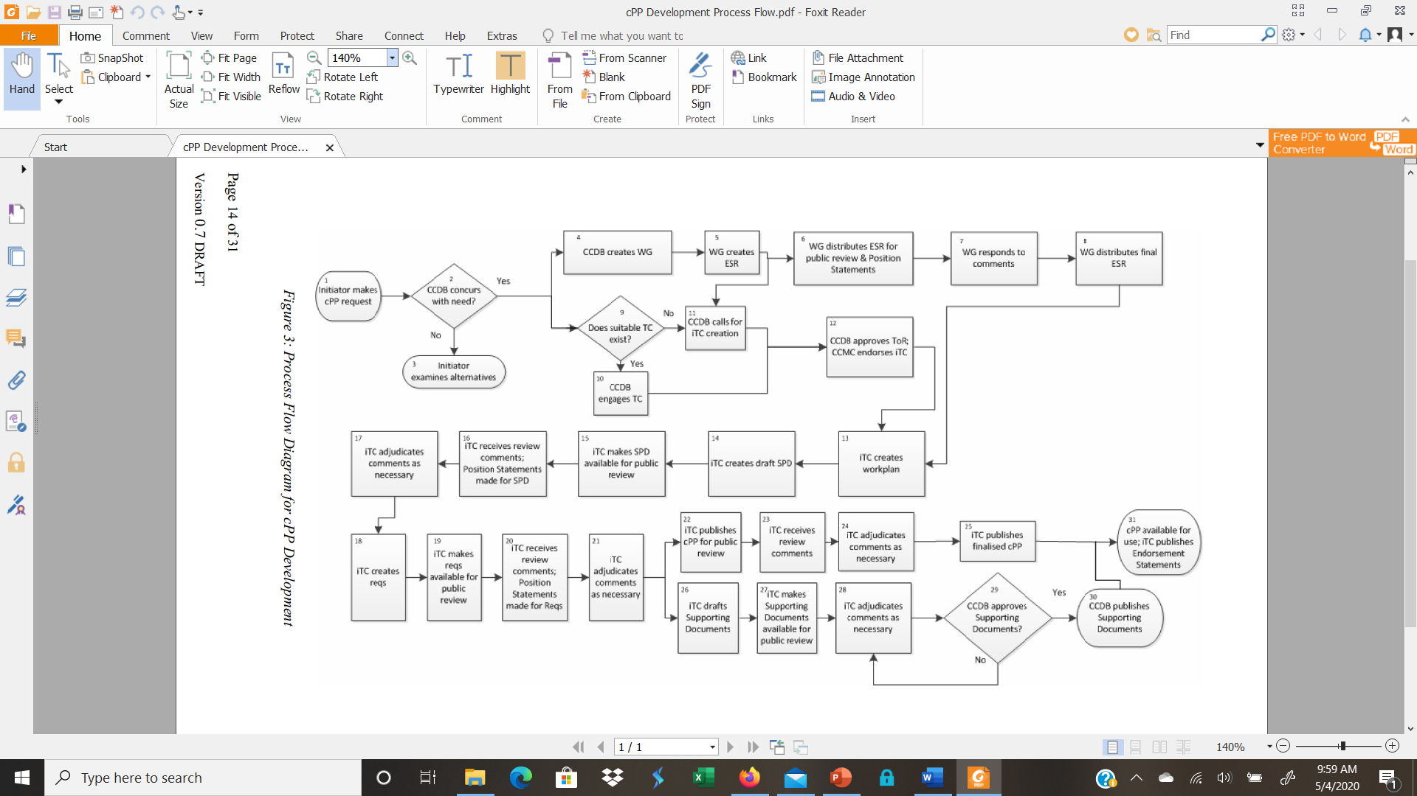
HCD iTC Status cPP Development Process Flow
Copyright © 2020 The Printer Working Group. All rights reserved.
9

Slide 10
HCD iTC Status
Collaboration Tool Updates
  GitHub repositories for HCD iTC set up with templates based on CCUF Tools WG Templates that are in asciidocs
  Editors group met to sync up the tasks that need to be performed
  Draft templates structure prepared and shared with editors for detailed changes such as SFRs and Annex.
  Plan is to use the proposed HCD Protection Profile (PP) v1.1 (which was never approved or issued) as the baseline for HCD collaborative PP (cPP) v1.0 and then add on content as agreed upon by the HCD iTC to form the eventual published HCD cPP v1.0.
    Take the applicable portions of the HCD PP v1.1 (which are in MS Word) that deal with requirements and put them into the cPP template to form the baseline HCD cPP v1.0
    Take the applicable portions of the HCD PP v1.0 (which are in MS Word) that deal with assurance activities and put the into the Supporting Documents (SD) template to form the baseline HCD SD v1.0
  Right now is a “cut and paste” operation; looking at automated tools to streamline the operation
Copyright © 2020 The Printer Working Group. All rights reserved.
10

Slide 11
HCD iTC Status
Editor Status
  Draft Work Plan has been created and is being reviewed by Kwangwoo before being distributed to iTC members.
  Brian V. is working on the draft cPP with some detail changes such as SFRs, Annex, and Asciidoc tasks. Brian was to finish this task for everything but the Appendices by the end of last week. The estimated delivery time to team will now be end of this week
  Jerry is going to do the Support Document. The draft SD will be completed by the next HCD iTC meeting on 5/14
  Ira requested whether we can have line number for easy review and comment
    I checked and asciidocs does not support line numbers very easily at all. To add line numbers we’ll have to do some type of post-processing if that is possible.
Copyright © 2020 The Printer Working Group. All rights reserved.
11

Slide 12
HCD iTC Status
  TLS 1.3: Ira McDonald (Draft: June 2020)
    AI: Kwangwoo to share the CCUF Trondheim April 2018 slides that presented by Tony Boswell. These slides are described how update on ND cPP/SD versioning
      https://ccusersforum.onlyoffice.com/Products/Files/doceditor.aspx?fileid=5689766
      https://ccusersforum.onlyoffice.com/Products/Files/doceditor.aspx?fileid=5684415
    AI: Ira to check whether NDcPP keep the same timeline & versioning schedule that mentioned in Trondheim
    Updated Compact TLS
Copyright © 2020 The Printer Working Group. All rights reserved.
12

Slide 13
HCD iTC Status
  Hardware-anchored integrity verification: Jerry Colunga (Draft: June 2020)
    Not so much progress. Jerry will make a progress and share it at the next HCD iTC meeting.
    AI: DSC has published the candidate cPP (v1.0). Jerry will review DSC cPP v1.0 document.
    DSC cPP v1.0 draft
      https://www.commoncriteriaportal.org/communities/docs/cpp_dsc_v10d_DRAFT_20200224.docx
    Latest DSC Status
      https://www.commoncriteriaportal.org/files/communities/Status.DSC.pdf
  SED & HDD Encryption: Alan Sukert (Draft: June 2020)
    No new updates to either FDE AA cPP/SD or FDE EE cPP/SD planned
    Only Interpretation Team (IT) activity going on with FDE iTC
      Latest IT activity and NIAP Technical Decisions do not appear to be in areas that impact either HCD CPP or HCD SD.
Copyright © 2020 The Printer Working Group. All rights reserved.
13

Slide 14
HCD iTC Status – Additional Questions
  Versioning (version x.y or even x.y.z)
    HCD iTC needs to determine:
      What constitutes a major (x) vs. a minor version (y or y.z) in terms of content
      Frequency of major vs. minor versions
        Major updates every 12 months vs every 18 months vs. every 24 months?
        Minor updates every 6 months or 9 months?
  EAL vs PP compliance
    Some European countries still require EAL certifications
    HCD PP does not specify an EAL; just specifies PP Compliance
    HCD cPP template is written around EAL1 so could technically specify EAL1
    What do we do with the HCD cPP?
Copyright © 2020 The Printer Working Group. All rights reserved.
14

Slide 15
HCD iTC Status – Additional Questions
  Exact Compliance
    HCD PP requires exact compliance because NIAP requires it
    Should the HCD cPP require exact compliance?
  Copyright
    Are there any copyright issues we need to be concerned about in developing the HCD cPP and HCD SD?
    There weren’t any in developing the HCD PP but we were only dealing with FIPS and NIST referenced documents. Now we are dealing with ISO/IEC referenced documents.
Copyright © 2020 The Printer Working Group. All rights reserved.
15

Slide 16
HCD cPP V1.0 Proposed Content –
My Thoughts as HCD iTC Deputy Chair
  KISS – KEEP IT SIMPLE STUPID! Or in other words – don’t try to do too much in v1.0; we can’t solve everything in two years.
  Just cover the basic requirements that HCD vendors will need in the 2022 time frame.
  We should plan for a v1.1 by the end of 2022 to cover any key SFRs we can’t get into v1.0.
  We need to keep in sync with the changes in the Network Device cPP but we can’t let the ND iTC control what we do either – there has to be a balance because HCDs are difference in many ways for other network devices
  We have to anticipate what is coming (e.g., FIPS 140-3, sunsetting SHA-1) as much as possible over the next two years in determining what SFRs to add/modify
Copyright © 2020 The Printer Working Group. All rights reserved.
16

Slide 17
MY HCD cPP V1.0 Proposed Content beyond what is in HCD PP v1.1
  Support for FIPS 140-3
  Removal of all SHA-1 support
  Removal of support for TLS 1.0 and TLS 1.1
  Implement the TLS and SSH packages coming from the CCDB Crypto Working Group
  IF rolled out in next 6-12 months via a TLS package or via ND cPP, support for TLS 1.3
  Implement any new NIAP TDs against the HCD PP
  Implement any ND cPP changes, any new NIAP TDs against the ND, FDE AA or FDE EE cPPs or any FDE AA cPP/FDE EE cPP interpretations that the HCD iTC determines are applicable
  Anything that the HCD iTC as a group determines is an “absolute must have” in v1.0; anything less has to go in v1.1 or later
Copyright © 2020 The Printer Working Group. All rights reserved.
17

Slide 18
HCD iTC – Next Steps
Approve the Work Plan
Complete the baseline HCD cPP v1.0 and HCD SD v1.0
Agree on the HCD cPP v1.0 and HCD SD v1.0 Content
Implement the Work Plan
  Complete the HCD cPP/SD v1.0 drafts
  Complete internal reviews/update of the HCD cPP/SD v1.0 drafts
  Update the HCD cPP/SD v1.0 drafts to address internal review comments
  Public review of the final HCD cPP/SD v1.0 version
  Update HCD cPP/SD v1.0 to address final comments
  Get CCDB approval of HCD SD v1.0
  Publish HCD cPP/SD v1.0
* - May be more than one draft
Copyright © 2020 The Printer Working Group. All rights reserved.
18

Slide 19
Proposed HCD cPP V1.0 Timeline
  Complete the HCD cPP/SD v1.0 drafts – Jul 2021
  Complete internal reviews/update of the HCD cPP/SD v1.0 drafts – Aug - Sep 2021
  Update the HCD cPP/SD v1.0 drafts to internal review comments – Oct 2021
  Public review of the final HCD cPP/SD v1.0 version – Nov – Dec 2021
  Update of final HCD cPP/SD v1.0 to address final review comments – Jan 2021
  Get CCDB approval of HCD SD v1.0 – Feb 2022
  Publish HCD cPP/SD v1.0 – Mar/Apr 2022
Copyright © 2020 The Printer Working Group. All rights reserved.
19

Slide 20
3
HCD Security Guidelines Status
Copyright © 2020 The Printer Working Group. All rights reserved.
20

Slide 21
HCD Security Guidelines Status
HCD Security Guidelines Development Schedule
  Next Interim Draft Q2 2020
  Prototype Draft Q4 2020 / Q1 2021
HCD Security Guidelines Development Plan
  1 Intro – complete
  2 Terminology – complete
  3 Rationale – complete
  4 HCD Network Security - first new text
    Key topics first - e.g., firewall, SSH, TLS, IPP
  5 HCD Local Security - second new text
    Key topics first - e.g., operating systems, local secure peripherals
  6 HCD System Architecture - third new text
    Key topics first - e.g., system isolation, process isolation
Copyright © 2020 The Printer Working Group. All rights reserved.
21

Slide 22
HCD Security Guidelines Status
HCD Security Guidelines Development Plan (cont’d)
  7 Conformance - last new text
  8 Internationalization Considerations - last new text
  9 Security Considerations - last new text
  10 References – ongoing
  11 Authors Addresses – ongoing
  12 Appendix A - Internet Protocol Suite - complete
  Latest interim draft from Jan 2020: https://ftp.pwg.org/pub/pwg/ids/wd/wd-idshcdsec10-20200120-rev.pdf
Copyright © 2020 The Printer Working Group. All rights reserved.
22

Slide 23
Other HCD Security Standards Activities
Copyright © 2020 The Printer Working Group. All rights reserved.
23

Slide 24
Potential Standards Activities To Be Watched
(1) IETF (Internet Engineering Task Force) - FREE!
* TLS (Transport Layer Security) WG
-- https://datatracker.ietf.org/wg/tls/charter/
-- vendors, cryptographers, and gov't agencies worldwide
* SACM (Security Automation and Continuous Monitoring)
-- https://datatracker.ietf.org/wg/sacm/about/
-- heavy TCG and US gov't participation - "son of SCAP“
* SAAG (Security Area Advisory Group)
-- https://www.ietf.org/mailman/listinfo/saag
-- heads-ups on new and ongoing security work
* RATS (Remote ATtestation ProcedureS) - brand new!
-- https://datatracker.ietf.org/wg/rats/about/
-- device and entity attestation - heavy TCG, GP, ARM, USG participation
* IRTF CFRG (Internet Research Task Force Crypto Forum RG)
-- https://datatracker.ietf.org/rg/cfrg/about/
-- pre-eminent group of cryptographers and security experts!
Copyright © 2020 The Printer Working Group. All rights reserved.
24

Slide 25
Potential Standards Activities To Be Watched
(2) TCG (Trusted Computing Group) - $15K/year for corporations
-- https://trustedcomputinggroup.org/
-- Ricoh, Canon, Google, Qualcomm, Samsung, Infineon, NXP, etc. members
* TPM (Trusted Platform Module)
-- https://trustedcomputinggroup.org/work-groups/trusted-platform-module/
-- voting TPM 2.0 r1.55 out for public review *and* publication
* TNC (Trusted Network Communications)
-- https://trustedcomputinggroup.org/work-groups/trusted-network-communications/
-- heavy collaboration w/ IETF NEA, SACM, RATS, and others
* EmSys (Embedded Systems)
-- https://trustedcomputinggroup.org/work-groups/embedded-systems/
-- SGs on Network Equipment, IoT, Industrial, Vehicles, etc.
-- home of former Hardcopy Device WG
* MPWG (Mobile Platform WG) and TMS (Trusted Mobility Solutions) WG
-- https://trustedcomputinggroup.org/work-groups/mobile/
-- mobile phones, telecom networks, 4G and 5G w/ ETSI, 3GPP, GP, etc.
Copyright © 2020 The Printer Working Group. All rights reserved.
25

Slide 26
Potential Standards Activities To Be Watched
(3) US NIST - FREE!
* LWC (Lightweight Cryptography)
-- https://www.nist.gov/programs-projects/lightweight-cryptography
-- for resource-constrained devices (including mobile phones)
* TC (Threshold Cryptography)
-- https://csrc.nist.gov/Projects/Threshold-Cryptography
-- multi-party signatures and encryption algorithms - hot stuff!
* CF (Cybersecurity Framework)
-- https://www.nist.gov/cyberframework
* PQC (Post-Quantum Crypto)
-- https://csrc.nist.gov/Projects/Post-Quantum-Cryptography
* SWID (Software Identification Tags)
-- https://csrc.nist.gov/Projects/Software-Identification-SWID
-- see also https://datatracker.ietf.org/doc/draft-ietf-sacm-coswid/
-- underlies runtime integrity and remote attestation work
* SWA (Software Assurance)
-- https://www.nist.gov/itl/ssd/software-assurance
Copyright © 2020 The Printer Working Group. All rights reserved.
26

Slide 27
Potential Standards Activities To Be Watched
* RATS (Remote ATtestation ProcedureS)
About RATS
In network protocol exchanges, it is often the case that one entity (a Relying Party) requires Evidence about a remote peer to assess the peer's trustworthiness, and a way to appraise such Evidence. The evidence is typically a set of claims about its software and hardware platform. This document describes an architecture for such remote attestation procedures (RATS).
Copyright © 2020 The Printer Working Group. All rights reserved.
27

Slide 28
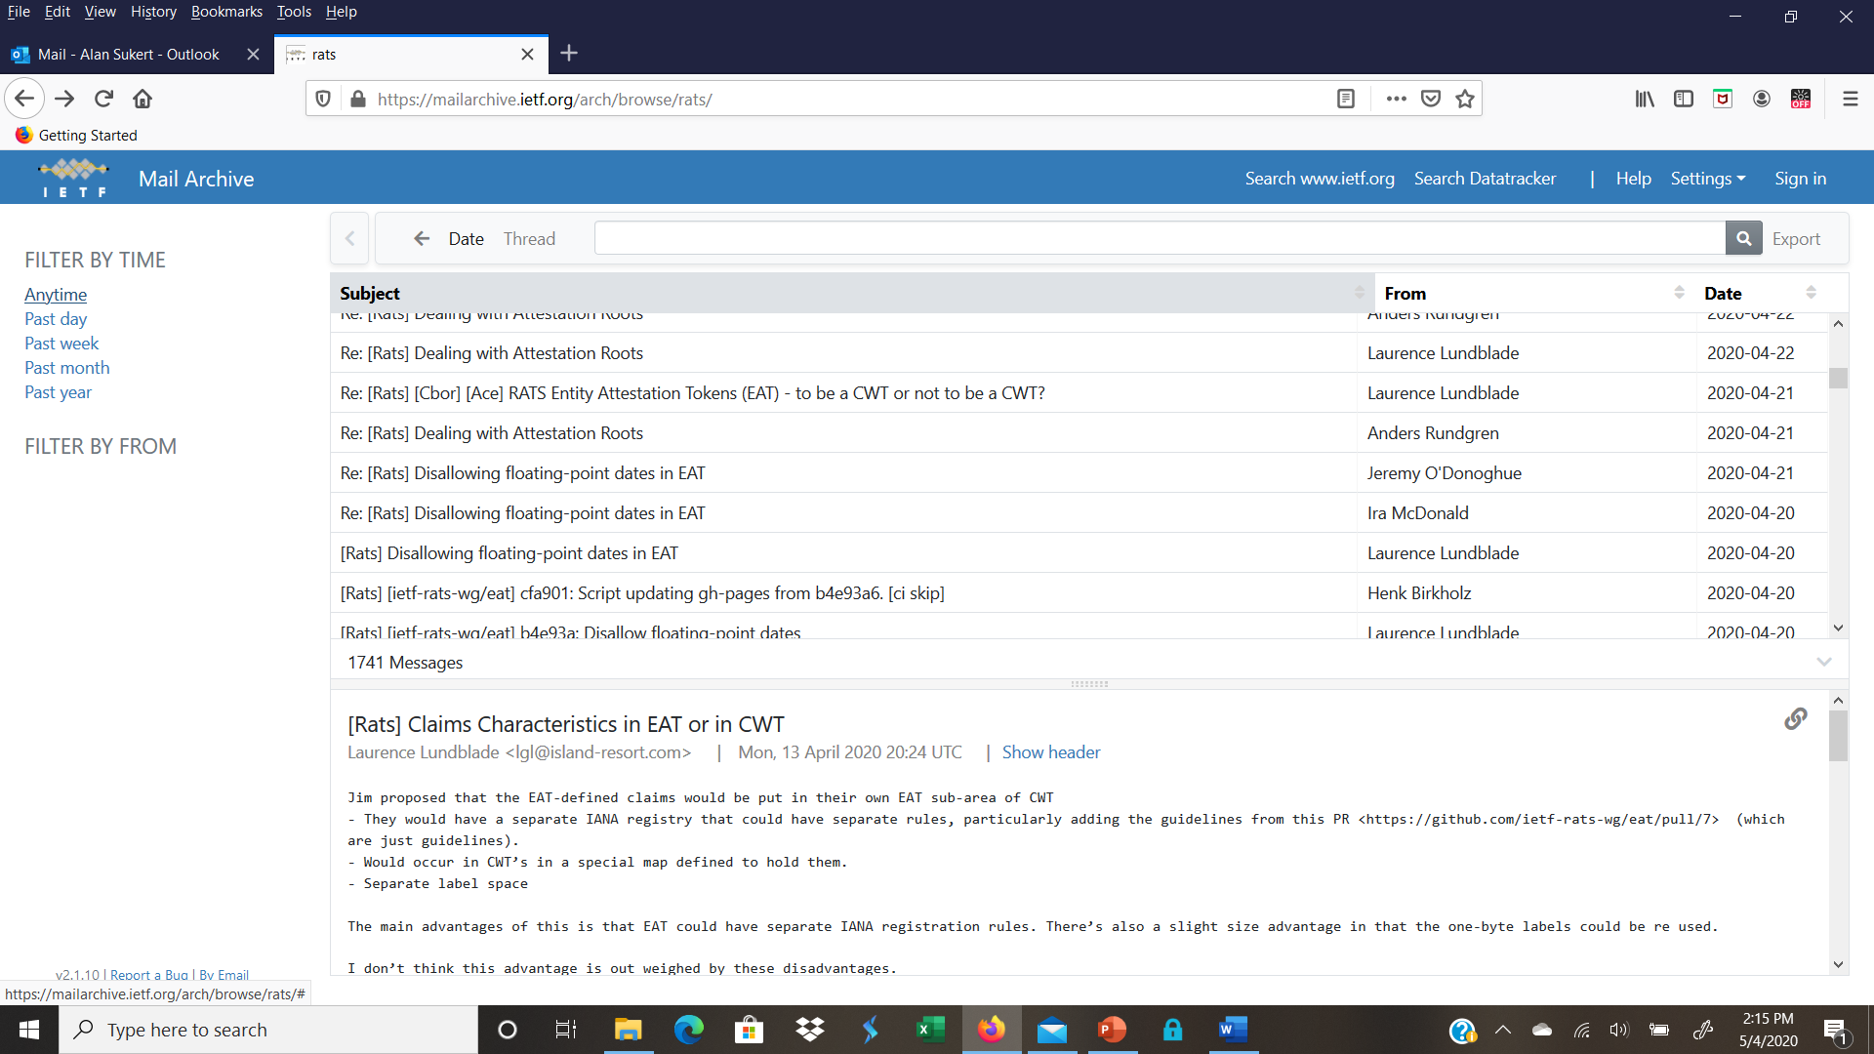
Potential Standards Activities To Be Watched
* RATS (Remote ATtestation ProcedureS)
Copyright © 2020 The Printer Working Group. All rights reserved.
28

Slide 29
Potential Standards Activities To Be Watched
* SAAG (Security Area Advisory Group)
About SAAG
The SAAG List is the IETF mailing list for the Security Area Advisory Group which meets once at each IETF meeting as part of the Security Area.
Copyright © 2020 The Printer Working Group. All rights reserved.
29

Slide 30
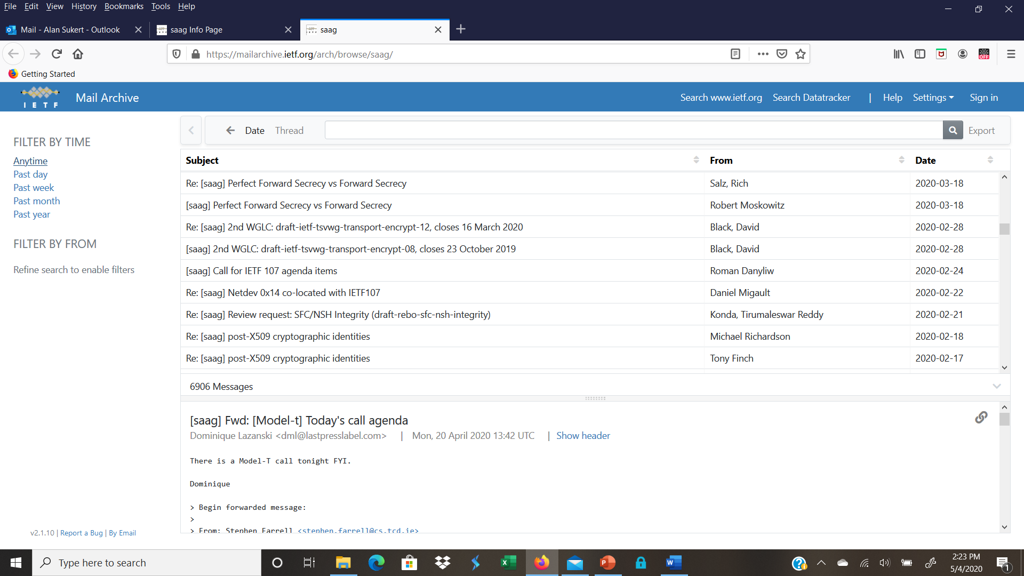
Potential Standards Activities To Be Watched
* SAAG (Security Area Advisory Group)
Copyright © 2020 The Printer Working Group. All rights reserved.
30

Slide 31
Next Steps – IDS WG
Next IDS Conference Call – May 28, 2020
Next IDS Face-to-Face Meeting Aug 26-27 (probably Aug 27), 2020 at next Virtual PWG F2F
Start looking at involvement in some of these other standards activities individually and maybe as a WG
Copyright © 2020 The Printer Working Group. All rights reserved.
31

