Slide 1

Imaging Device Security
The Printer Working Group
November 21, 2019
PWG November 2019 Virtual Face-to-Face
Copyright © 2019 The Printer Working Group. All rights reserved.
1

Slide 2

Agenda
When | What
9:00 – 9:05 | Introductions, Agenda review
9:05 – 10:35 | Discuss results of latest HCD TC Meetings and potential HCD cPP content
10:35 – 10:50 | HCD Security Guide 1.0 Status
10:50 – 11:00 | Wrap Up / Next Steps
Copyright © 2019 The Printer Working Group. All rights reserved.
2

Slide 3
Intellectual Property Policy
  “This meeting is conducted under the rules of the PWG IP policy”.
    Refer to the IP statements in the plenary slides
Copyright © 2019 The Printer Working Group. All rights reserved.
3

Slide 4
Officers
Chair:
  Alan Sukert (Xerox)
Vice-Chair:
  TBD
Secretary:
  Alan Sukert (Xerox)
Document Editor:
  Ira McDonald (High North) – HCD Security Guide
Copyright © 2019 The Printer Working Group. All rights reserved.
4

Slide 5
HCD Technical Community Status
Copyright © 2019 The Printer Working Group. All rights reserved.
5

Slide 6
HCD PP TC Status
Overview
  History of the Hardcopy Devices Protection Profiles
    IEEE 2600 PPs
    HCD PP v1.0 (Protection Profile for Hardcopy Devices – V1.0)
    Why didn’t we just make the existing IEEE PPs conform to the new paradigm?
  Challenges in Developing a new PP for HCDs
    Challenges during PP development
    Challenges after PP publication
  HCD iTC Status
    Essential Security Requirements
    Terms of Reference
    Key Person and affiliations
  Lessons Learned
Copyright © 2019 The Printer Working Group. All rights reserved.
6

Slide 7
IEEE 2600 Protection Profiles
Initiated in 2004, more than 100 individuals from more than three dozen organizations have participated in working group meetings, teleconferences, and email discussions.
The IEEE P2600 Working Group developed IEEE Std. 2600TM-2008 with security requirement and best practices for HCD vendors and customers in a variety of operational environments.
The P2600 WG created Protection Profiles for two of those operational environments:
  IEEE Std. 2600.1TM-2009 at EAL3 was adopted as the US PP for HCDs, until NIAP changed its policy rejecting EAL4 and EAL3.
  IEEE Std. 2600.2TM-2009 at EAL2 was adopted as the new US PP for HCDs, adding additional functional requirements via NIAP Scheme Policy#20.
Copyright © 2019 The Printer Working Group. All rights reserved.
7

Slide 8
Hardcopy Device Protection Profile Version 1.0
Developed by the MFP Technical Community
  Effort was initiated by JISEC in 2012 to replace IEEE Std. 2600.2TM
  A working group was formed in May 2012 to create PP based on draft created by JBMIA, and an MFP TC had its kick-off meeting in
  September 2012
  After many drafts, a final version was published and approved by US and Japanese CC Schemes in September 2015
  HCD PP became effective immediately in the US; Japan gave vendors a two-year grace period
  HCDs have been certified conforming to HCD PP in the US, Japan, Canada, and Sweden.
Copyright © 2019 The Printer Working Group. All rights reserved.
8

Slide 9
Hardcopy Device Protection Profile Version 1.0
Why didn’t we just make the existing IEEE PPs conform to the new paradigm?
  It may not be possible to add tailored assurance to an existing PP that was not designed to accommodate it.
  Also, it is important to have some consistency with other new paradigm PPs, such as the Network Devices PP.
  Copyright to the existing PPs is owned by the IEEE Standards Association, so we can’t just edit the existing PP as a starting point.
  We are making one collaborative PP that can be the basis for procurement for the governments of Japan and the US.
Copyright © 2019 The Printer Working Group. All rights reserved.
9

Slide 10
Hardcopy Device Protection Profile Version 1.0
Challenges during PP development
  Some scheme policy changes were disruptive to vendors and
  confusing to customers:
    Weeks after approving 2600.1, NIAP un-approved 2600.1, and instead, approved 2600.2 with NIAP policy #20.
      It was difficult to explain this sudden change from EAL3 to EAL2.
    Two weeks after DoD’s DLA-Documents Services began requiring PP conformance, NIAP un-approved IEEE Std. 2600.2 as a US PP and archived Policy #20; DLA-DS rescinded.
    In 2013, NIAP stopped accepting evaluations that do not conform to a NIAP-approved PP, but HCD PP was not published until two years later (Sep. 2015).
    Vendors were forced to evaluate HCDs outside of the US.
Copyright © 2019 The Printer Working Group. All rights reserved.
10

Slide 11
Hardcopy Device Protection Profile Version 1.0
    Challenges after PP publication
    HCDPP does not claim conformance to an EAL, and it is not a cPP, so it does not adhere to CCRA mutual recognition rules.
      For procurement, some nations recognize IEEE 2600.2, others recognize HCDPP, forcing vendors to certify to two PPs.
    NIAP’s Scheme Policy#5 enforces cryptographic details that are not part of HCDPP. Certified products may or may not meet the requirement of Policy #5, distinguishable
    only by whether or not their certificates are listed on NIAP’s PCL.
    NIAP certifies only HCD PP.
    Japan and Sweden certify HCD conformance to HCD PP, 2600.1, or 2600.2.
    Canada certifies HCDPP but treats 2600.2-conformant products as EAL2+ALC without PP conformance.
    Korea certifies HCD conformance to 2600.2.
Copyright © 2019 The Printer Working Group. All rights reserved.
11

Slide 12
HCD iTC Status – “Key Persons” List
HCD TC (Kwangwoo Lee) requested several HCD stakeholders to invite the SME(s) list of HCD iTC. According to the feedbacks of each organization, HCD TC created a draft Hardcopy Device International Technical Community – Key persons and affiliations
  Made key roles ‘TBD’
Document submitted to HCD WG and accepted. Was forwarded to CCDB and approved with the ToR.
The Status of Subject Matter Experts
  Industry SMEs: 30 members 14 organizations
  Lab SMEs: 14 members 9 organizations
  Certification Body SMEs: 4 members 3 schemes (KR, JP, SE)
    Waiting the official feedback from 1 scheme (US)
  Other SMEs: 4 members (IEEE-ISTO PWG experts/Biometric iTC expert
Copyright © 2019 The Printer Working Group. All rights reserved.
12

Slide 13
HCD iTC Status
Copyright © 2019 The Printer Working Group. All rights reserved.
13

Slide 14
HCD iTC Status
  CCDB at its Oct 2018 Meeting chartered a CCDB Working Group (WG) containing the Korean and Japanese schemes. Goal was formation of the HCD iTC at the April CCDB meeting in Rome in April 2019
  HCD WG has created the following documents to be submitted to the CCDB for review at the April CCRA meeting:
    Essential Security Requirements (ESR)
    Terms of Reference (ToR)
  At the same time the HCD TC as creating its own versions of the same two documents plus a “Key Persons” document that will be referenced by the ToR
  Goal was to fold the HCD TC documents into the HCD WG versions that are submitted to the CCDB
  Currently, HCD TC is waiting the voting results from Common Criteria Management Committee (CCMC)
    Common Criteria Development Board (CCDB) approved both documents
Copyright © 2019 The Printer Working Group. All rights reserved.
14

Slide 15
HCD iTC Status –
Essential Security Requirements
  [March 25, 2019] The HCD WG was aware of HCD TC works including the draft ESR done by the HCD TC since HCD TC provided the latest resolution of review comment as an input to support the HCD WG’s works.
  [April 15, 2019] The HCD WG shared the HCD WG ESR v0.6 that agreed by CCDB HCD WG members. Note that US scheme provided their feedback as CC experts on this technology area.
  [April 15, 2019] Call for Comment
    HCDTC members are encouraged to review the HCD WG draft ESR and submit comments on Causeway.
    HCD WG mentioned that they welcome any improvement for the ESR if it is helpful to increase the security level of hardcopy
    devices.
    HCD TC created the Gap Analysis between HCD_TC_ESR_v0.61 and HCD_WG_ESR_v0.6
      Alan provide the comparison by section of the latest draft ESR created by the HCD TC to the latest draft ESR provided by the HCD Working Group.
Copyright © 2019 The Printer Working Group. All rights reserved.
15

Slide 16
HCD iTC Status –
Essential Security Requirements
  [June 3, 2019] Review comment for the HCD_WG_ESR_v0.6
      HCD TC received 9 comments for the HCD _WG_ESR_v0.6 by May 24th, 2019 from HCD TC members. After that, HCD TC members reviewed the comments during the HCD TC monthly teleconference meeting.
    [June 15, 2019] HCD TC submit the review comments for the HCD_WG_ESR_v0.6 and shared the updated HCD ESR to
    HCD WG (ITSCC, JISEC).
      HCD WG (ITSCC) responded that they will review the updated ESR and review comments from mid of July if there was no negative opinion or objection from CCDB members during the CCDB ToR approval voting process. It will be discussed by HCD WG members before the HCD iTC creation.
Copyright © 2019 The Printer Working Group. All rights reserved.
16

Slide 17
HCD iTC Status –
Terms of Reference
  HCD TC shared the draft version of HCD iTC ToR to HCD WG (ITSCC, JISEC).
  [March 8, 2019] HCD WG reviewed the draft ToR that was provided by HCD TC. HCD WG provided the review comment based on HCD WG’s agreement. Based on HCD review comment, HCD TC revised the
  voting text.
  [March 28, 2019] HCD TC shared the draft version of HCD iTC ToR - v0.5.docx to HCD WG (ITSCC, JISEC).
  [April 12, 2019] HCD WG shared the CCRA voting process and tentative schedule of HCD iTC establishment during 15th CCUF Workshop in Rome
  [April 17, 2019] HCD WG submitted the ToR to CCDB.
  [May 13, 2019] HCD TC checked the CCDB voting progress thru HCD WG (ITSCC). They mentioned that the CCDB ToR voting is not initiated yet.
Copyright © 2019 The Printer Working Group. All rights reserved.
17

Slide 18
HCD iTC Status –
Terms of Reference
  [June 3, 2019] HCD WG shared that CCDB HCD iTC ToR approval voting is started in May.
  [July 7, 2019] HCD WG shared that they didn’t hear any negative sound/opinion and objection from CCDB
  chair yet.
  [Aug 19, 2019] HCD WG shared that HCD iTC ToR approval voting is completed without negative sound/opinion and objection from CCDB (Aug 12). Also, CCDB chair requested next process to CCMC Chair.
Copyright © 2019 The Printer Working Group. All rights reserved.
18

Slide 19
HCD iTC Status –
Key Persons and Affiliations
HCD TC requested several HCD stakeholders to invite the SME(s) list of HCD iTC
  According to the feedbacks of each organization, HCD TC have created the draft Hardcopy Device International Technical Community – Key persons and affiliations.
The Status of Subject Matter Experts (v0.8) – 62 members 33 organization
  Industry SMEs: 34 members 14 organizations
  Lab SMEs: 19 members 10 organizations
  Certification Body SMEs: 4 members 3 schemes (KR, JP, SE)
  Other SMEs: 5 members (IEEE-ISTO PWG experts/Biometric iTC expert/JBMIA)
Copyright © 2019 The Printer Working Group. All rights reserved.
19

Slide 20
  HCD CPP v1.0
Copyright © 2019 The Printer Working Group. All rights reserved.
20

Slide 21
HCD cPP v1.0
Planned Content
  Planned content for what was going to be in HCD PP V1.1 including HCD PP Errata #1
  Any NIAP Technical Decisions against the HCD PP
  The list of issues discussed at the Sep 2019 HCD TC Face-to-Face Meeting in Singapore
Goal is the following:
HCD PP v1.1 HCD cPP v1.0 draft 1
HCD SD draft 1
Copyright © 2019 The Printer Working Group. All rights reserved.
21

Slide 22
HCD cPP v1.0 Considerations
TLS 1.3, deprecation of TLS 1.1 and inputs from TLS TC - YES
Internationally-friendly crypto requirements that don’t rely on FIPS - YES
Management of Crypto keys - YES
Additional IPSec requirements -- YES
Protection of authentication passwords -- NO
Inclusion of Wi-Fi (especially with development of WPA3) -- NO
Addition of requirements for support of SNMPv3 -- ???
Audit Log Server Requirements & SIEM -- NO
Inclusion of TPMs and SSDs -- YES
Incorporation of GDPR and privacy implications -- NO
Password policies -- YES
Continued syncing with NDcPP and FDE cPPs -- YES
HCD iTC need to consider the new templates that was provided by Tool WG. -- YES
Copyright © 2019 The Printer Working Group. All rights reserved.
22

Slide 23
HCD cPP v1.0
Planned Content
  Planned content for what was going to be in HCD PP V1.1 including HCD PP Errata #1
  Any NIAP Technical Decisions against the HCD PP
  The list of issues discussed at the Sep 2019 HCD TC Face-to-Face Meeting in Singapore
Copyright © 2019 The Printer Working Group. All rights reserved.
23

Slide 24
HCD cPP v1.0 Proposed Schedule
All times in months after initiation of iTC
Finalize Content – 12 months
Preliminary Draft – 13 months
Draft submitted to iTC membership for review – 13 months
Review Comments Received – 14 months
Final Draft Submitted for Outside Review -- 20
Final Version for Approval -- 23 Months
HCD cPP v1.0 published – 24 months
It’s aggressive, but if we don’t think aggressively it will take 4 years and we can’t wait that long
Copyright © 2019 The Printer Working Group. All rights reserved.
24

Slide 25
  Lessons Learned
Copyright © 2019 The Printer Working Group. All rights reserved.
25

Slide 26
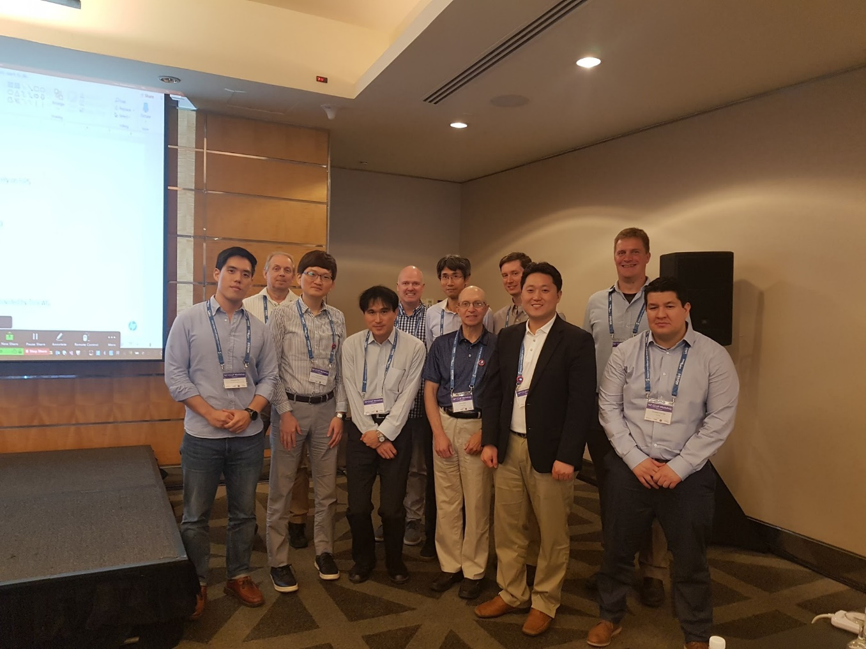
Lessons Learned
It takes a core group of very dedicated people to get a PP created or updated.
Copyright © 2019 The Printer Working Group. All rights reserved.
26

Slide 27
Lessons Learned
It took much longer than we expected or planned to create or update the HCD PP, so don’t expect a new or
update PP to be developed quickly either.
The Schemes that sponsor an PP or cPP need to commit the necessary resources support from the beginning to the TC/iTC to address questions/concerns/issues as they come up.
If you pull in requirements into a PP from other PPs or cPPs, ensure these requirements are assessed to make sure they apply to the PP they are being inserted into or modify them so they apply.
Copyright © 2019 The Printer Working Group. All rights reserved.
27

Slide 28
Lessons Learned
Have a plan and process in place from the beginning for updating a PP once it is approved, because updates will be needed.
Make sure you get the involvement from vendors, consultants, and CCTLs as well as the Schemes in developing the requirements that are to go into a
PP.
Make sure assurance activities are consistent with
their corresponding requirements and can be performed by vendors and CCTLs
Have a process in place from the beginning to
obtain interpretations and questions on requirements or assurance activities as the PP is being created, and more importantly, as the PP is being implemented.
Copyright © 2019 The Printer Working Group. All rights reserved.
28

Slide 29
HCD TC to HCD iTC Transition
Copyright © 2019 The Printer Working Group. All rights reserved.
29

Slide 30
HCD → HCD iTC Transition
Questions that need to be addressed:
Leadership
  Probably the most important question now -- who will take on the following roles defined in the ToR:
    iTC Chair -- Kwangwoo Lee
    iTC Vice-Chair – Alan Sukert
    Record Manager (aka “Secretary”) -- TBD
    Technical Editor(s) – Alan Sukert, Brian Volkov, Gerardo Colunga
  How do we determine who takes each role and when will that
  occur
    How long the terms of office will be for each of these roles
    The original thought was that theses roles would be “voluntary” in
    terms of how they are assigned and the term would be for as long
    as the volunteers wanted to serve in that role.
    Do we (or should we) make this more formal?
Copyright © 2019 The Printer Working Group. All rights reserved.
30

Slide 31
HCD → HCD iTC Transition
Questions that need to be addressed:
  What iTC or TC, if any, should we pattern the formation and processes of the HCD iTC after –
    Network Device – Most Likely this one
    Full Drive Encryption
    OS
    Some other TC
    None of the above
  Should the HCD iTC implement some type of “NIT” process like the ND iTC has where a small team develops any interpretations needed? Yes
    If so, how soon after formation of the iTC – Defer to 1 year after initiate iTC
Copyright © 2019 The Printer Working Group. All rights reserved.
31

Slide 32
HCD → HCD iTC Transition
Questions that need to be addressed:
  How should we handle comments against the cPP drafts?
  How often should the HCD iTC meet
    We have the Spring and Fall Face-to-Face Meetings as part of the CCUF now; do we need additional Face-to-Face Meetings beyond these two?
      If so, where would we hold them
    Should we have monthly Conference Calls, and if so how often – Yes; may even need to go to more frequent (weekly or bi-weekly as needed)
  iTC participation
    Should we have some type of minimum participation requirement on the part of a voting entity to allow that entity to vote
    How do we get as many vendors, labs and schemes as possible to participate in the iTC
Copyright © 2019 The Printer Working Group. All rights reserved.
32

Slide 33
HCD → HCD iTC Transition
Questions that need to be addressed:
  How often should we update the ToR
  How often should we issue updates to the HCD cPP
    Major version update (e.g., 1.0 → 2.0) once 1-2 years and minor updates at least once every six months
    Some other cadence
Copyright © 2019 The Printer Working Group. All rights reserved.
33

Slide 34
Updates Since the September
HCD TC Face-to-Face
Copyright © 2019 The Printer Working Group. All rights reserved.
34

Slide 35
As of 11/11/19 CCMC still had not started to vote on ToR and ESR submitted by HCD WG
  “Supposed to take 1-2 months to complete”
  We hope this gets done in Jan/Feb 2020
At the 11/11/19 HCD TC Conference Call, JBMIA indicated that they support inclusion of the “roots of trust” requirement into the ESR and will recommend that to JBMIA
New Version (0.8) of the HCD Key persons and affiliations list issued
  Added the members of Industry SMEs/Certification Body SME
  Updated the key person roles (Chairperson, Deputy Chairperson, CCD Liaison, Technical Editors) based on the agreement of CCUF F2F meeting in Singapore (2019) and ToR
Copyright © 2019 The Printer Working Group. All rights reserved.
35

Slide 36
Learned that the HCD iTC can update the ESR without requiring CCDB approval; CCDB approval is only required for supporting documents
HCD iTC editors have started setting up environment on GitHub to transfer HCD PP v1.1 into cPP (SFRs) and Supporting Document(Assurance Activities) GitHub templates so when iTC is approved “we can hit the ground running”
Copyright © 2019 The Printer Working Group. All rights reserved.
36

Slide 37
HCD Security Guide Status
Copyright © 2019 The Printer Working Group. All rights reserved.
37

Slide 38
Next Steps – HCD cPP v1.0
Implement the transition from the HCD TC → HCD iTC
  Complete GitHub setup
  Set up iTC processes and operating procedures
  Have the first iTC meeting
Start work on HCD cPP v1.0
  Develop detailed plan for development, review and release of HCD cPP v1.0
  Determine detailed list of issues for HCD iTC to review for inclusion in HCD cPP v1.0
  Generate subgroup to divide issues for easier cPP generation
  Generate first HCD cPP v1.0 draft
  Update and review drafts as necessary to create “final” version
  Get iTC review and approval for “final” version
  Release HCD cPP v1.0
Copyright © 2019 The Printer Working Group. All rights reserved.
38

Slide 39
Next Steps – Security Guide
Develop Initial Draft Version
  Review content with IDS WG at Conference Calls and F2F Meetings as it is created
Develop Final Draft
Obtain PWG Approval Process
Copyright © 2019 The Printer Working Group. All rights reserved.
39

Slide 40
Next Steps – IDS WG
Next IDS Conference Call – Dec 12th (last one for 2019)
First 2020 IDS Conference Call – Jan 9th and/or Jan 23rd (depends on what happens at Dec 9th, 2019 HCD TC Conference Call)
Next IDS Face-to-Face Meeting probably Feb 4, 2020
Start looking at involvement in other HCD standards activities starting in 2020
Copyright © 2019 The Printer Working Group. All rights reserved.
40

