Slide 1
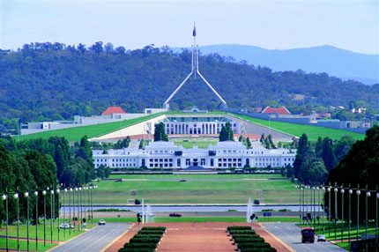
HCD protection profile update
As of May 1 2015:
Draft 0.9.2 issued
Two meetings held in Canberra, Australia, during the CCUF-CCDB workshops:
  US/JP/KR scheme meeting
  Technical (industry) meeting
In other news

Slide 2
Draft 0.9.2 – and next…
Issued in mid March with an end-of-March comment deadline
  Several hundred comments were received
  Almost the same as were received for 0.9.1 ☹
More than 150 comments remain open
  About half are likely simple edits
  Quite a few are duplicates, already done
Next draft in mid May
  Presumably, end-of-May comment deadline
  If relatively few comments are received, then final publication could happen in June
  If hundreds of comments are received, then who knows?

Slide 3
US/JP/KR scheme meeting
April 22, 9AM-10AM AEDT; attendees:
  Mike Matta / NIAP, Murata-san / IPA, Il-gon Kim / ITSCC, Alan Sukert / Xerox, Kwangwoo Lee / Samsung, and Brian Smithson / Ricoh.
KR scheme had some issues with the US/JP PP:
  Crypto is too limiting (algos, protocols, eval): fix in iTC
  The use of “Exact Compliance”: CCDB working on it
Discussed plans for drafts and final publication
Planning for an iTC / cPP to follow the US/JP PP
  All three schemes are interested in co-sponsoring
  First step is to form a CCDB working group with those schemes to write an ESR
  IPA wrote an ESR a year ago, needs to update it
  JP scheme is leading, maybe start in July

Slide 4
Technical (industry) meeting
April 24, 1PM-3PM AEDT:. Attendees:
  Alan Sukert / Xerox, Kwangwoo Lee / Samsung, Lachlan Turner / Ark Infosec, and Brian Smithson / Ricoh.
We worked on issues tagged “access control” and “options” in the master issues list
“Access control” issues were mainly from HP, and were resolved as follows:
  From the HCD’s perspective, whoever has the necessary credential is a (if not the) Job Owner
  As used in the AC SFP tables, “Containers” are like Job Data. We sort of don’t care about them. So we are removing “containers” from the tables.
“Options” issues were about image overwrite and purge functions, minor edits fix most of them.

Slide 5
In other news
Mario Tinto has retired!
His last day at Aerospace (contracted to NIAP) was April 30.
On behalf of the MFP TC, IEEE P2600, PWG, etc., I presented (online) him the following certificate.
Yes, I’ll follow up with hardcopy.

