Slide 1

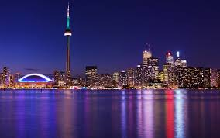
MFP Technical Community
Toronto face-to-face meeting
August 15, 2014
Held as part of the PWG-IDS F2F meeting

Slide 2
Agenda
Recent activities and progress
Latest plan and schedule
Current issues to be resolved

Slide 3
Recent activities and progress
Since Istanbul:
Draft 0.7 incorporated "SFR related assurance activities v.0.3" and "draft SAR v0.3" into the draft.
  Also includes input from Lachlan Turner and Alan Sukert
  SFR are formatted as heading level 3 for navigation
Draft 0.7.1 cleaned up some issues that were resolved between NIAP and IPA
Draft 0.8 incorporated input from NIAP and reviewed by IPA, mostly regarding cryptographic and related SFRs based NDPP v1.1 with Errata #2 and the SW FDE PP v1.1.
Draft 0.8.1 contains additional additions/changes/deletions from NIAP and IPA which should constitute all of their requirements

Slide 4
Latest plan and schedule
Steps to complete this PP:
  Industry submits comments
  NIAP/IPA and Industry negotiate resolutions
  Another draft (or drafts) produced as needed
  Everyone is reasonably happy, and NIAP/IPA approve
  Final draft published as PP
Schedule:
  NIAP proposed a schedule completing on 19 Sep
  I proposed a schedule completing on around 31 Oct

Slide 5
Current issues to be resolved
There are about 70 open issues
More are expected next week (as Japan returns from summer vacation week)
Some issues will be easy to resolve:
  Simple editorial / consistency corrections
  Issues that have been resolved or are no longer relevant in subsequent drafts
Other issues need NIAP, IPA, and industry review and discussion

Slide 6
Open discussion

