Slide 1
NAP / PWG Discussion
August 17, 2009

Slide 2










NAP Deployment Overview
No Corpnet Connectivity
Corpnet
Various Computing Resources
(Application, Infrastructure, Remediation Servers, Other healthy devices, etc).
Network Clients
Network Access
Servers
Laptop
Network Packet Flow
LDAP
AD
Media-specific
Protocol
802.1x Switch
Desktop
PC
RADIUS
Virtual Circuit
OLEDB/
ODBC
Mac
NAP Server
(“NPS”)
802.1x Wireless AP
PDA
SQL
Smartphone
Network Packet Flow
VoIP
Phone
Remediation
Servers
Remediation Network
Notes:
Consider adding UAG to NAS box

Slide 3





NAP Architecture
Health
Policy Servers
Active
Directory
Health
Remediation Servers
Configuration/
Compliance
Validation
User/Machine
Authentication
Updates
NAP Client
NAP Server
System Health Agents (SHA)
System Health Validators (SHV)
Windows
(Inbox)
Forefront
SCCM
Other
Windows
(Inbox)
Forefront
SCCM
Other
NAP Compliance Check States
NAP Agent
Network Policy Server (NPS)
MS-SOH Protocol (Health Data Exchange)
Enforcement Servers (ES)
(“Network Access Servers”)
Enforcement Clients (EC)
Various
Network
Protocols
Network Access
Control Protocol
(RADIUS)
802.1x
IPsec
TSG
HRA
VPN Srv
DHCP srv
…
VPN
DHCP
Others
802.1x
Switch

Slide 4
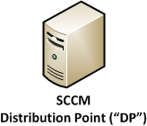
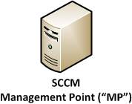
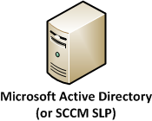
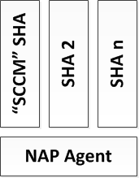
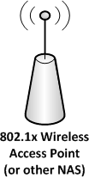
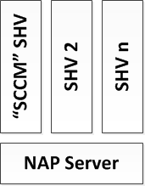


SCCM SHA – Health Evaluation
Client Requesting
Network Access
[Client Non-Compliant]
Client Requesting
Network Access
[Client Now Compliant]
SCCM SHA Collects “SCCM Policy Cookie” from SCCM Agent
SCCM SHA Packages Cookie in SCCM SOH
Compare Client-submitted
“SCCM Policy Cookie”
with
AD-reported “SCCM Policy Cookie”
2. What SCCM Policy is
assigned to client?
Lookup machine and obtain
AD-expected “SCCM Policy Cookie”
3. Retrieve Patches/Software
1. Where is the SCCM Management Point?
Client does scan to determine what’s missing
Client finds its missing patch “X”
SCCM Policy Cookies (Client and AD Reported)
MATCH. Therefore:
Client is compliant.
Client is provided with FULL network access
SCCM Policy Cookies (Client and AD Reported)
DON’T MATCH. Therefore:
Client is non-compliant.
Client access may be restricted
Client asked to remediate non-compliance
(“Get Patched”)
Compare Client-submitted
“SCCM Policy Cookie”
with
AD-reported “SCCM Policy Cookie”
NAP Remediation Network
[Client Access is Restricted]
Request Network Access with SOH
(including SCCM Policy Cookie)
4. Install Patches and/or
Software Retrieved
from SCCM DP.
Request Access with SOH
(including SCCM Policy Cookie)

Slide 5
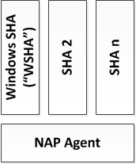
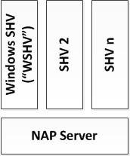
Windows SHA – Health Evaluation
WSHA Check States MATCH
WSHV-Defined Check States?
WSHA checks MATCH WSHV checks?
Client given FULL ACCESS
WSHA checks DO NOT MATCH
WSHV Checks?
Client given RESTRICTED ACCESS
Client Remediates
Tries Again
Request Network Access with SOH
(including WSHA Check States)
Request Access with SOH
(including WSHA Check States)
WSHA Collects “Check States” from Windows Action Center (AV, Patch, Firewall)
WSHA Packages Checks in WSHA SOH

Slide 6
QA

Slide 7
Appendix

