Slide 1
PWG October Survey Results
November 3, 2010
Notes:
1

Slide 2
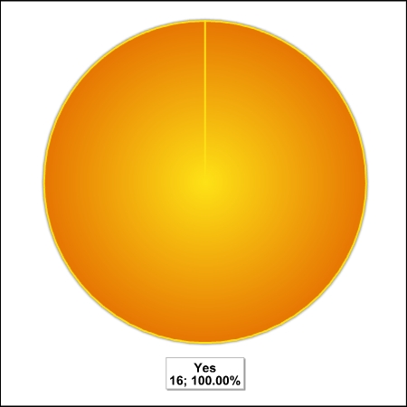
Question #1:
Regarding your thoughts about PWG Articles for the MPSA?
As someone involved in the print services industry, do you think that this series of articles about what the standards that the hardcopy industry is working on will be useful to you in your business?

Slide 3
Question #2:
What level of detail would you like to see in these articles?
Rate your level of Importance (5 being very important):
Category | Rating
a. Identification of Subject: | 3.94
b. An idea how it might affect MPS: | 4.1
c. What sort of solutions are being considered or have been identified in what standards: | 4.1
d. A description of the issue and the proposed solutions: | 4.38
e. References on where to find more details: | 4.2

Slide 4
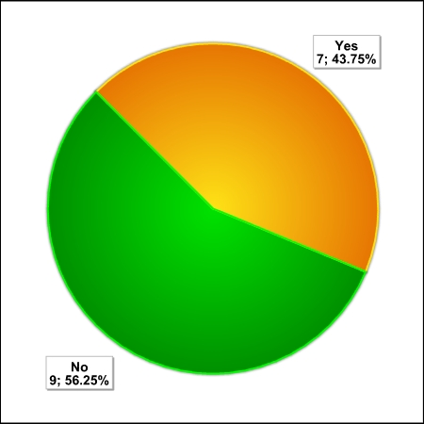
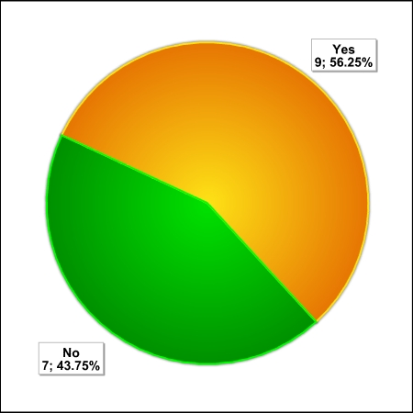
Question #3:
Are you seeing in your MPS activities increased interest in support for:
A. Printing from remote locations to some main office? | B. Printing while on the road to some local printer (perhaps a printer for which you are responsible)?

Slide 5
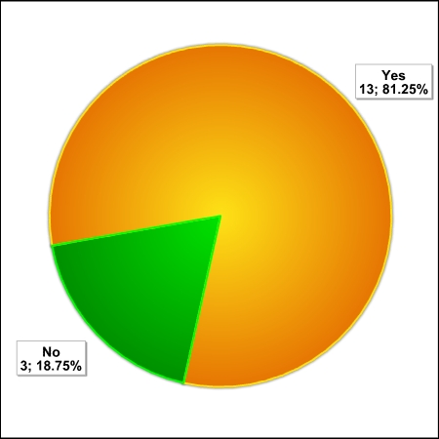
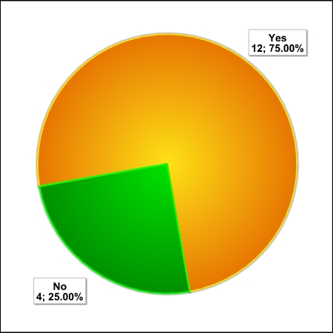
Question #4:
Have any of the aspects of network security and/or security of information on the network
a. Affected the way you install or maintain networked printers or multifunction devices? | b. Been a factor in which products you select?

Slide 6
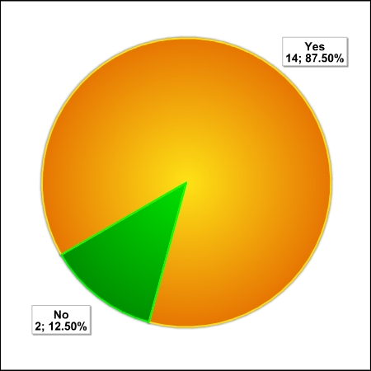
Question #5:
Is network security an important issue in your MPS activities now or do you see becoming an important issue in the near future?

Slide 7
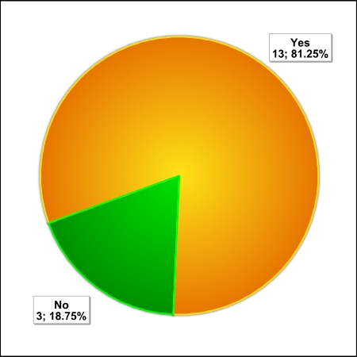
Question #6:
Is the security of information being sent to printers and other hardcopy devices an important issue in your MPS activities now or do you see it becoming an important issue in the near future?

Slide 8
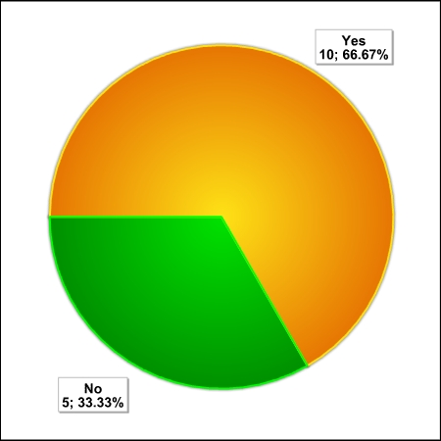
Question #7:
The use of SNMP for the management of networked hardcopy devices and acquisition of use data for billing has faced some problems because of security issues and firewall blocking of SNMP.
a. Have you experienced such device management problems in your MPS activities? | b. Are some of the environments in which you operate going to a “Web Services” approach for network device management?

Slide 9
Question #8:
Do you think it important that manufacturers implement standard solutions to interface issues such as MIBs and Protocols rather than proprietary solutions, even if the proprietary solutions may be better?

Slide 10
Question 9:
When considering new products:
Question | % Yes
a. Are you aware of what formal standards you want the product to satisfy? | 44%
b. Would you like to know what formal standards might be applicable, and what they encompass? | 100%
c. Does the vendor advertizing tell you about what standards are implemented? | 33%
d. Is the vendor representative knowledgeable about the applicable standards and to what extent his products are compliant to these standards. | 47%

Slide 11
Question 10:
What would you like to see in this series of articles? What subjects would you like addressed? What would you like as “take away” from them?
More on the possibility of the MIB moving to Web Services in the future
I'm looking to educate myself on how vendors compare to one another on these new and emerging standards.
1. How to track Printer Up-Time for SLA reporting.\n2. OEM's roadmap for future MIB and Firmware support such as what HP is doing with their FutureSmart firmware.\n3. Would like to see an MPSA User Tips & Tricks document{things we learn from using the tools} for the popular tools. PrintSOLV, Print4, Carbon6, PrintFleet, FM Audit etc...
end user feedback on their perceptions of MPS and best practices of processes.
How these standards fulfill the requirements of HIPPA, HITECH, Sorbanes Oxeley, etc.
As the board sponsor for the MPSA Standards Committee, I would enjoy an opportunity to speak with a PWG representative, as I'm sure our Chairperson and Co-Chairperson would as well.\n\nRegards,\nKen Stewart
Create a Open/public MIB standard for MPS (much more info), in such a case we can use it to qualify printers in the selection process
I definitely see a benefit to these articles, and further research and compilation of findings around printers. I think industry average servicibility of a devicesome of the primary areas I would like addressed would be device readbility from a data collection tool, industry average servicibility of a device, ability of device to report from a local connection.\nI would like to see how devices meet certain criteria and stack up against each other for all the data points.

