Slide 1

Cloud Imaging Working Group
May 15st , 2013
Cupertino, CA (hosted by Apple)
Copyright © 2012 The Printer Working Group. All rights reserved.

Slide 2
Cloud Imaging WG
Meeting Agenda May 15
When | What
 | May 15
9:00 – 9:15 | Introduction and Administrative Issues Intellectual Property Policy Statement Identify Minute Taker Introduce Participants Consider Agenda Acceptance of Previous Minutes ftp://ftp.pwg.org/pub/pwg/cloud/minutes/cloud-concall-minutes-20130429.pdf
9:15 – 9:30 | Action Items Review
9:30– 9:45 | Charter updates
9:45– 11:45 | Cloud Imaging Requirements and Model
11:45 – 12:00 | Next Steps

Slide 3
Officers & Editors
Chair: Ron Nevo (Samsung)
Vice Chair: Bill Wagner (TIC)
Secretary: Michael Sweet (Apple)
Document Editor Volunteers:
  Larry Upthegrove: Cloud Imaging Requirements and Model
  Ron Nevo (Samsung): Cloud Imaging Requirements and Model
  Michael Sweet (Apple): Cloud Imaging Requirements and Model

Slide 4
Action Items
Continue discussion of Model document on the cloud mailing list
Action: Bill to post correction as wd-cloud-charter-2013mmdd for approval by PWG steering committee
Action: Bill and Larry to work together to post updated Cloud Imaging Requirements and Model prior to the face-to-face
Action: Bill and Ron to work together to post slides for Cloud Imaging WG session

Slide 5
Status
Charter
  Charter was changed, terminating the Cloud Printing Requirements and Model effort in favor of concentrating on Cloud Imaging Requirements and Model.
  Revised Charter approved by PWG Steering Committee: ftp://ftp.pwg.org/pub/pwg/cloud/charter/ch-cloud-charter-20130510.pdf
Cloud Printing Requirements and Model Specification
  Detailed Use Cases were again added
  Applicable Cloud User Operations identified
  New Cloud Print Manager Operations Defined
  Based on provisions in IPP SIX draft, restriction on one Cloud Manager destination per Cloud Print Service was eliminated
  Decision to abandon effort and transfer work done to date to Cloud Imaging Requirements and Model
Cloud Imaging Requirements and Model Specification
  Initial draft modified to provide Interim draft reflecting decisions made for Cloud Printing Model
  Additional Use Cases and Operations up for discussion
  Further development necessary

Slide 6
Cloud Printing Model

Slide 7
Cloud<services>Model

Slide 8
Discussion Items
Updated Charter
  ftp://ftp.pwg.org/pub/pwg/cloud/wd/ch-cloud-charter-20130430.pdf
Conceptual Questions
  Level and Naming of Cloud Imaging Service
    The Cloud-based ‘Imaging Service’ offers one or more of the identified Imaging Services to a User/Client.
    Do we agree that it may (must?) offer a System Control Service to a User/Client with proper authority?
    If the cloud entity offers a System Control Service as well as one or more standard Imaging Services, do we agree that such control is of the Cloud System object, not the system the Imaging Device?
    Do we agree that the Cloud Imaging Service is conceptually an Imaging System (or at the same level as a System Object)?
    If so, what is an appropriate name?

Slide 9
Replace Printing with Imaging

Slide 10
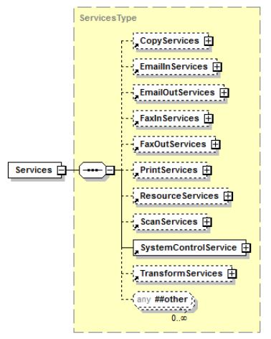
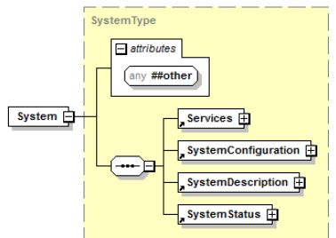
Semantic Model System

Slide 11
Discussion Items
Conceptual Questions
  Level and Naming of Cloud Imaging Manager/Imaging Device(s)
    Because of the Firewall or other isolation factor, Cloud Imaging Service cannot initiate communication with the Imaging Device. The'Manager' actor acts as a client in contacting the Cloud Based Service to provide communication between it and the Device.
    A 'reverse' set of operations is defined by which this 'Manager' communicates with the Cloud based Service. We do not define the interface between the ‘Manager” and the Device(s) it interfaces.
    The Device itself could range from a 'dumb' device to an MFD. But the "Manager" is in fact representing one or more Imaging Services; i.e., the information which it exchanges with the Cloud Based Service is the same as would be exchanged in a basic (non-managing) Service to Service exchange. What is a preferable name for the Imaging Device Manager?
    From an interface viewpoint, the Manager/Device may be considered to present one or more Imaging Services to the Cloud Based Imaging Service. Therefore, is it proper to maintain that the Manager reports on a Job which the Manager/Device created in response to Cloud Service Job information that the Device Manager pulled from the Cloud Imaging Service (?)

Slide 12
Cloud Imaging Requirements and Model
Interim Draft
  Update to:
    ftp://ftp.pwg.org/pub/pwg/cloud/wd/wd-cloudimagingmodel10-20130508.pdf
    ftp://ftp.pwg.org/pub/pwg/cloud/wd/wd-cloudimagingmodel10-20130508.docx
  Last changes
    Concentrate on a Cloud Imaging model rather that just Cloud Printing
    Allow fanout from a Cloud Imaging Manager to multiple Cloud Imaging Managers
    Additional Use Cases for other Imaging Services
    Requirements
    Operations
    Sequences
  Discussion of Cloud-oriented Operations
    ftp://ftp.pwg.org/pub/pwg/cloud/white/Cloud%20Imaging%20Operations%20-6%20May.pdf

Slide 13
Next Steps
Cloud Imaging Model and Requirements
Cloud Imaging Model and Requirements
  Editor: Larry & Bill
  Additional Contributors: ?
  Schedule: PWG Last Call of Cloud Imaging Requirements and Model – (Mid Q4 2013)
Specific Action Items!

Slide 14
Cloud Imaging WG Participation
We welcome participation from all interested parties
Cloud Imaging Working Group Web page
  http://www.pwg.org/cloud/index.html
Cloud Imaging Working Group Wiki
  http://pwg-wiki.wikispaces.com/Cloud+Imaging
Subscribe to the Cloud mailing list
  https://www.pwg.org/mailman/listinfo/cloud
  cloud@pwg.org
Cloud Imaging WG holds bi-weekly phone conferences announced on the Cloud mailing list
  Next conference call is June 3, 2013 at 3 pm (ET)
  Conferences on opposite weeks of IPP WG calls

